Slide 1
Introduction to Latent Dirichlet Allocation (LDA) with Collapsed Gibbs Sampling

Slide 2
Introduction(1/2)
Suppose you have the following set of sentences:
I like to eat broccoli and bananas.
I ate a banana and spinach smoothie for breakfast.
Chinchillas and kittens are cute.
My sister adopted a kitten yesterday.
Look at this cute hamster munching on a piece of broccoli.
What is latent Dirichlet allocation? It’s a way of automatically discovering topics that these sentences contain.

Slide 3
Introduction(2/2)
For example, given these sentences and asked for 2 topics, LDA might produce something like
Sentences 1 and 2: 100% Topic A
Sentences 3 and 4: 100% Topic B
Sentence 5: 60% Topic A, 40% Topic B
Topic A: 30% broccoli, 15% bananas, 10% breakfast, 10% munching, … (at which point, you could interpret topic A to be about food)
Topic B: 20% chinchillas, 20% kittens, 20% cute, 15% hamster, … (at which point, you could interpret topic B to be about cute animals)
The question, of course, is: how does LDA perform this discovery?

Slide 4
LDA Model
In more detail, LDA represents documents as mixtures of topics that spit out words with certain probabilities. It assumes that documents are produced in the following fashion: when writing each document, you
Decide on the number of words N the document will have (say, according to a Poisson distribution).
Choose a topic mixture for the document (according to a Dirichlet distribution over a fixed set of K topics). For example, assuming that we have the two food and cute animal topics above, you might choose the document to consist of 1/3 food and 2/3 cute animals.

Slide 5
LDA Model
Generate each word w in the document by:
First picking a topic (according to the multinomial distribution that you sampled above; for example, you might pick the food topic with 1/3 probability and the cute animals topic with 2/3 probability).
Using the topic to generate the word itself (according to the topic’s multinomial distribution). For example, if we selected the food topic, we might generate the word “broccoli” with 30% probability, “bananas” with 15% probability, and so on.
Assuming this generative model for a collection of documents, LDA then tries to backtrack from the documents to find a set of topics that are likely to have generated the collection.

Slide 6
Learning
So now suppose you have a set of documents. You’ve chosen some fixed number of K topics to discover, and want to use LDA to learn the topic representation of each document and the words associated to each topic. How do you do this? One way (known as collapsed Gibbs sampling) is the following:
Go through each document, and randomly assign each word in the document to one of the K topics.
Notice that this random assignment already gives you both topic representations of all the documents and word distributions of all the topics (albeit not very good ones).
So to improve on them, for each document d…

Slide 7
Go through each word w in d…
And for each topic t, compute two things:
1) p(topic k | document d) = the proportion of words in document d that are currently assigned to topic k
2) p(word w | topic k) = the proportion of assignments to topic k over all documents that come from this word w.
Reassign w a new topic, where we choose topic k with probability
p(topic k | document d) * p(word w | topic k)
(according to our generative model, this is essentially the probability that topic k generated word w, so it makes sense that we resample the current word’s topic with this probability).
In other words, in this step, we’re assuming that all topic assignments except for the current word in question are correct, and then updating the assignment of the current word using our model of how documents are generated.

Slide 8
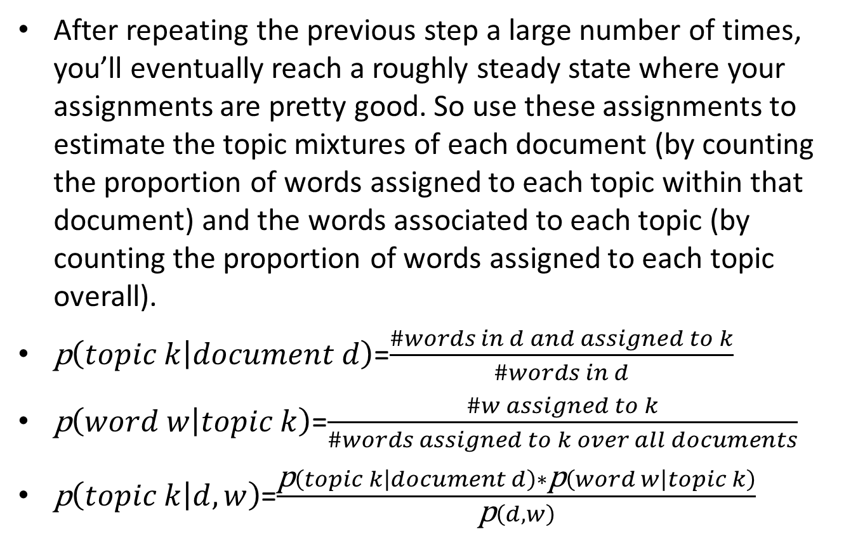
After repeating the previous step a large number of times, you’ll eventually reach a roughly steady state where your assignments are pretty good. So use these assignments to estimate the topic mixtures of each document (by counting the proportion of words assigned to each topic within that document) and the words associated to each topic (by counting the proportion of words assigned to each topic overall).
$\text{p}\left(topic k | document d\right)$=$\frac{\#words in d and assigned to k}{\#words in d}$
$\text{p}\left(word w | topic k\right)$=$\frac{\#w assigned to k}{\#words assigned to k over all documents}$
$\text{p}\left(topic k | d, w\right)$=$\frac{\text{p}\left(topic k | document d\right)∗\text{p}\left(word w | topic k\right)}{\text{p}\left(d,w\right)}$

Slide 9
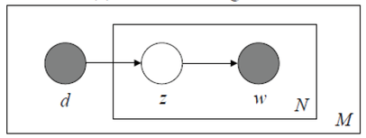

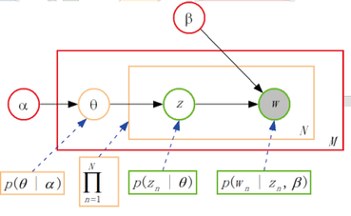


Slide 10
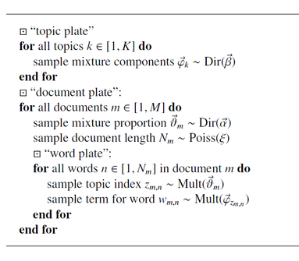
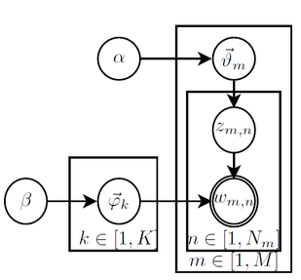
Generative model for latent Dirichlet allocation

Slide 11
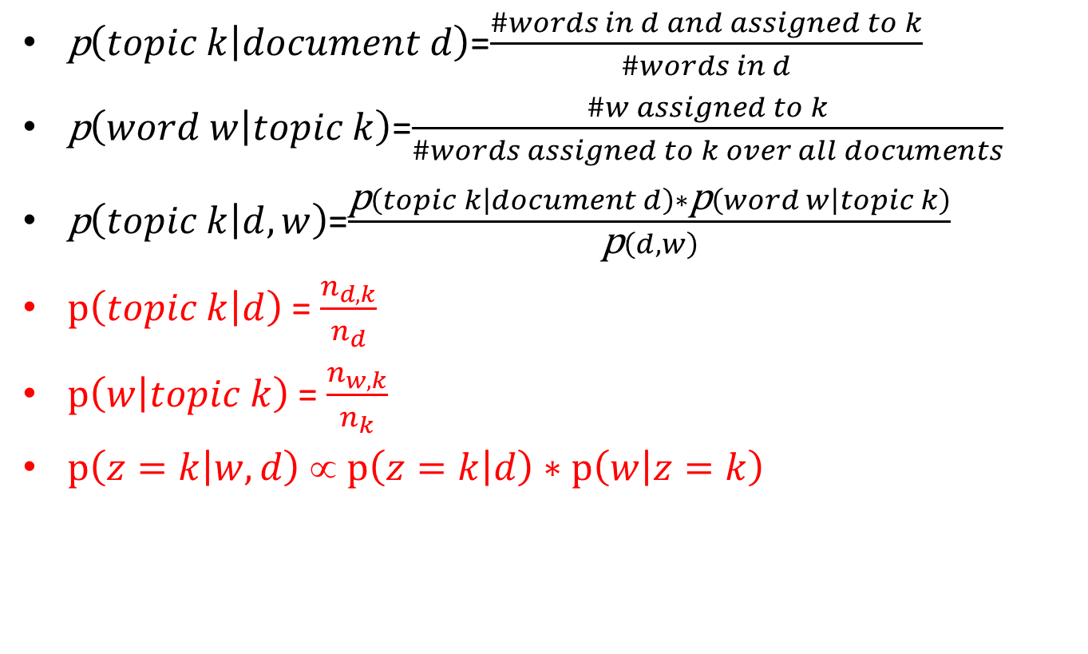
$\text{p}\left(topic k | document d\right)$=$\frac{\#words in d and assigned to k}{\#words in d}$
$\text{p}\left(word w | topic k\right)$=$\frac{\#w assigned to k}{\#words assigned to k over all documents}$
$\text{p}\left(topic k | d, w\right)$=$\frac{\text{p}\left(topic k | document d\right)∗\text{p}\left(word w | topic k\right)}{\text{p}\left(d,w\right)}$
$\text{p}\left(topic k | d\right)$ = $\frac{n_{d,k}}{n_{d}}$
$\text{p}\left(w | topic k\right)$ = $\frac{n_{w,k}}{n_{k}}$
$\text{p}\left(z=k | w,d\right)$ ∝ $\text{p}\left(z=k | d\right)∗\text{p}\left(w | z=k\right)$

Slide 12
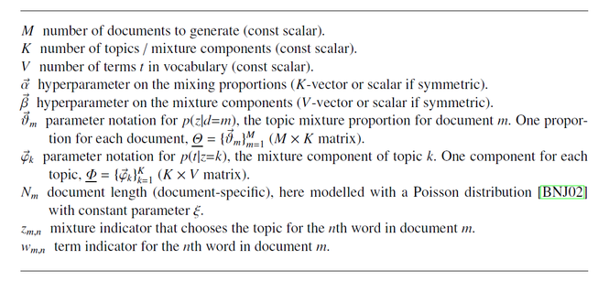

Slide 13
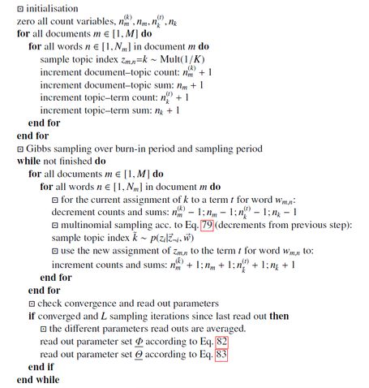

Slide 14
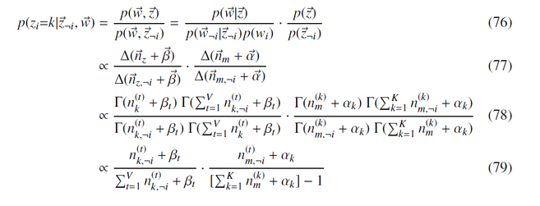

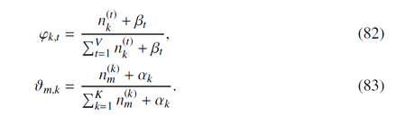

Slide 15
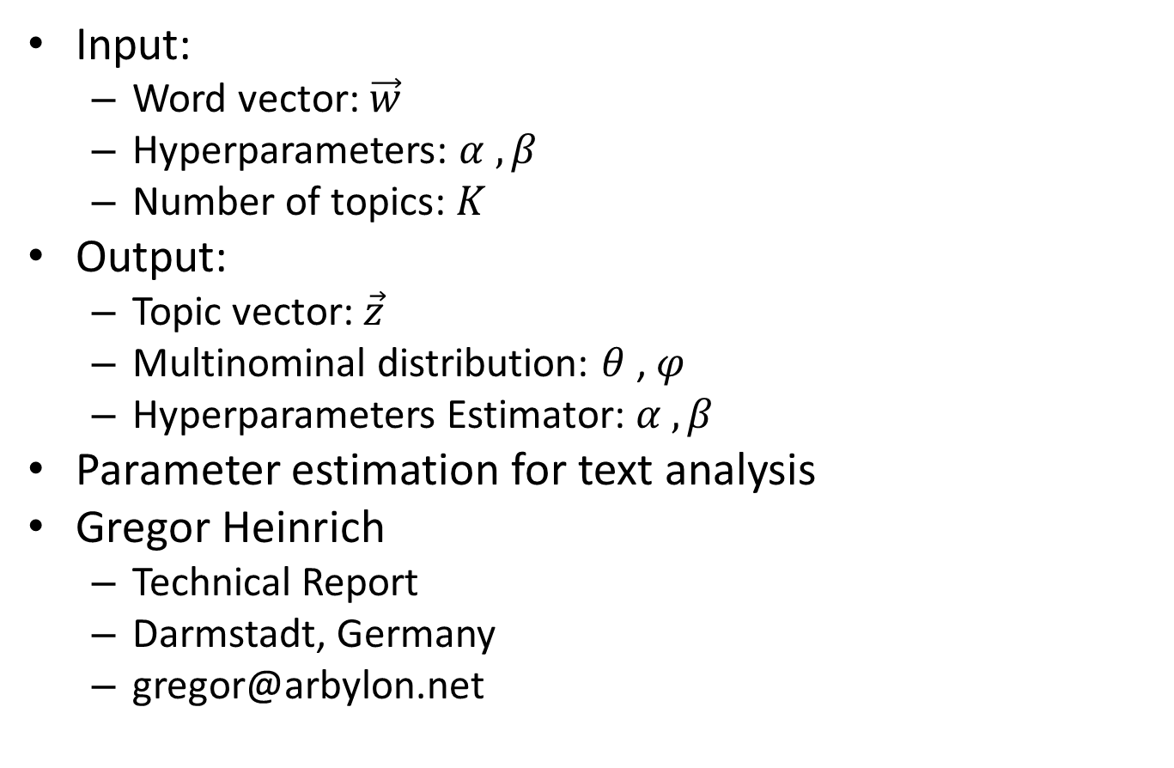
Conclude
Input:
Word vector: $\vec{w}$
Hyperparameters: $α , β$
Number of topics: $K$
Output:
Topic vector: $\vec{z}$
Multinominal distribution: $θ$ , $φ$
Hyperparameters Estimator: $α , β$
Parameter estimation for text analysis
Gregor Heinrich
Technical Report
Darmstadt, Germany
gregor@arbylon.net

