Slide 1
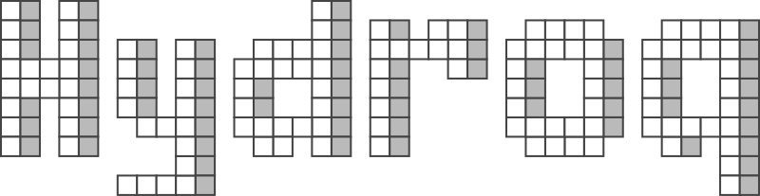
Vision document
Adam Vesecký

Slide 2

What it is all about
2D Realtime strategy
Main goal: to build, explore, attack and defeat
Features:
Every facet basks in clean simplicity
Optimized for mobile platform (Android)
Very simple to control (no complex actions)
Pixel art graphic

Slide 3

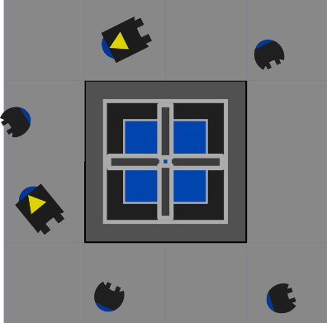
Story
Takes place on a small water planet, covered with islands
On this planet operate two robotic factions: Blue and Red
Both of them use islands for the construction of drilling rigs
Rig provides everything the faction needs (ore, materials, energy)

Slide 4
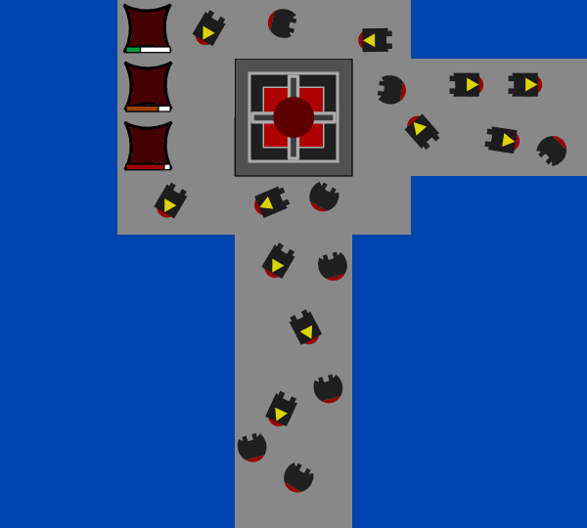
Story
Blue and Red struggle for supremacy
Every faction wants to control the entire planet
Once the rig is built, a base is established
The base produces droids: builders and warriors
Builders build bridges and platforms between islands
Warriors destroys droids of the other faction
The goal is to occupy all islands or destroy the enemy

Slide 5
Gameplay
The main difference compared to other strategies:
player has to build bridges to reach the unknown areas
player doesn‘t operate the individual units, he creates attractors instead
attractor is an area which the selected units are attracted to
only one type of source must be ensured – drilling rig
everything else comes secondary (electricity, factory, ...)
all functions and extensions are applied globally
player doesn‘t have to upgrade each building/unit separately

Slide 6
Factions
There are two factions: Blue and Red
Specification of differences is still in progress, but there are some ideas:
red‘s are more aggresive, have stronger warriors
red's can use radar to explore unknown areas
blue‘s are rather defensive, have faster builders and defense towers
blue's can use materials from dead enemies

Slide 7
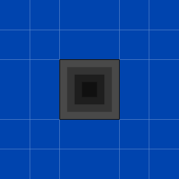
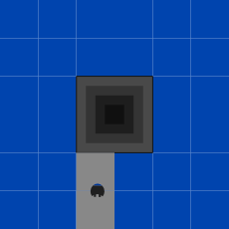
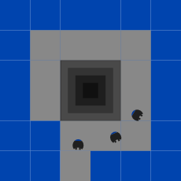
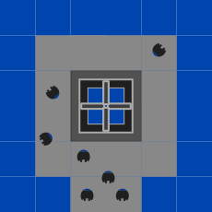
Drilling rigs
the whole planet is covered by islands (design still in progress)
when a unit gets to the island, it builds a platform around it
then it constructs a drilling rig, a key element to obtain materials

Slide 8
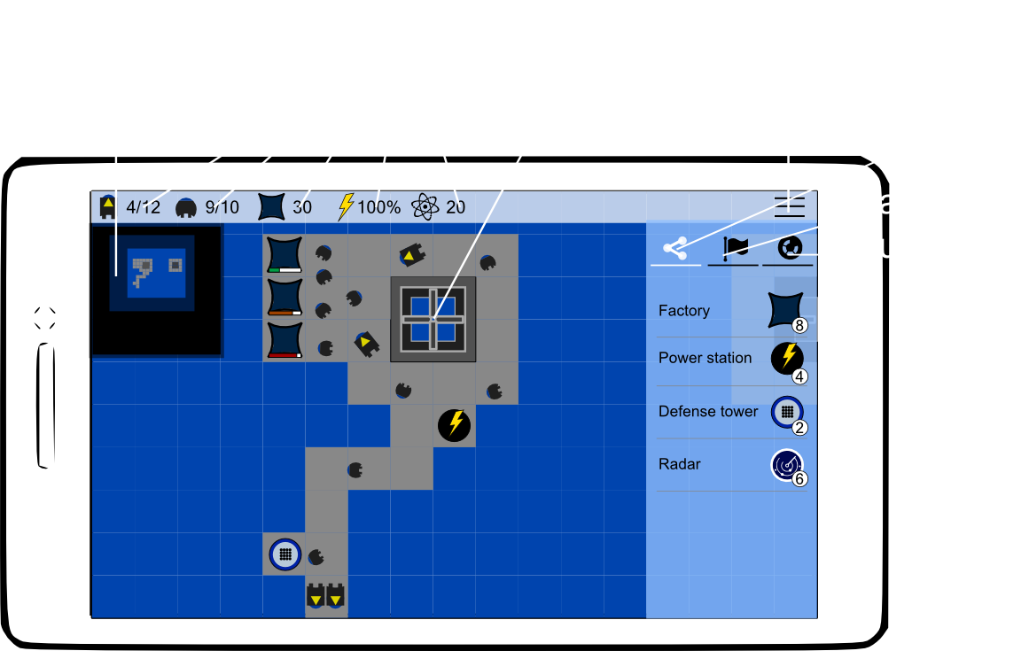
UI mockups: Main game window
Indicators:
number of builders
number of warriors
capacity
electric energy
available material

Slide 9
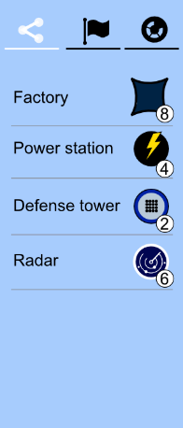
UI mockups: Building panel
Number in a circle specifies count of already created buildings
Factory
creates new droids
the more factories we build, the more droids we can have
has a capacity (maximum number of droids that can be created)
Power station
provides electric energy (essential for building)
Defense tower
attacks enemy droids
Radar
uncover distant areas (fog of war)

Slide 10
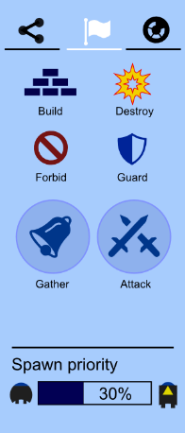
UI mockups: Action panel
Build
tool for building bridges/platforms
Destroy
destroys already created areas
Forbid
tool for specifying forbidden/dangerous areas
Guard
tool for specifying areas which should be guarded
Gather
specifies a meeting place
Attack
similar to gather but units behave differently
Spawn priority
what type of unit should be constructed more frequently

Slide 11
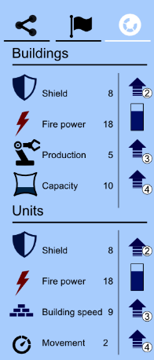
UI mockups: Upgrade panel
Shield (buildings/units)
fortification of buildings/units against enemy attacks
Fire power (buildings/units)
fire power of defense towers and warriors
Production
construction speed of new droids
Capacity
capacity of factories
Building speed
tower building speed
Movement
speed of droids

Slide 12
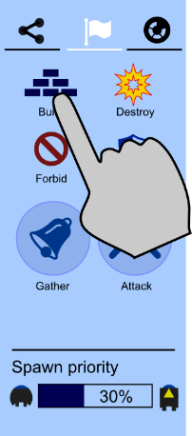
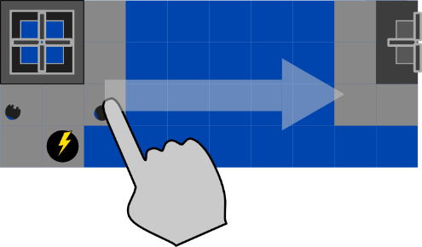
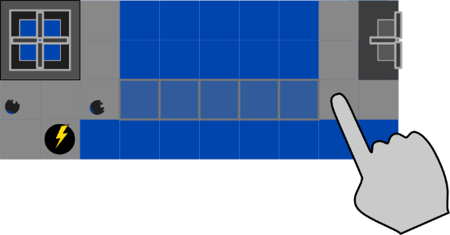
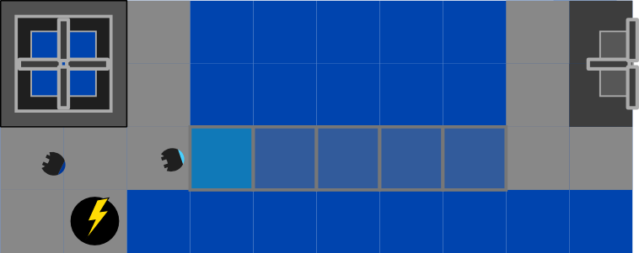
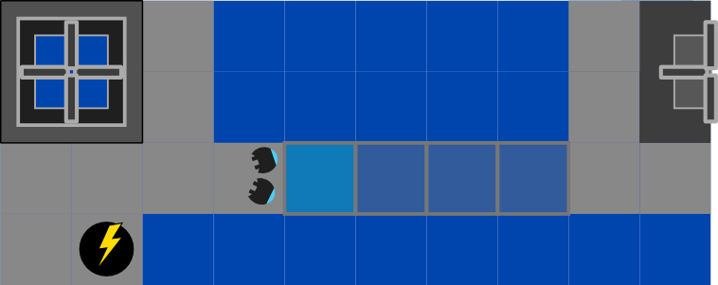
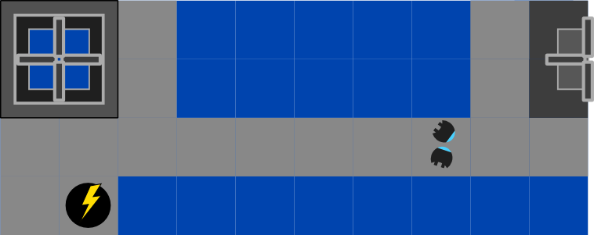
UI mockups: Building the bridge

Slide 13
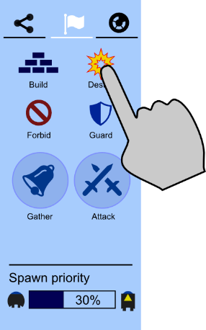
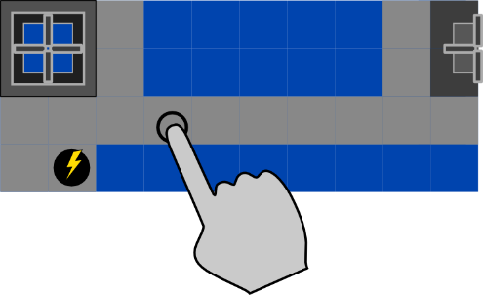
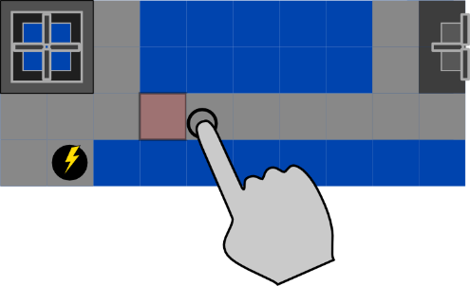
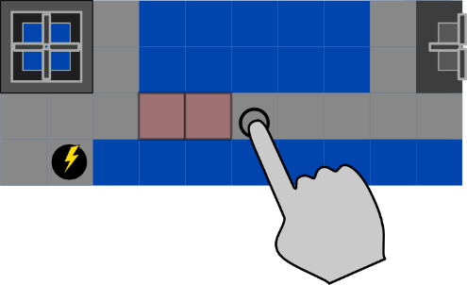
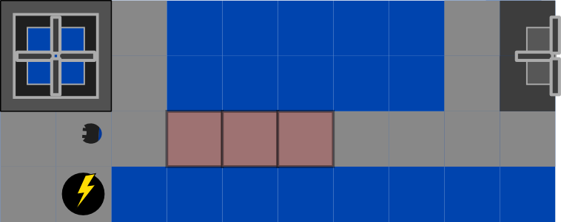
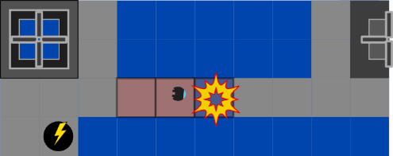
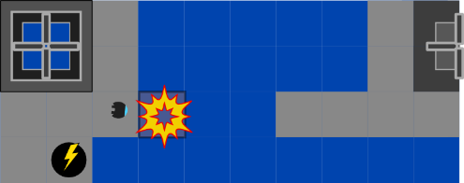
UI mockups: Destroying bridge

Slide 14
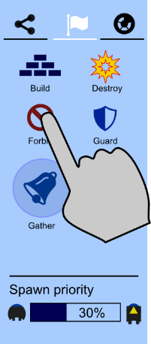
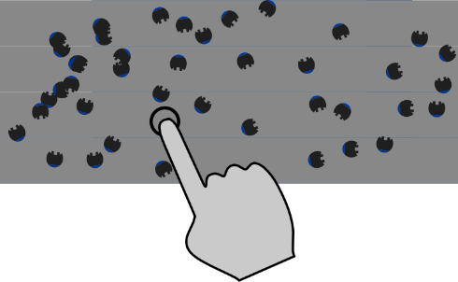
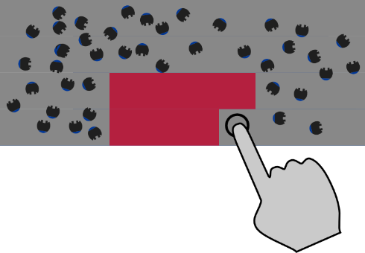
UI mockups: Forbidden area
units may cross this area in case of danger or if there is no other way

Slide 15
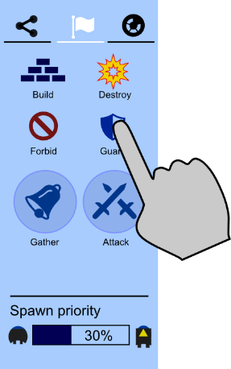
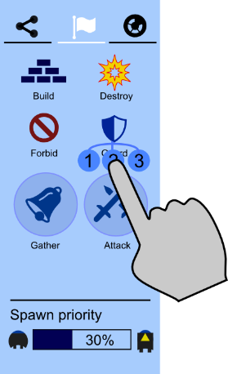

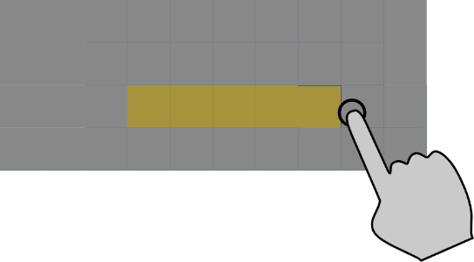
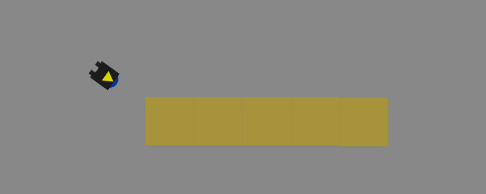
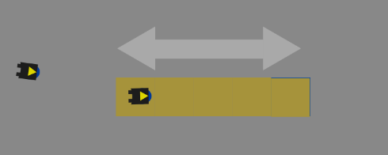
UI mockups: Guard area
user can choose the number of guardians

Slide 16
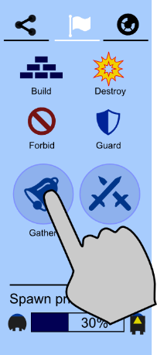

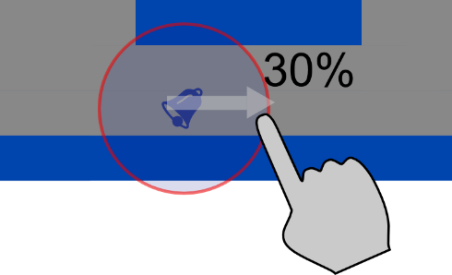

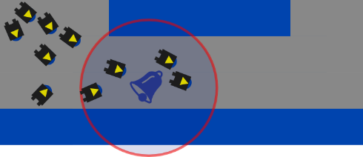
UI mockups: Meeting place
user can specify the percentage of all (remaining) units

Slide 17
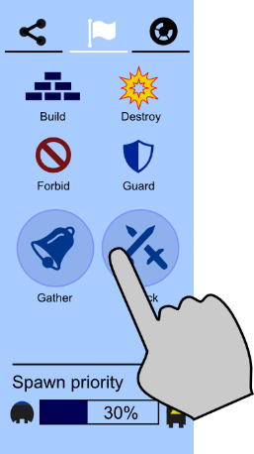
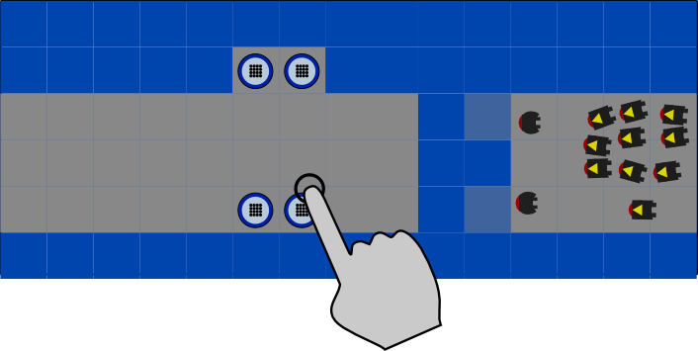
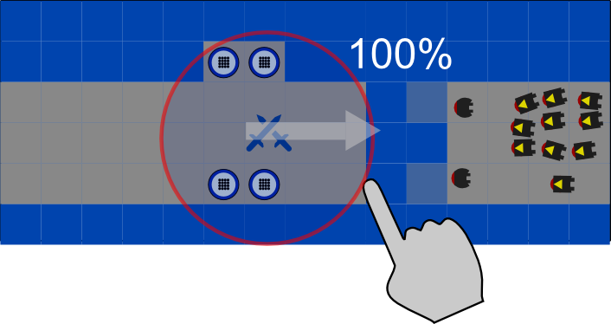
UI mockups: Attack 1/2
user has noticed approaching enemy units
he sends all his warriors to fend off the incoming attack

Slide 18
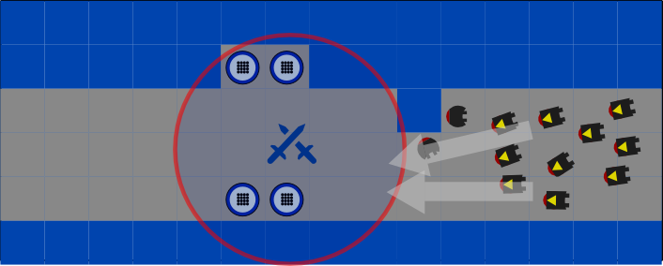
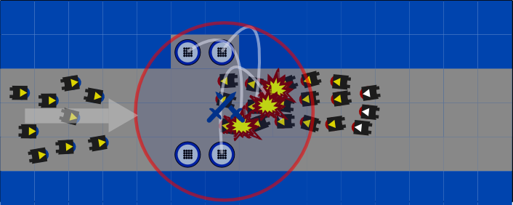
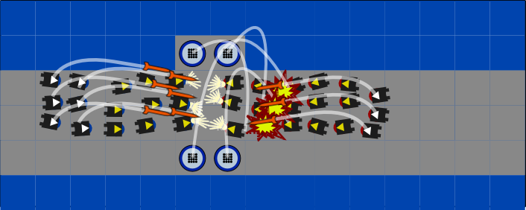
UI mockups: Attack 2/2
meanwhile, enemy units have reached user‘s base

Slide 19
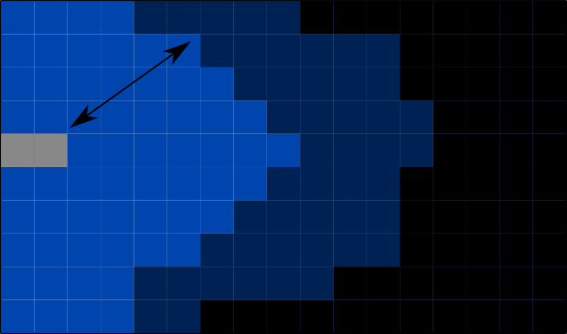
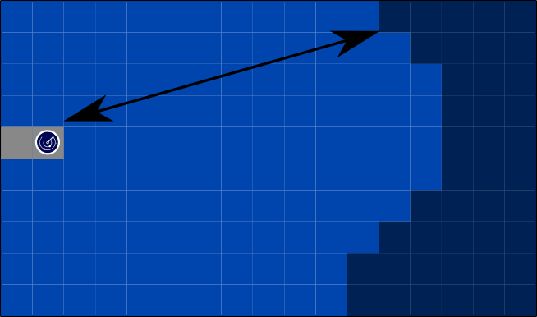
UI mockups: Fog of war
same as in other games
radar can uncover a large circular area
specification still in progress...

Slide 20
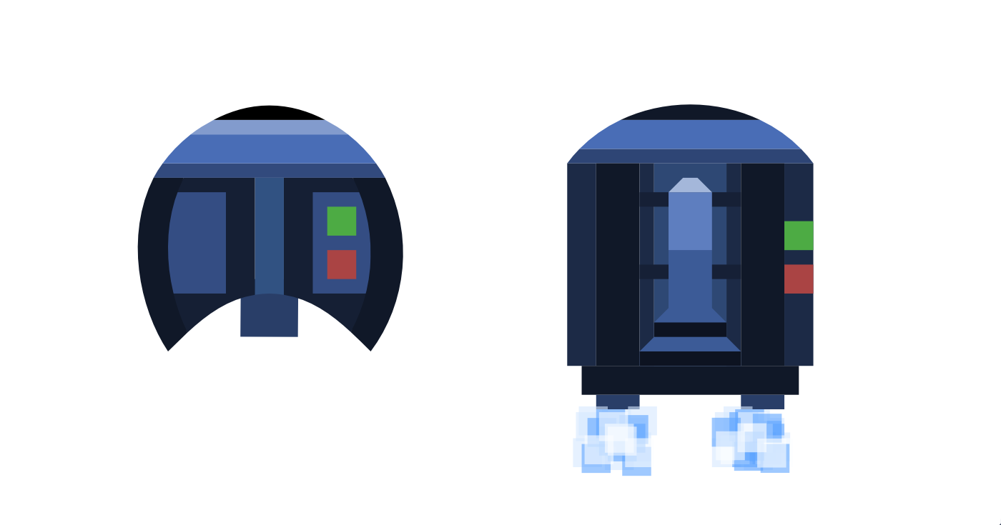
Design
builders and warriors

Slide 21
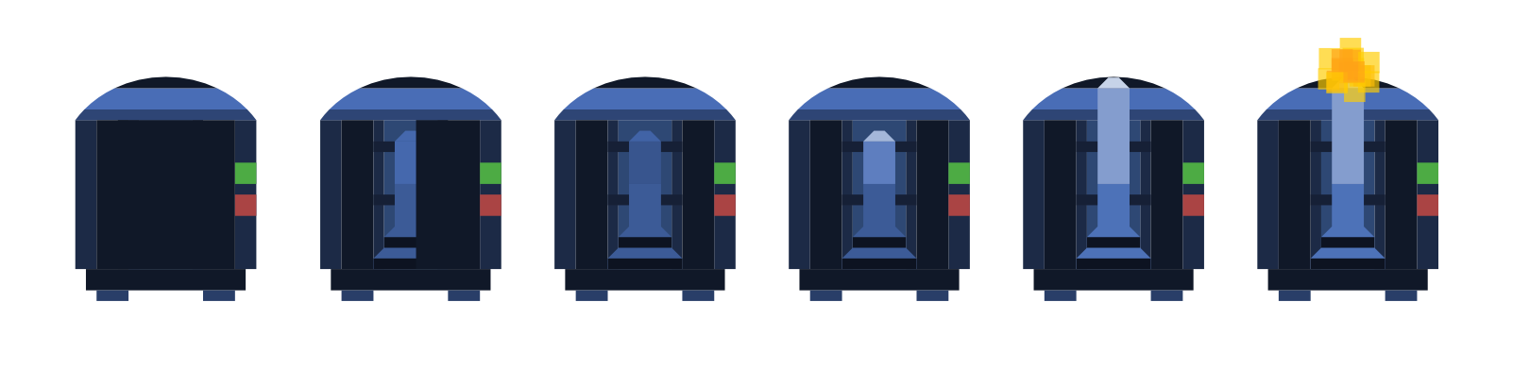
Design
missile launch

Slide 22

Design
game logo (still in progress)

Slide 23
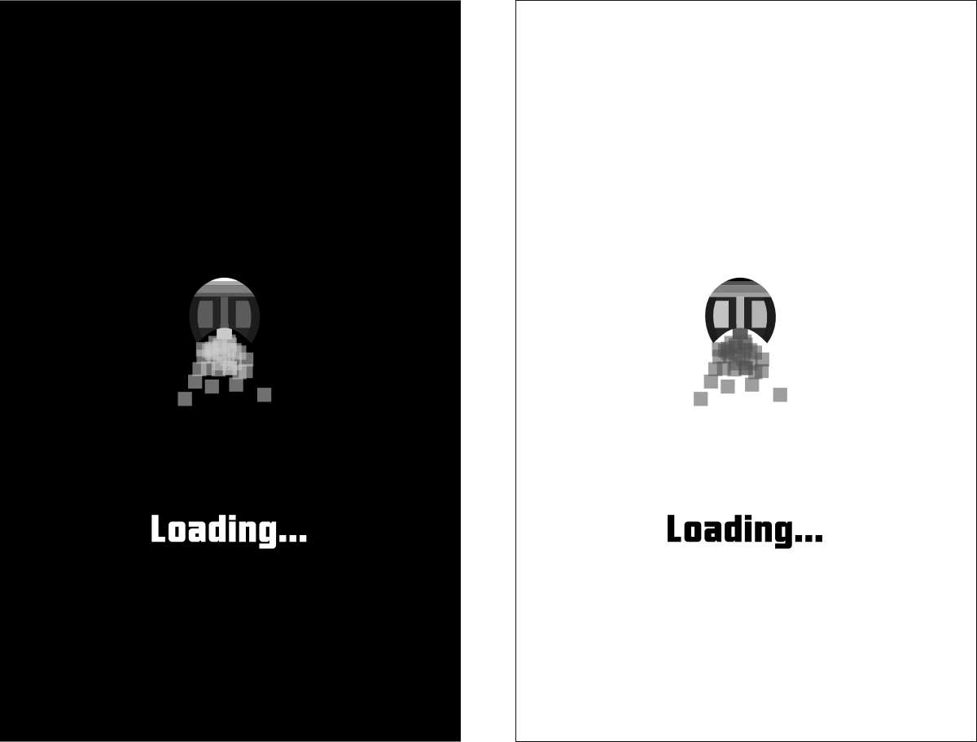
Design
loading window (dark and light version)

Slide 24
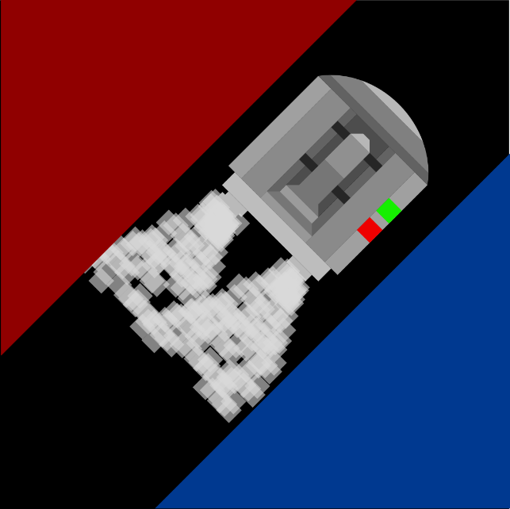
Design
game icon (still in progress)

Slide 25
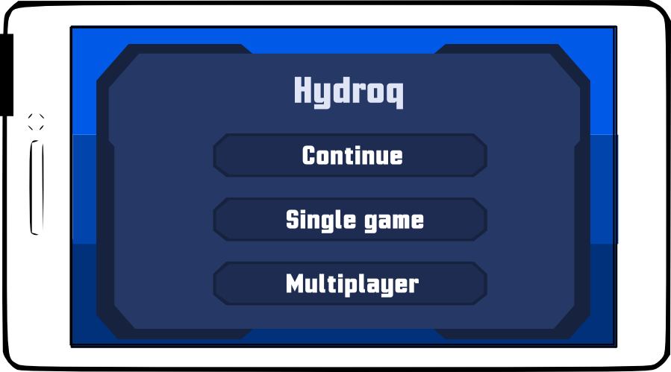
Design
game menu and font (still in progress)

Slide 26
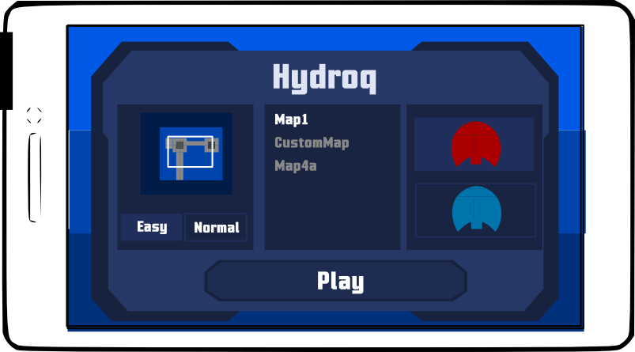
Design
game menu and font (still in progress)

Slide 27
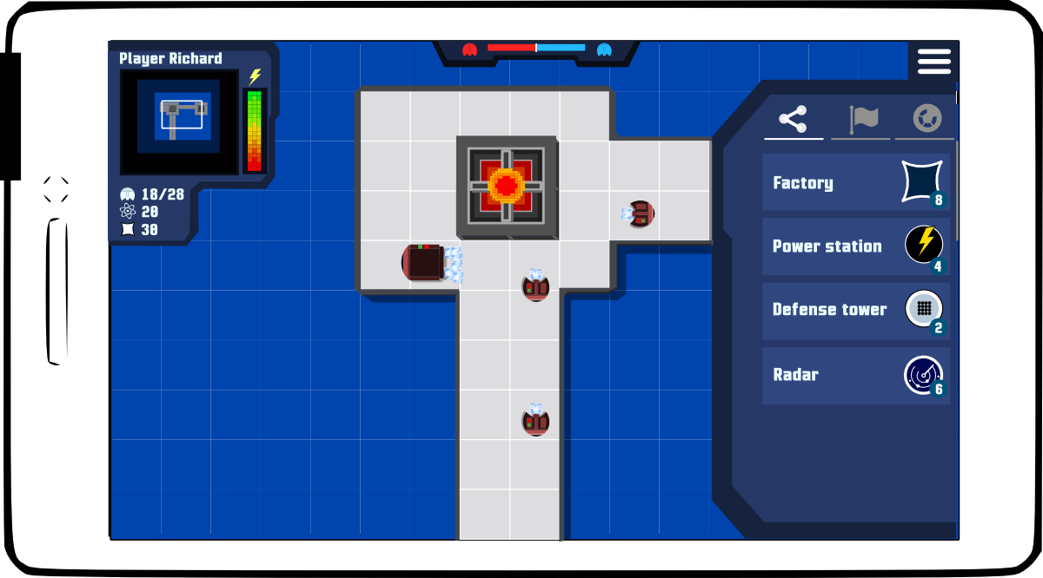
Design
game window (top bar displays balance of forces)

