Slide 1

DBM1: UEFA Champions League 2016-2022
Andrei-Marian Enache
Maria Minodora Mares

Slide 2


Our Dataset
Taken from Kaggle
2770 players
80 managers
750 matches
2200 goals
85 stadiums
74 teams

Slide 3
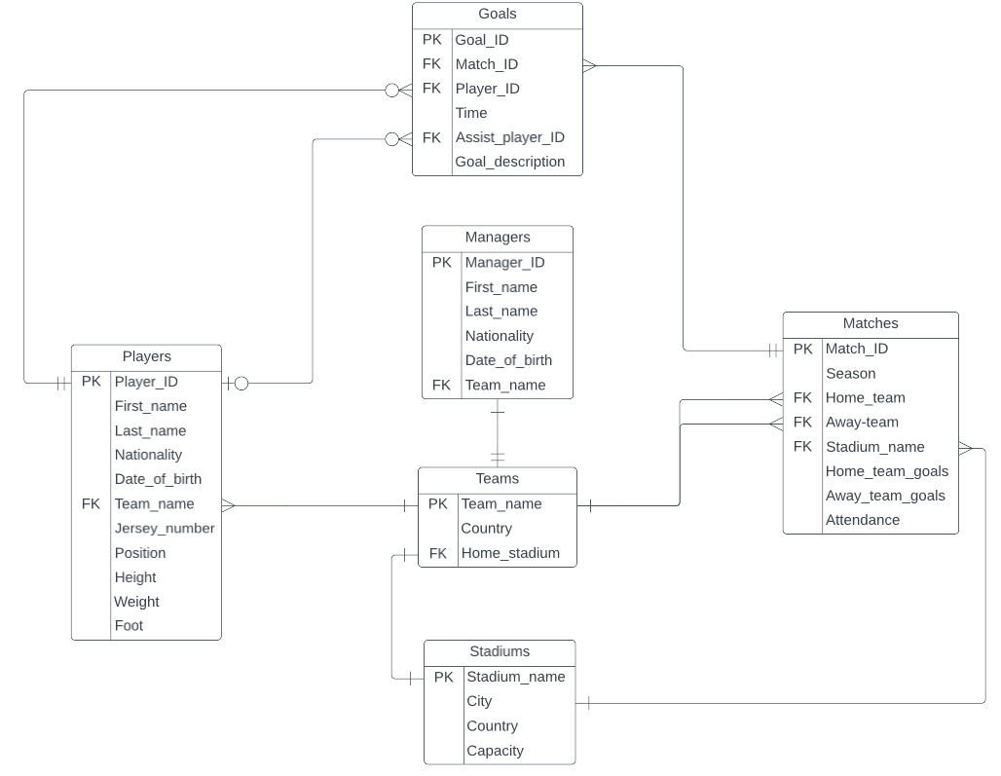
ER Diagram

Slide 4
SQL Queries
Display the details of the players and the number of goals scored during the 2021-2022 season.
select first_name, last_name, count(goal_ID)
from players inner join goals on players.player_ID = goals.player_ID natural join matches
group by (first_name, last_name, season)
having season = '2017-2018'
What are the stadiums where more than 20 matches were played?
select stadium_name, counts
from(
select stadium_name, count(match_ID) as counts
from stadiums natural join matches
group by stadium_name) number_of_matches
where counts > 20

Slide 5

Questions? Feedback? Thank you!

