Slide 1


Slide 2


















OUR PARTNERS
PLATINUM
GOLD
SILVER
bronze
Media
partner
SUPPORTING PARTNERS

Slide 3

Ве молиме исклучете ги мобилните уреди
Please turn off your mobile devices

Slide 4
Angular for Large Teams
Jovan Panev

Slide 5
What will we cover
What are the challenges that enterprise teams face
What is the Solution
How the solution can be implemented

Slide 6
Challenges
Consistency across apps
Code sharing(de-duplication of effort)
Fast development
Agile and adaptable
Testing?
Coding standards
Preserve team autonomy

Slide 7
Solution
Collaboration
Code Storage
Code organization

Slide 8
Code storage
Monorepo
Polyrepo
Code is stored in one repo
Atomic changes for entire repo
Single version of the dependencies(packages)
Code split in many repos
Independent package versions
Each repo is single compilation unit

Slide 9
Code organization
Monolith
Modular
App is a single compilation unit
Apps and libraries are composed of many de-coupled reusable units

Slide 10
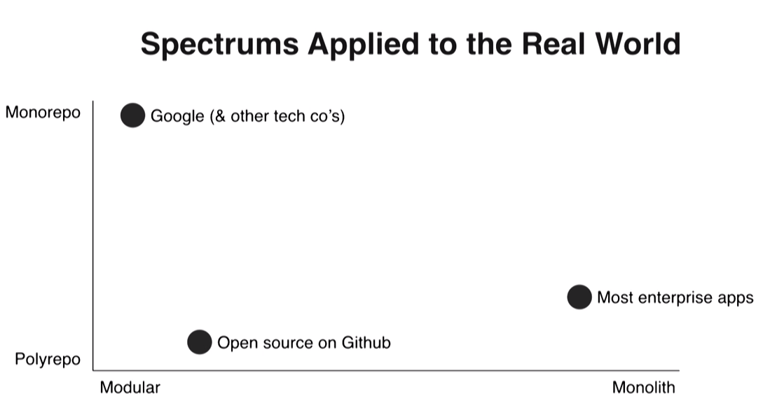

Slide 11
Monolithic polyrepo
With polyrepos it is easier to do the wrong thing
With polyrepos it is hard to share code
With polyrepos it is hard to test integration
Polyrepo is good in theory but in reality they often end up making life harder
Monolithic polyrepo is the enemy of collaboration

Slide 12
Modular monorepo
Consistency and reusability are easy
Libraries have clear boundaries
Libraries and apps integration tests
Promotes unified coding standards to all teams

Slide 13
Solution

Slide 14
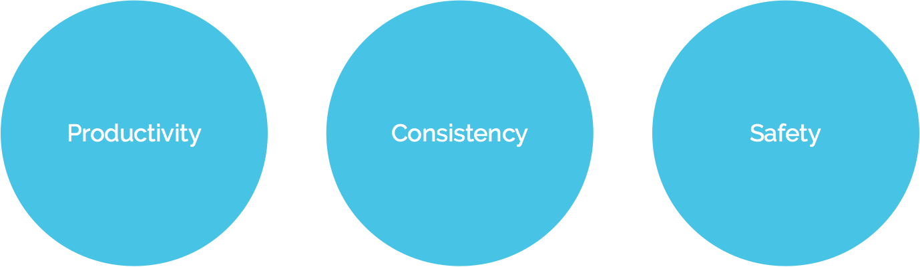
Nrwl Extensions for Angular
nrwl.io
Libraries have clear boundaries
Libraries and apps integration tests
Promotes unified coding standards to all teams
NgRx support

Slide 15
What Nx Provides
Nx Workspace
Analyzing and Visualizing the Dependency Graph
Imposing Constraints on the Dependency Graph
Rebuilding and Retesting What is Affected
Nx helps promote best practices.
Linters
Code Formatter
Build on Angular CLI

Slide 16

Thanks!
Any Questions?

