Slide 1
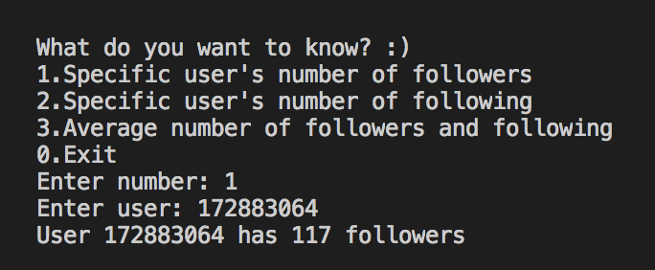
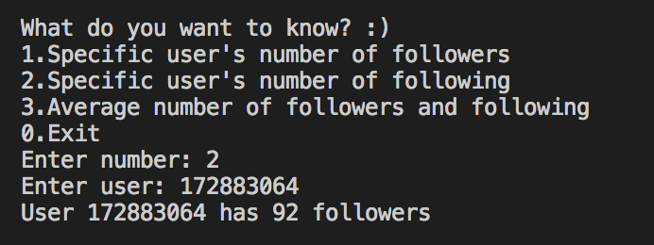
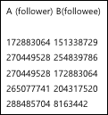
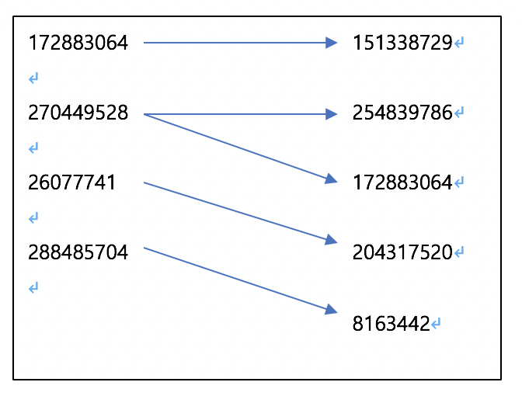
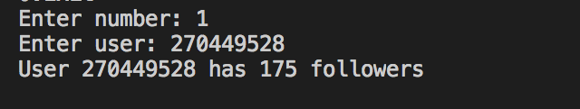
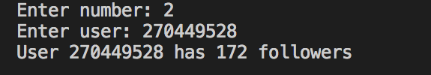
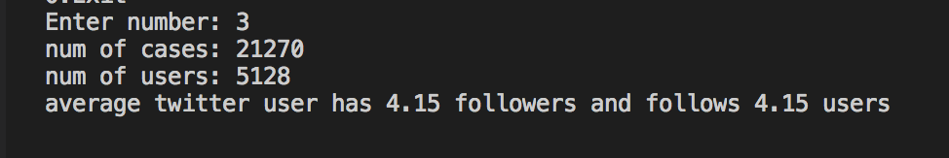
Question 1
To achieve the purpose of the program, it is required not only to store the data, but also to search the data. Thus, data structure with these two functions would increase convenience.
Hashing structures has been introduced in many HGU lectures, including data structure, java programming, practical projects and so on. Hash table has functions to store the data and search the data, thus was implemented in this program.
Below is a demonstration of this program for the first question with ‘twitter_sampled.txt’
Overview : Hash Table
The purpose is to set up a program that prints the number of followers and followings of a specific user that the program user enters. The input file contains multiple lines of two types of information in each line, a follower(user that is following) and a followee(user being followed). The ‘follower’ part of information is a set and the ‘followee’ part of information is also a set. One follower and one followee is a ordered pair. Therefore, there is a relations from ‘follower’ to ‘followee’. Below is a table that illustrates what follower and followee part of the information means; it is first five lines from ‘twitter_sample.txt’.
Each ordered pair represents one one-sided relationship - X following Y. Thus, an average number of followers and number of following of twitter users is equal. This average number is number of ordered pair / number of users.
With this information, three data are stored for each user: user identification, number of followers and number of following. These data types are saved in a structure ‘user’ with the variable name, ‘key’, ‘wer’ and ‘wing’.
As the program reads the data from the input file, it increases the variable ‘wing’ of follower by 1 and increases the variable ‘wer’ of followee by 1 for each ordered pair.

Slide 2
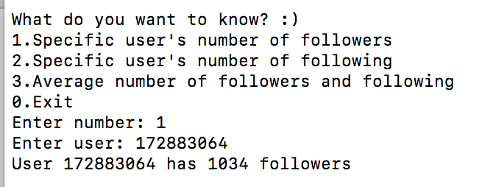
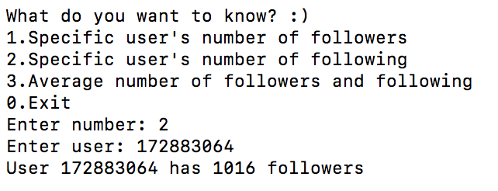
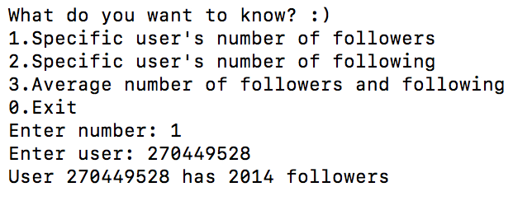
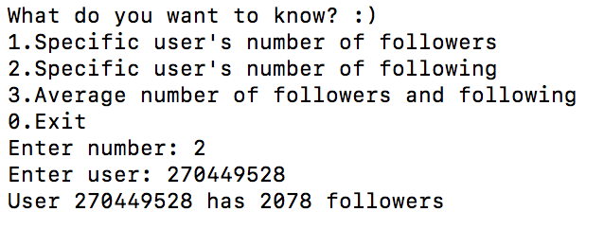
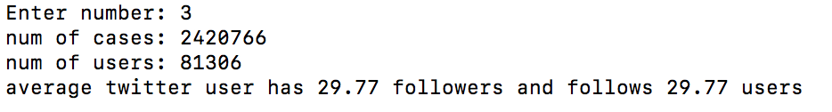
Demonstration with full data
Below is a demonstration of this program for the first question with full data retrieved from https://snap.stanford.edu/data.
The website states there are 1,768,149 followings, but the actual data has 2,420,766 followings.
Tips for TA running my code
To run the code will full data, changed the SIZE in the global on line 5 to 81306 and change input file name, which is on line 103

Slide 3
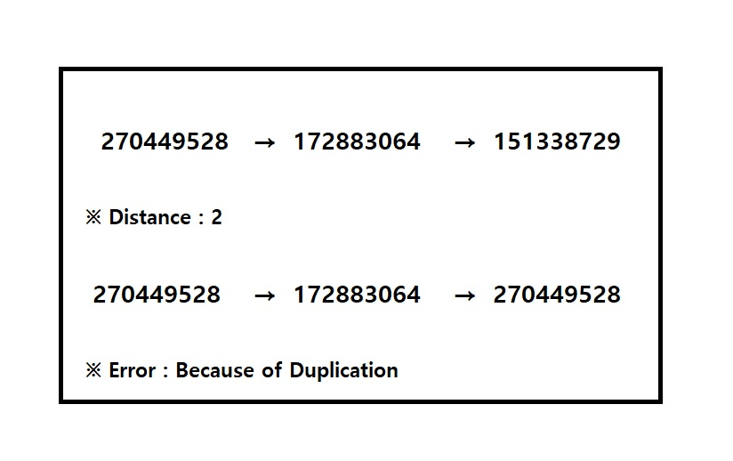
Question 2
Overview : Problem Approach
Look at the Twitter. In a User’s page, there are lists of people, whom a user follows. A user can approach an page whose page is followed by a user by mouse clicking. When a user approach a following user’s page by clicking at once, we call this distance ‘1’.
This problem’s issue is to find out a maximum distance that a user can approach following user’s page. Looking at the input file, (twitter_sampled.txt) It means that left user follows right user. Of course that two user can follow each other. Starting at a user’s page, we can repeat approaching another user’s page, by clicking a user’s following list in page. It’s called the ‘distance’, that numbers of clicking mouse.
The thing to be careful about the problem is that we should not go back the way we came. If two users follow each other, we can go back the way we came, because this is not an one-way. The maximum distance will be infinite, if we allow the way back.
Issue & Algorithm
We will use hash-functions like solution of problem 1, and 3. And we will use Linkedlist, and Depth First Algorithm like solution of problem 3. Linkedlist is a data structure which stores data. In linkedlist, each node has a data and pointer, and they are connected in one-line. As you can see the ‘linked’, each node which stores data is connected with each other. The node's pointer is take charge of connecting to the next or previous node. By using hash-function, we can handle key number for the size that we decide for each users. Finally, because this task is repeated, we also will use ‘recursion’.
Unfortunately, I didn’t get a class, which name is ‘Data Structure’ that is an computer science subject. So I can’t use hash-function, It’s very lethal to us. Is not there a way to do it?
Of course not, we can solve the problem by using depth first algorithm, time-complexity, normal array, recursion, and Linux code which makes the sorted data file. Instead of using hash-function, we will use linux command “sort”, and “uniq” which sort the twitter_sampled.txt, the sorted data is called ‘sorted_id_list.txt’.
<Linux code>
cat twitter_sampled.txt | cut -d " " -f 1 | sort -n | uniq > sort1
cat twitter_sampled.txt | cut -d " " -f 2 | sort -n | uniq > sort2
cat sort1 sort2 | sort -n | uniq > id_list.txt

Slide 4
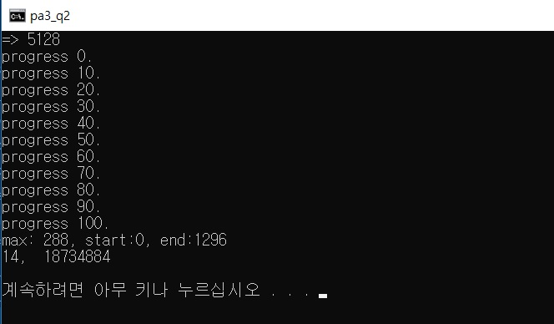
We will store the data in the array which name is ‘userData’. Then we will define several method, which names are ‘insert’, ‘b_search’, and ‘dfs’. The method ‘insert’ is to store the data into the array ‘userData’. ‘b_search’ does binary search. And the method which name is ‘dfs’ implements depth first algorithm. To get the max distance in these data, we will use an int variable which name is ‘visited’ which purpose is to avoid duplication. And finally, by using recursion, and time complexity, we can solve that problem.
In other words, a user passes the value of ‘cnt++’ to the following users. Users who receive the value recursively give ‘cnt++’ to following users until they can no longer proceed. In code, we define a variable which name is ‘cnt_max’. If cnt is
bigger than the maximum value, we save the cnt value into cnt_max. Than we can compare with two users whose value is bigger than another one.
Tips for TA running my code
To run the code, you need a text input file which name is ‘sorted_id_list.txt’. I will submit this project, by attaching “sorted_id_list.txt” together.

Slide 5
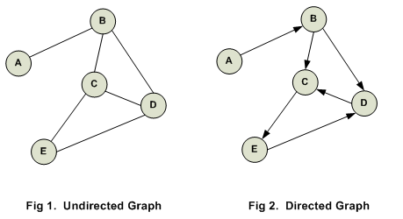
Question 3
Fortunately, we know how many users are in data. So we can take static way to make graph. Because we know dynamic is more costly than static as long as we know the size of container. So we can make matrix for graph or list for graph. But we don’t know how many followers are of each users. For memory rather than making each allocation in advance for all unknown data, it is better to allocate memory when we get the information of followers. But for each list, we need at least one start point. the number of it is just size of users!
So, sub-issues are clear but, main issue is how to handle just key number for the size we decide for each users. The answer is hash-function. It is kind of magic, each key numbers are matched after hash-function. There are lots of way to implement. for easier way we choose the Linear Probing. It has critical problem of Primary Clustering but in our data, we can conquer it. so by hash algorithm we clear all issue!
- How can we change directed graph to undirected graph
Overview : Undirected Graph and DFS
Our data is relation data set, so I think directed graph structure is good for this data. because (X Y) means (X -> Y), not (Y->X). once I use graph, problem just been easier than I solved it first. The 3rd problem says X and Y are “connected” iff X follows Y, or Y follows X, or there is another user Z who is connected with X and Y at the same time. It means that we can consider directed edges into undirected edges which stand for “connected”. So almost done, now we can easily answer the question that is every connected with another one? In other words, are all members in twitter connected? umm… At now I don’t know but DFS will tell us the answer. Let’s see the DFS at algorithm part, but now we focus on how do I put this data on limited memory.
We make insert function for broad usable interface, like insert(X, Y). intuitively. So this function make chain for X’s index of Hasharray. In order to make this directed relation to undirected relation, we just use twice insert call like insert(X, Y) and insert(Y, X) so that we can access each other as free like undirected graph. so that it is used for DFS later.
- How do I search all connected partitions as faster as possible?
Issue & Algorithm :
Using data structure knowledge from handong CS lecture, we should search from one vertex to another vertex which is connected to previous vertex to the extent we can. Just one time DFS is enough. We make member variable like ‘boolean’ to each users for checking visited or not. Starting point is not matter.
- How can we handle many of just key numbers by graph in limited memory?
1. Static? Dynamic?
2. Adjacency matrix? adjacency list?

Slide 6
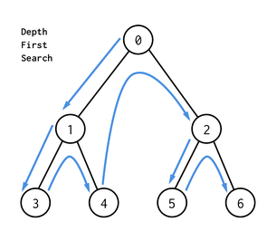
Just start any vertex and check the chain of the vertex that now we are in, and then to each chain we call DFS function call recursively. Once we visit any vertex we change the variable of visited to true and go on, if the vertex we gonna visit is already visited, we ignore this vertex. Like this process we can check the one partition and then we just move next vertex of hash-array, do same process again, if the vertex is visited, move next vertex of hash-array not chain. so for this start from index 0 of hash-array is better way.
Tips for TA running my code
All attribute about size of data and file name of data are in code. You can easily check the data by changing SIZE value and File name.
SIZE is in part of global, File name is in part of main.
Analysis :
Time complexity is O(|V|) we can find all partition by just one visit of vertex.
Space complexity S(|V|+2*|E|) we have hash-array for all users so we need space for all users and all relation space need but we allocate twice for undirected worst case is S(SIZE + 2*Follow cases)

Slide 7

Question 5
$tMat\left[i\right][j]$ = $\frac{link\left[i\right]\left[j\right]}{outdegree\left[i\right]}∗0.9+\frac{1}{SIZE}∗0.1$
Overview : Provide random surfers the environment to freely search pages!
This problem is to find the most frequently visited user page according to the given related data.
As the data is relations, I created an array which contains all the followers to the structure ‘user’. After storing all the following information to the array, a transition matrix for the surfer is created. A number of random surfers start to surf for a given number of clicks based on the matrix. As the surfer visits each page, I increase the random page’s frequency. After each surfer finishes surfing. It sorts all the counts and return the top twenty pages.
<The Formula for the transition matrix which decides which page to go>
2. How can I find 20 most influential users? Is it enough to have one surfer to find top 20 GENERALLY popular pages?
To accumulate the times the surfer visited, I create an array that contains frequency of a random surfer visits. Also, I created a variable called ‘TRIAL’ that shows how many pages the surfer could visit.
To find the most popular pages, I first consider putting larger numbers to ‘TRIAL’. However, as it starts from just one particular page, the further it might be circular even though it has ten percent chance to go to random pages. For example, if a starting page is a Handong student’s, it has a high possibility to go to Handong student’s pages circularly. Also, the given sampled data has some users who have no followers, which can lead to high frequency to the same page. Therefore, I create variable called ‘SURFER’ to have various starting pages.
Issue & Algorithm
1. How can I tell the random surfer which pages to go?
As all data has its links, I considered putting all the pages as the linked list. Thus, I created an array under a structure that contains the user name that he follows. After the program finishes reading the input file and putting data to the array, it starts random surfing.
To let the surfer to start surfing, I get intuitions from the given references.
First, I created a 2X2 matrix called linkbased on the structure which contains who each user follows in the structure named ‘user’. After doing so, I added up all numbers of the row to find the outdegree. The outdegree is used to determine the possibility of the next visiting page. This means that if link[10][5] = 1 and link[10][6] = 2, the chance to visit 6 is higher than 5 when the surfer is at 10. By dividing each row’s number by the outdegree, it creates a matrix named “link probability”. Since the core of random surfing is that the surfer visits a random page for ten percent. I created a leap probability matrix which all the element of the array has the value of 0.1/SIZE. I the final transition matrix is created by 0.9*link probabilities + 0.1*leap probabilities.
<Multiple surfers from different start pages will bring more accurate result.>
For the result to show, I was considering different sorting algorithms that I know. As it needs only top 20, I was thinking the bubble sorting algorithm can be fast as O(20n). However, with the given sample data, using the quick sort algorithm is shown to be faster as O(n log(5128)) which is O(n*3.7).

Slide 8
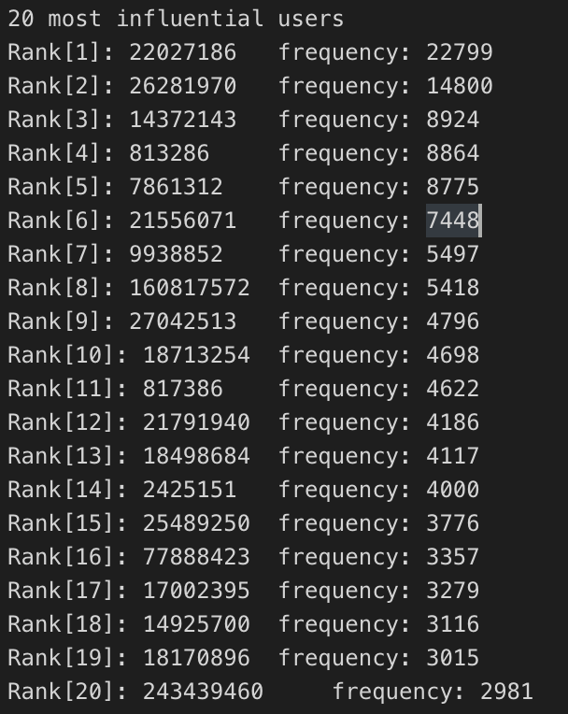
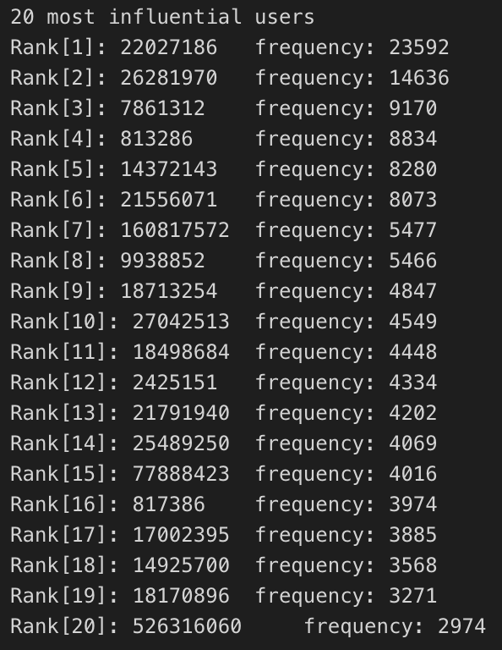
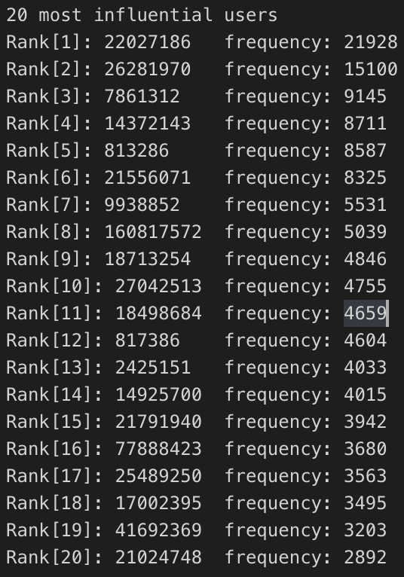
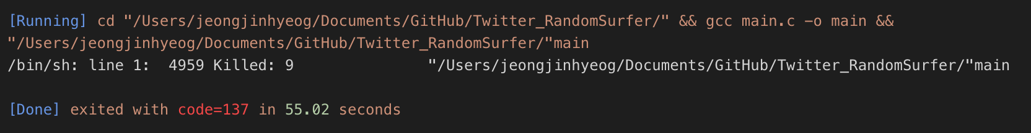
Analysis
Tips for TA running my code
As our algorithm uses the hash table functions, it is much faster to find data by going to the index it is saved. Without using the hash table, it could take much longer time to search, since it has to search from all data.
As it is only runnable for the sample data, It should have the ‘twitter_sampled.txt’ file in the same directory.
If you run and wait for few minutes the rank will be shown.
Result
For now, the the number of users is 5128, and the count for a surfer visit is 1000, and the number of surfers are 1000.
<Using hash functions, Hash table makes storing data easier and query faster.>
However, for the original data which has 81,306 users, my random surfer did not go well. I have not found an exact reason for this issue. However, as we need to make the transition matrix which is a two dimensional array, the size of array needed is 81,306 * 81,306. It might be too big for the CPU to have enough memory for the array. To solve this issue, I searched how to GPU and other method. I thought out that dividing data and using the data load to work on such big data can solve the issue that I encounter. If I can have a chance, I want to learn more about big data processing.
For each time, the ranking changes, but the top 2 seem to stay the same, and it tends to be have similar users on the list.
<the program stops running with 81,306 users>

