Slide 1
A decentralized Machine Learning based model for health care system

Slide 2
Team Members
Name | Roll No
Shubham Parihar | 1918716
Ankit Negi | 1918223
Mahima Bisht | 1918443
Abhishek Suyal | 1918130

Slide 3
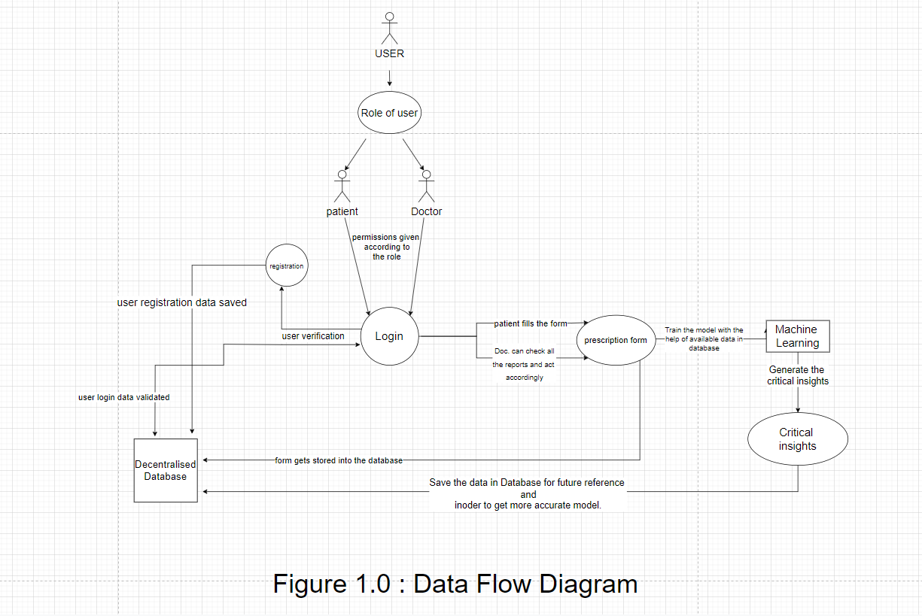
Project Structure

Slide 4
Objective
Use cloud to store medical records so that the patient can easily manage them.
Provide doctors with access to medical records of a patient for easier diagnosis and treatment.
Save time and money of patients.
Use of Machine Learning to provide key insights into patient’s health.

Slide 5
Future Scope
Link with a unique identification number like AADHAR card, PAN card, etc.
Help with intake of medicine or upcoming appointments. They will be notified when the time comes.
Add a feature which will show if the doctor is present at the hospital or not.

Slide 6
Tool Used
React.js (UI)
Next.js (Routing, Bundling, and Code Splitting)
Supabase (Database and Storage)
Vercel (Hosting)

Slide 7
Sustainable Development Goals
Push for a healthy lifestyle
Good health and well-being of society

Slide 8
Thank you

