Slide 1


Slide 2


Kinematic Analysis and Explainability of the S-JEPA Architecture on the
NTU RGB+D 120 Dataset
Group 15
Nguyễn Quang Tùng – 20233884
Đỗ Nguyễn Anh Đức – 202414618
Nguyễn Thị Thúy Huyền – 20233854
Supervisors
Assoc.Prof. Trần Thị Thanh Hải
TA. Bùi Hạnh Trang
1

Slide 3

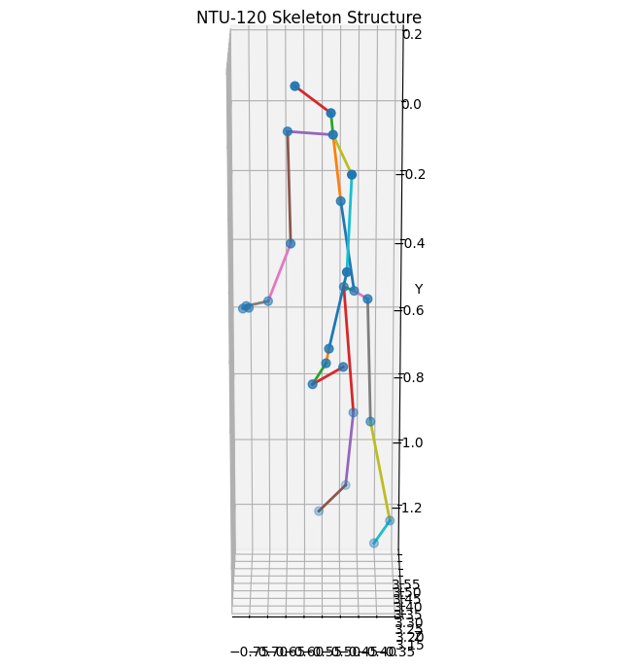
Problem Definition
Objective
Develop a deep learning pipeline for skeleton-based human action analysis using the NTU RGB+D 120 dataset and the S-JEPA framework.
Project Scope
Analyze skeleton-based human motion data.
Explore spatial and temporal motion characteristics.
Prepare high-quality data for S-JEPA representation learning.
Improve the interpretability of learned motion representations.
Dataset
NTU RGB+D 120
114,480 skeleton sequences
120 action classes
25 body joints (x, y, z).
2

Slide 4
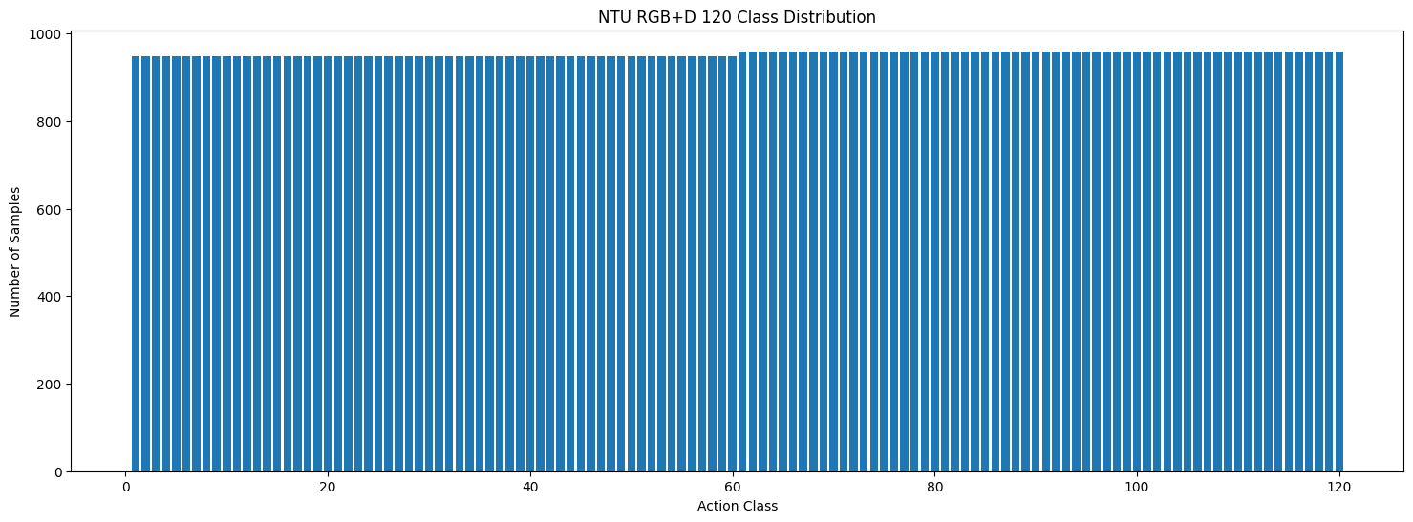
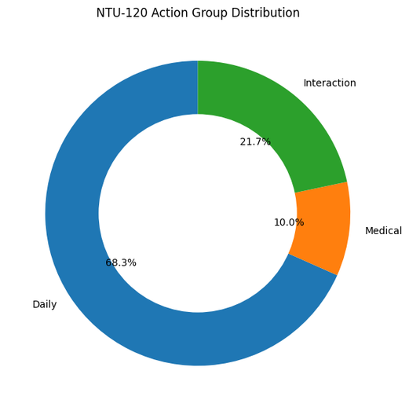
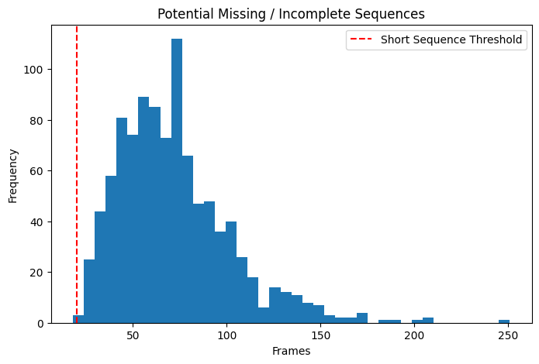
Exploratory Data Analysis (EDA)
Dataset Analysis
Class Distribution
Action Group Distribution
Sequence Length Analysis
Data Quality Assessment
Missing / Short Sequences
High Completeness
Consistent Skeleton Representation
Applied Techniques
Distribution Analysis
Missing Data Analysis
Data Quality Assessment
The dataset is balanced, high-quality, and suitable for skeleton-based representation learning.
2

Slide 5
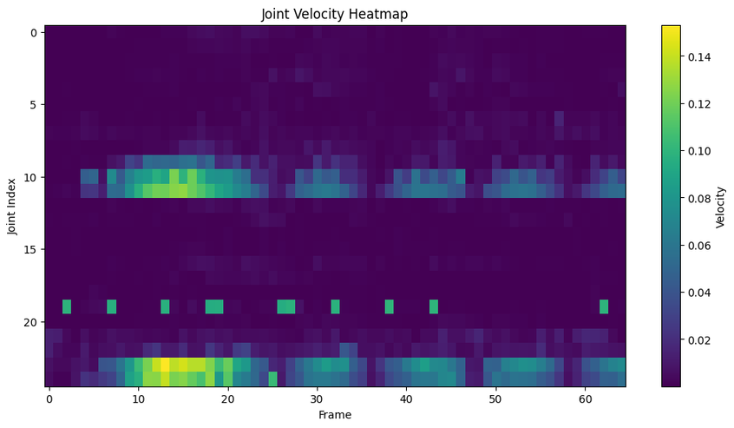
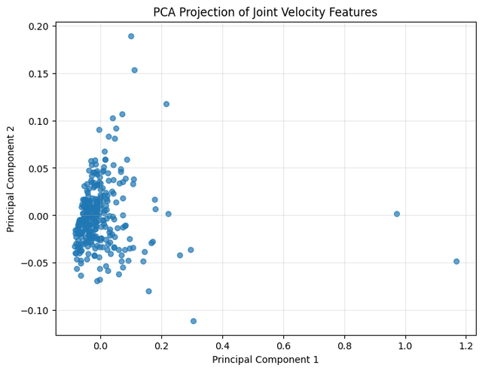
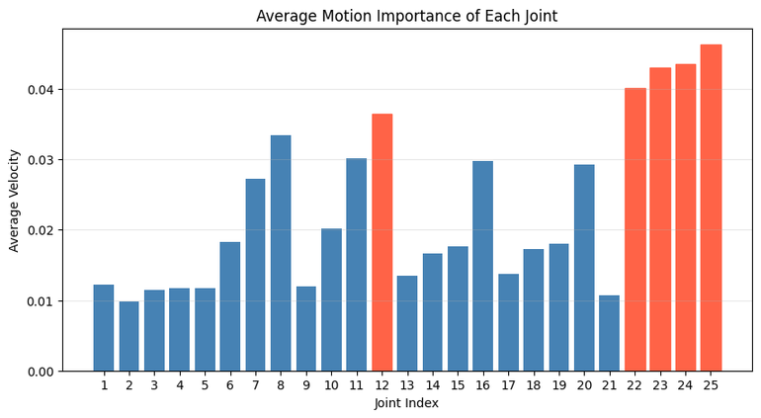
Feature Analysis
Spatial Features
Skeleton Structure
Joint Relationships
Temporal Features
Velocity Analysis
Acceleration Analysis
Explainability
PCA Visualization
Top-5 Important Joints
Applied Techniques
Spatial Feature Analysis
Temporal Feature Extraction
PCA
Explainability Analysis
2

Slide 6
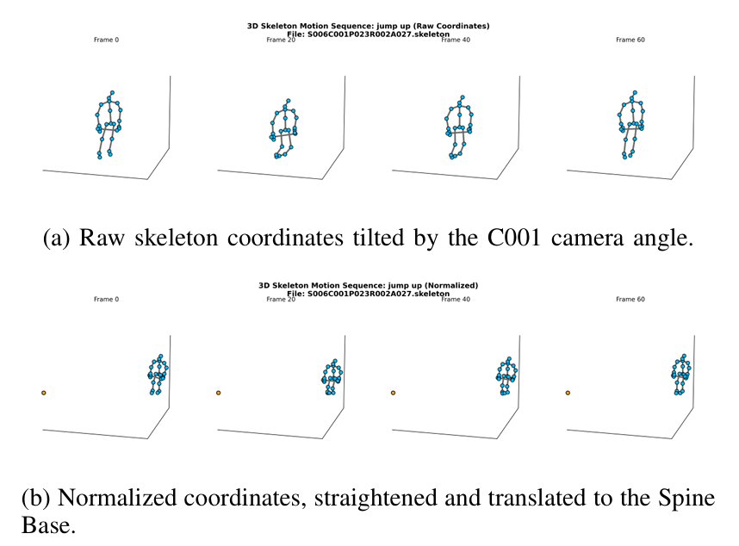
Data Preprocessing for S-JEPA
Frame Standardization: truncation or zero-padding to 40 frame-sequences
Outlier Removal
Statistical Outliers: Tukey’s method
Density Outliers: DBSCAN
Data Normalization
Origin Translation: Skeleton is centered at origin
Rotation Alignment: create view-invariant representation
2

Slide 7
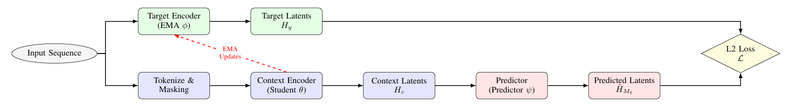
Spatio-Temporal Joint-Embedding Predictive Architecture (S-JEPA)
Input: X in R (TxJx3)
Spatio-Temporal Tokenization: Transforms skeleton sequences into temporal patches and joint spatial embeddings
Context Encoder: Processes the masked input sequence to learn contextual motion representations from visible tokens
Target Encoder: Encodes the full sequence to generate stable target representations for self-supervised learning
Predictor and Loss Function: Predicts the latent representations of masked tokens and minimizes the L2 distance to target latents
→ For evaluation, only the frozen Context Encoder is used with a Linear Classifier
5
Notes:
Phase 1: Data Preparation
"First, in the Data Preparation phase, raw skeleton data undergoes Normalization and Alignment to ensure coordinate consistency. We then apply Fixed-length Sampling and Data Augmentation to create a robust input for the model."
Từ khóa: Coordinate consistency (nhất quán tọa độ), Robust input (đầu vào mạnh mẽ/ổn định).
Phase 2: S-JEPA Core Architecture (Trọng tâm)
"Moving to the core architecture, we utilize S-JEPA. Here, the data is split into two branches. The Masking Block removes certain skeletal joints or frames, which are then processed by the Context Encoder. Meanwhile, the Target Encoder, updated via EMA (Exponential Moving Average), generates embeddings from the full skeleton. The Predictor's job is to map the context to the target in the latent space by minimizing the L2 Distance."
Từ khóa: Latent space (không gian tiềm ẩn), Skeletal joints (khớp xương), Masked patches (vùng bị che).
Phase 3: Evaluation & Downstream Task
"Finally, in the Evaluation Phase, we use the pre-trained Context Encoder for Action Classification. We evaluate our results using a Confusion Matrix and visualize the learned features through t-SNE to demonstrate how well the model clusters different human actions."
Từ khóa: Linear probing (thử nghiệm tuyến tính), Clusters (phân cụm).
6

Slide 8

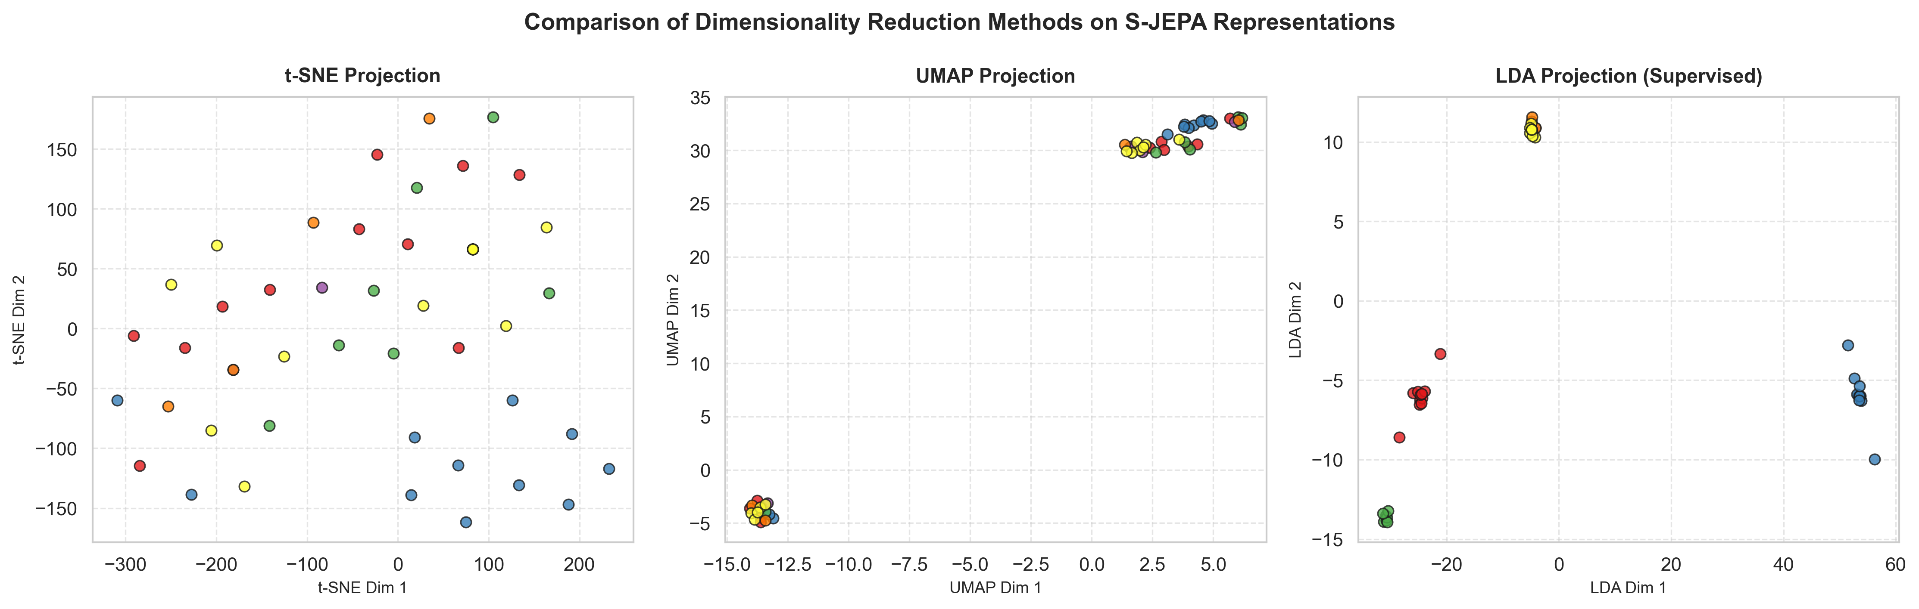
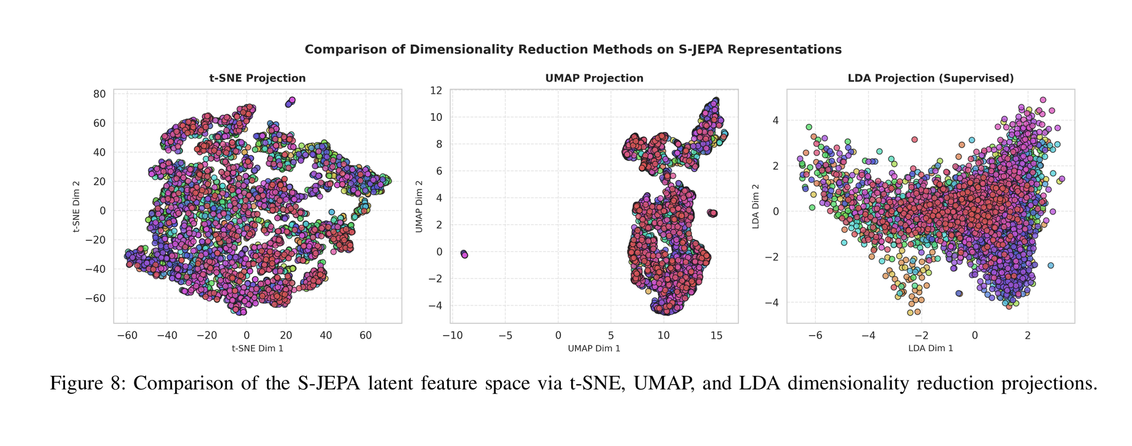
Latent Feature Visualization
Color Legend:
🔴 Drink Water (A1)
🔵 Waving Hand (A23)
🟢 Jumping (A27)
🟣 Punching (A50)
🟠 Walking (A59)
t-SNE, UMAP, and LDA all produce overlapping mixed-color visualizations
→ 120 classes cannot be visualized by only 2 dimension
6

Slide 9
Feature Selection
Filter method: use Mutual Information for joints and action classes
→ Hand joints (7,11) and foot joints (15,19) possess high MI
Wrapper method: incrementally add joints into the downstream linear classification model
→ Only 12 primary joints (hands, feet, head) maintain 95% accuracy while reducing computational load by 50%.
Embedded Method: select via Self-Attention weights from Context Encoder
→ Moving joints receive the largest Attention Share
6

Slide 10
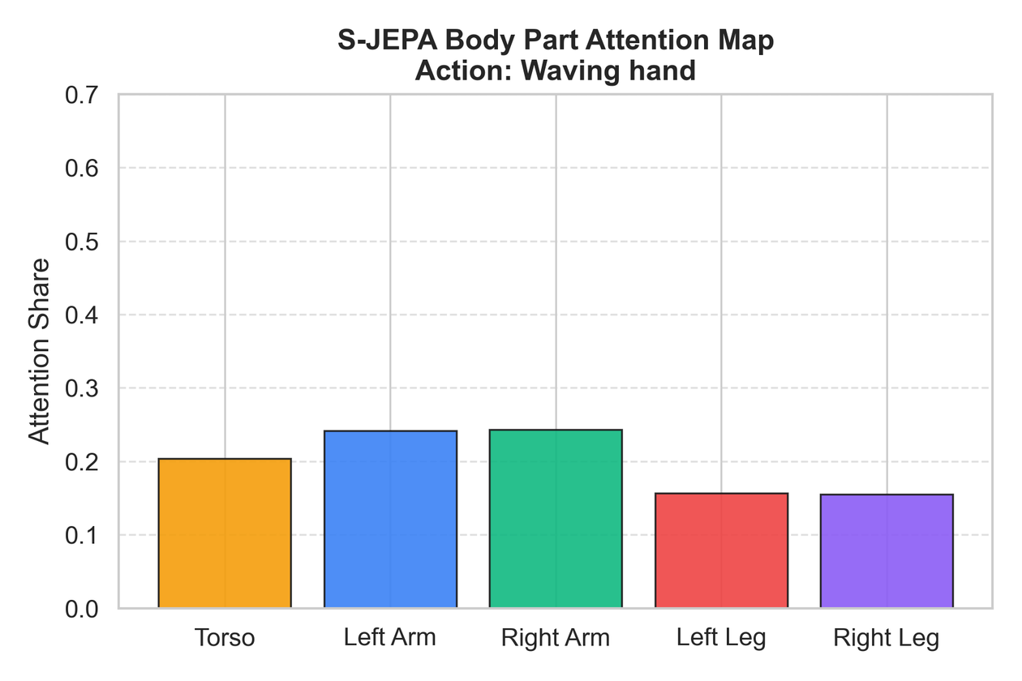
Model Explanation: Attention Rollout
To understand which joints the model focuses on when recognizing an action.
For action Waving hand, the attention concentrated highly on both arms
6

Slide 11
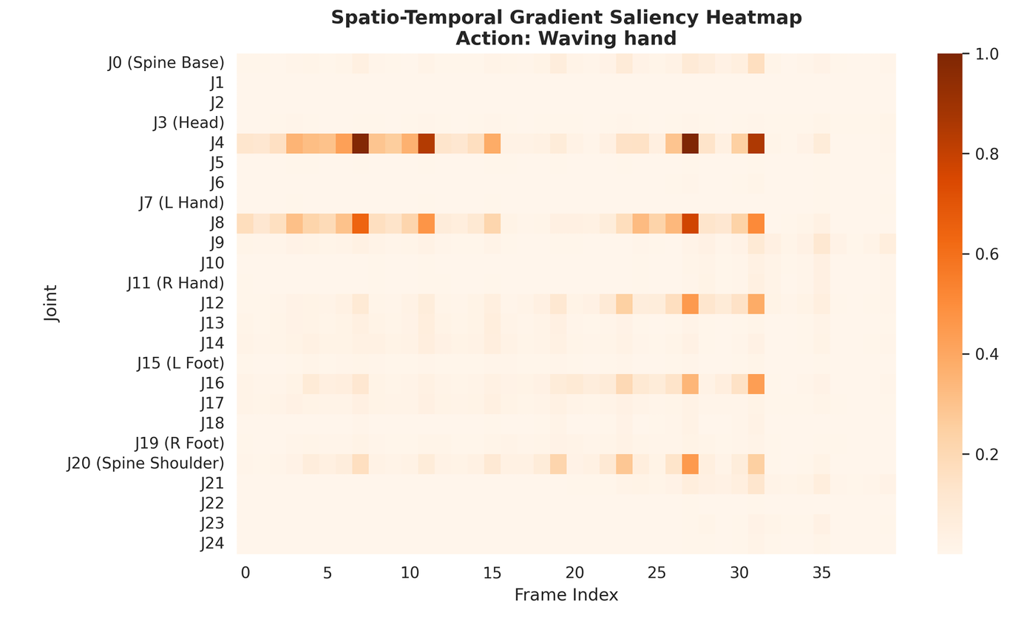
Model Explanation: Gradient Saliency
To identify which input joints and frames have the greatest influence on the model’s output.
For action Waving hand, sensitivity is highly concentrated on the hand joints and the upper body during the frames executing the motion
6

Slide 12
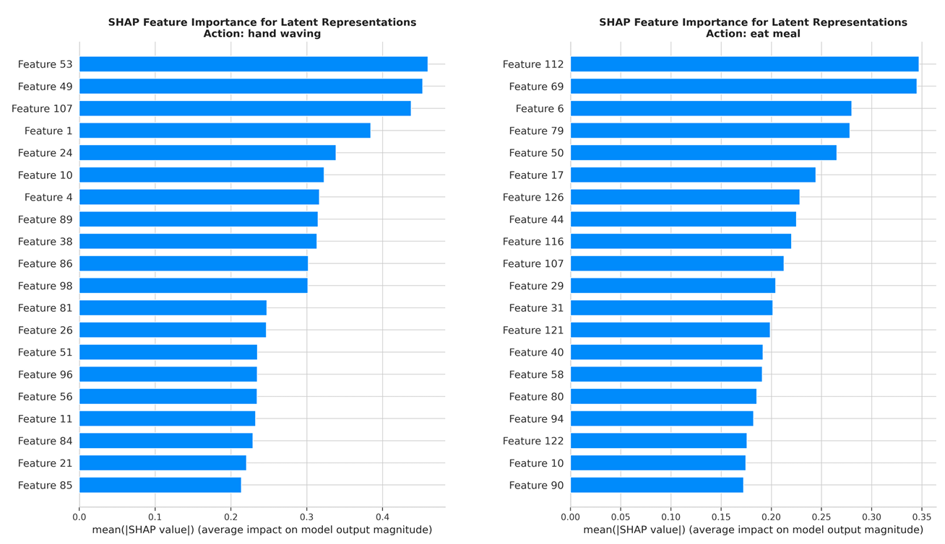
Model Explanation: SHAP
To quantify the contribution of each latent feature to the model’s prediction.
6

Slide 13
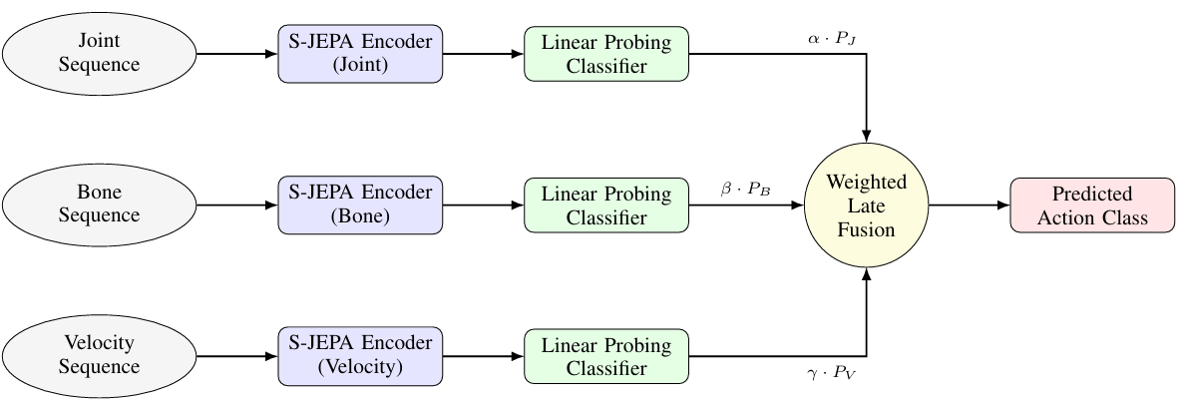
Late Fusion and Results
Multi-stream late fusion pipeline:
The output soft labels of three independent streams Joint, Bone, and Velocity are fused with a optimal weight set
7

Slide 14
Late Fusion and Results
Method/ Data Stream | NTU-120X-Sub(%) | NTU-120X-Set (%)
Joint Stream | 73.73 | 75.85
Bone Stream | 71.72 | 73.60
Velocity Stream | 65.81 | 68.20
Ensemble Late Fusion | 78.30 | 80.50
Method | NTU-120X-Sub(%) | NTU-120X-Set (%) | Input
LongTGAN | 35.6 | 36.8 | Joint
SkeletonMAE | 72.5 | 74.2 | Joint
CrossCLR | 67.9 | 69.1 | Joint+Bone+Motion
ActCLR | 74.3 | 75.7 | Joint+Bone+Motion
MAMP | 78.6 | 80.9 | Joint
Ours - Ensemble | 78.3 | 80.5 | Joint+Bone+Velo
Ensemble Late Fusion is much better than every single stream
→ Each stream contains complementary information, not redundant
Our work surpassed most of the SOTA deep learning baseline, coming nearly to MAMP
7

Slide 15

Conclusion
Contributions:
Implemented a full data science pipeline for 3D skeleton-based action recognition on NTU RGB+D 120
XAIs confirm that the model learns genuine features rather than noise
Multi-stream Late Fusion results outperform any single stream and approaching current SOTA self-supervised methods
Future works:
Incorporate stronger augmentation to the preprocessing stage
Efficiency evaluation and move toward real-time deployment for downstream tasks
4

Slide 16

THANK YOU !

