Slide 1

스마트공장 제조혁신을 위한 AI 프레임워크 개발 시계열 예측 부분 (AI Framework Development for the Innovation of Smart Factory Manufacturing Time Series Data Forecasting Part)
2021.02.17
류덕형 (Duckhyung Ryu)

Slide 2
Forecast Overview
Forecast
is to predict the future values based on a time-series data.
List of Models
Prophet : Prophet is easiest way to forecast if users don’t have any background
ARIMA : Autoregressive Integrated Moving Average.
SARIMA : stands for Seasonal ARIMA so this is adequate to use on seasonal data.
VAR : Vector Autoregression is available to process more than one columns and consider the relations between them

Slide 3
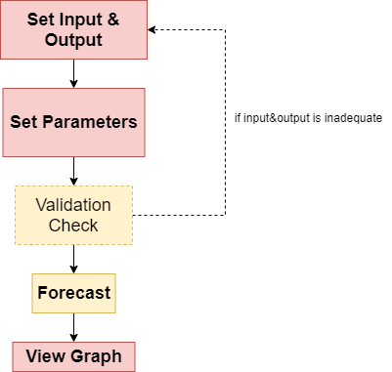
Using Process - Overview

Slide 4
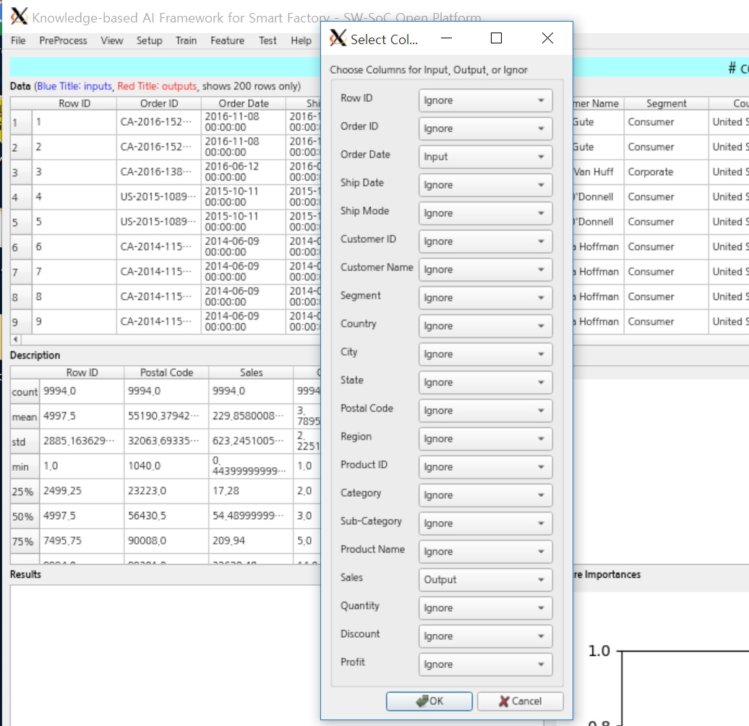
Using Process – Set Columns
Menu : Setup – Set Column
Set Input and Output
set a time related column as Input
*should be just one column
a target column as output
*if you want to use VAR model, you can choose more than one columns
*It can work properly only on the numeric target
Others should be set as ignore

Slide 5
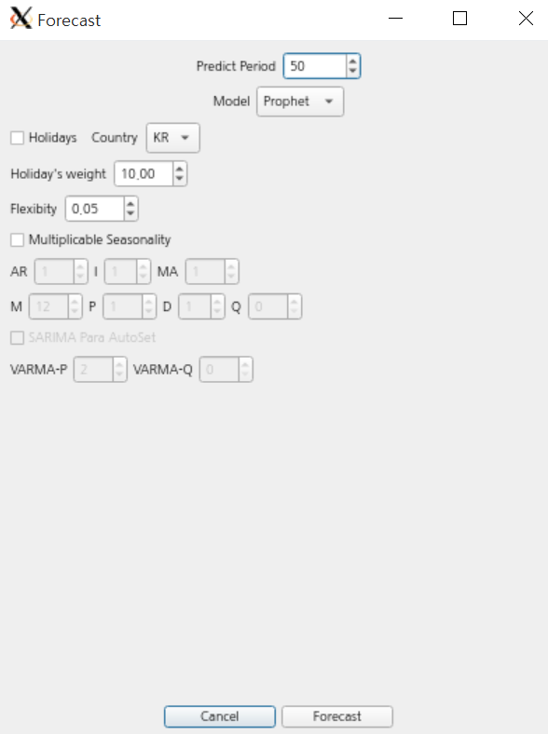
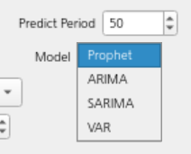
Using Process – Select Model & Parameters
Menu : Time Series – Model Forecast
Set Model and Prameter
Predict Period : number of days user want to forecast
Models :
Depends on this, only related parameters input would be activated

Slide 6
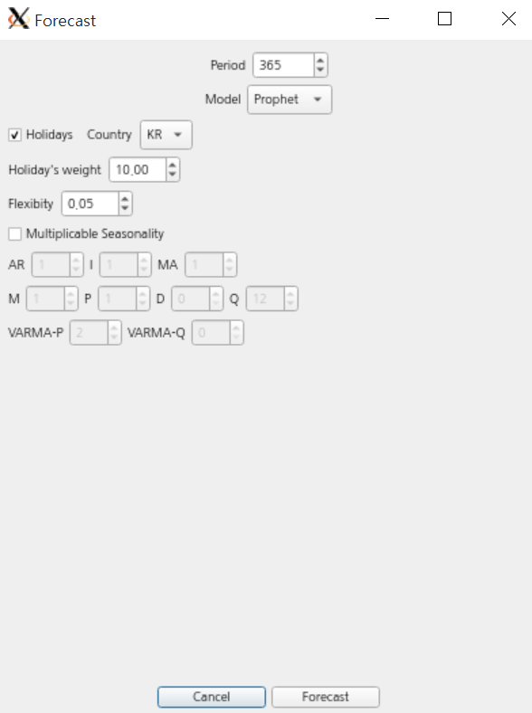
Using Process – Prophet Parameter Set
Prophet Parameters
Holidays : Weights holiday’s value more.
Holiday’s Weight : can control holiday’s weight.
Flexibility : can control overall graph’s flexibility.
Multiplicable Seasonality : if data has an obvious seasonality,
checking this can increase the precision.
(Korea, India, England, China, Russia, US ‘s holidays are available)
default is unchecked(not using) and default Country is Korea.
ex) Forecasting the theme park’s ticket sales, checking this would be good
(if Holidays is unchecked, this value is meaningless)
Default is 10 , range 0.01~20
Default is 0.05 , range 0.01~20
Default is unchecked

Slide 7
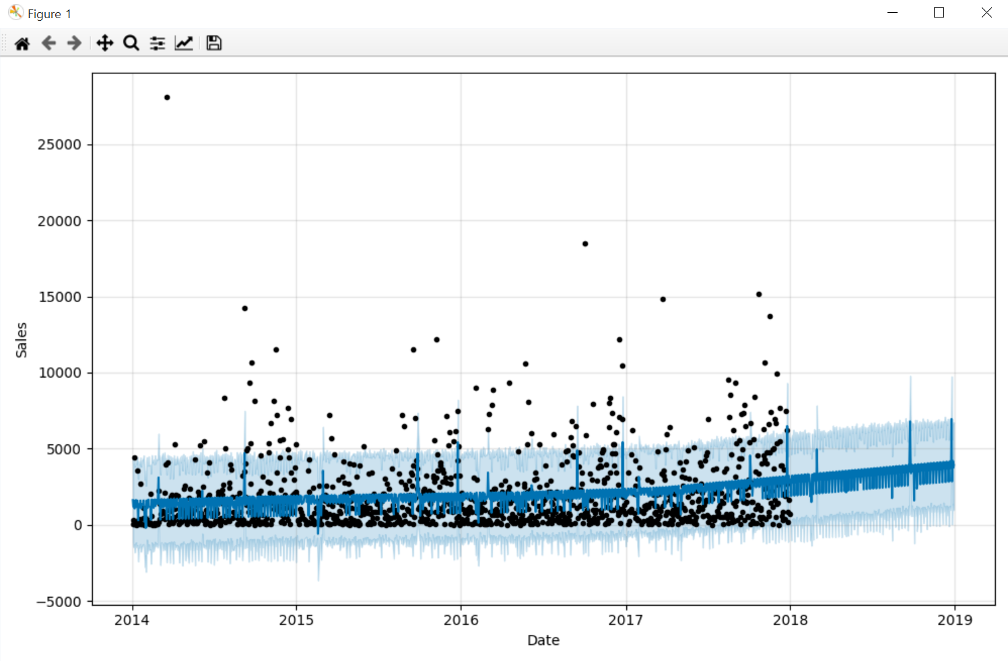
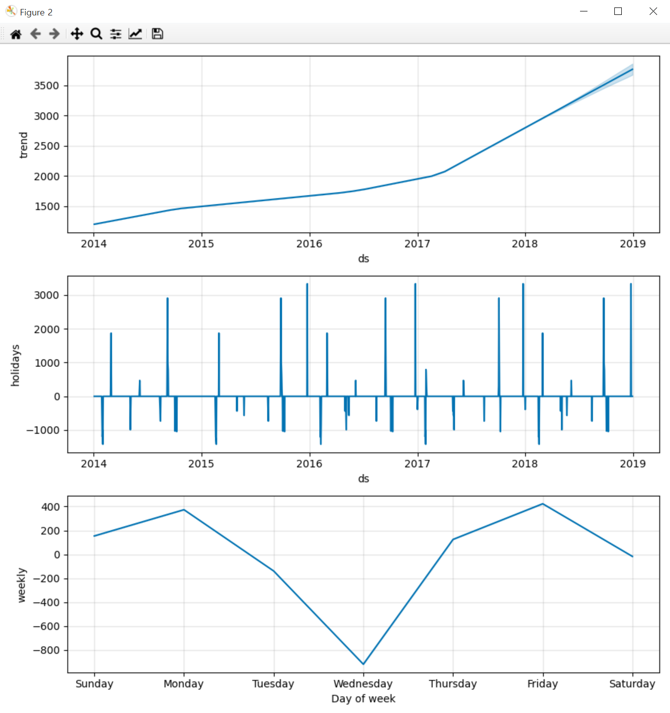
Using Process – Prophet Result
Figure 1 – forecast analysis graph
Figure 2 – component’s trend graphs
Black Dots : Input Data
Dark Blue Line : expected trend
Light Blue Area : error range
Trend : overall trend expectation
Holiday, Weekly : trend of the components
(if holiday is unchecked, holiday part will not come out)

Slide 8
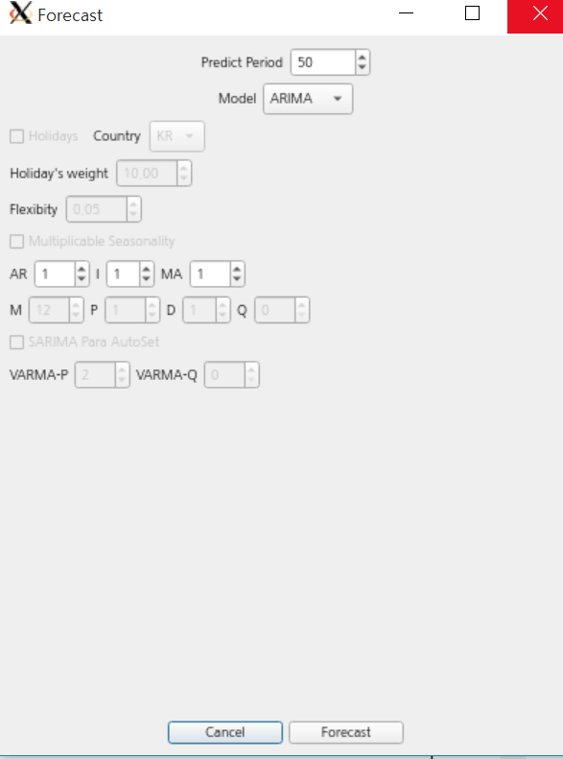

Using Process – (S)ARIMA Parameter Set
AR : Auto Regression. Called q as well
I : Integration. Called d as well
MA : Moving Average. Called q as well
M : number of series repeating seasonal pattern
P : Seasonal AR
D : Seasonal I
Q : Seasonal MA
SARIMA Para AutoSet
: find best parameters automatically for SARIMA
*it may takes time
(using Grid Search Method, finding lowest AIC)
ARIMA Set
SARIMA Set

Slide 9
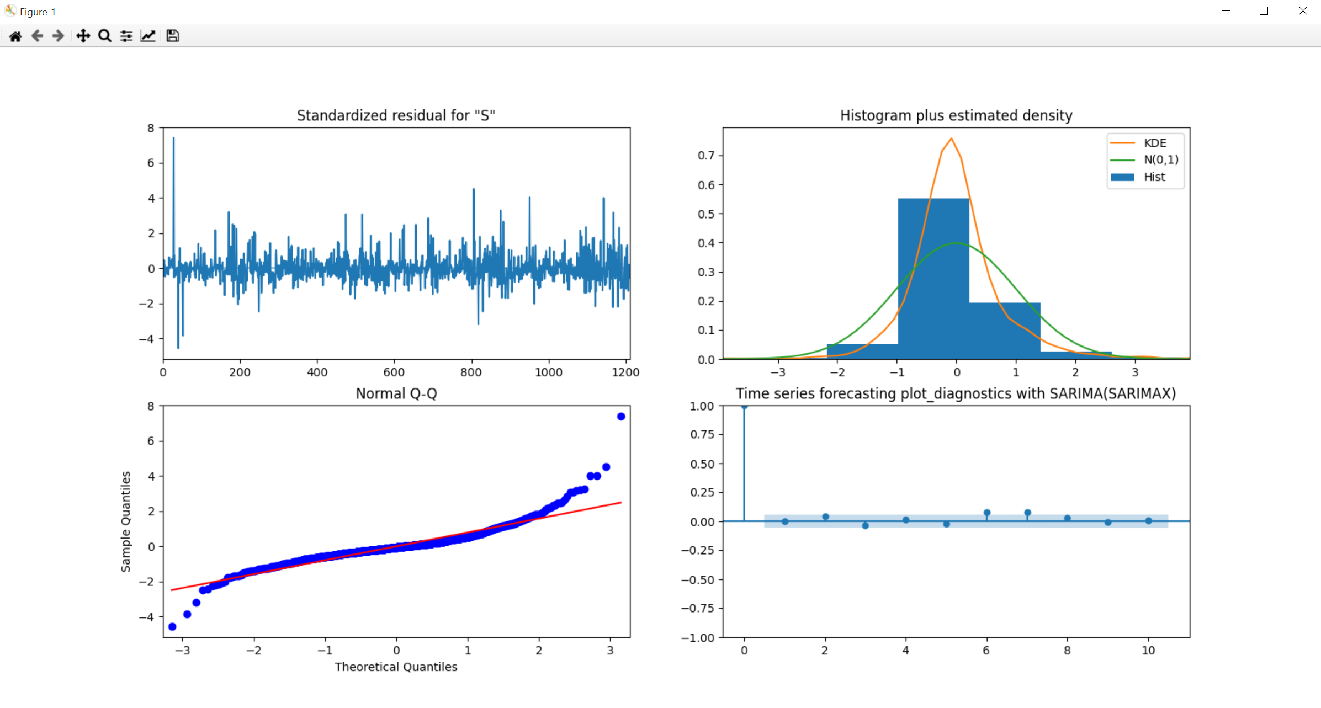
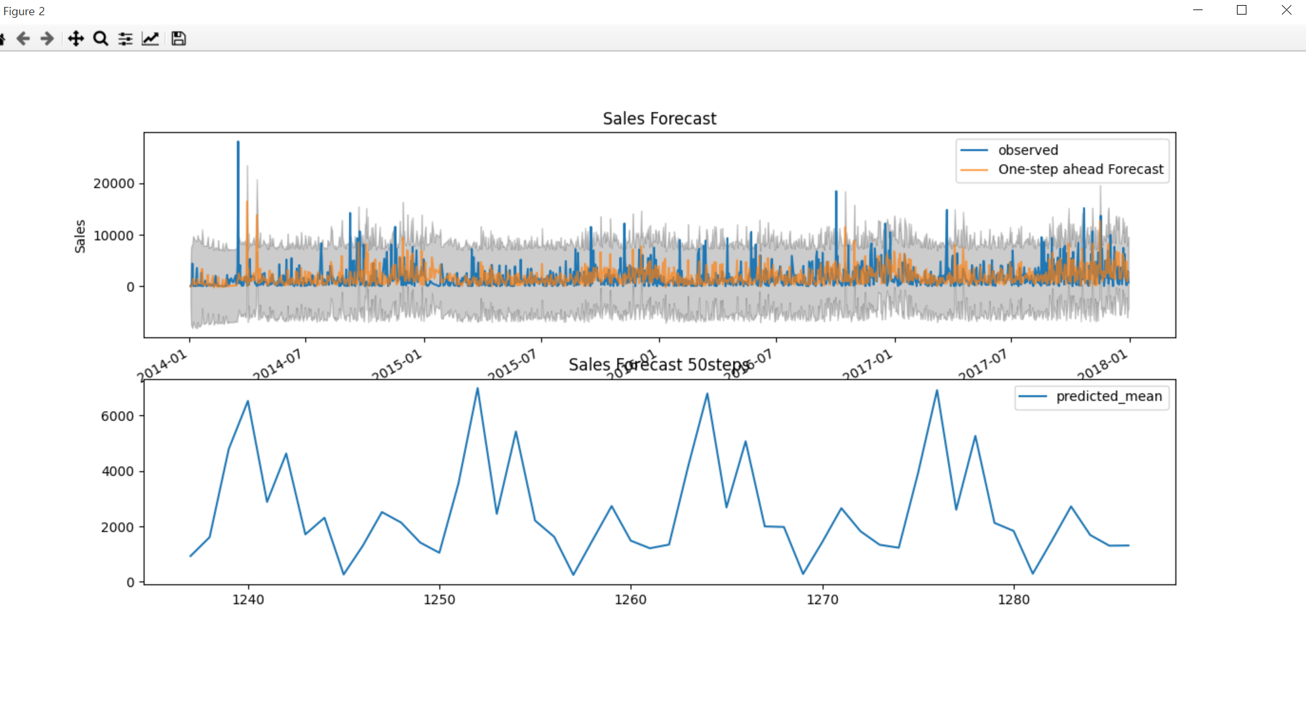
Using Process – (S)ARIMA Result
Figure 1 – diagnostics graphs
Figure 2 – forecast estimation graph
Upper one : learning data
(if predicted(yellow) is too different from blue, forecast is not also very precise, so parameters should be changed)
Lower one : future estimation
Refer these graphs to edit the parameters in (S)ARIMA model

Slide 10
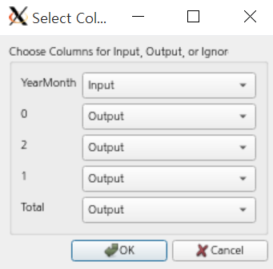
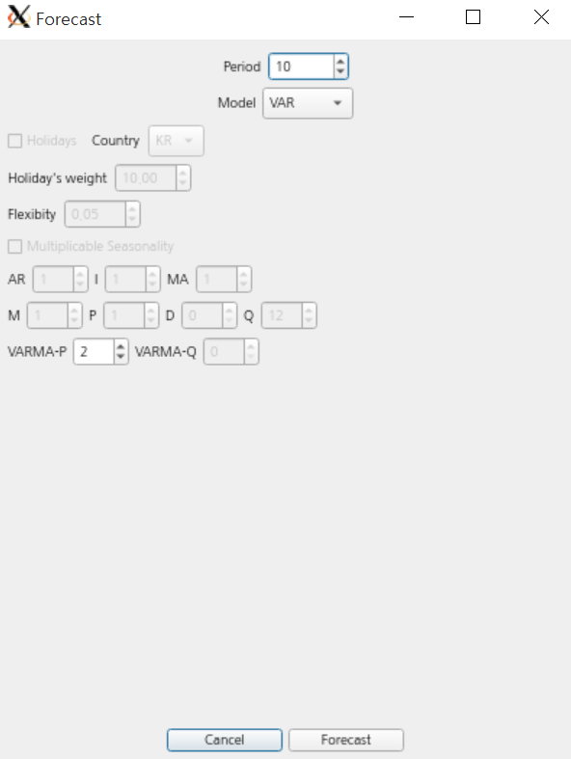
Using Process – VAR Parameter Set
P : Auto Regression
(same concept with AR in ARIMA Model)
In ‘setup – select columns’
You can choose multiple outputs with VAR forecasting

Slide 11
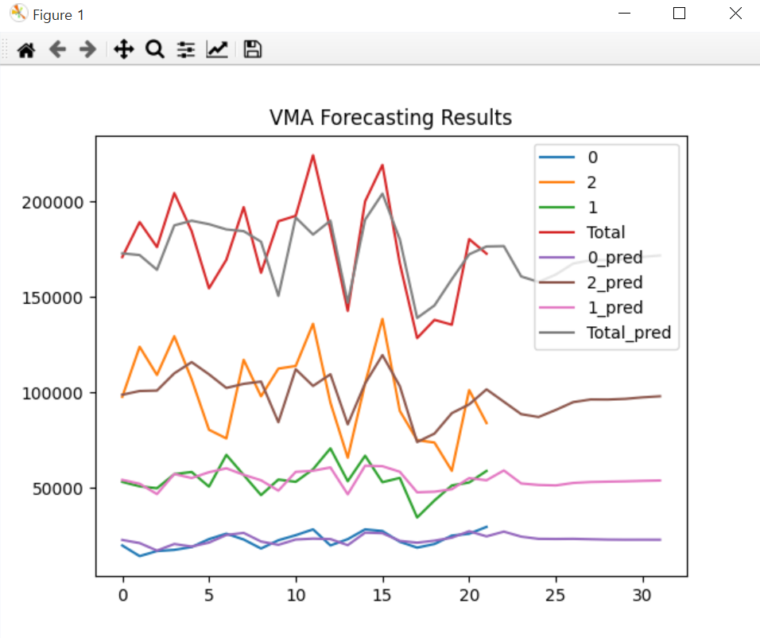
Using Process – VAR Result
Figure 1
can see the all output column’s prediction includes forecasting at the same time

Slide 12
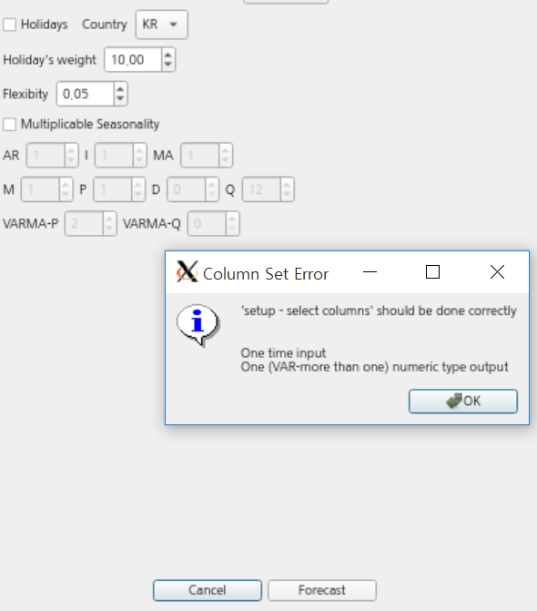
Using Process – Error Handling
Validation Check when user pressed ‘Forecast’ button
If inadequate number of input and output columns
-> this error message comes out
& forecast will not be started.

