Slide 1
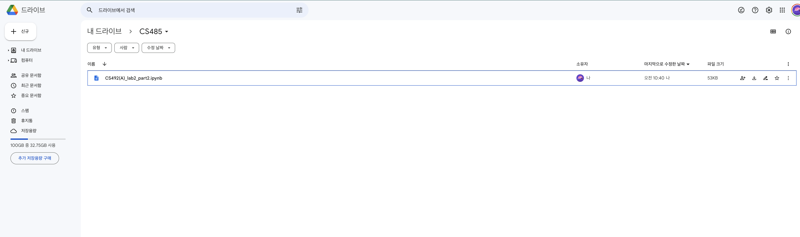
1. Upload the file to your google drive.

Slide 2
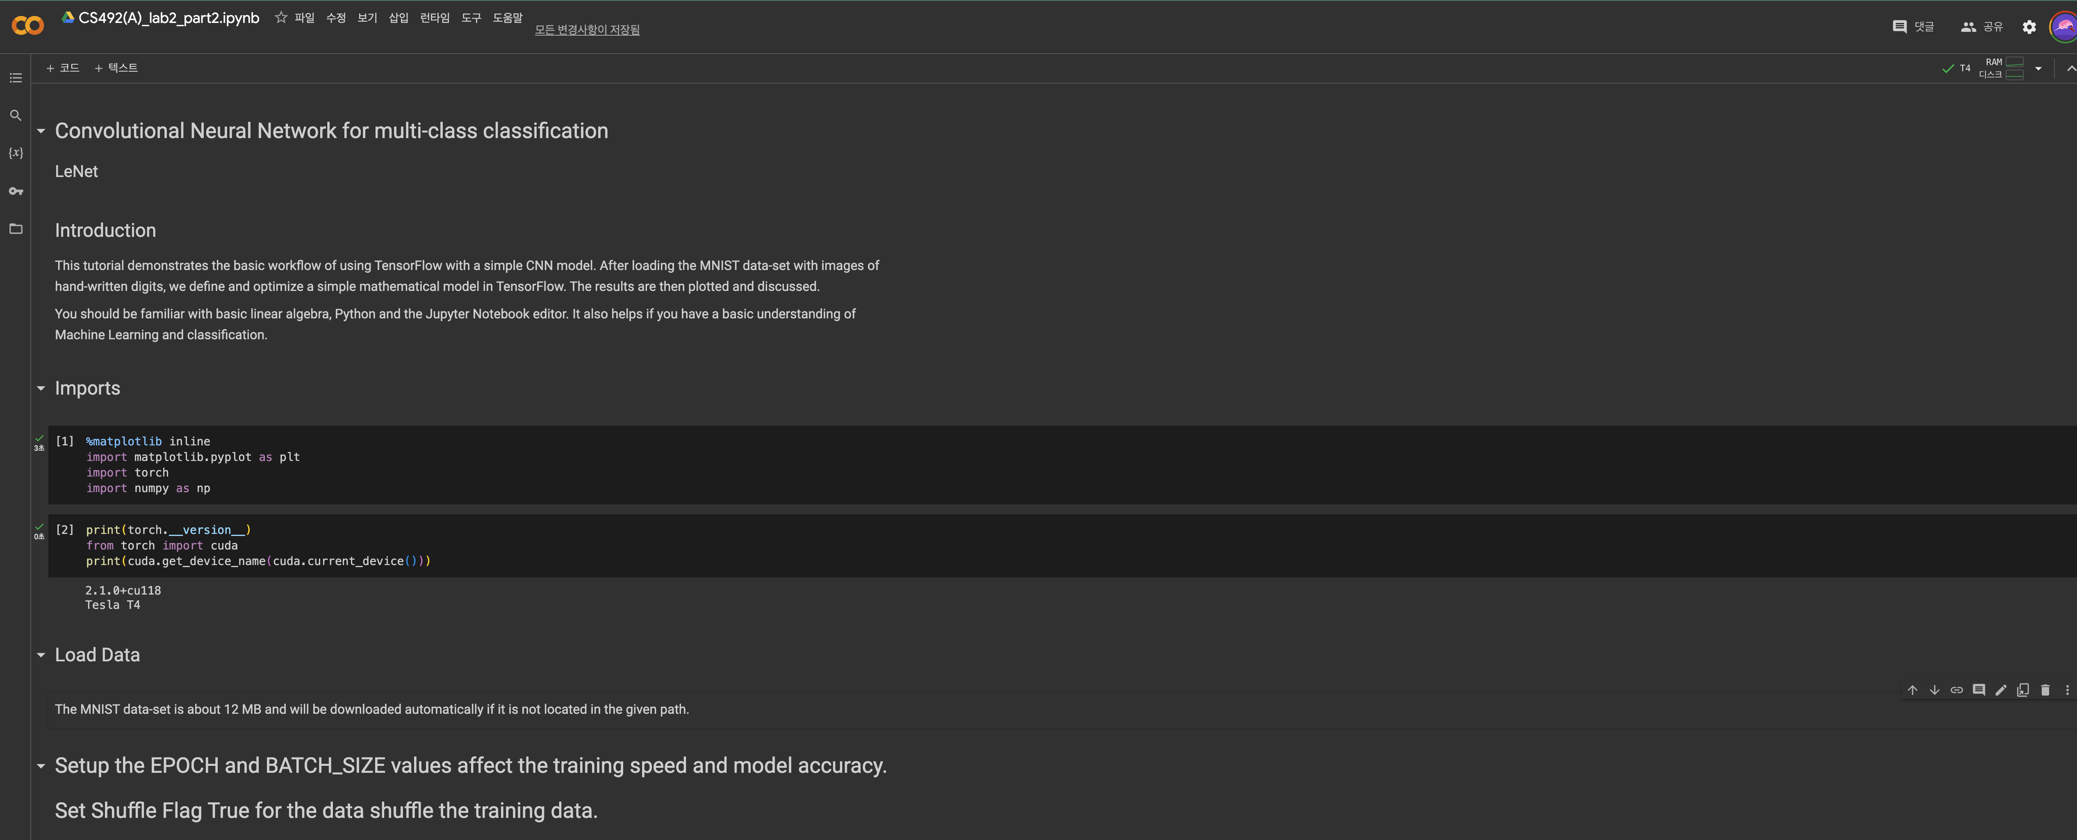
2. If you open the file, you can see this screen.

Slide 3
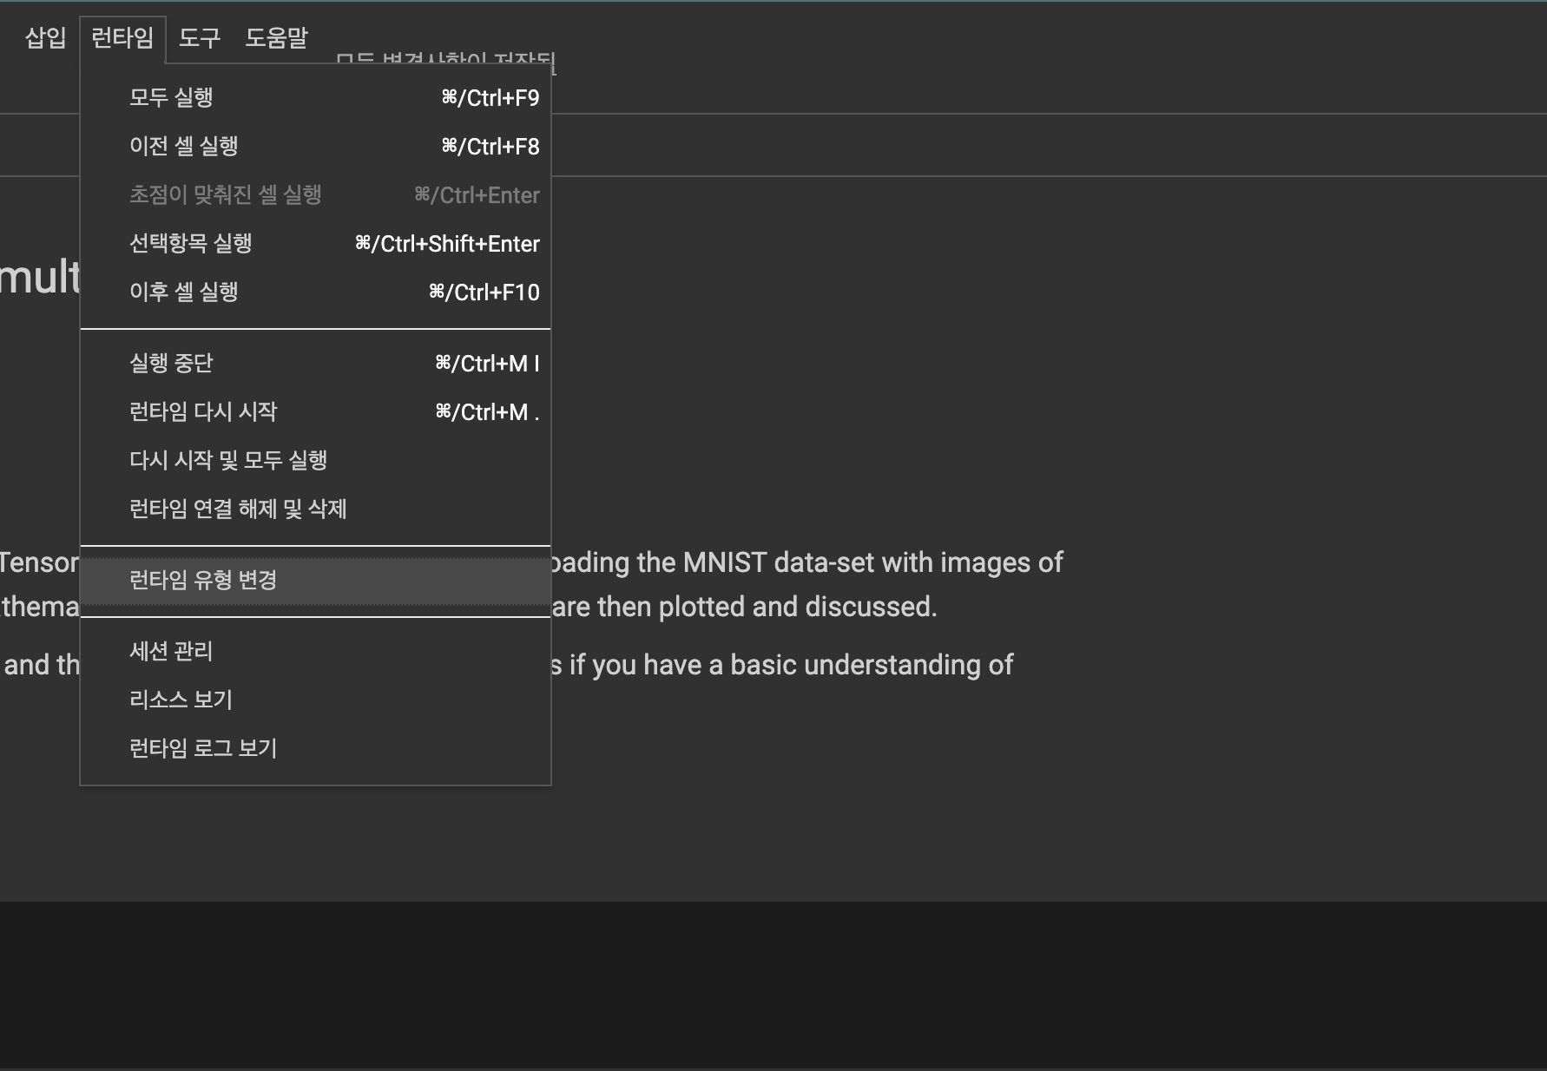
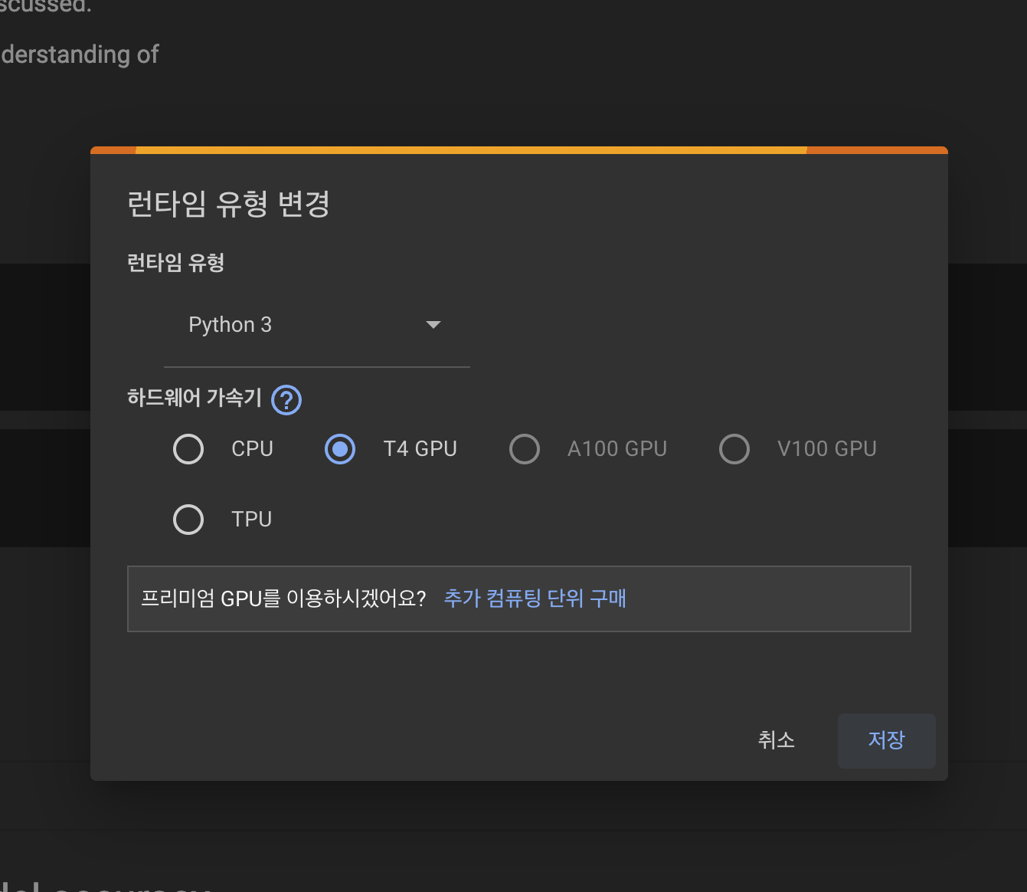
4. Click the runtime
5. And change it to T4 GPU or TPU.

Slide 4
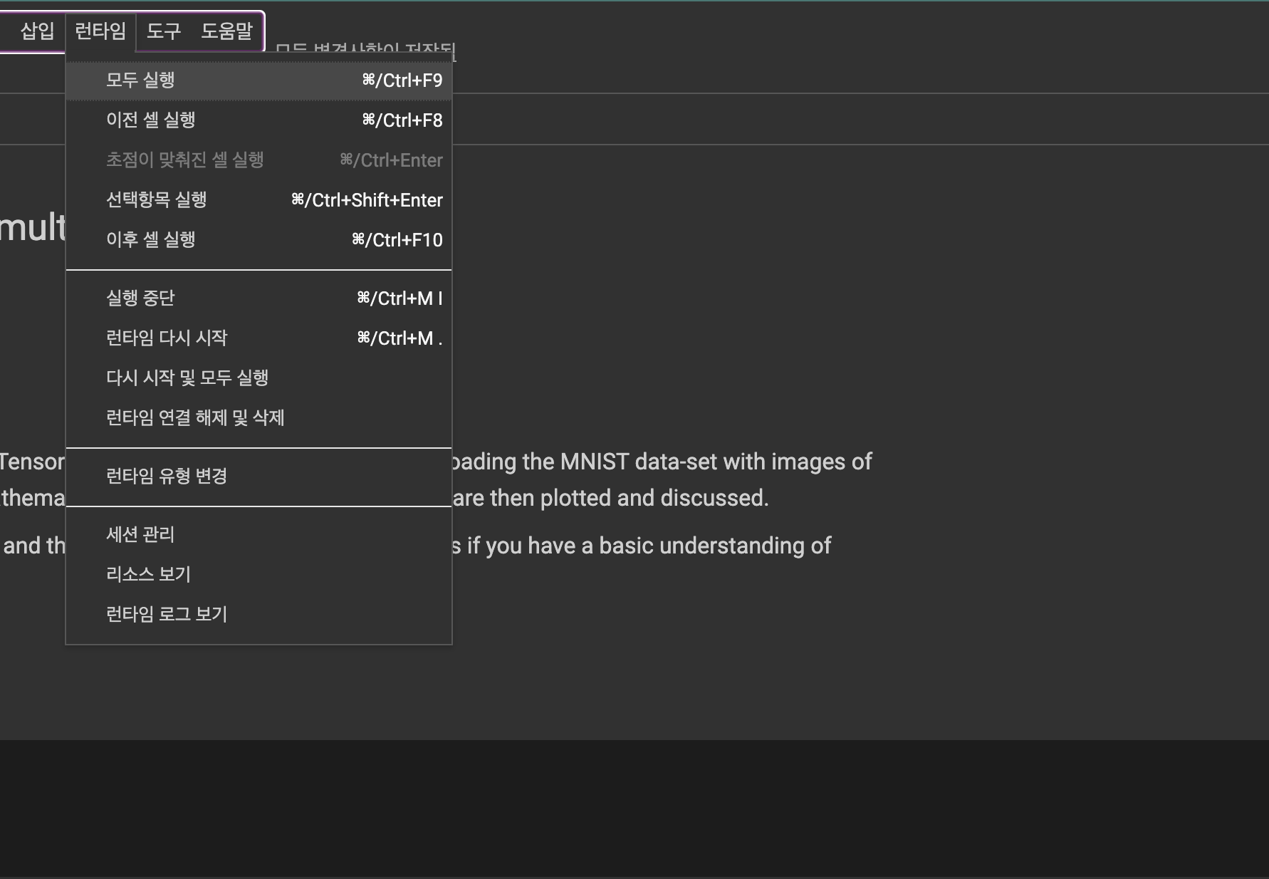
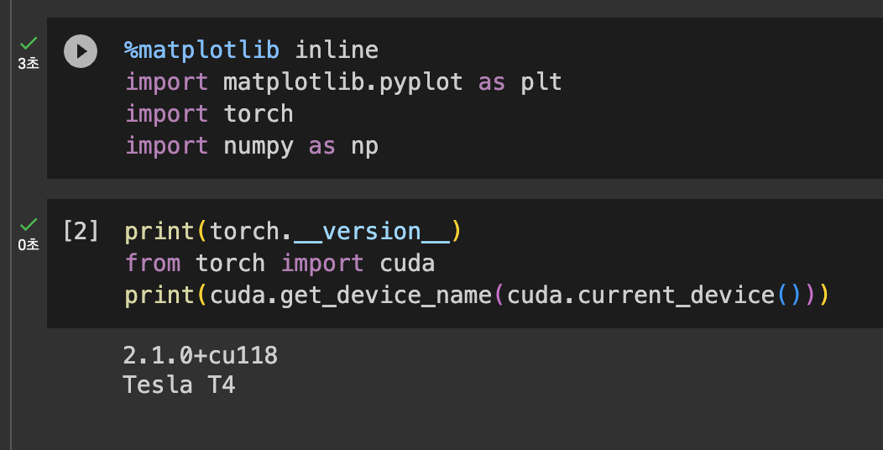
5. You can run this code, all at once, only the cell in run time menu. Or by clicking play button in the cell.

