Slide 1
Income Prediction by Team zanzibar
Doe Edinam Abla
Enoch Taylor Nketiah

Slide 2
AGENDA
Introduction​ and Problem statement
Data Source and Preprocessing
Exploratory Data Analysis (EDA) and Hypothesis
​Modeling
Evaluation
​Deployment

Slide 3
Introduction
The growing disparity in income distribution poses a significant challenge, especially in developing nations. Traditional methods of monitoring income levels between census years are costly and may lack accuracy. This project addresses this issue by employing machine learning to predict income levels, offering a more efficient and precise alternative for policymakers.
This project aims to leverage machine learning to predict whether an individual's income surpasses or falls below a specific threshold.(50k)
The goal is to develop a model that not only reduces the cost but also enhances the accuracy of monitoring key population indicators, providing valuable insights for policymakers to mitigate and prevent global income inequality.

Slide 4
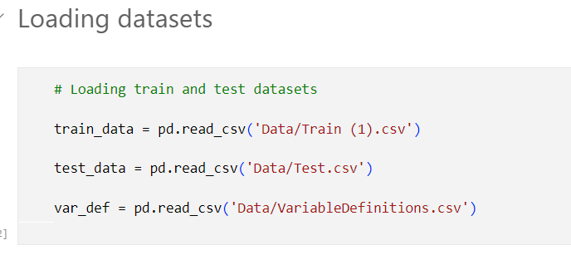
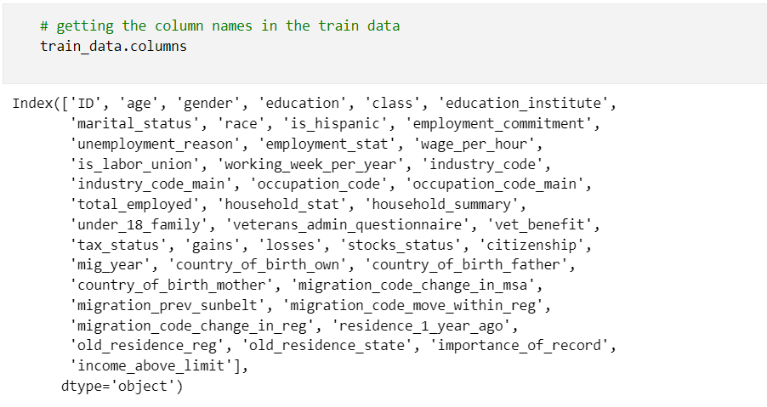
Data Source and Preprocessing
Source of the dataset (Zindi).

Slide 5
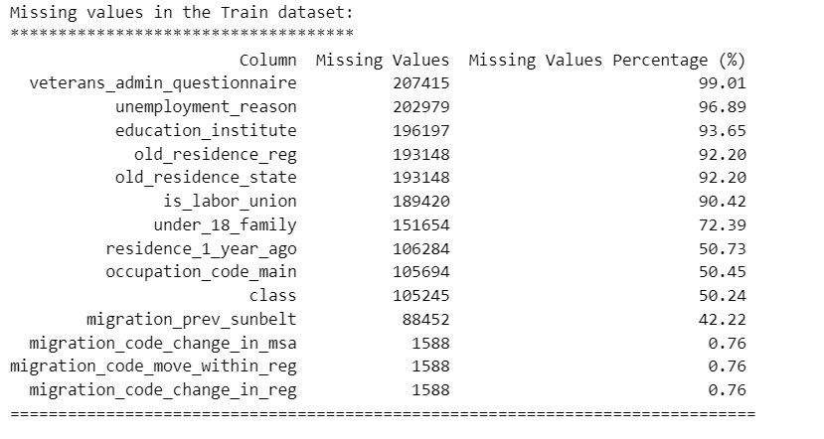
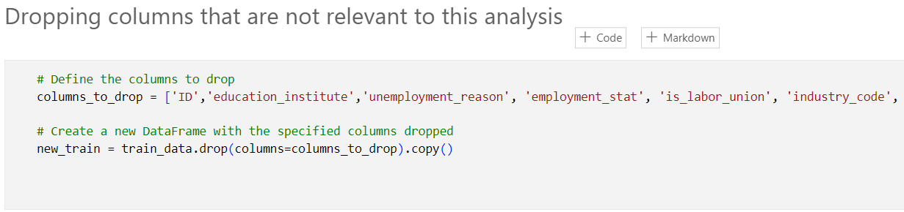
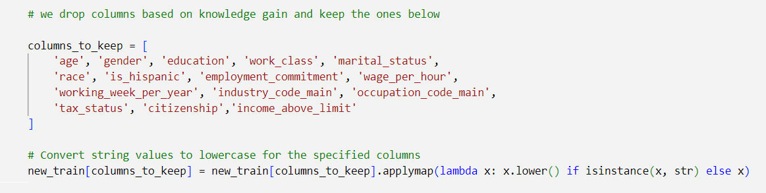
Data cleaning steps.

Slide 6
Exploratory Data Analysis (EDA)
Focused demographic variables are age, gender, education, class, marital status, race, industry code, occupation code, tax status, and citizenship.
Analytical Questions:
Univariate Questions:
What is the distribution of age in the dataset?
How is gender distributed among individuals in the dataset?
What is the most common education level among the individuals?
Bivariate Question:
How does education correlate with employment commitment?
Multivariate Question:
How does the combination of education, age, and race relate to income levels?
How does the combination of gender, marital status, and class relate to income levels?

Slide 7
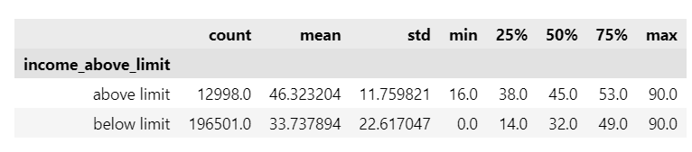
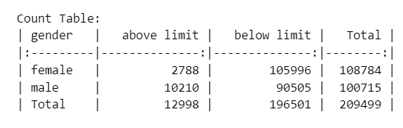
Highlights on the key EDA for these Demographics
Age
Gender

Slide 8
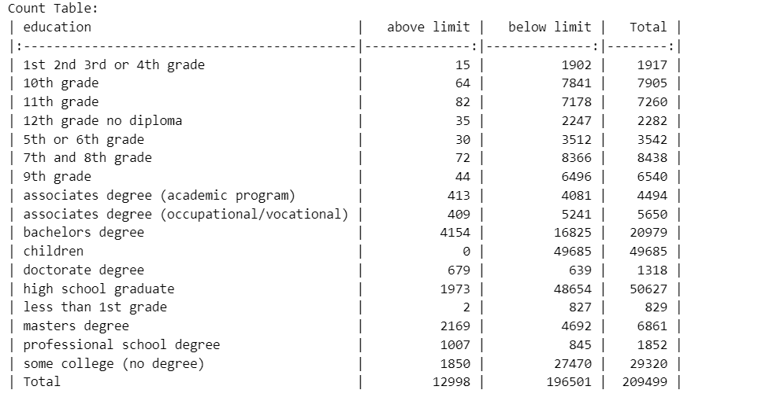
Education

Slide 9
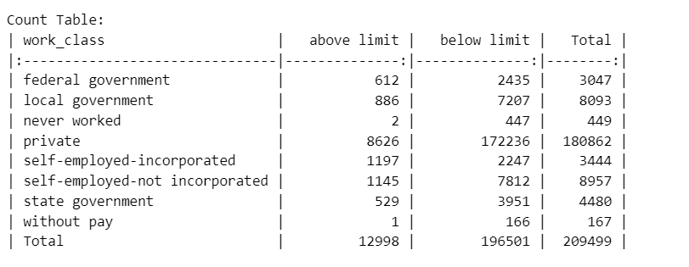
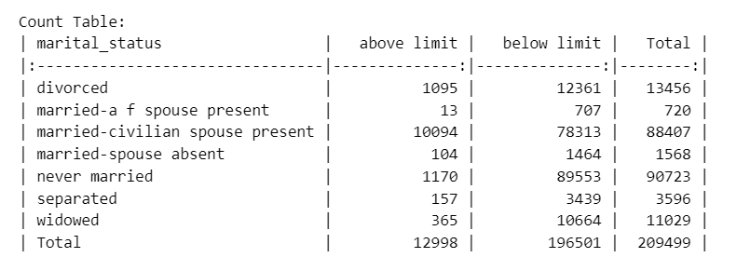
Work class
Marital Status

Slide 10
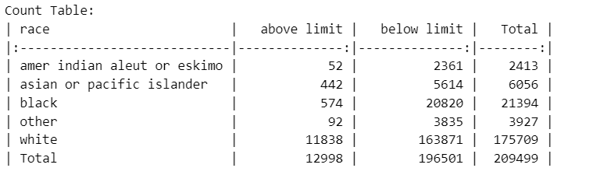
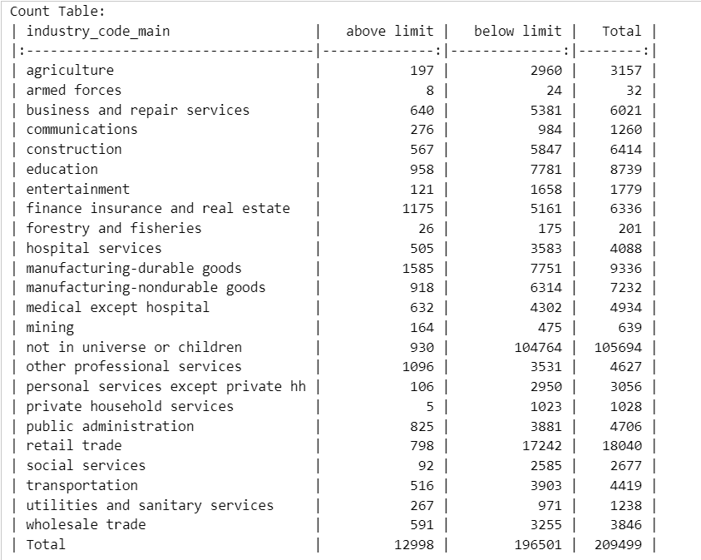
Race
Industry Code

Slide 11
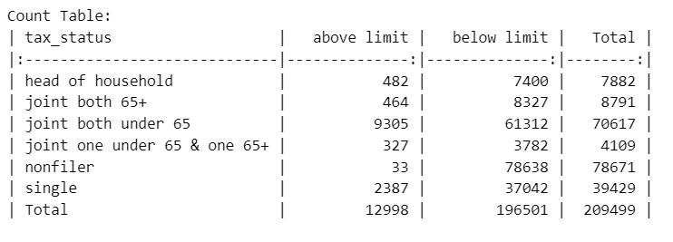
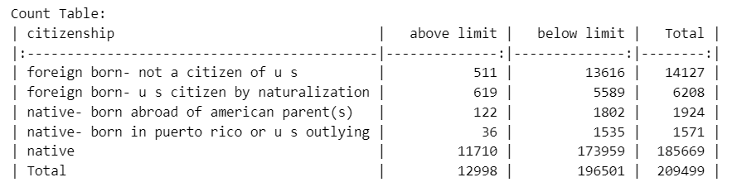
Tax status
Citizenship

Slide 12
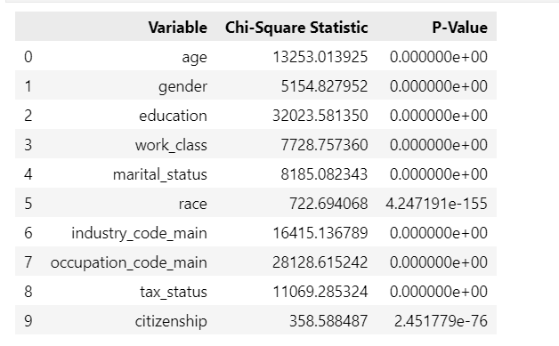
Hypothesis
Null hypothesis (H0): there is no association between the examined demographic variables and income levels.
Alternate hypothesis (H1): there is a significant association between these demographic variables and income distribution.
All p values were below 0.05 hence we accept the alternate hypothesis and reject the null

Slide 13
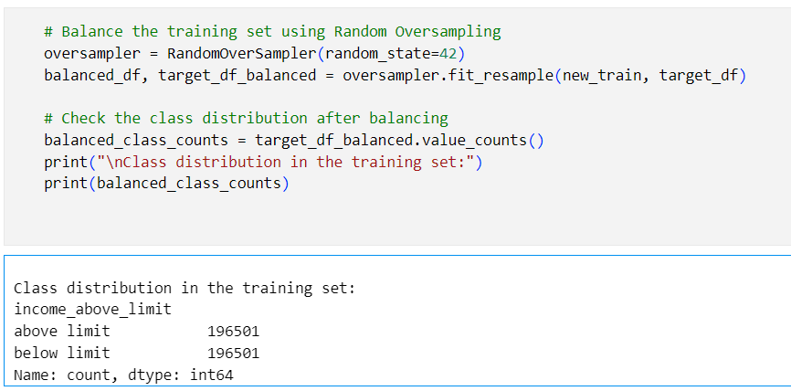
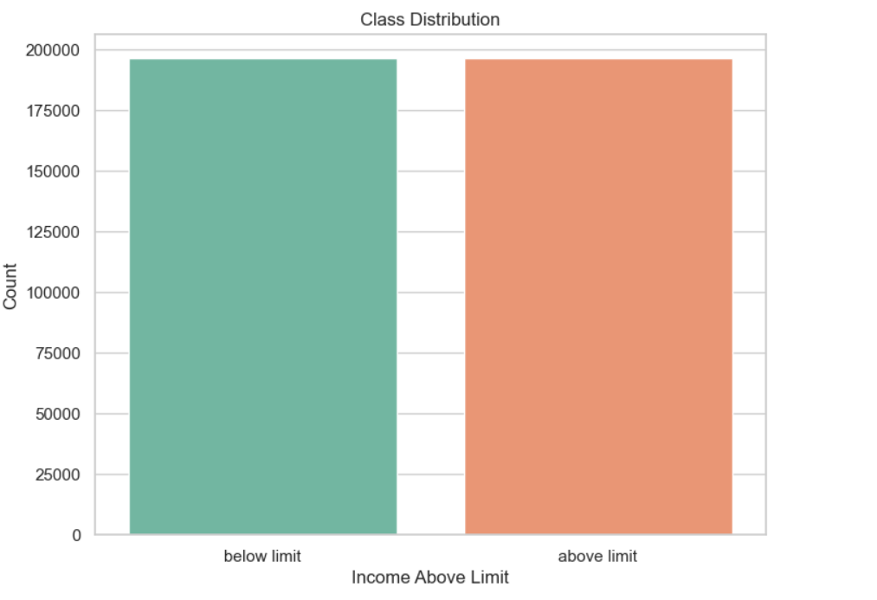
Machine Learning Models
Balancing and Modeling

Slide 14
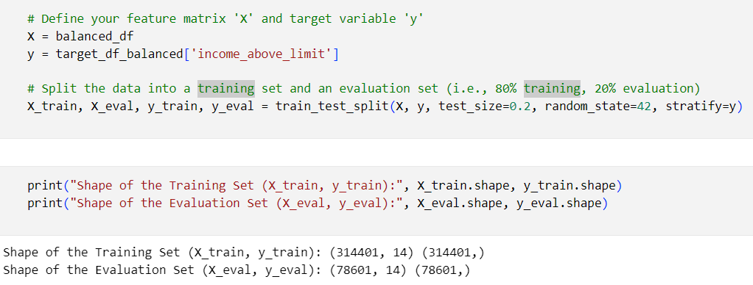
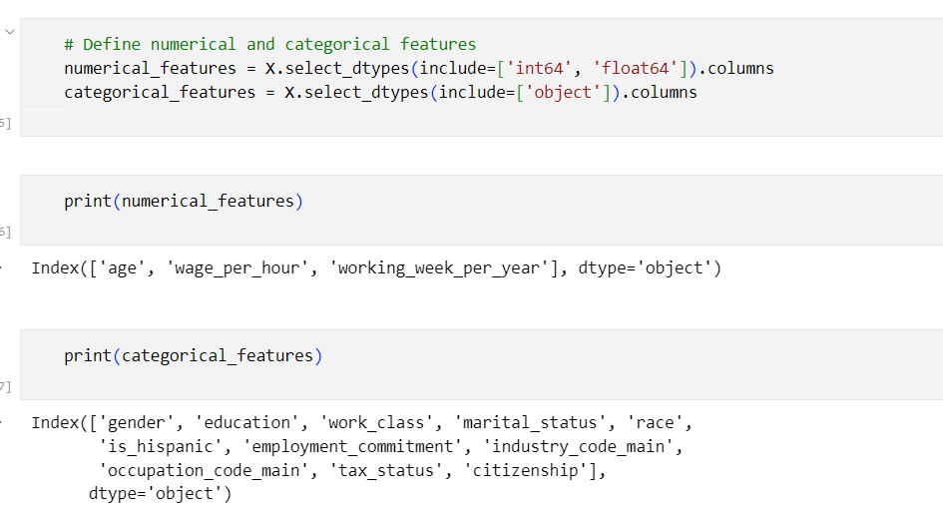
MOdeling
Data Splitting
Creating Pipeline and Preprocessor

Slide 15
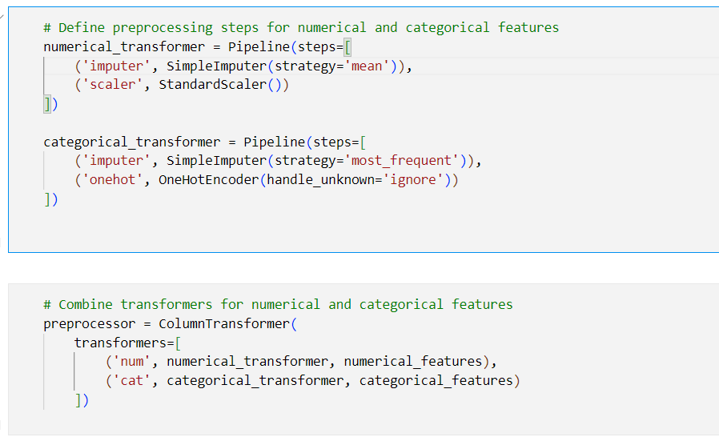
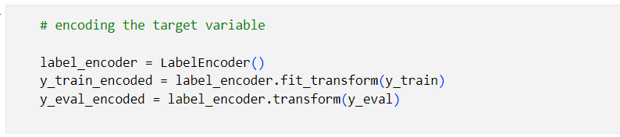
Creating pipeline and preprocessor cont.
Encoding target Variable

Slide 16
Models Used
Catboost: This model is designed to handle categorical features efficiently without the need for one-hot encoding however it is computationally intensive.
Decision Tree: These are easy to interpret and understand. They provide a clear representation of decision-making based on features but it is prone to overfitting.
Logistic Regression: Logistic Regression provides coefficients for each feature, allowing for straightforward interpretation of the impact of each feature on the target variable however it assumes that features are independent of each other even if they are highly correlated,which might affect model performance.

Slide 17
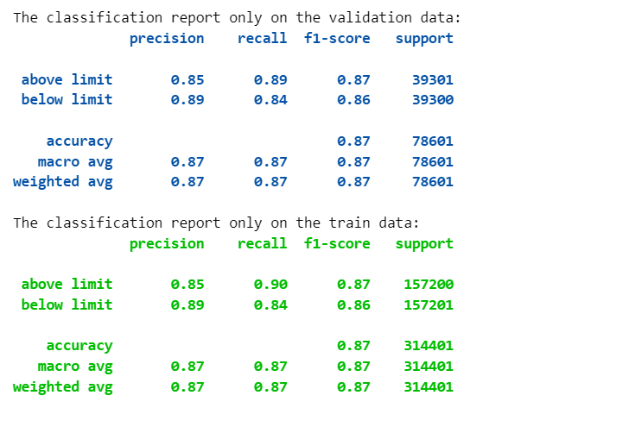
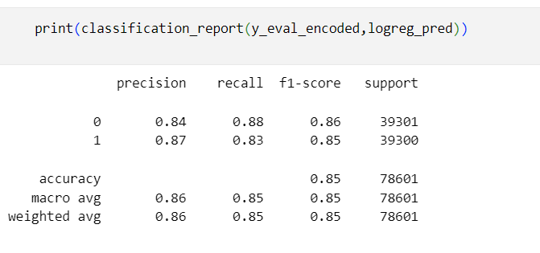
Model Evaluation
Catboost
Logistic Regression

Slide 18
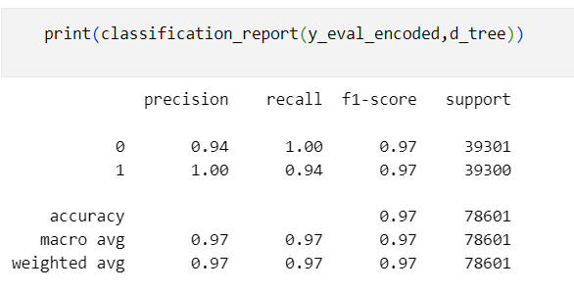
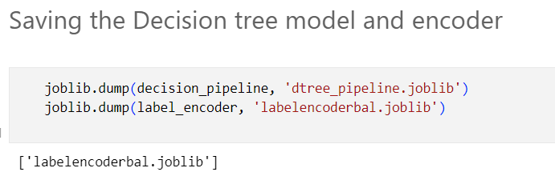
Decision Trees
For the high recall and high accuracy, Decision tree was the model of choice for building apps. This was used on the teste data for prediction which yielded a good report.

Slide 19
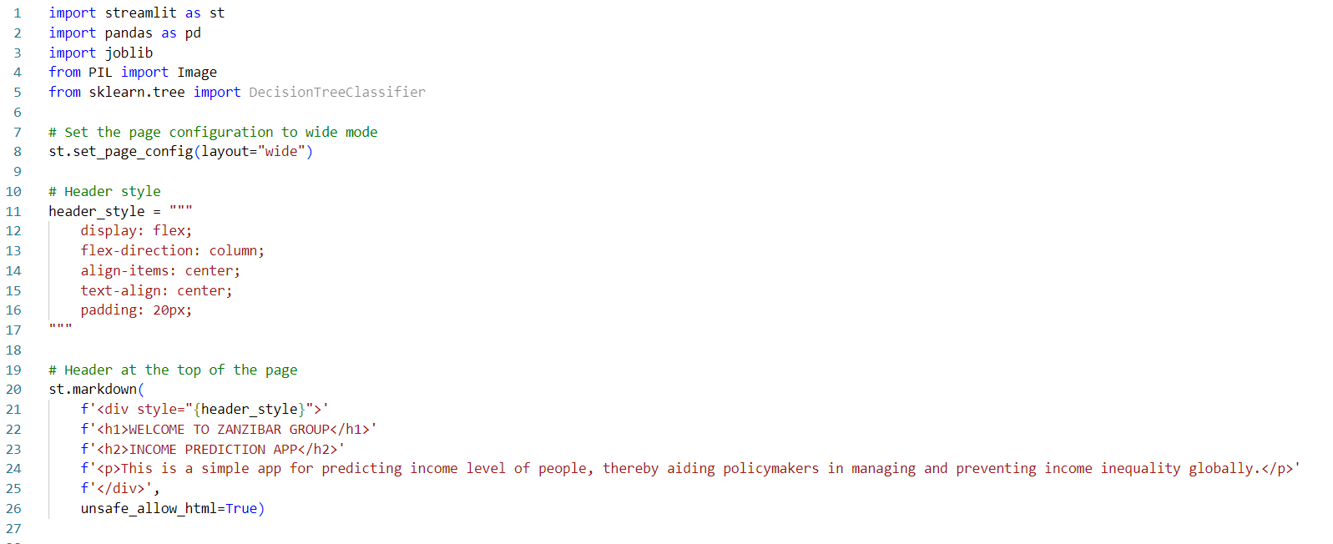
Deployment Overview
Streamlit App: To run the app (streamlit run streamapp.py)
Link for deployment: http://localhost:8501
sent on January 12, 2024 7:43 AM

Slide 20
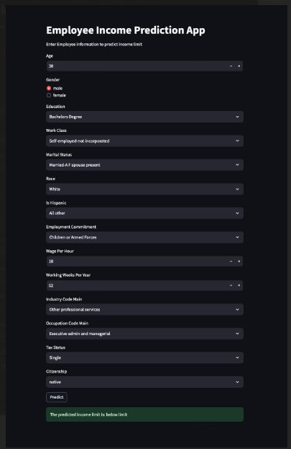

Slide 21
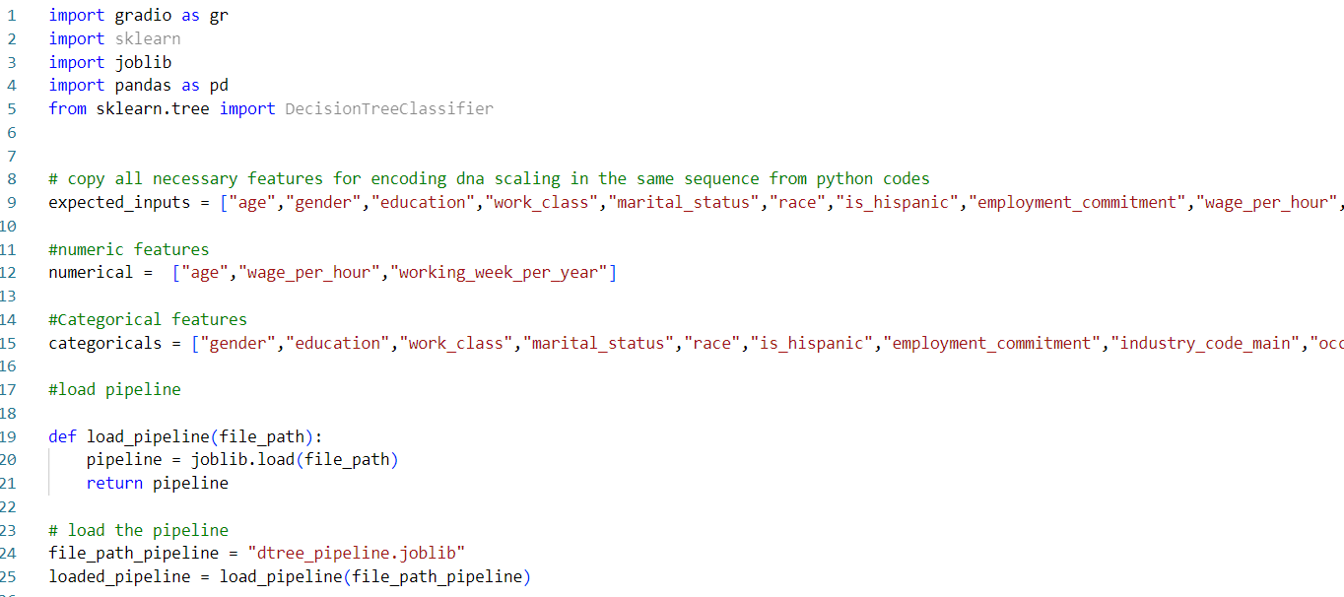
Gradio App: To run the app (python gradapp.py)
Link for deployment: https://83c14a02c91af37eaa.gradio.live
sent on January 12, 2024 7:11 AM

Slide 22
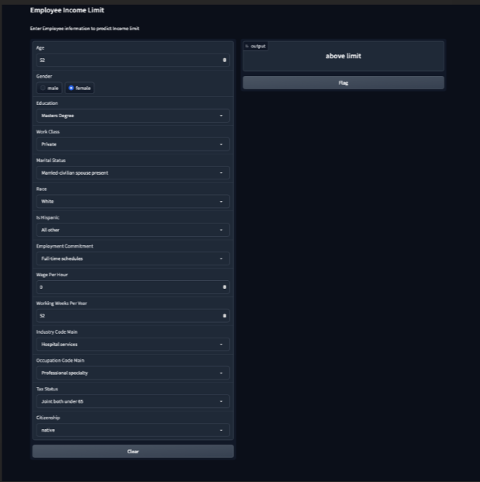

Slide 23
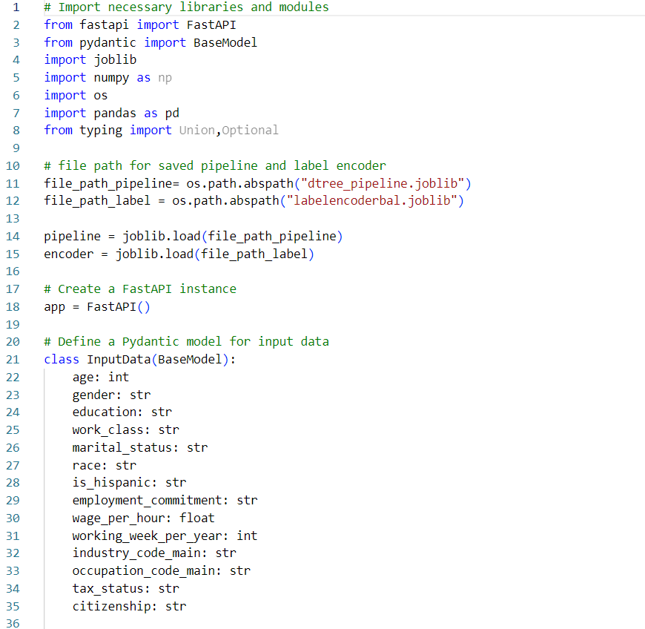
FastAPI: To run app (uvicorn main:app --reload)
Link for deployment: http://127.0.0.1:8000/docs#/default/predict_predict_post

Slide 24
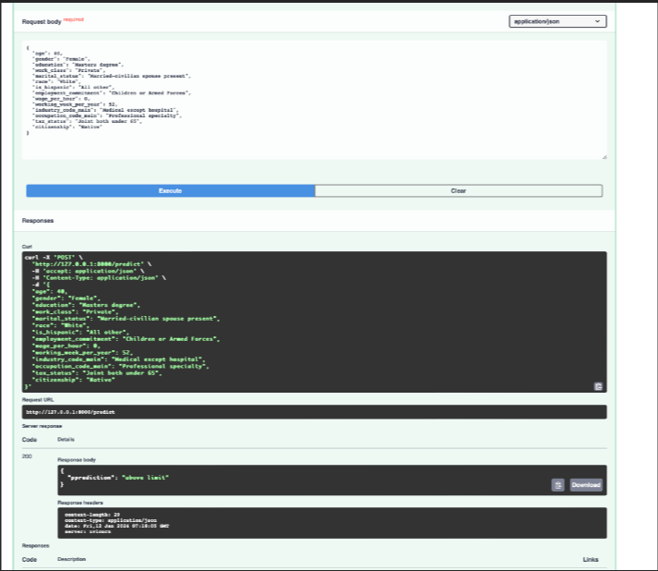

Slide 25
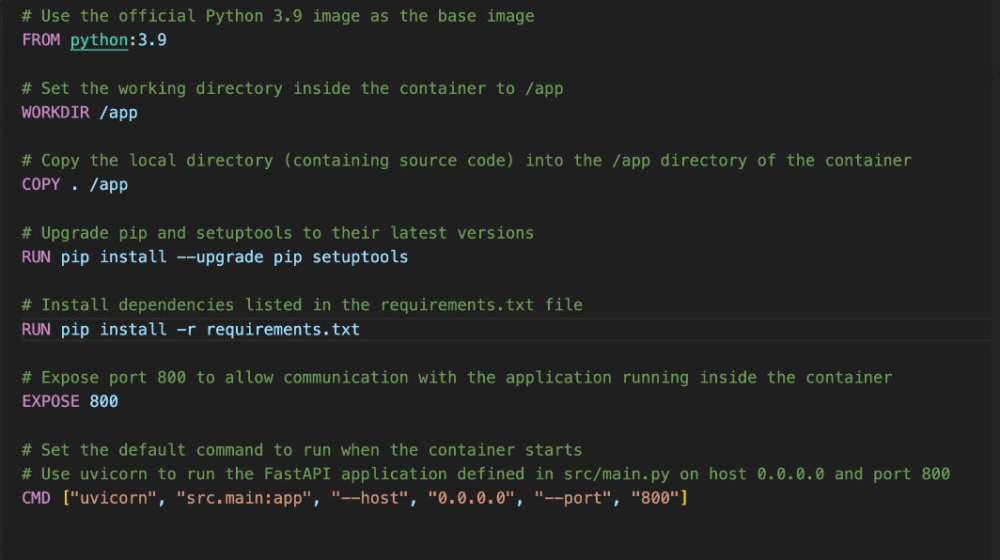
Dockerization
Create a dockerfile
Link for docker deployment : http://localhost:800/docs#/default/predict_predict_post doc...

Slide 26
Conclusion
Age Significance: Age is a critical factor influencing income levels, indicating that strategies focusing on age-related workforce development and support could positively impact income distribution.
Gender Disparities: Substantial income disparities exist between genders, emphasizing the need for targeted initiatives to address gender-related challenges and promote equal opportunities in the workforce.

Slide 27
Educational Impact: Higher levels of education are associated with increased income, suggesting that investing in education and skill development programs can contribute significantly to reducing income inequality.
Work Class Influence: The type of employment significantly affects income, highlighting the importance of creating diverse job opportunities and improving working conditions across different sectors.

Slide 28
Marital Status Matters: Marital status plays a significant role in income distribution, indicating that policies supporting various marital statuses could contribute to a more equitable income distribution.
Racial Disparities: Noteworthy differences in income distribution among different races suggest the importance of implementing strategies to address racial disparities and promote inclusivity in the workforce.

Slide 29
Industry and Occupation Impact: The industry and occupation in which individuals are employed significantly influence income levels. Tailoring policies to specific industries and occupations can help address income disparities effectively.
Tax Status Implications: Tax-related policies have a substantial impact on income, underscoring the importance of fair and inclusive tax structures in promoting economic equality.
Citizenship Influence: Citizenship status affects income distribution, indicating the need for policies that ensure fair opportunities and rights for individuals of different citizenship categories.

Slide 30
In summary, a multifaceted approach is necessary to address income inequality, considering factors such as age, gender, education, work class, marital status, race, industry, occupation, tax status, and citizenship. Tailored interventions in these areas can contribute to a more equitable distribution of income and foster inclusive economic growth

Slide 31

So we round off with our work pushed to our github and docker hub .
| Doe Edinam | https://github.com/doeabla |
| Enoch Taylor-Nketiah | https://github.com/kojoboyoo |
| Kofi Asare Bamfo | https://github.com/akbamfo |

Slide 32
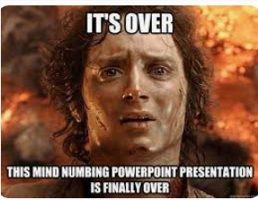
THANK YOU

