Slide 1
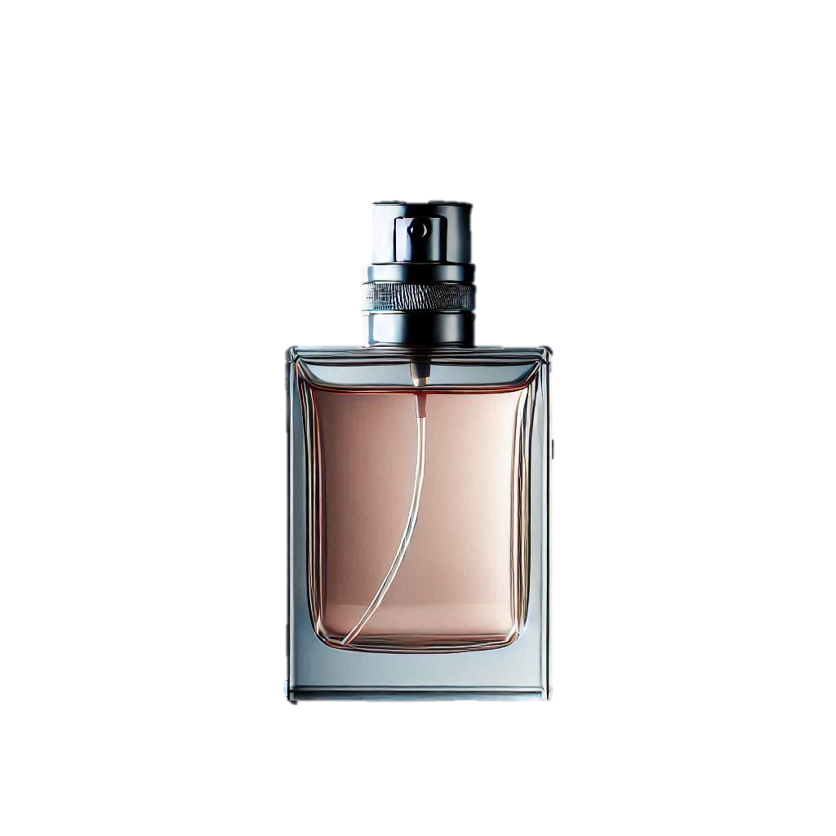



Parfumo
The Scent of Data
The main accords, base notes, middle notes, and top notes are extracted from the 50 highest rated perfumes.
Top Notes
Middle Notes
30 brands with the most perfumes
Base Notes
Main Accords
Notes:
Sam has received 34 confessionals, 9 more than expected

