Slide 1
Goal & Introducing Game
Goal: Multi-Agent Reinforcement Learning with Atari‘s Pong
Introducing Pong
Playable as Single Agent (Gymnasium API) & Multi Agent (PettingZoo API)
Procedure: Start with SA, transfer knowledge to MA
Nico
Deep Reinforcement Learning → Image
Lisa
Single-Agent
DQN Algo → Pseudocode + Code
Lisa
Model-Architecture → Code
Nico
Extend Model to Multi-Agent RL
Hendrik
Results (Troubleshooting)
Hendrik

Slide 2
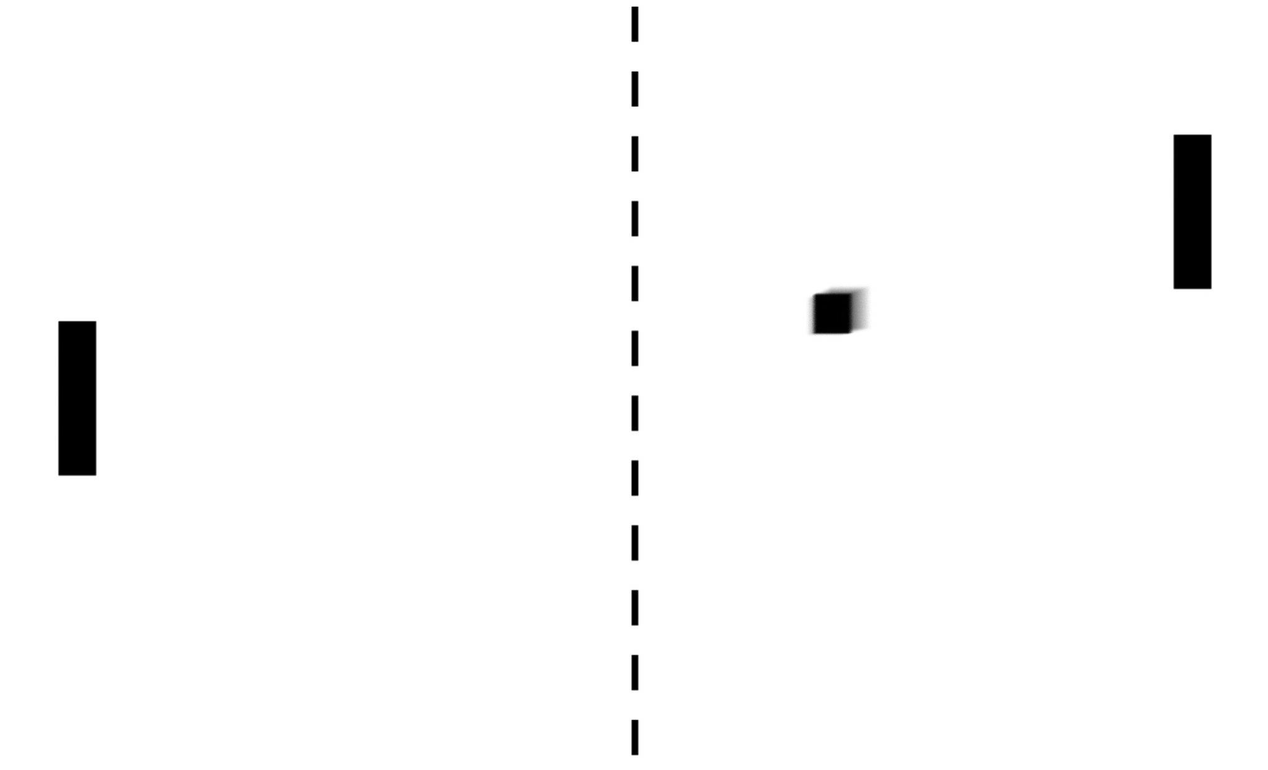
MULTI-AGENT REINFORCEMENT LEARNING WITH ATARI‘S PONG
Implementing Artificial Neural Networks with TensorFlow (IANNwTF)
Winter Term 22/23
Nico Burgstaler, Lisa Dollmann, Hendrik Warnecke

Slide 3
AGENDA
Introduction
Deep Reinforcement Learning
Singe-Agent RL Implementation
Extend to Multi-Agent RL
Results

Slide 4
INTRODUCTION Goal of our Project

Slide 5
INTRODUCTION Atari‘s Pong

Slide 6
INTRODUCTION Atari‘s Pong in Reinforcement Learning
Single Agent
Multi Agent

Slide 7
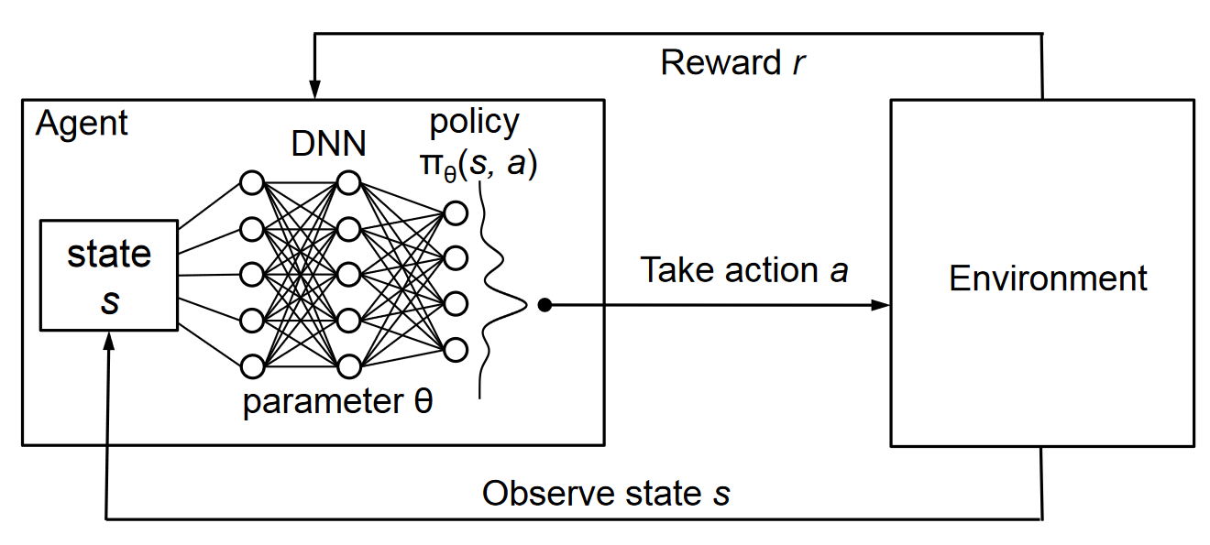
DEEP REINFORCEMENT LEARNING
[1]

Slide 8
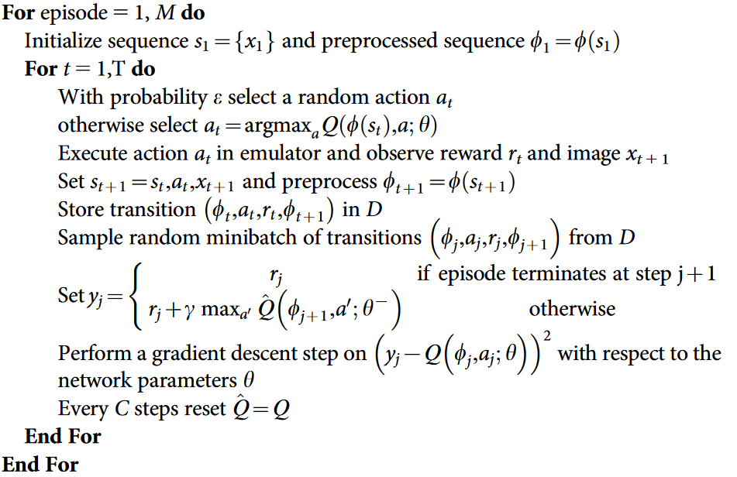
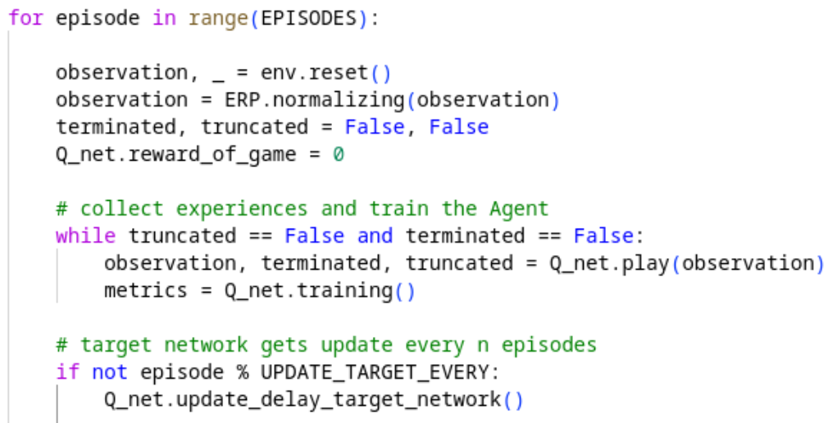
SINGLE-AGENT REINFORCEMENT LEARNING Deep Q-Network
Pseudocode
Our Implementation

Slide 9
SINGLE-AGENT REINFORCEMENT LEARNING Model Architecture

Slide 10
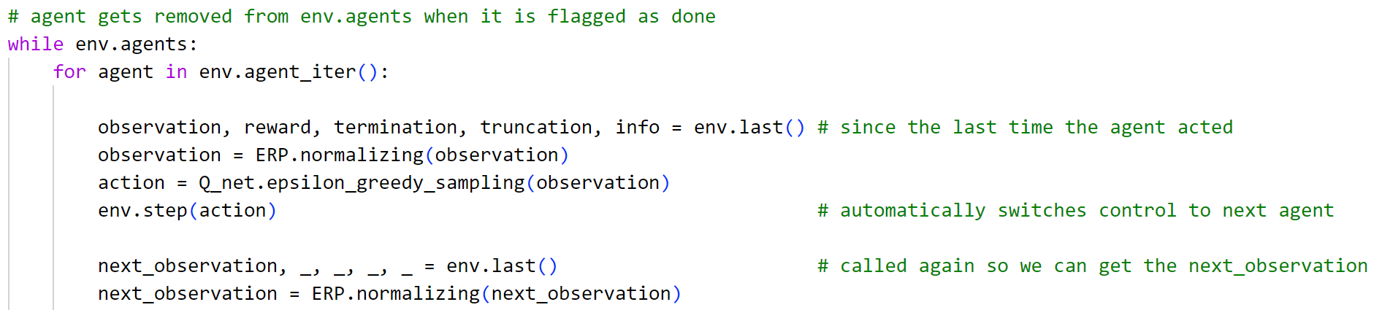
Extend Model to Multi-Agent RL PettingZoo

Slide 11
Extend Model to Multi-Agent RL Self Play
Both agents share:
Action-space
General task
Reward structure
Observation (space)
Benefits:
Only one network to train
Higher efficiency as all the computing power is concentrated on one network
Opponent difficulty scales nicely

Slide 12
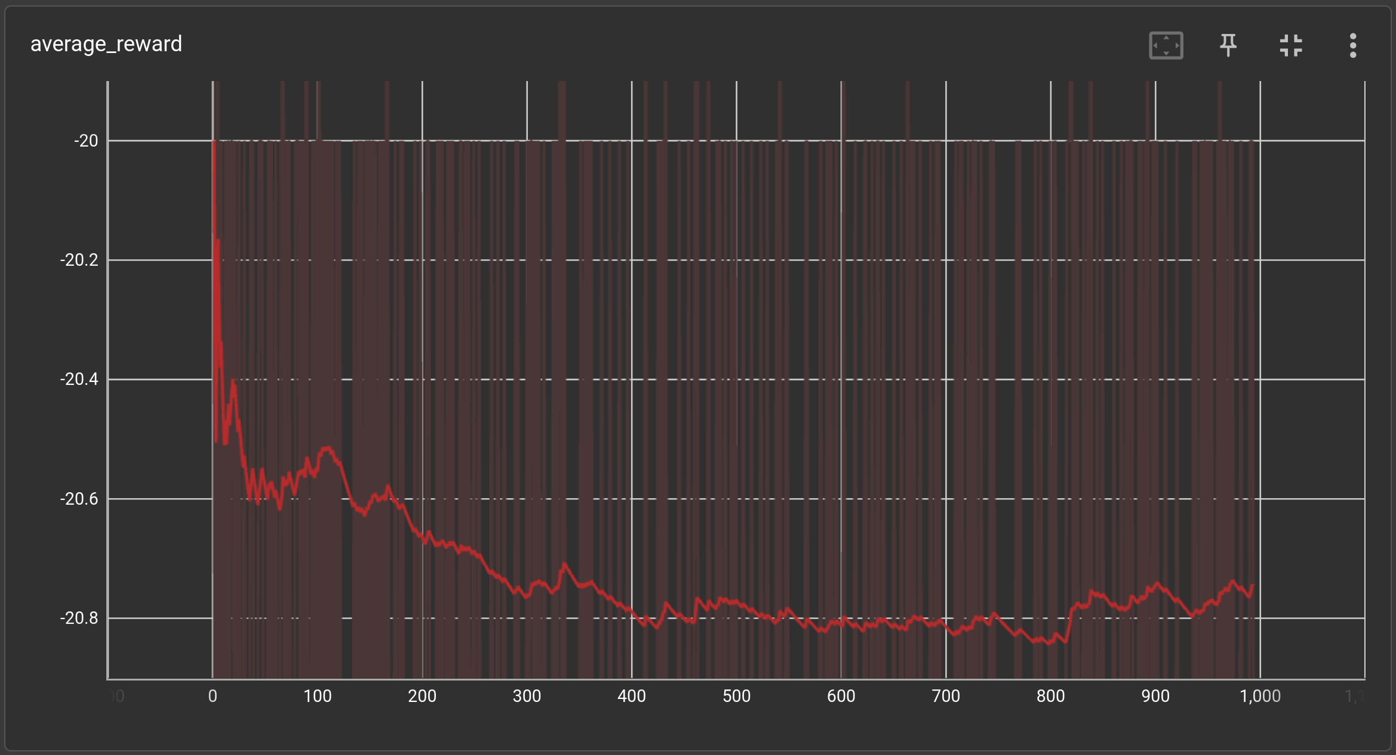
RESULTS single-agent

Slide 13
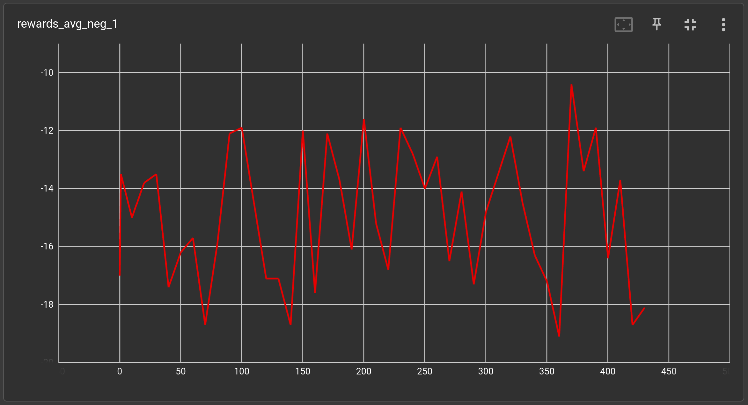
RESULTS multi-agent

Slide 14
RESULTS Troubleshooting
Hyperparameter (especially ERP size)
Network Architecture (Pooling layers)
Datastructure of the ERP and training data
Storing as numpy array but training as tf.dataset

Slide 15
REFERENCES
[1] https://www.novatec-gmbh.de/en/blog/deep-q-networks/

