Slide 1
Goal & Introducing Game
Goal: Multi-Agent Reinforcement Learning with Atari‘s Pong
Introducing Pong
Playable as Single Agent (Gymnasium API) & Multi Agent (PettingZoo API)
Procedure: Start with SA, transfer knowledge to MA
Nico
Deep Reinforcement Learning → Image
Lisa
Single-Agent
DQN Algo → Pseudocode + Code
Lisa
Model-Architecture → Code
Nico
Extend Model to Multi-Agent RL
Hendrik
Results (Troubleshooting)
Hendrik

Slide 2
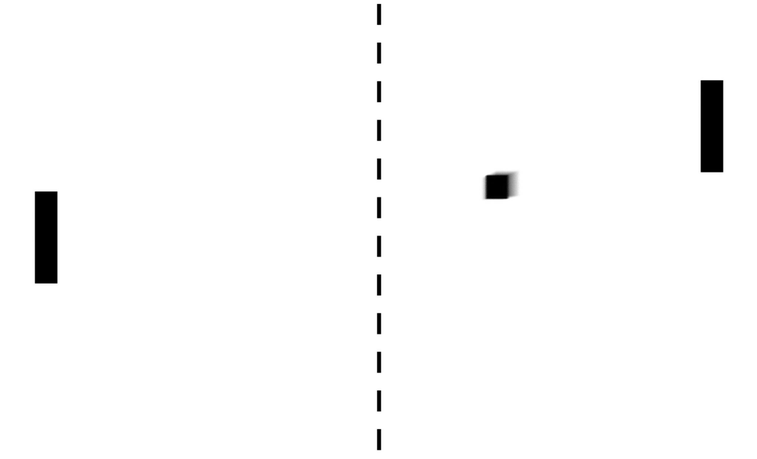
MULTI-AGENT REINFORCEMENT LEARNING WITH ATARI‘S PONG
Implementing Artificial Neural Networks with TensorFlow
Winter Term 22/23
Nico Burgstaler, Lisa Dollmann, Hendrik Warnecke

Slide 3
AGENDA
Introduction
Deep Reinforcement Learning
Singe-Agent RL Implementation
Extend to Multi-Agent RL
Results

Slide 4
INTRODUCTION Goal of our Project
Observation Space
Agent 2
Action
Agent 1
Goal = Reward
[1]

Slide 5
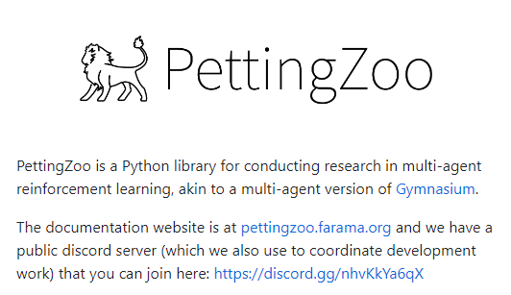
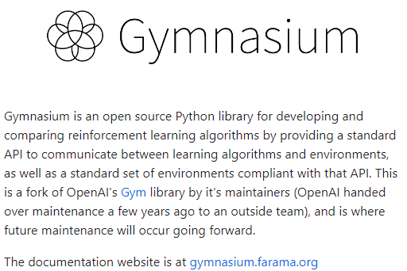
INTRODUCTION Atari‘s Pong in Reinforcement Learning
Single Agent
Multi Agent
[2]
[3]

Slide 6
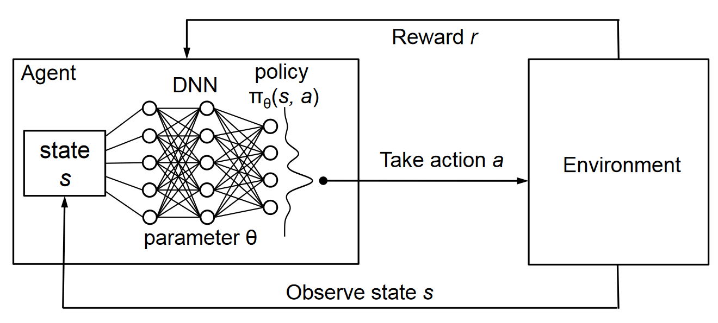
DEEP REINFORCEMENT LEARNING
[4]

Slide 7
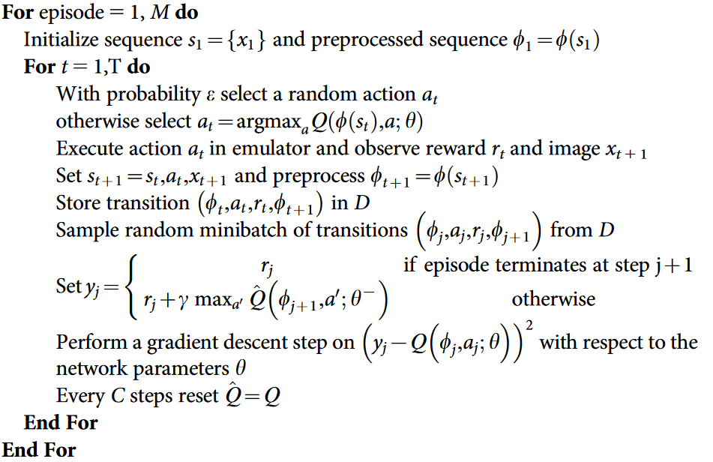
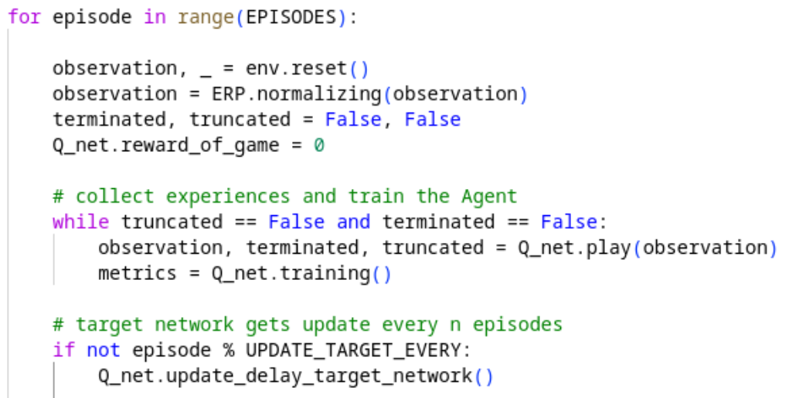
SINGLE-AGENT REINFORCEMENT LEARNING Deep Q-Network
Pseudocode
Our Implementation
[5]

Slide 8
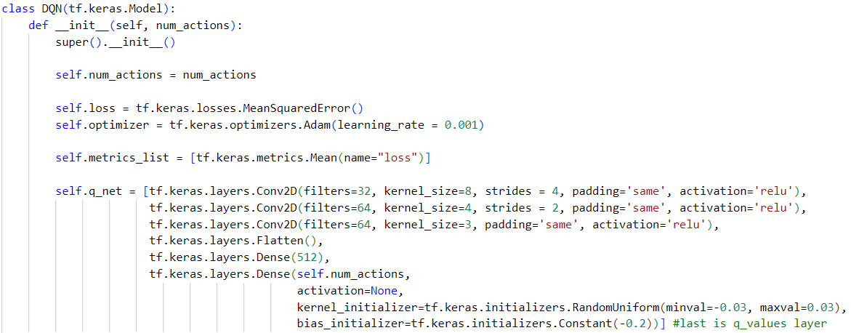
SINGLE-AGENT REINFORCEMENT LEARNING DQN Model Architecture

Slide 9
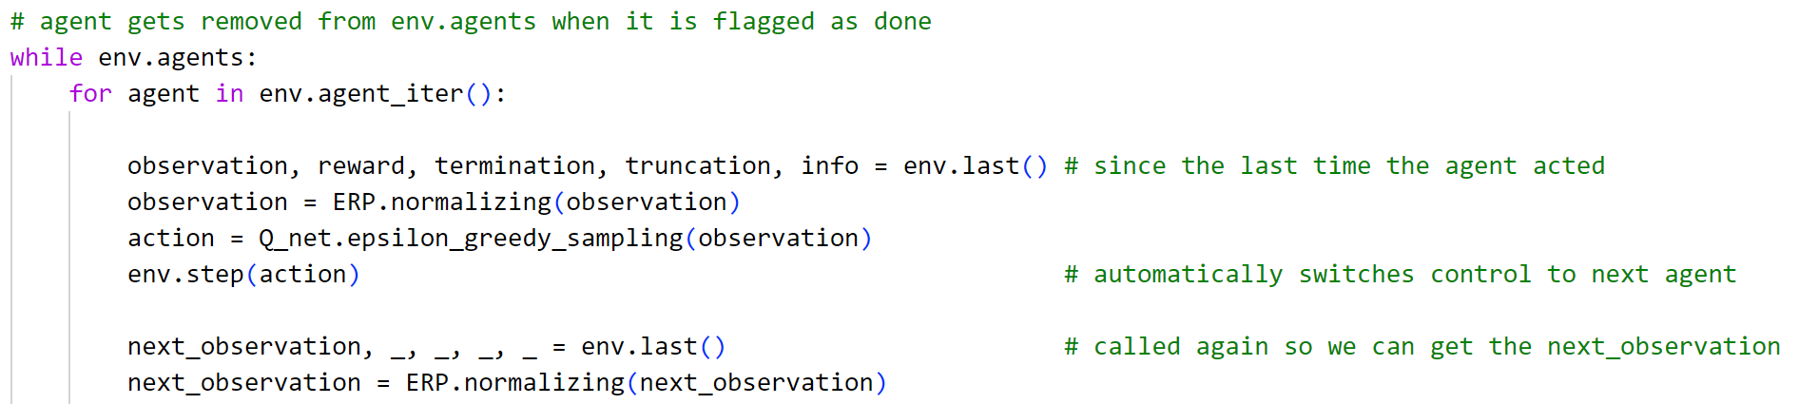
Extend Model to Multi-Agent RL In PettingZoo

Slide 10
Extend Model to Multi-Agent RL Self Play
Both agents share:
Action-space
General task
Reward structure
Observation (space)
Benefits:
Only one network to train
Higher efficiency as all the computing power is concentrated on one network
Opponent difficulty scales nicely

Slide 11
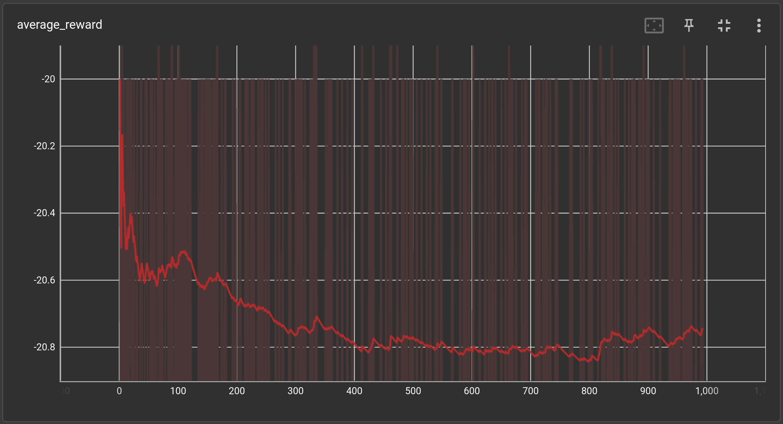
RESULTS Single-Agent

Slide 12
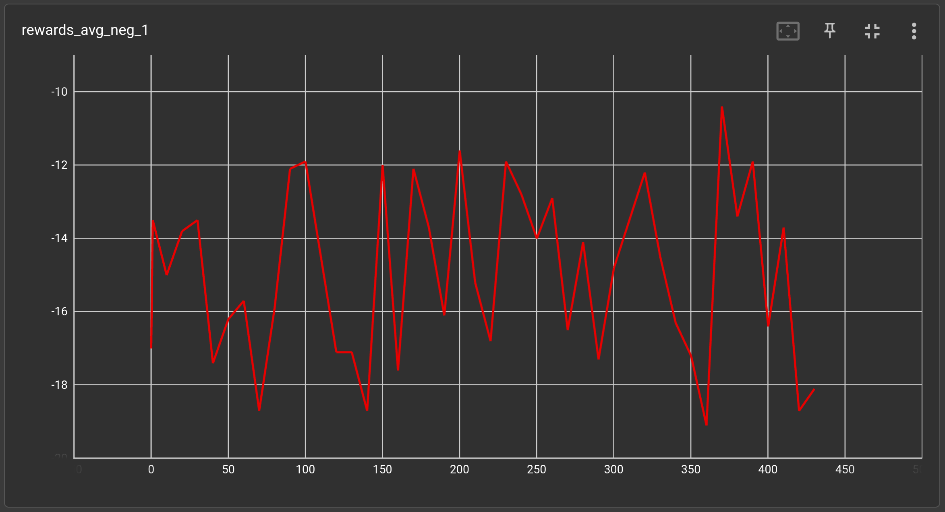
RESULTS Multi-Agent

Slide 13
RESULTS Troubleshooting
Hyperparameter (especially ERP size)
Network Architecture (Pooling layers)
Datastructure of the ERP and training data

Slide 14
REFERENCES
[1] https://www.sfgate.com/local/article/bay-area-roots-pong-atari-17824939.php
[2] https://github.com/Farama-Foundation/Gymnasium
[3] https://github.com/Farama-Foundation/PettingZoo
[4] https://www.novatec-gmbh.de/en/blog/deep-q-networks/
[5] V. Mnih, K. Kavukcuoglu, and D. e. a. Silver, “Human-level control through deep reinforcement learning,” Nature 518, 529–533 (2015), 2015. DOI: https://doi.org/10.1038/nature14236

Slide 15
Thank you for your attention!

