Slide 1
Goal & Introducing Game
Goal: Multi-Agent Reinforcement Learning with Atari‘s Pong
Introducing Pong
Playable as Single Agent (Gymnasium API) & Multi Agent (PettingZoo API)
Procedure: Start with SA, transfer knowledge to MA
Nico
Deep Reinforcement Learning → Image
Lisa
Single-Agent
DQN Algo → Pseudocode + Code
Lisa
Model-Architecture → Code
Nico
Extend Model to Multi-Agent RL
Hendrik
Results (Troubleshooting)
Hendrik

Slide 2
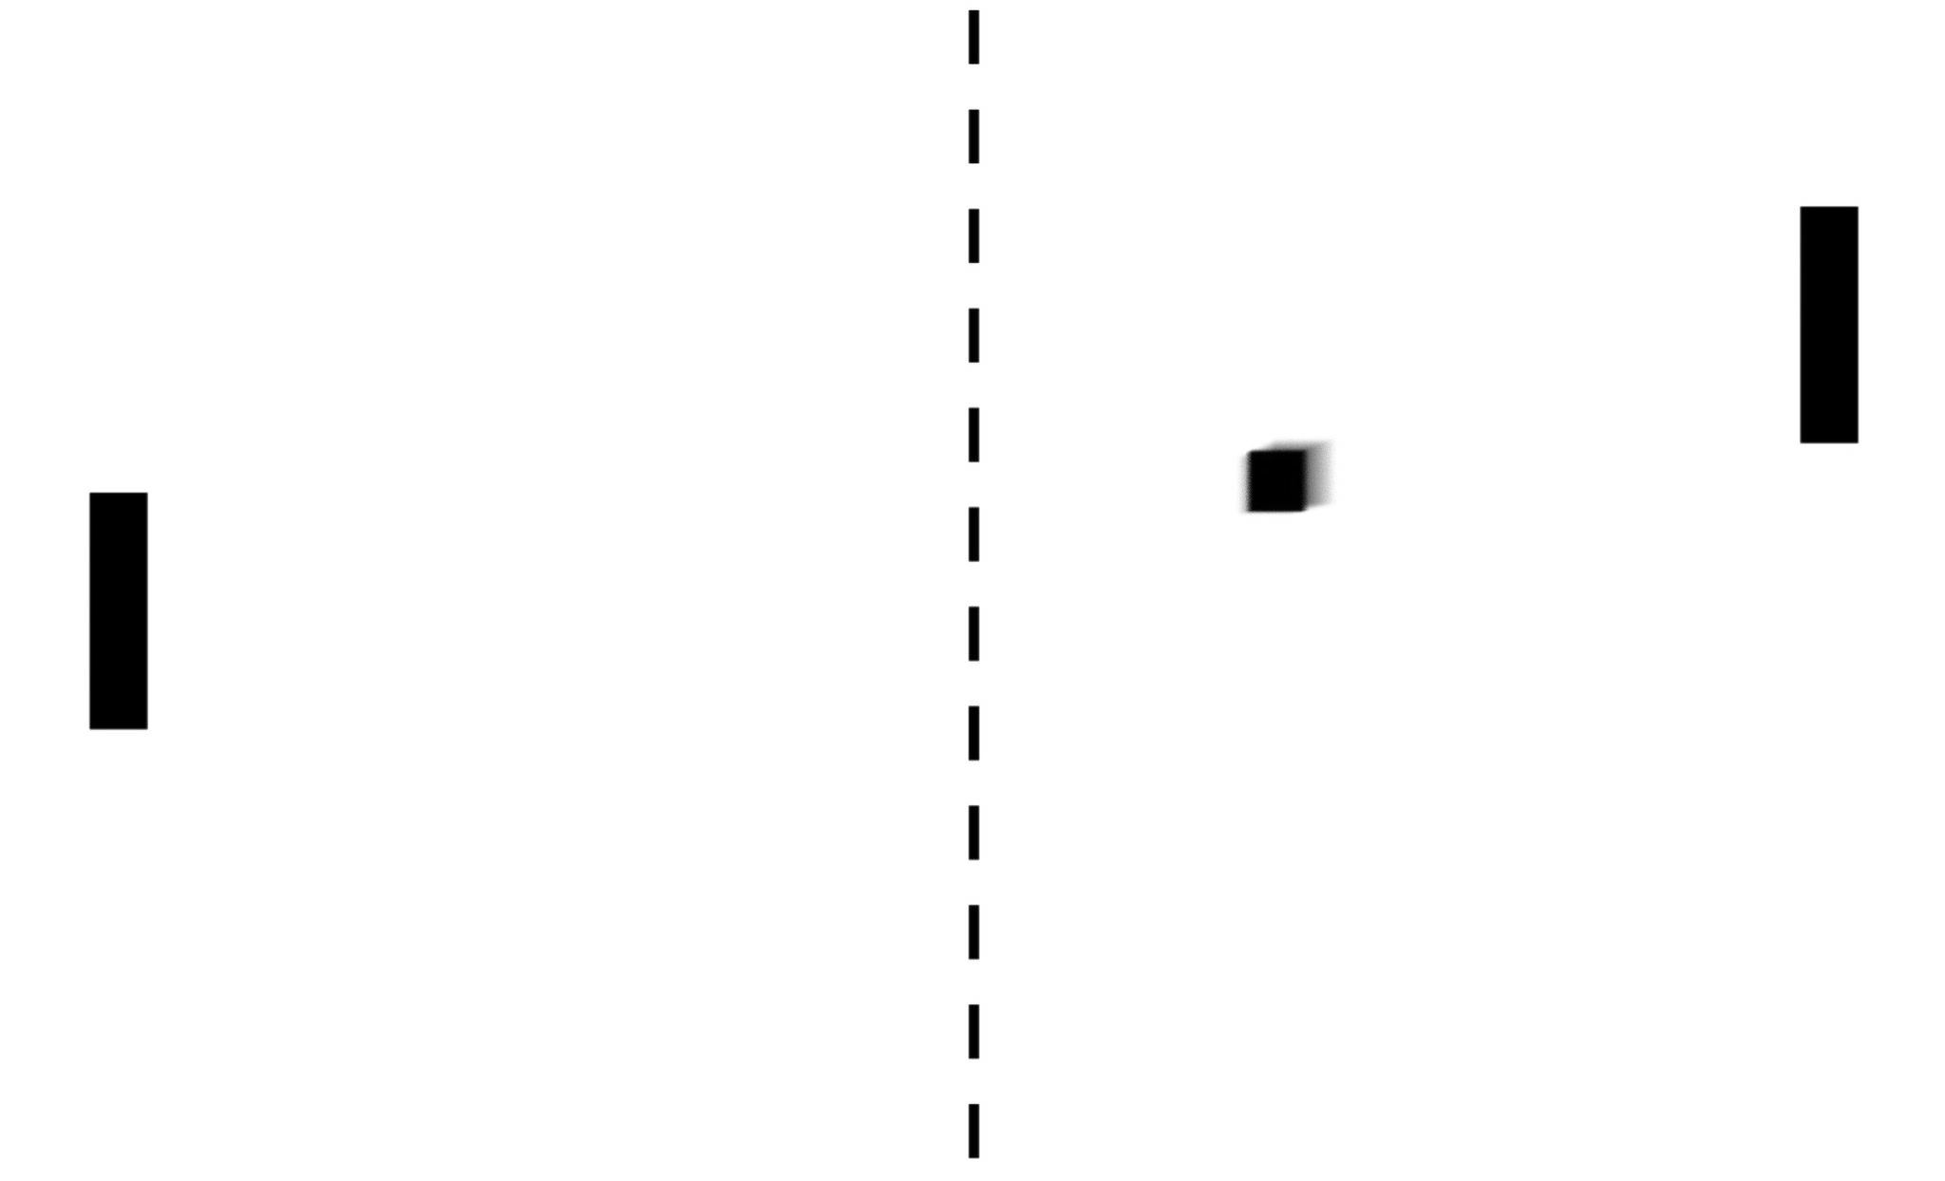
MULTI-AGENT REINFORCEMENT LEARNING WITH ATARI‘S PONG
Implementing Artificial Neural Networks with TensorFlow (IANNwTF)
Winter Term 22/23
Nico Burgstaler, Lisa Dollmann, Hendrik Warnecke

Slide 3
AGENDA
Introduction
Deep Reinforcement Learning
Singe-Agent RL Implementation
Extend to Multi-Agent RL
Results

Slide 4
INTRODUCTION Goal of our Project

Slide 5
INTRODUCTION Atari‘s Pong

Slide 6
INTRODUCTION Atari‘s Pong in Reinforcement Learning
Single Agent
Multi Agent

Slide 7
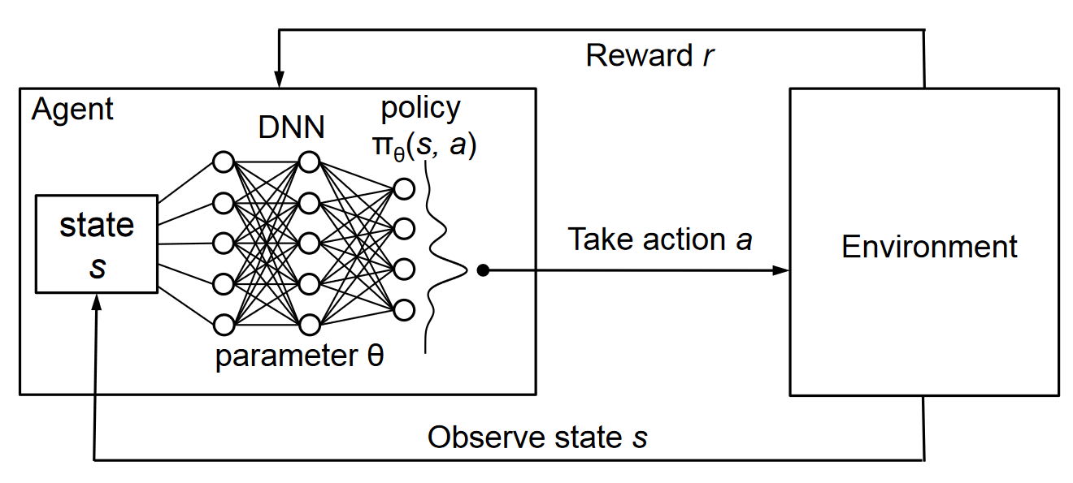
DEEP REINFORCEMENT LEARNING
[1]

Slide 8
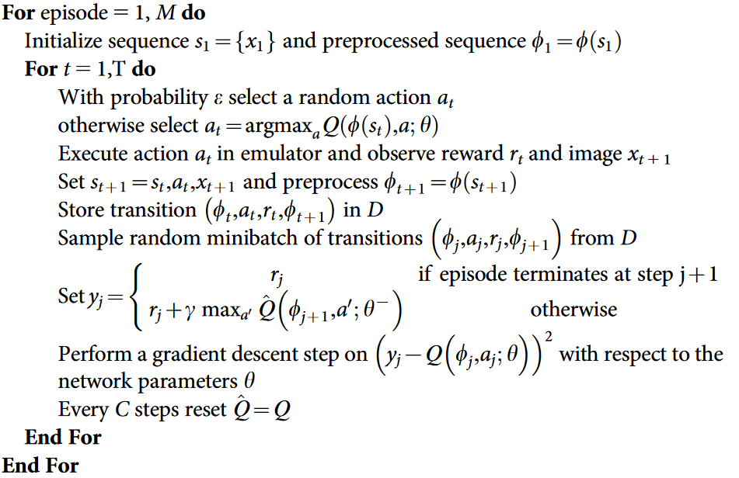
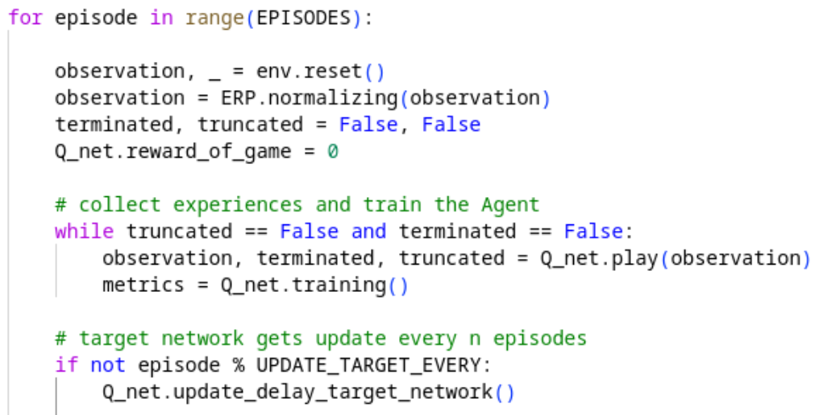
SINGLE-AGENT REINFORCEMENT LEARNING Deep Q-Network
Pseudocode
Our Implementation

Slide 9
SINGLE-AGENT REINFORCEMENT LEARNING Model Architecture

Slide 10
Extend Model to Multi-Agent RL Self Play

Slide 11
RESULTS Metrics

Slide 12
RESULTS Troubleshooting

Slide 13
REFERENCES
[1] https://www.novatec-gmbh.de/en/blog/deep-q-networks/

