Slide 1
Insulin Receptor Activity and Dynamics
Timothy Welsh, Baihan Lin, Hyeon-Jin Kim, Trent Nivala

Slide 2
Introduction
Role of Endosomal Trafficking Dynamics on the Regulation of Hepatic Insulin Receptor Activity: Models for Fao Cells
Hori, S.S., Kurland, I.J. & DiStefano, J.J. Ann Biomed Eng (2006) 34: 879. doi:10.1007/s10439-005-9065-5
Notes:
This is the (long) title of the paper. Essentially, the paper’s goal was to model the dynamics of insulin receptors. These dynamics are the chemical state the insulin receptor is in.

Slide 3
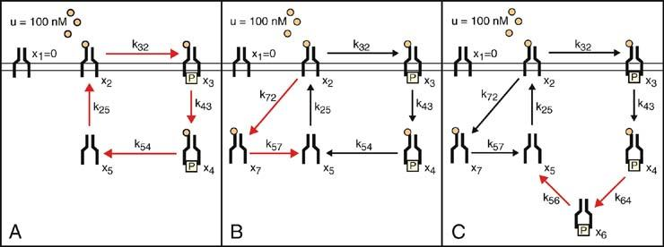
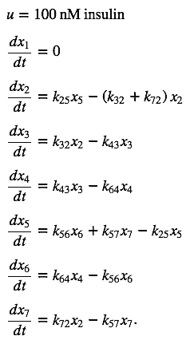
Original Model
Notes:
These are the original ordinary differential equations that model the system described in the paper. Note that there are 7 possible states that the insulin receptor can be in--the x1, x2, and x3 represent the membrane states, and x4, x5, x6, and x7 are internalized states. A key assumption of this model is that the insulin concentration in the system is constant.

Slide 4
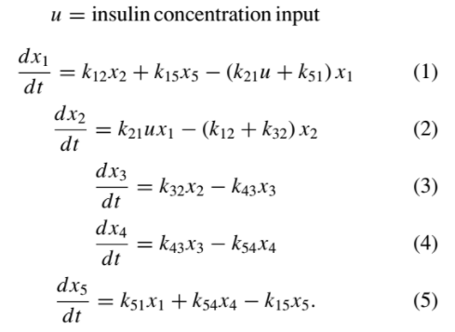
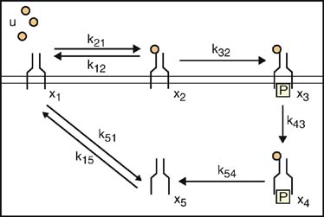
Insulin Concentration Dependent Six Pool Model
What does the model look like when insulin is not saturated in the system?

Slide 5
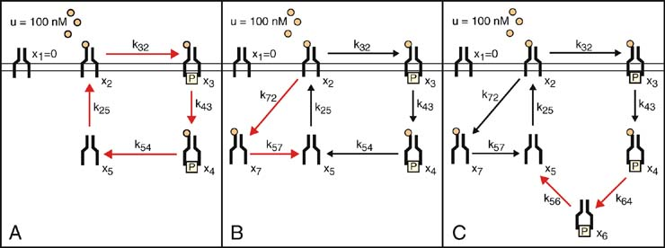
+

Slide 6
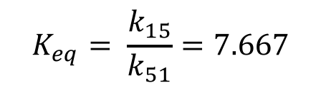

+
 | Estimates
k25 | 0.0737 min⁻¹
k21 | 0.015 nM⁻¹min⁻¹
k12 | 0.00074 min⁻¹
k15 | 0.0737 min⁻¹
k51 | 0.0009613 min⁻¹
$$K_{eq}= \frac{k_{15}}{k_{51}}=7.667$$
$$k_{15}=k_{25}$$

Slide 7
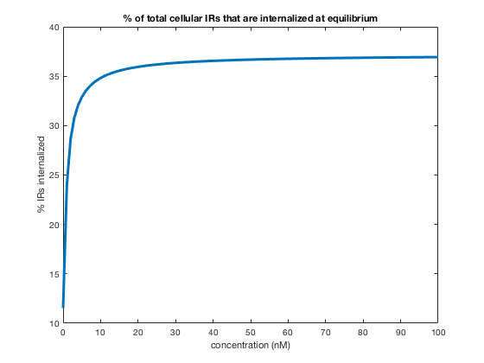
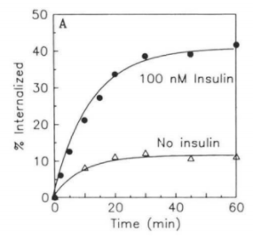
Results

Slide 8

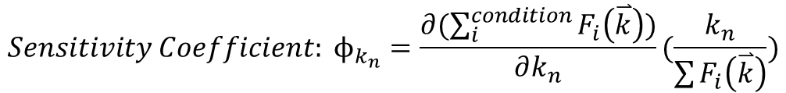
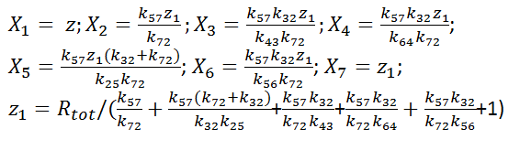

Differential Parameter Sensitivity Analysis
 | Sensitivity Coefficient ϕ for various conditions
parameter | Internalized | phosphorylated
k₂₅ | -0.30977 | 0.18342
k₃₂ | -0.00247 | 0.01763
k₇₂ | 0.01263 | -0.00748
k₄₃ | 0.61795 | -0.15006
k₆₄ | -0.09620 | -0.01383
k₅₆ | -0.21906 | -0.03150
k₅₇ | -0.00306 | 0.00181
0;

Slide 9
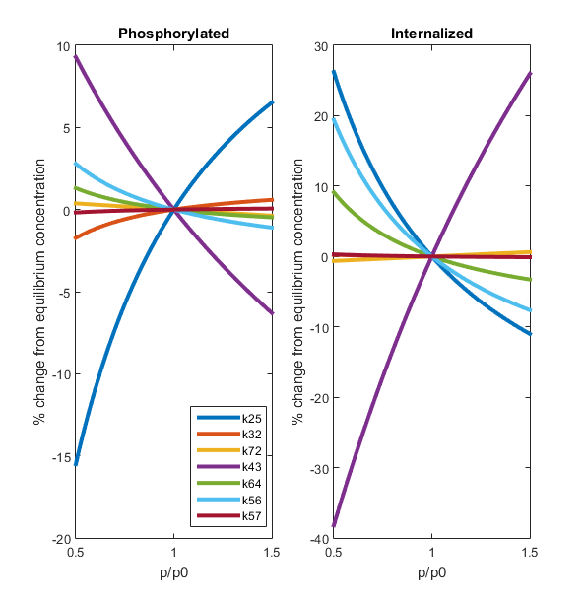
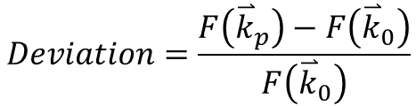
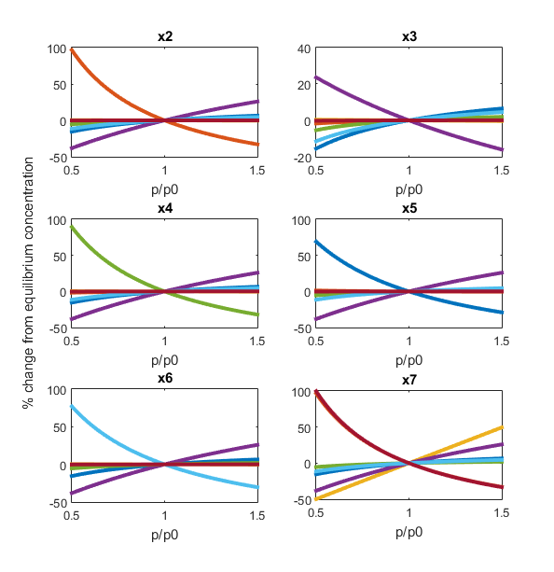
One-at-a-time Sensitivity Measures

Slide 10
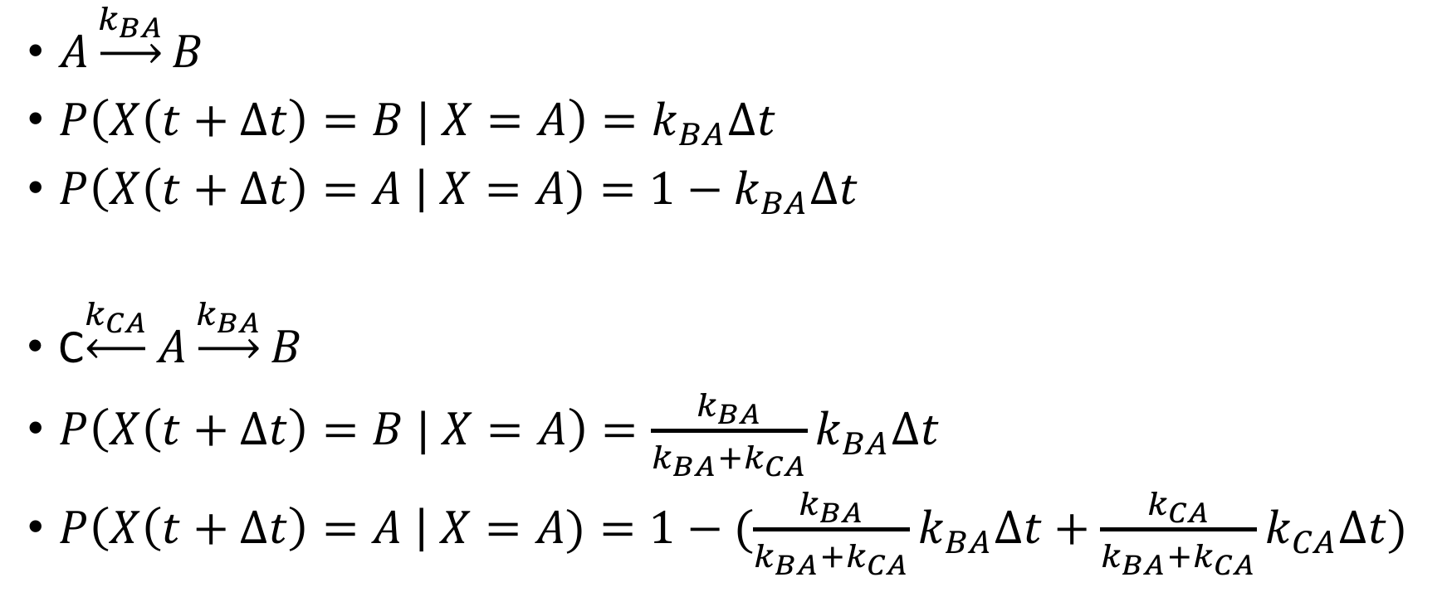
Stochastic Model

Slide 11
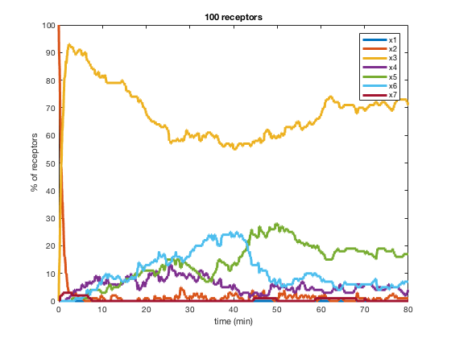
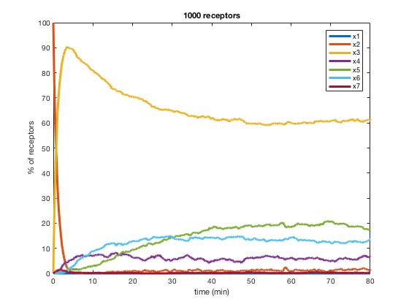
Stochastic Model

Slide 12
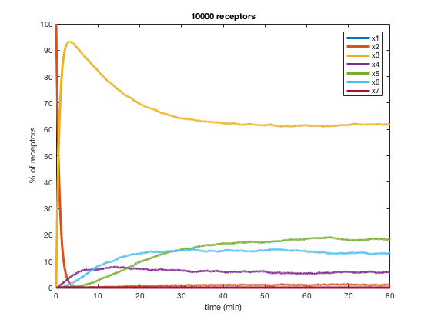
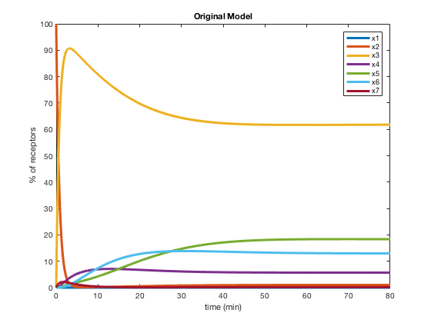
Percentages of receptors at equilibrium
 | x1 | x2 | x3 | x4 | x5 | x6 | x7
Stochastic | 0.0 | 1.10 | 61.90 | 5.710 | 18.070 | 13.210 | 0.010
ODEs | 0.0 | 1.0157 | 61.794 | 5.6959 | 18.3417 | 12.9708 | 0.1815
Stochastic Model
ODE Model

Slide 13
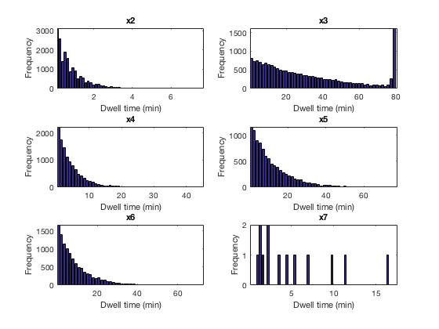
Stochastic Model – Dwell Times

Slide 14
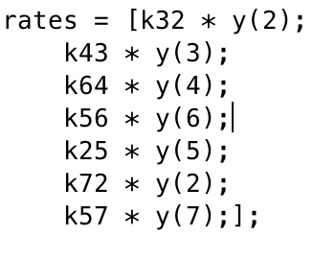
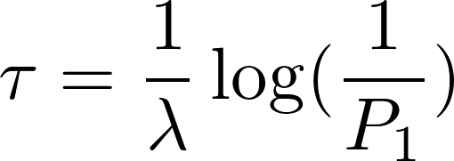
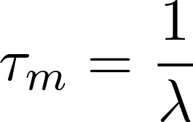
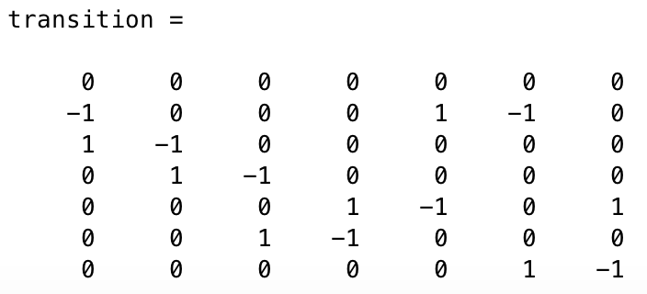
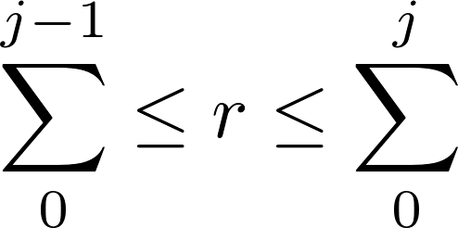

Stochastic Model II - Monte Carlos Simulation
Random waiting time
Randomly choose a reaction
Poisson

Slide 15
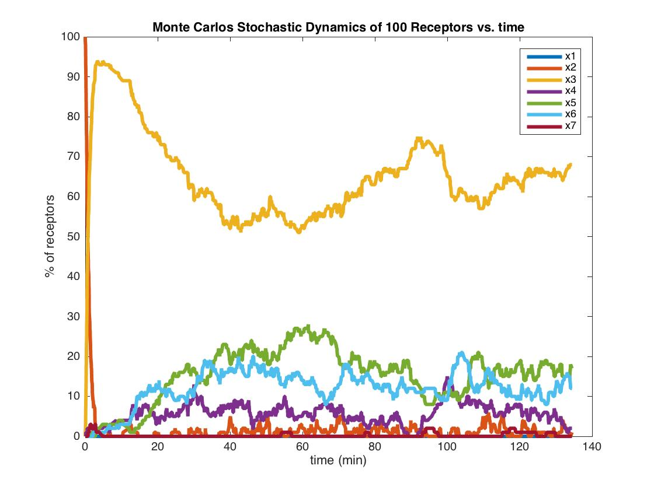
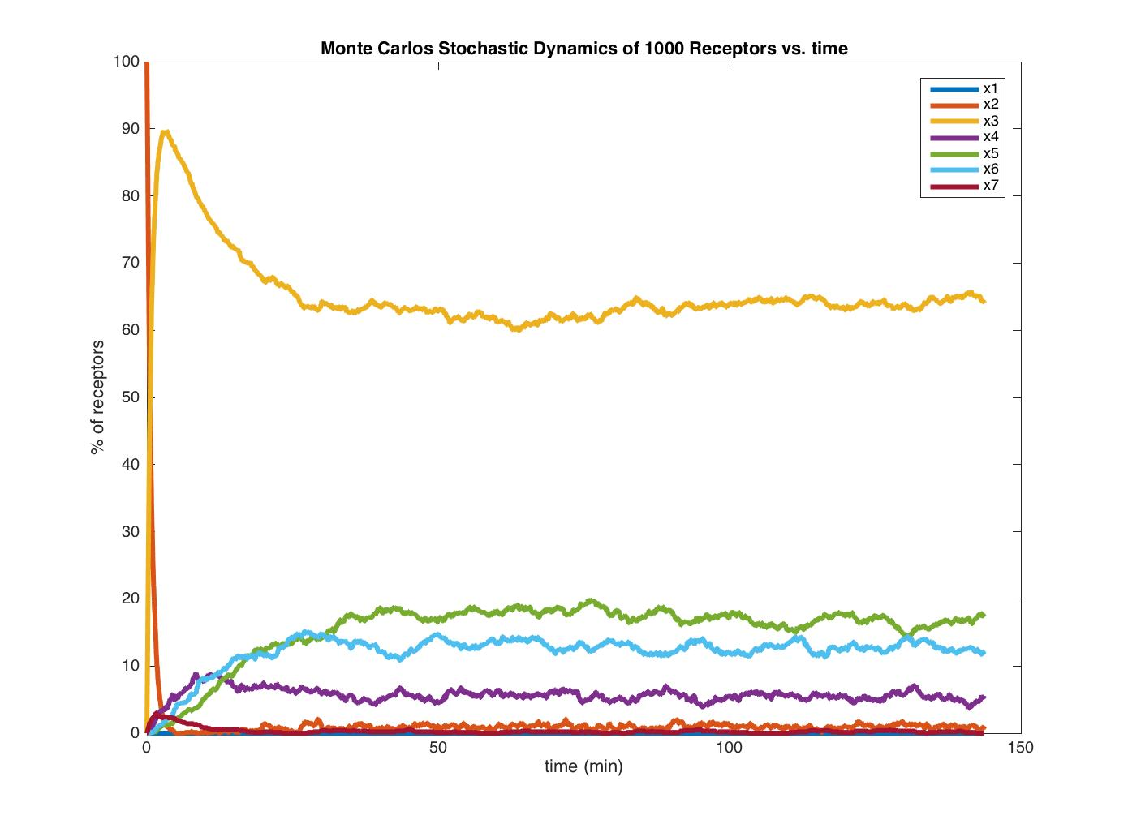
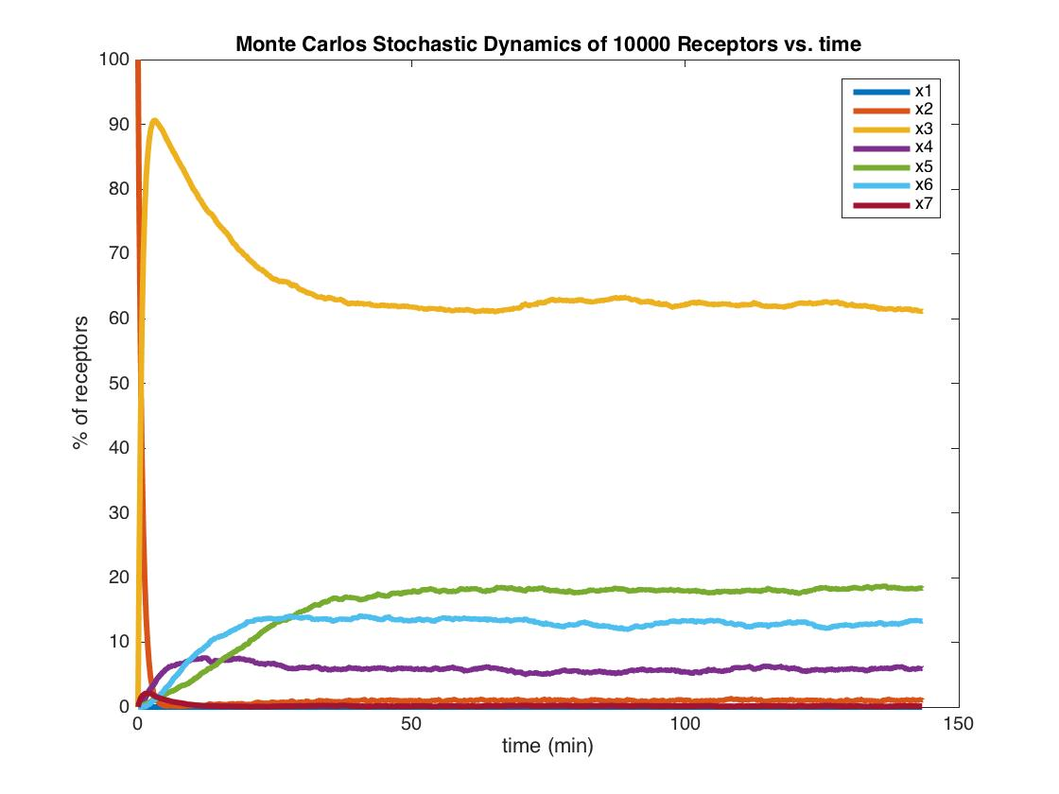
Stochastic Model II - Monte Carlos Simulation
N = 100, steps = 1000 N = 1000, steps = 10000 N = 10000, steps = 100000
Interesting findings:
Simulation steps required to reach the same time spent is proportional to the number of receptors.
That means the waiting time in each step is inversely proportional to the number of receptors.

Slide 16
Conclusions
Insulin Concentration Dependent Six Pool Model:
Model matches endpoints (reported in literature) for % of insulin internalized in cell.
Parameter Sensitivity Analysis:
Parameters are weighted differently in their effects on the state distribution of the system at equilibrium. Parameters k₂₅ and k₄₃ have the largest effect on the phosphorylated and internalized states.
Stochastic Model:
Modeling the system stochastically produces same result as our deterministic ODE model.

Slide 17
Implications of Modeling Insulin
Insulin is primarily used to process sugar in the body
This is a critical aspect of metabolism
Dysfunctions in this process is the basis for Diabetes, a disease which affects 415 million people worldwide

Slide 18
References
H. Schmidt, M. Jirstrand: Systems Biology Toolbox for MATLAB: A computational platform for research in Systems Biology, Bioinformatics Advance Access, November 2005, DOI 10.1093/bioinformatics/bti799 [PDF]
Gillespie, Daniel T. "A General Method for Numerically Simulating the Stochastic Time Evolution of Coupled Chemical Reactions." Journal of Computational Physics 22.4 (1976): 403-34. Web.
Wanant, Sumanas, and Michael J. Quon. "Insulin Receptor Binding Kinetics: Modeling and Simulation Studies." Journal of Theoretical Biology 205.3 (2000): 355-64. Web.
Hori, Sharon S., Irwin J. Kurland, and Joseph J. Distefano. "Role of Endosomal Trafficking Dynamics on the Regulation of Hepatic Insulin Receptor Activity: Models for Fao Cells." Annals of Biomedical Engineering 34.5 (2006): 879-92. Web.
Dykeman, Eric C. "An Implementation of the Gillespie Algorithm for RNA Kinetics with Logarithmic Time Update." Nucleic Acids Research 43.12 (2015): 5708-715. Web.
Backer, John. "Tyrosine Phosphorylation of the Insulin Receptor during Insulin-stimulated Internalization in Rat Hepatoma Cells." The Journal of Biological Chemistry. U.S. National Library of Medicine, 1988. Web.
Hamby, D. M. "A Review of Techniques for Parameter Sensitivity Analysis of Environmental Models." Environmental Monitoring and Assessment 32.2 (1994): 135-54. Web.

Slide 19


