Slide 1
i RNA
Ø
DNA
protein
Ø
mRNA
Ø

Slide 2
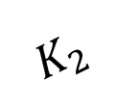

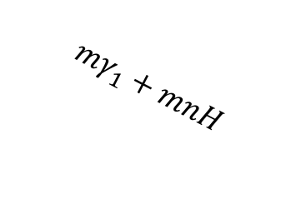
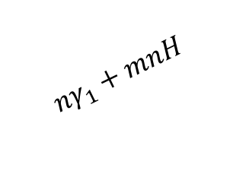


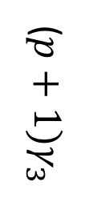

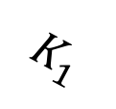

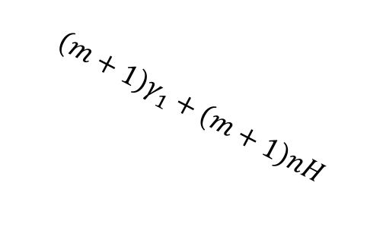
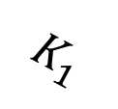
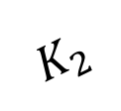
(m, n, p+1)
($m+1)K_{3}$
(m-1, n, p)
(m, n-1, p)
($p+1)γ_{3}$
$$mK_{3}$$
$$K_{1}$$
$${nγ}_{1}+mnH$$
$$mγ_{1}+mnH$$
$$K_{2}$$
protein
(m, n, p)
($m+1)K_{3}$
iRNA
$$\left(n+1\right)γ_{1}+m\left(n+1\right)H$$
$$K_{1}$$
mRNA
$$\left(m+1\right)γ_{1}+\left(m+1\right)nH$$
(m, n+1, p)
$$K_{2}$$
(m+1, n, p)
$$mK_{3}$$
$$pγ_{3}$$
(m, n, p-1)

