Slide 1
Decentralization Rules:
Linking Solid Pods in Different Vocabularies using Notation3
Dörthe Arndt and William Van Woensel

Slide 2
Outline
Problem
Idea
Realisation

Slide 3

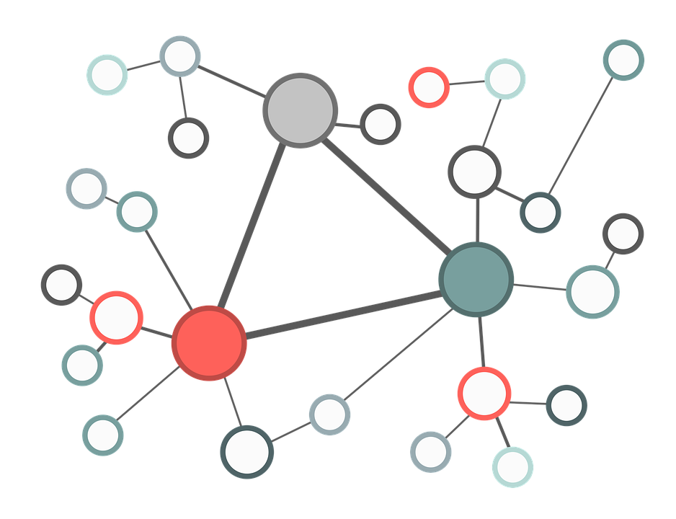
Solid: Personal data pods
Storage of personal data in decentralized pods
User controls data access
Standard open data formats
Different applications can use the same data

Slide 4

Solid in practice: Flanders
Every citizen will get a Solid pod
Use of RDF
Vocabularies: OSLO, ISA, SKOS, …

Slide 5
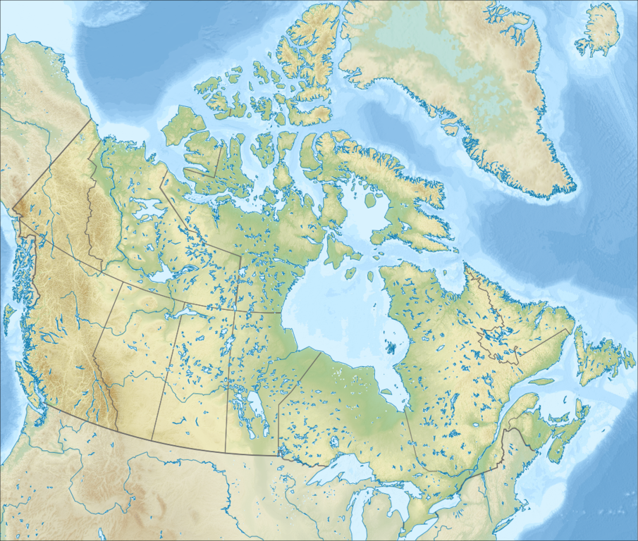
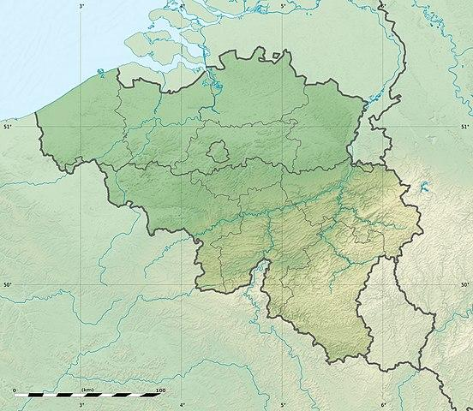



Use Case: Flemish traveller
Different vocabularies
!
Solid Pod: OSLO
EHR: HL7 FHIR

Slide 6
Outline
Problem: Decentralised graphs use different vocabularies
Idea
Realisation

Slide 7
Different standards use different terminology
“Pieter is male.”
OSLO
FHIR
:pieter a person:Person;
vp:geslacht "male".
:pieter a fhir:Patient;
fhir:Patient.gender [
fhir:value "male"].

Slide 8
Translation as rule application
:pieter a person:Person;
vp:geslacht "male".
:pieter a fhir:Patient;
fhir:Patient.gender [
fhir:value "male"].
?x a fhir:Patient;
fhir:Patient.gender
[ fhir:value ?y].
Then
If
?x a person:Person;
vp:geslacht ?y.

Slide 9
Notation3 Logic
Rule-based extension of RDF
Different implementations (reasoners: CWM, EYE, jen3, ...)
Support of existential rules (= production of blank nodes)
Various built-ins (e.g. string operations, de-referencing of iris, …)
Easy to customize
Try it: http://ppr.cs.dal.ca:3002/n3/editor/

Slide 10
Outline
Problem: Decentralised graphs use different vocabularies
Idea: Use Notation3 Rules for translation
Realisation

Slide 11
We implemented N3 translation rules from OSLO citizen profiles to FHIR patient profiles

Slide 12
Translation example: Gender
:pieter a person:Person;
vp:geslacht "male".
:pieter a fhir:Patient;
fhir:Patient.gender [
fhir:value "male"].
{?x a fhir:Patient;
fhir:Patient.gender
[ fhir:value ?y].}
{?x a person:Person;
vp:geslacht ?y.}
=>
Executable example: http://ppr.cs.dal.ca:3002/n3/editor/s/iNEQM8aQ

Slide 13


Translation example: Link traversal
:sofie vp:gebruikteVoornaam "Sofie";
foaf:familyName "Smit" .
:pieter fhir:Patient.contact.name [
fhir:HumanName.family [ fhir:value "Smit" ];
fhir:HumanName.given> [ fhir:value "Sofie"]].
:pieter person:heeftPersoonsrelatie [
a vp:Huwelijk ;
person:isRelatieMet :sofie ].
{
?x person:heeftPersoonsrelatie [ a vp:Huwelijk;
person:isRelatieMet ?y].
?y log:semantics [
log:includes {?y vp:gebruikteVoornaam ?first;
foaf:familyName ?family.}
].
}
=>
{
?x fhir:Patient.contact.name [
fhir:HumanName.family [ fhir:value ?family ] ;
fhir:HumanName.given [ fhir:value ?first ]] .
}.
Executable example: http://ppr.cs.dal.ca:3002/n3/editor/s/EKYO9uY2

Slide 14
Translation from OSLO to FHIR
The full example:
http://ppr.cs.dal.ca:3002/n3/editor/s/CjUiEimP

Slide 15
Outline
Problem: Decentralised graphs use different vocabularies
Idea: Use Notation3 Rules for translation
Realisation: Executable decentralised translation rules

Slide 16
Notation3 makes distributed RDF graphs interoperable

