Slide 1
DUEPROCESS AI
Not a legal chatbot.
The product is the packet: source facts, gaps, adverse facts, QC status, and court-safe export.
Evidence-to-action legal intelligence.
A source-bound engine for turning messy legal records into violation maps, QC-cleared reports, writ packets, and exportable work product.
Private beta command deck
2026-06-30

Slide 2
MARKET PAIN
02
The market is not short on legal AI. It is short on reviewable proof.
92%
1 in 2
40%
18%
of substantial civil legal problems get no or not enough legal help
LSC-funded legal-aid requests are turned away for limited resources
of professional organizations now use GenAI, up from 22%
of professionals say their organizations track AI ROI
Translation: buyers do not need more generated paragraphs. They need evidence compression, source anchors, issue ranking, and outputs that a human can trust or reject fast.
Sources: LSC Justice Gap Study; Thomson Reuters 2026 AI in Professional Services Report.

Slide 3
POSITIONING
03
The wedge is a proof packet, not broad SaaS theatre.
Sell a judgment artifact
A buyer can evaluate a packet outside the app: timeline, violation ledger, missing records, adverse facts, source appendix.
Category claim
Run one ugly real matter
Packet
engine
Selected files first, then whole case. It must survive bad OCR, duplicates, stale docs, and low-confidence findings.
Measure the human review delta
The value is not magic. It is fewer hours wasted finding what matters and fewer unsupported claims sneaking into filings.
Only then pitch recurring software
The chat is the steering wheel. The packet is the product.
If the artifact cannot be exported and understood by a stranger, it is not a sellable lane yet.

Slide 4
ENGINE
04
The backend job: keep every conclusion tied to a source or downgrade it.
1
Intake
2
Anchor
3
Analyze
Upload, OCR, dedupe, hash, classify.
Extracted text, source SHA, quote support.
Agents produce structured findings.
4
QC
5
Synthesize
6
Export
Block, downgrade, approve, demand more proof.
Combine findings into one work-product packet.
PDF/DOCX/Markdown with appendix and warnings.
Design rule: missing records are valuable, but they are demands/gaps, not proven misconduct.

Slide 5
FIRST CUSTOMER BASES
05
Start where the records are painful and the artifact is judgeable.
Pro se Case Builder
One narrow case packet a non-lawyer can follow.
$99/mo or $149 packet
Civil-rights firm pilot
Leverage memo with Monell gaps, immunity routes, adverse facts.
$499-$1.5k pilot
Defense / habeas
Transcript, Brady, competency, speedy-trial, writ route.
$499-$2.5k review
Legal aid / clinics
Reviewer handoff packet with facts, gaps, deadlines, exclusions.
$750-$2.5k pilot
Watchdog archive
Evidence ledger, actors, contradictions, public-records targets.
$1.5k-$5k project
Source map: docs/MARKET_CUSTOMER_BASES.md; LSC, RAND, ABA, Clio, Thomson Reuters.

Slide 6
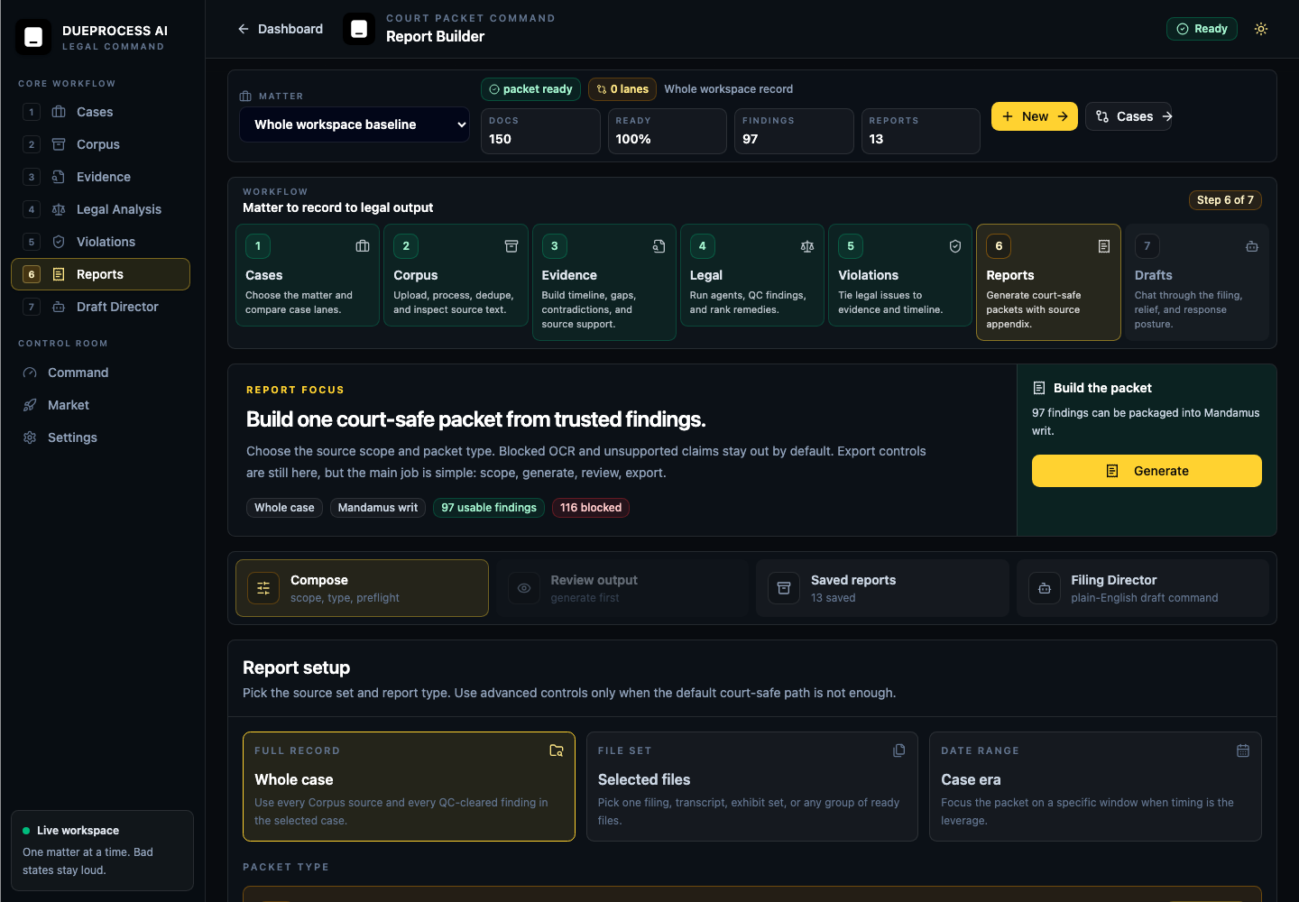
CURRENT PRODUCT PROOF
06
The app now exposes the workflow instead of hiding the engine.
Cases -> Corpus -> Evidence -> Legal Analysis -> Violations -> Reports -> Draft Director. Broken states are supposed to be loud, because silent failure is how legal software becomes liability confetti.
Multi-case workspace
Compare matters without mixing evidence.
Packet readiness
Reports show ready docs, findings, blocked claims, and export state.
Filing Director
Plain-English filing command becomes structured report/draft inputs.

Slide 7
OUTPUT STANDARD
07
The moat is not prettier AI prose. It is disciplined legal posture.
Source-bound
Court-safe
Every record-supported finding needs quote/source anchors, file names, document IDs, confidence, and QC status.
Inferences stay inferences. Missing records become demands. Adverse facts are captured instead of buried.
Mandamus-grade
Appellate quality
Clear duty, refusal/delay, beneficial interest, no adequate ordinary remedy, appendix proof, narrow command.
Issue, rule, record facts, application, limits, adverse facts, requested disposition.
ABA Formal Opinion 512 reinforces competence, confidentiality, supervision, communication, and verification concerns for lawyer AI use.

Slide 8
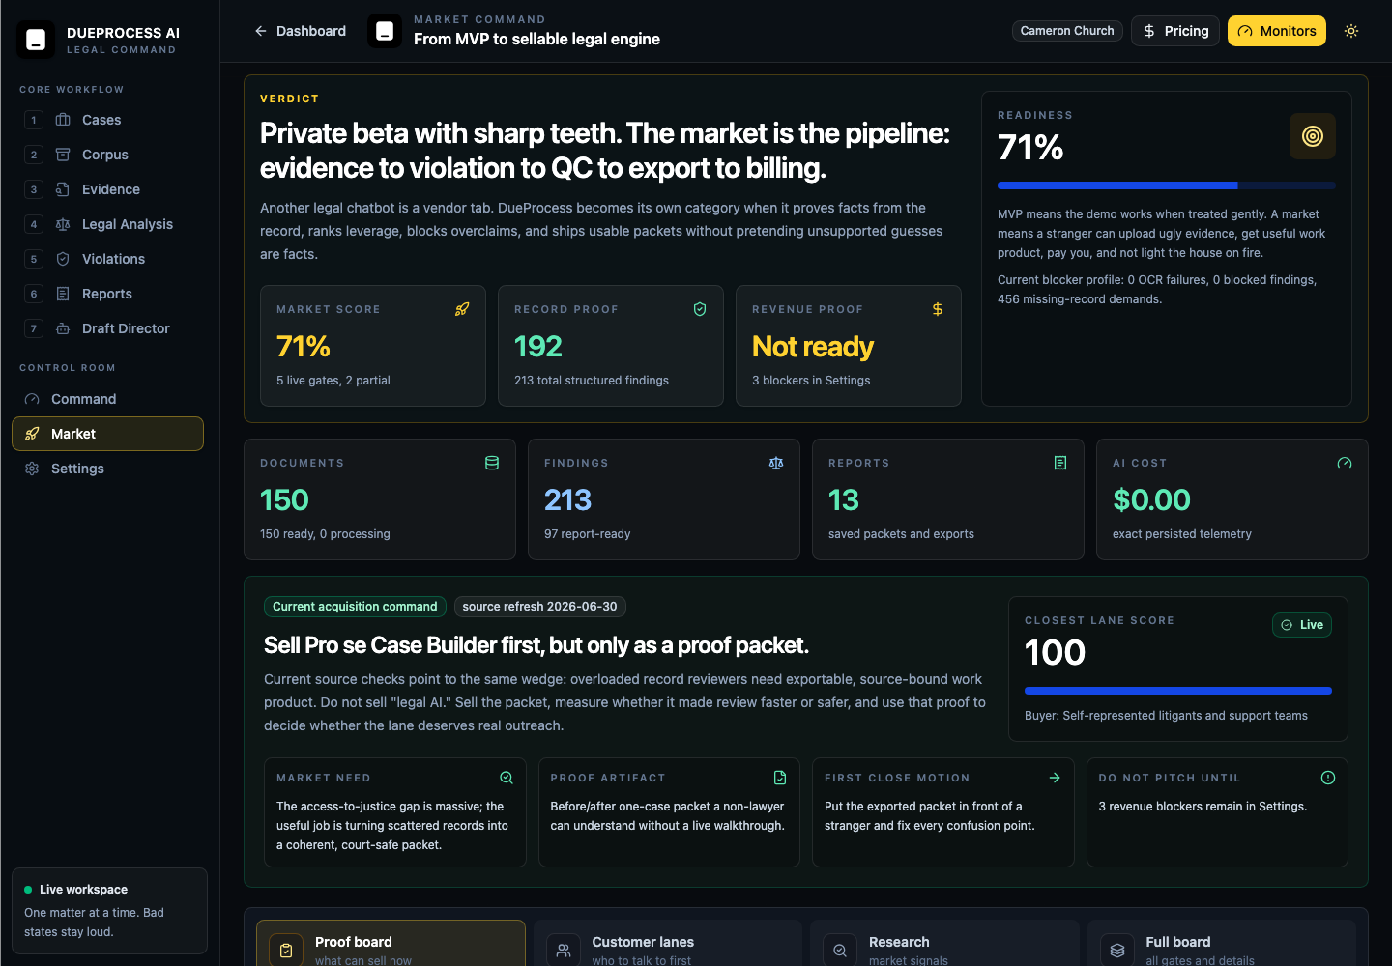
MARKET OPERATING BOARD
08
Market research became a product gate.
The board answers: what proof can sell now, which customer lane is closest, what artifact proves value outside the app, and what blocker prevents responsible launch.
Current command
Sell Pro se Case Builder first, but only as a proof packet.

Slide 9
MONETIZATION
09
Make money by selling judgment-ready artifacts first.
Lane
Buyer
Price motion
Close proof
One-case packet
Pro se / family support
$149 packet or $99/mo
Needs stranger-readable export
Civil-rights pilot
Owner attorney / investigator
$499-$1,500 matter
Needs measured review-time delta
Firm usage plan
Small firms
$199/mo base + usage
Needs Stripe/tier enforcement
Clinic pilot
Legal-aid / law schools
$750-$2,500 pilot
Needs reviewer notes and role flow
Archive/API project
Watchdogs / legal-tech
$1,500-$5,000 project
Needs tenant keys, webhooks, SDK

Slide 10
EXECUTION PLAN
10
The next work is boring in exactly the profitable way.
1
2
3
4
5
Prove selected-file engine
Harden intake
Export quality
Billing gates
Pilot proof
Run 3-5 real docs through findings -> QC -> report. No handwaving.
OCR states, retry, duplicate consolidation, text preview, source hash proof.
Pleading paper PDF, DOCX, source appendix, reliability certificate.
Stripe products, server-side limits, usage telemetry, firm metering.
Put packets in front of buyers and capture what they missed, trusted, or hated.
Private beta first. Public release only after auth isolation, unsupported-claim blocking, billing/tier matches, and OCR failure visibility are proven.

Slide 11
CURRENT STATUS
11
Working alpha. Private-beta credible. Not public-release safe yet.
Green
Core app starts locally; reports, market board, Draft Director, and violations routes render.
Green
Structured findings, QC, saved reports, token telemetry, and protected exports exist in backend shape.
Yellow
Must prove ugly upload-to-export path on real scanned/duplicated/mixed files.
Red
Stripe price IDs, tier enforcement polish, and final release monitors still decide whether this can charge safely.
Repo proof used: current docs, report generator contracts, route screenshots, and prior private-beta execution report.

Slide 12
NEXT 30 CONVERSATIONS
12
The ask is not money first. It is brutal packet review.
Put one exported packet in front of each buyer lane and ask four questions: what did it miss, what did it overclaim, what did it make faster, and what would make you pay?
8
Police accountability / civil-rights firms
5
Pro se support and law-library ecosystems
6
Legal aid and clinic intake teams
3
Watchdogs and public-records teams
5
Defense, habeas, innocence teams
3
Archive and API integration partners
Rule: every conversation starts with an exported artifact, not a feature tour.

Slide 13
SOURCES AND PROOF BASIS
13
Sources used
Legal Services Corporation
Justice Gap executive summary: 92% unmet substantial civil legal problems; legal-aid turn-away pressure.
Thomson Reuters Institute
2026 AI in Professional Services Report: adoption, workflow shift, ROI measurement gap.
ABA Formal Opinion 512
Competence, confidentiality, supervision, communication, and verification obligations around generative AI.
RAND
National Public Defense Workload Study: excessive caseloads, digital discovery, modern defense workload pressure.
DueProcess repo
Market map, mandamus skill, senior handoff, private-beta execution report, and live route screenshots.
Deck conclusion: sell source-bound packets first; keep broad platform claims behind proof gates.

