Slide 1
112-2 NGS+BI+GM
HW2
Using NTU Galaxy http://galaxy2.cc.ntu.edu.tw/ (連線需要在台大網域內)

Slide 2
NTU Galaxy / Public Galaxy
NTU Galaxy（需要使用台大網域或利用 VPN 連線）
http://galaxy2.cc.ntu.edu.tw/
Homework History
https://galaxy2.cc.ntu.edu.tw/u/chienyuchen/h/shared-history-hw2-data
Public Galaxy（此帳號與 NTU Galaxy 無關）
https://usegalaxy.org

Slide 3
Objective
Given the assembly of the two haplotypes of an individual (HG002)
HG002.1
HG002.2
Determine the CYP2D6 allele type of the two HG002 haplotypes, respectively
https://www.pharmvar.org/gene/CYP2D6

Slide 4
Data
The assembly of HG002 (from HPRC)
HG002.1
HG002.2
CYPD26 allele sequences
CYPD26 refseq (NG_008376.4)
Copy the history to your NTU Galaxy account
https://galaxy2.cc.ntu.edu.tw/u/chienyuchen/h/shared-history-hw2-data

Slide 5
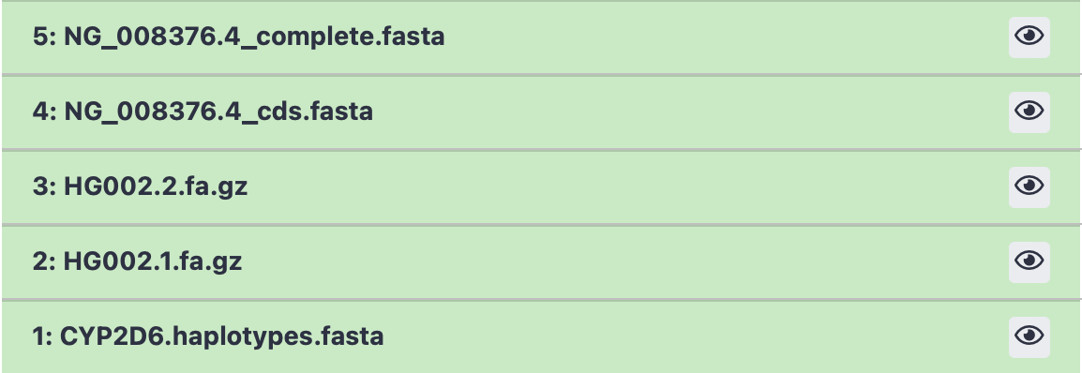
Data
CYPD26 refseq
CYPD26 refseq split exon
Haplotype
Haplotype
Alleles

Slide 6
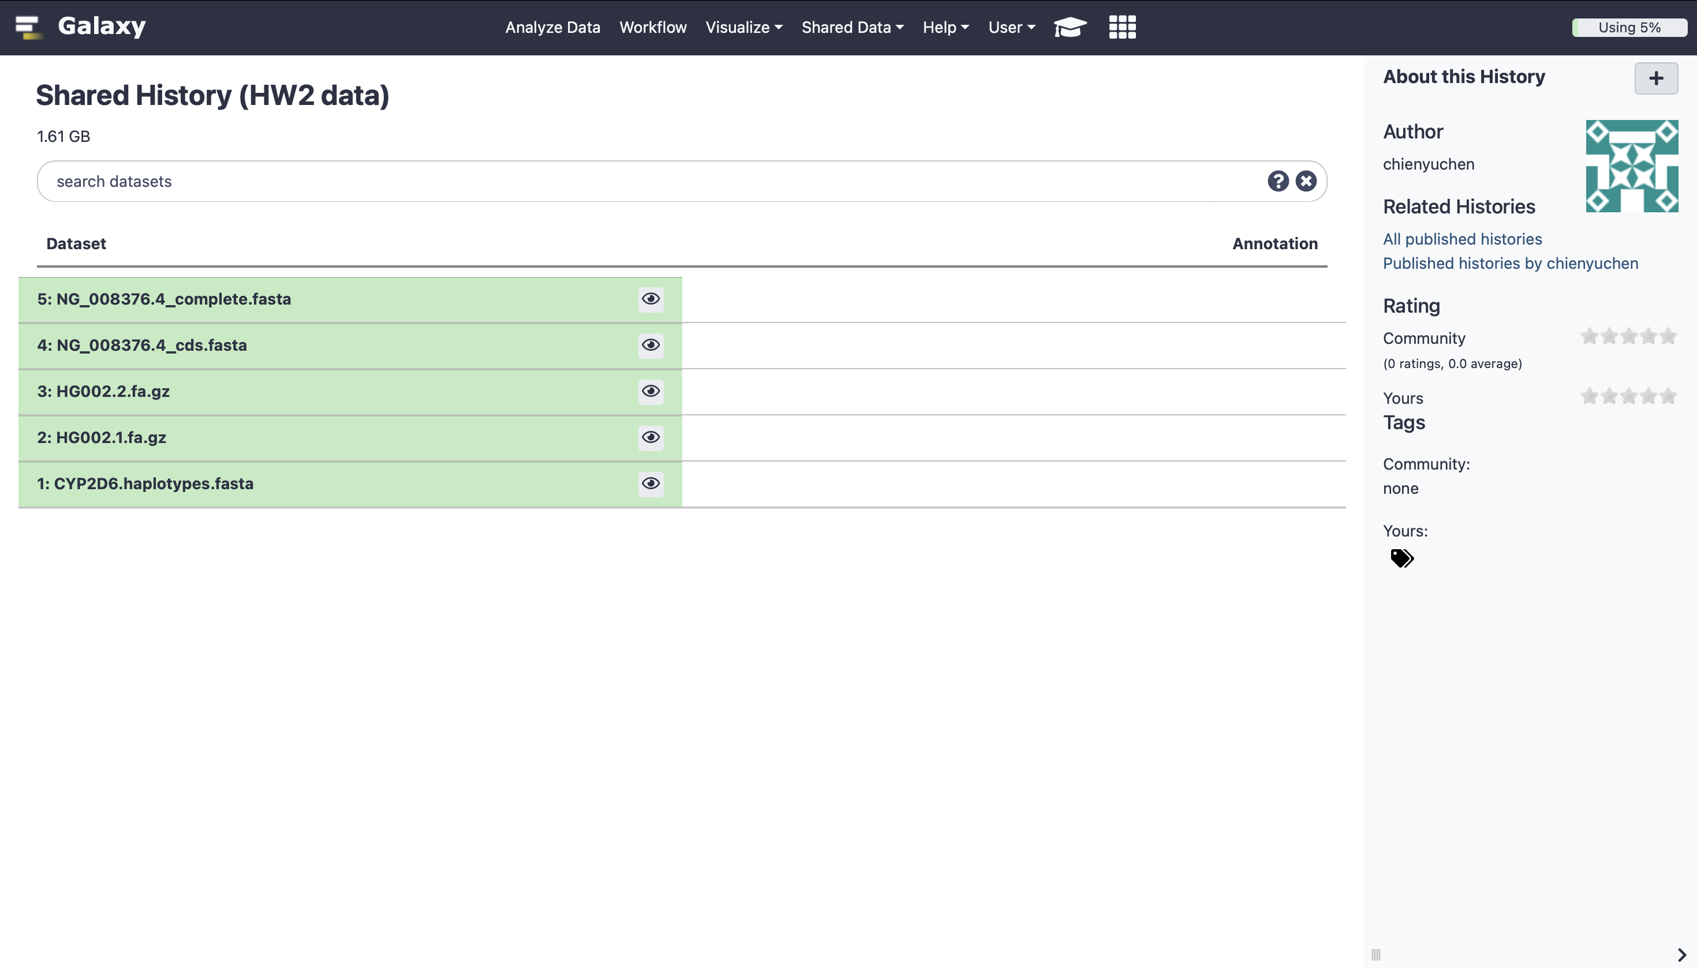

Slide 7
Suggested procedures to determine the allele
makeblastdb (HG002.1)
blastn
database (HG002.1) query (NG_008376.4_complete)
extract sequence from HG002.1 using getfasta from bedtools
as HG002.1-CYP2D6
makeblastdb (CYP2D6 haplotypes)
blastn
database (CYP2D6 haplotypes) query (HG002.1-CYP2D6)
check the alignment
Output format : Pairwise
HG002.1-CYP2D6 vs. NG_008376.4_complete
There are many ways to find the answer, so you may try your own procedures.

Slide 8
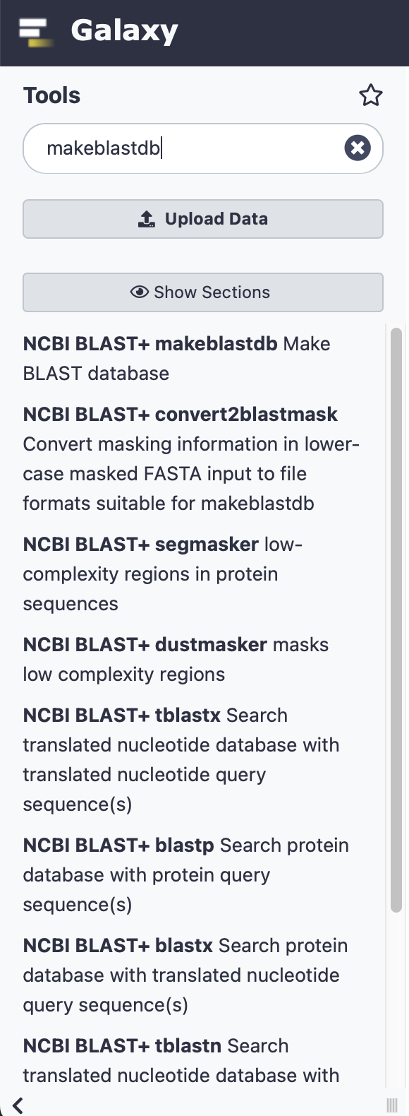
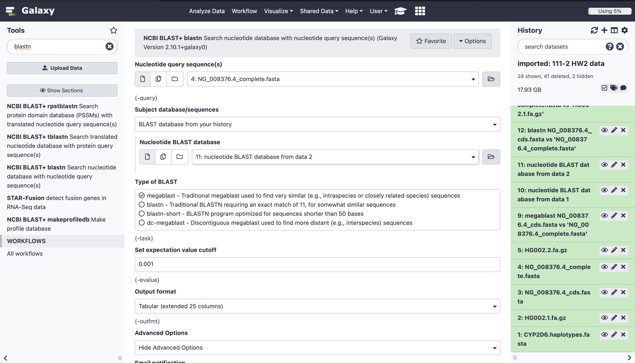

blastn example
Change different output format for different usage

Slide 9
BLAST Details
Why use makeblastdb when blastn can select fasta files as a database?
We may use same database for several times, we don’t want to waste the resource
What is the meaning of the output format?
There is a table below the blastn page describing the meaning of each column. Think about what you want to find out in the jobs.
Also, it‘s hard to observe the pairwise relationship in the tabular data, check the output format to find out more options.

Slide 10
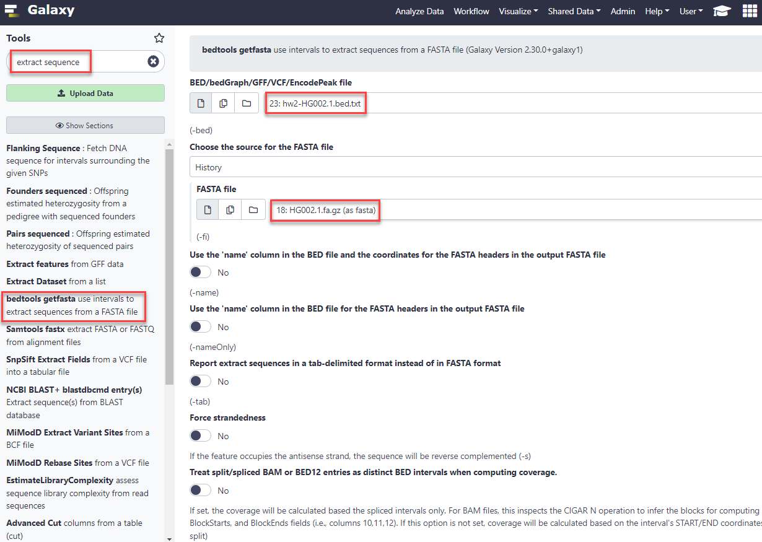
We won't provide this query, you should compose it yourself.

Slide 11
Bed Details
You have to write the query yourself for bedtools.
The format can be found in: https://en.wikipedia.org/wiki/BED_(file_format)
You can find the contig format from the fasta file. (Don’t download it, it’s too big, you can view the first few lines in NTU galaxy)

Slide 12

When scores of the top-k alleles are close to each other
Examine the pair-wise alignment for the mismatches needed for an allele candidate.
For example, CYP2D6*7 contains a variant of “2936A>C”, which is located at the position 7955 of NG_008376.4. In order to claim CYP2D6*7, you will need to observe the corresponding mismatch in the pair-wise alignment of HG002 assembly against NG_008376.4_complete.

