Slide 1
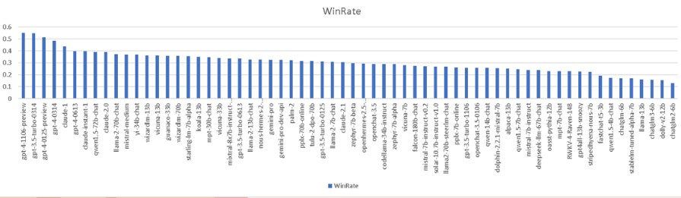


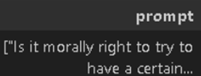


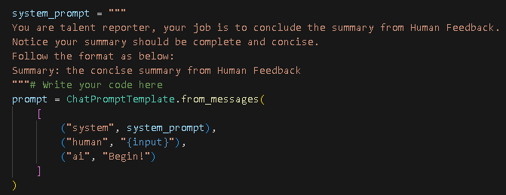
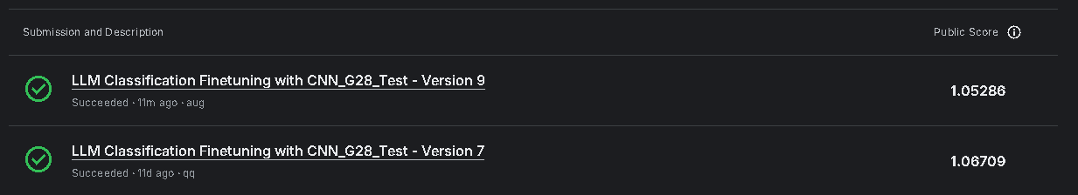

自然語言處理 NLP 2024 Term Project
Task: LLM-Classification-Finetuning Team ID: 28 Team Member: 趙秉祥、林東甫
Abstruct:
This competition challenge aims to predict which responses users will prefer in a head-to-head battle between chatbots powered by large language models (LLMs). A dataset of conversations from the Chatbot Arena was given, where different LLMs generate answers to user prompts. By developing a winning machine learning model, the purpose will be improve how chatbots interact with humans and ensure they better align with human preferences.
This challenge aligns with the concept of "reward models" or "preference models" in reinforcement learning from human feedback (RLHF). Previous research has identified limitations in directly prompting an existing LLM for preference predictions. These limitations often stem from biases such as favoring responses presented first (position bias), being overly verbose (verbosity bias), or exhibiting self-promotion (self-enhancement bias).
Our approaches will focus on data augmentation from the dataset, for quick study the feasibility, we only use llama3.2:1b, a tiny llm model to rewrite the question-answer pair (response_a, response_b). And the backbone model we choose to use simple CNNs model and do some training. The result shows that the data augmentation could achieve better loss function (which is the score for this Kaggle contest) than do nothing. For the computing resource, we only create 1K augmented data pairs. I think the score would be better if more data pairs generated.
Data Source And Metric:
The data introduction for this challenges: (1) total datasets: 57477 question-answer pairs; (2) LLM A wins: 20064 ; LLM B wins: 19652 ; LLMs tie: 17761; (3) Model distributions: gpt4 & gpt3.5 win most battles, for open-source LLM, vicuna 33b, and mixtral 8x7b achieve about 55% gpt4 performance.
For the metric the leaderboard uses is log loss, which could be formula as below:
Methods:
For generating augmentation data, I choose the in-context-learning method to rebuild the response sentences with condense words and keep the details in the same time, the following is my prompt for llama 3.2:1b. Some of the origin LLM responses deliver long messages to describe their thoughts.
I hope to use this method we could alleviate the sentences length bias.
Results:
Our best result so far is 1.05286, which is similar with the other CNN-based team. And if we use original CNNs method only, the score will be 1.06709. Our achievement is to determine whether the re-generate contents from another LLM could help classification task such this contest performance. It seems actually enhance the data diversity and could let model learn better about human’s preference.
"The question of whether it is morally right to aim for a certain percentage of females in managerial positions is a complex ethical issue that involves considerations of fairness, equality, diversity, and discrimination.\\n\\nHere are some arguments in favor of and against such policies:\\n\\n**Arguments in favor:**\\n\\n1. **Correcting Historical Inequities:** Women have historically been underrepresented in leadership roles due to various cultural, institutional, and social barriers. Aiming for a specific percentage can be seen as a corrective measure to address past and ongoing discrimination.\\n\\n2. **Promoting Diversity:** Diverse leadership teams can enhance decision-making and represent a broader range of perspectives. This can lead to better outcomes for organizations and society as a whole.\\n\\n3. **Equality of Opportunity:** Setting targets for female representation in management can help ensure that women have equal opportunities to advance in their careers.\\n\\n4. **Role Modeling:** Increased visibility of female leaders can inspire and encourage other women and girls to pursue leadership roles.\\n\\n**Arguments against:**\\n\\n1. **Reverse Discrimination:** Setting a quota for female representation might lead to the perception or reality of reverse discrimination, where men might be overlooked for positions despite being qualified, simply to meet the gender target.\\n\\n2. **Meritocracy Concerns:** Critics argue that employment and promotion should be based solely on merit and qualifications, not gender. They fear that quotas could compromise the quality of leadership if less qualified individuals are promoted to meet gender targets.\\n\\n3. **Tokenism:** There is a risk that women appointed to meet quotas might be seen as \\"tokens,\\" undermining their legitimacy and potentially leading to resentment among colleagues.\\n\\n4. **Oversimplification of Diversity:** Focusing only on gender might overlook other important aspects of diversity, such as race, ethnicity, socioeconomic background, or sexual orientation.\\n\\nUltimately, the morality of aiming for a certain percentage of females in managerial positions depends on one\'s ethical framework and the context in which such policies are implemented. Proponents of gender diversity targets often argue that these measures are necessary as a transitional mechanism to create a level playing field, while opponents may argue for a \\"color-blind\\" or \\"gender-blind\\" approach to hiring and promotions.\\n\\nOrganizations and societies must carefully consider the implications of these strategies and strive to implement policies that promote fairness and equality while minimizing negative consequences. It is also important to address the root causes of gender inequality, such as unconscious bias, work-life balance challenges, and lack of supportive policies, to create an environment where everyone has the opportunity to succeed based on their capabilities and contributions.","Ah, the age-old culinary conundrum that has divided nations and dinner tables: does pineapple belong on a pizza? The tropical twist of pineapple on pizza, known as Hawaiian pizza, is a hotly debated topic where taste buds battle and pizza purists protest.\\n\\nLet\'s slice into the debate with a zest of fun:\\n\\n**Team Pineapple:** \\"Absolutely, yes! Pineapple on pizza is like a beach party in your mouth. The sweet juiciness of pineapple chunks frolicking with savory ham or bacon creates a flavor wave that surfs across the cheesy ocean of deliciousness. It\'s the Mardi Gras of pizzas, where sweet meets savory in a jubilant jamboree!\\"\\n\\n**Team No-Pineapple:** \\"No way, not in a million pizzas! Pineapple is a fruit that should be sunbathing on a tropical fruit platter, not freeloading on a sacred slice of pizza. The thought of warm, melty cheese conspiring with pineapple\'s sugary mischief is enough to make Italian ancestors turn in their tomato patches. Keep the pineapple in the fruit salad where it belongs!\\"\\n\\nAt the end of the day, whether pineapple belongs on pizza is a matter of personal taste. Some say it\'s a match made in heaven, others say it\'s a culinary crime. But let\'s face it, in the world of pizza toppings, where you can find everything from anchovies to zucchini, there\'s room for a little pineapple pizzazz. So, if your taste buds crave that sweet and tangy twist, go ahead and let your pineapple flag fly atop that glorious cheese-covered dough. Bon app\\u00e9tit, or as they say in pineapple paradise, \\"Aloha-ppetite!\\" \\ud83c\\udf4d\\ud83c\\udf55"
'The question of whether it is morally right to aim for a certain percentage of females in managerial positions involves complex considerations of fairness, equality, diversity, and discrimination. While some argue that this approach can correct historical inequities and promote diversity, others fear potential negative consequences such as reverse discrimination, tokenism, and oversimplification of diversity.', 'The debate over whether pineapple belongs on a pizza is ongoing, with some passionately advocating for its inclusion and others fiercely opposing it, citing personal taste preferences.'

