Slide 1
Урок 0: Предварительный

Slide 2
Concurrency Models
Pessimistic concurrency:
  Data integrity maintained using locks
  Only one user can access a data item at once
  Writers block readers and other writers; readers block writers
Optimistic concurrency:
  Data is checked for changes before update
  Minimal locking
Notes:
Students may find it helpful to work through a simple example of a concurrent update; perhaps a bank account balance.
10987C
5: SQL Server Concurrency

Slide 3
Concurrency Problems
Dirty read
  Uncommitted data is included in results
Lost update
  Two concurrent updates; the first update is lost
Non-repeatable read
  Data changes between two identical SELECT statements within a transaction
Phantom read
  Data is read, then deleted before reading completes
Double read
  Data in a range is read twice because the range key value changes
Notes:
Make sure students understand all the types. They might have difficulty understanding or differentiating between lost updates, double reads, and repeatable reads.
Be clear that these issues do not always occur; they can be controlled with concurrency settings.
10987C
5: SQL Server Concurrency

Slide 4
Transaction Isolation Levels
Pessimistic isolation levels:
  READ UNCOMMITTED
  READ COMMITTED
    READ_COMMMITTED_SNAPSHOT OFF
  REPEATABLE READ
  SERIALIZABLE
Optimistic (row versioning) isolation levels:
  READ COMMITTED
    READ_COMMMITTED_SNAPSHOT ON
  SNAPSHOT
Notes:
Students might be aware of all the concurrency models. Use this slide as a recap. If required, spend time on SNAPSHOT vs READ_COMMITTED_SNAPSHOT ON and highlight the differences.
This topic mentions locks of various kinds. Locks are discussed in more detail in the next lesson.
Note the difference in default READ_COMMITTED_SNAPSHOT settings between SQL Server installations and Azure SQL Database.
10987C
5: SQL Server Concurrency

Slide 5
Working with Row Versioning Isolation Levels
Row versioning benefits:
Fewer locks
Less blocking
Row versioning issues:
Versioning is expensive and adds load to tempdb
Applications need to handle update conflicts
Other considerations:
Lock hints still apply
Writers still block writers
Setting READ_COMMITTED_SNAPSHOT ON requires a single active connection
Notes:
Locks, blocking, and deadlocks will be covered in the next lesson.
10987C
5: SQL Server Concurrency

Slide 6
Transactions
A logical unit of work, made up of one or more Transact-SQL statements
  Atomicity
  Consistency
  Isolation
  Durability
Transaction management modes:
  Auto-commit
  Explicit transactions
  Implicit transactions
  Batch-scoped transactions
Notes:
10987C
5: SQL Server Concurrency

Slide 7
Working with Transactions
Naming Transactions:
  Label only; no effect on code
Nesting Transactions:
  Only the state of the outer transaction has any effect
  @@TRANCOUNT track transaction nesting
Terminating Transactions:
  Resource error
  SET XACT_ABORT
  Connection closure
Transaction Best Practices:
  Keep transactions as short as possible
Notes:
10987C
5: SQL Server Concurrency

Slide 8
Locking Architecture
Locking architecture is designed as a balance between consistency and concurrency:
  Locks—logical level
  Latches—physical level
Lock manager manages locks:
  Each lock has a lock block
  Each lock block has one or more lock owner blocks
  Lock hash table maintained for better performance
Notes:
10987C
5: SQL Server Concurrency

Slide 9
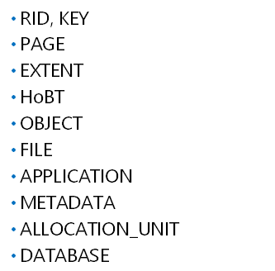
Lock Granularity and Hierarchy
Notes:
10987C
5: SQL Server Concurrency

Slide 10
Lock Escalation
Reduces lock manager memory overhead by converting many fine-grained locks to a single coarser-grained lock
  Row and page locks escalate to table locks
Control at table level with ALTER TABLE SET LOCK_ESCALATION
Control at session or instance level with trace flags 1224 and 1211
Notes:
Students could find many Internet sources stating that lock escalation occurs when 5,000 row or page locks are acquired. Microsoft documentation states that the most recent version of SQL Server this hard-coded limit applies to is SQL Server 2008 R2; there is no mention of a hard-coded limit in later versions.
10987C
5: SQL Server Concurrency

Slide 11
Lock Modes
Data Lock Modes:
  Shared
  Exclusive
  Update
  Intent
  Key-range
Special Lock Modes:
  Schema
  Conversion
  Bulk update
Lock mode names are abbreviated in DMVs
Notes:
10987C
5: SQL Server Concurrency

Slide 12
Lock Mode Compatibility
Compatibility between common lock modes
 | Existing granted mode
Requested mode | IS | S | U | IX | SIX | X
Intent shared (IS) | Yes | Yes | Yes | Yes | Yes | No
Shared (S) | Yes | Yes | Yes | No | No | No
Update (U) | Yes | Yes | No | No | No | No
Intent exclusive (IX) | Yes | No | No | Yes | No | No
Shared with intent exclusive (SIX) | Yes | No | No | No | No | No
Exclusive (X) | No | No | No | No | No | No
Notes:
The lock compatibility matrix on the slide includes common lock modes that students are likely to encounter; several rarer lock modes are not included.
10987C
5: SQL Server Concurrency

Slide 13
The Data Modification Process
Relevant data pages located in the Buffer Pool
Locks before data modification:
  Update lock on affected rows
  Intent exclusive lock on pages table
  Intent exclusive lock on table
  Shared lock on database
Data modification locks:
  Update lock converted to an exclusive lock on affected rows
  Intent exclusive lock on pages table
  Intent exclusive lock on table
  Shared lock on database
Notes:
10987C
5: SQL Server Concurrency

Slide 14
Locking Hints
Hints Affecting Lock Mode:
  ROWLOCK
  PAGLOCK
  TABLOCK
  TABLOCKX
  UPDLOCK
  XLOCK
Hints Affecting Table Isolation Level:
  READCOMMITTED
  READCOMMITTEDLOCK
  READUNCOMMITTED or NOLOCK
  REPEATABLEREAD
  SERIALIZABLE or HOLDLOCK
  READPAST
Notes:
Emphasize:
Locking hints should only be used as a last resort.
NOLOCK/READUNCOMMITTED hints allow all the side effects of the READ UNCOMMITTED isolation level (dirty reads, phantom reads, non-repeatable reads, and so on).
10987C
5: SQL Server Concurrency

Slide 15
Deadlock Internals
Deadlocks are resolved by the Lock Manager:
  Runs every five seconds by default; frequency increases as deadlocks are detected
  Deadlock victim is selected and terminated
Deadlock priority can be used to influence the likelihood that a transaction will be selected as the deadlock victim
Notes:
10987C
5: SQL Server Concurrency

Slide 16
Latches and Spinlocks
Latches:
  Protect pages in memory
  I/O latches. PAGEIOLATCH_ waits
  Buffer latches. PAGELATCH_ waits
  Non-buffer latches. LATCH_ waits
Spinlocks:
  Very lightweight locks
  Rarely cause performance problems
Notes:
10987C
5: SQL Server Concurrency

Slide 17
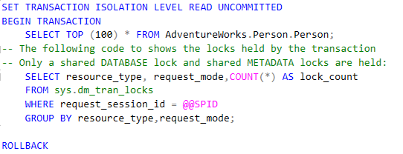

Блокировки на уровне изоляции READ UNCOMMITED
1

Slide 18
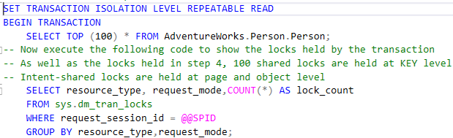
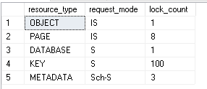
Блокировки на уровне изоляции REPEATABLE READ
2

Slide 19
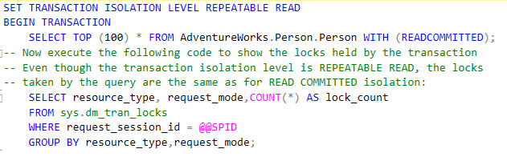
REPEATABLE READ + опция READCOMMITED
3

Slide 20
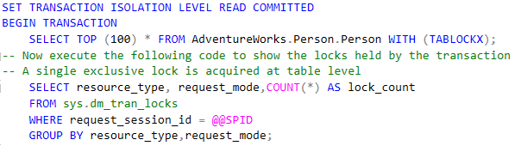

READ COMMITED + опция TABLOCKX
4

Slide 21
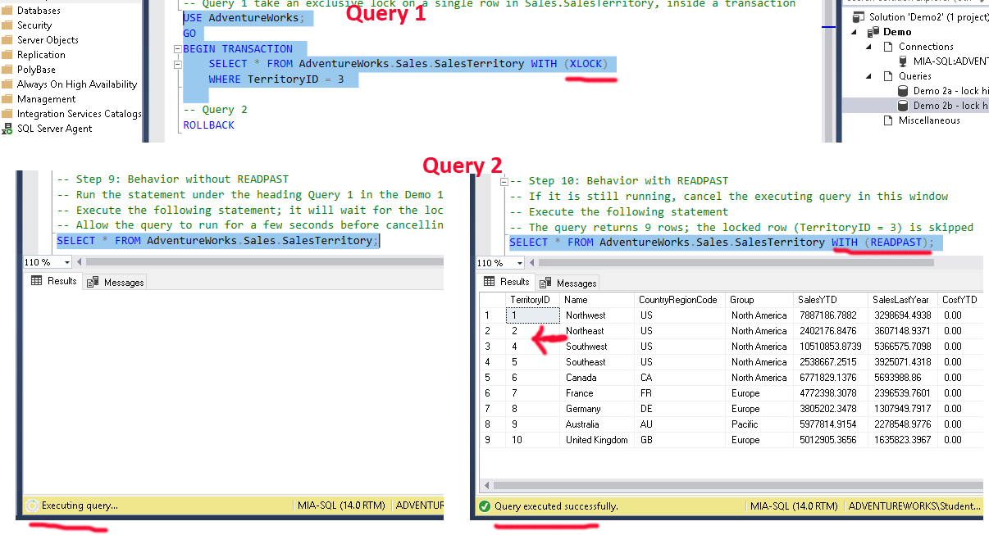
Опция READPAST
5

