Slide 1
Homework 1
Statistical Machine Learning II

Slide 2
Introduction
Goal – Determine what factors determine drug use in youth
Data – Survey From National Survey on Drug Use and Health
Features – Demographic, Family, School, Behavioral
Models & Methods – Decision Trees, Random Forest, Boosting

Slide 3
Introduction
Has the person ever used alcohol?
What is the frequency of their alcohol use? (None, Light, Moderate, Heavy)
How often specifically do they use alcohol?

Slide 4
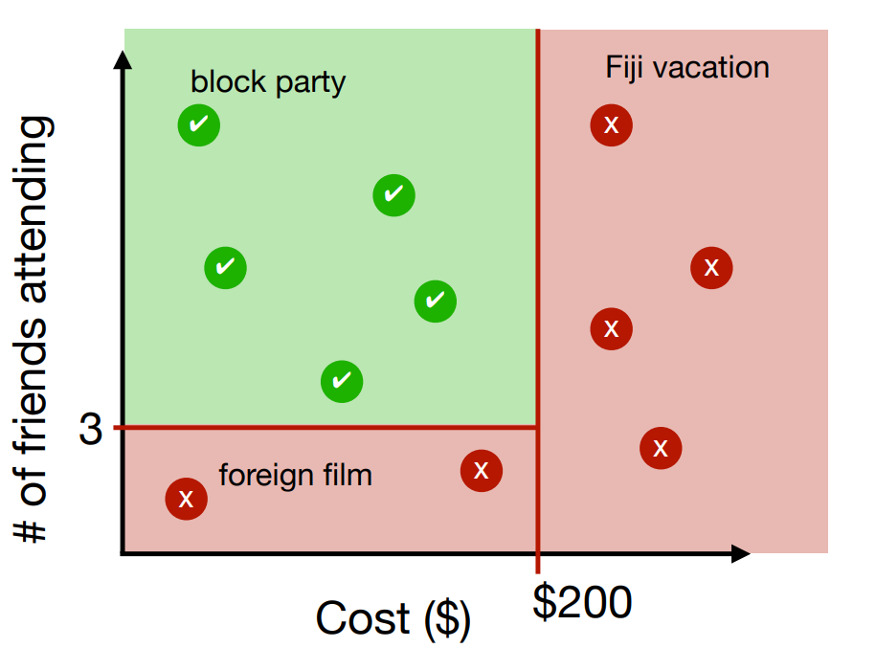
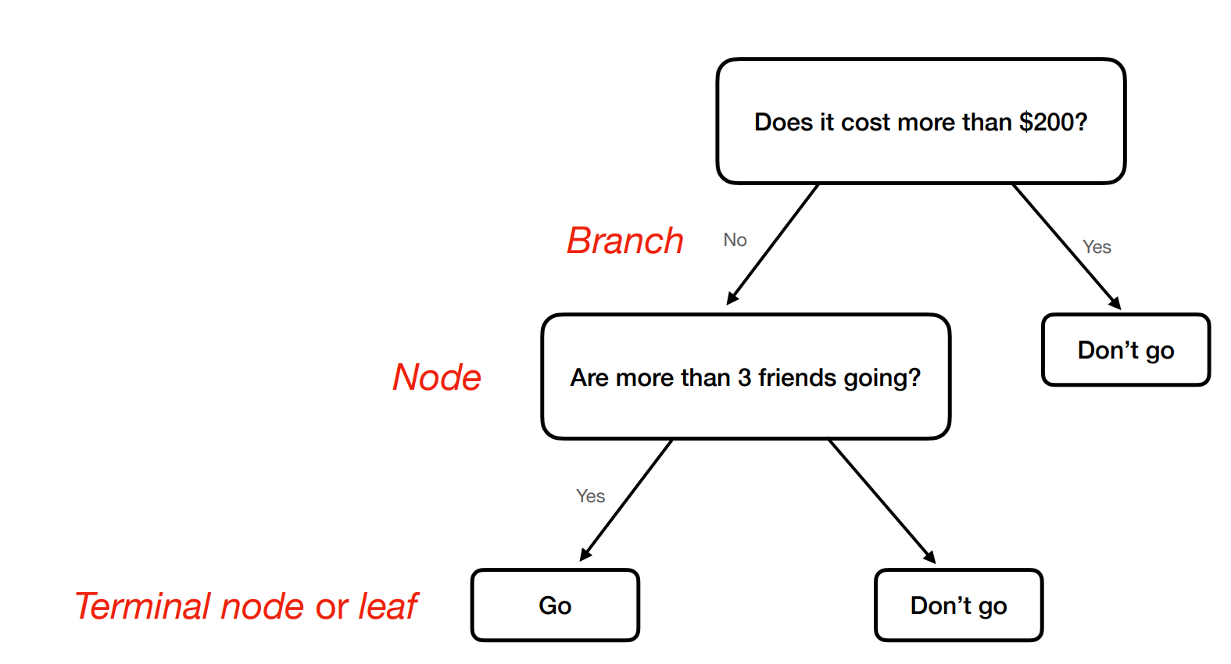
Tree Based Methods
Decision Trees: Split the data on each branch to categorize data. The model is then used to predict which terminal node future data points will land on.
Use Cases:
You want a simple, interpretable model
The data has nonlinear patterns or interactions
You're dealing with both classification or regression tasks
Advantages
Simple & Interpretable
Can use Categorical and Continuous Variables
Analyzes both linear & Non-linear relationships
Disadvantages
High Variance
Prune to Overfitting
Approach – Recursive Binary Splitting
1. For each predictor variable, find the optimal split threshold
2. Compute a measure of “goodness” of each split
3. Choose one split, label regions
4. Continue splitting within all regions

Slide 5
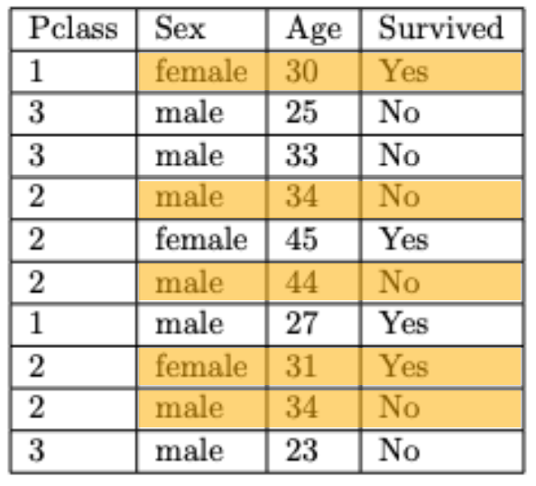
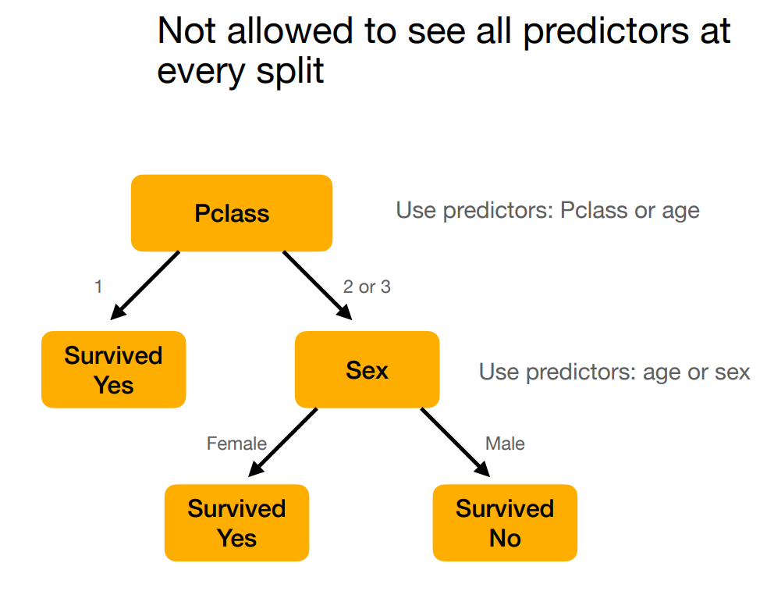
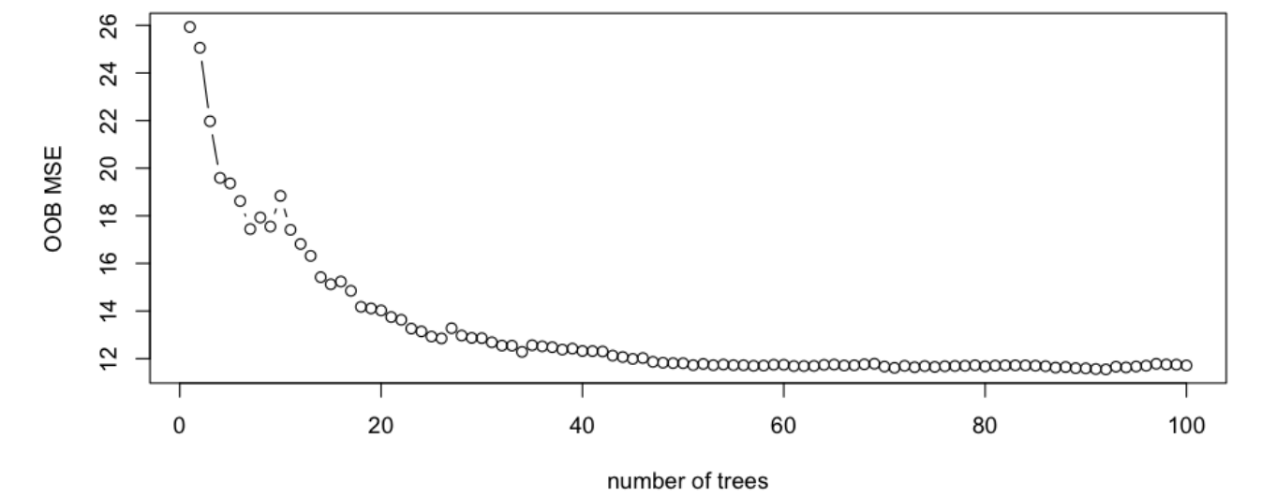
Random Forests
Random Forests: Build many deep decision trees on bootstrapped datasets and average their predictions, reducing variance and overfitting. They also provide useful feature importance scores by randomly selecting features at each split.
Use Cases:
Data has many correlated features
Need feature importance metrics
Need a very powerful ensemble model
Advantages
Reduce Variance
Handling missing data
Handles large data
Disadvantages
Slow
Hard to interpret
Parameters:
P = n.o. predictors determined by data
M = n.o. predictors considered at each split

Slide 6
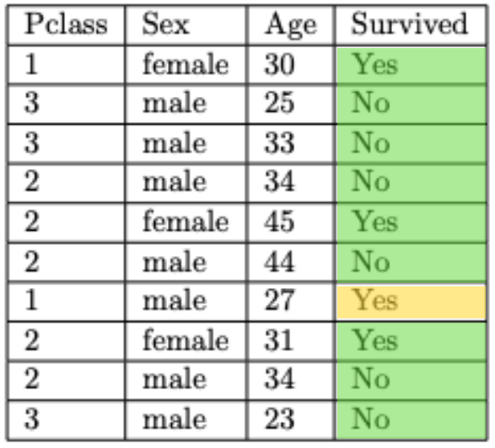
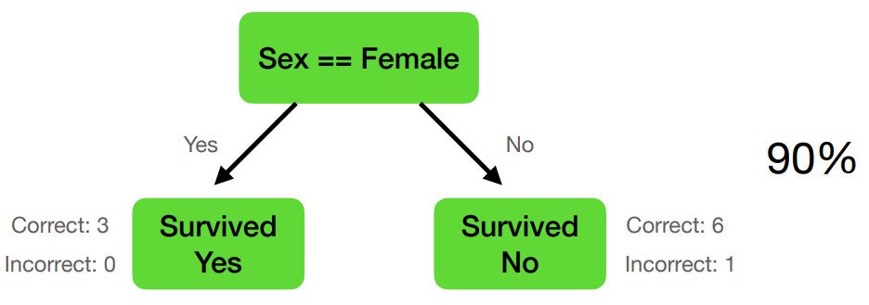
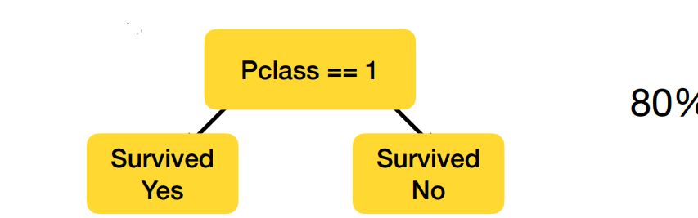
Boosting
Boosting: Build a small tree, compute residuals (errors) and scale the tree based on its performance, build a new tree to estimate the residuals.
Use Cases:
Need high prediction accuracy
Advantages
Reduce Variance
Very high performance
Focused Learning
Disadvantages
Slow
Sensitive to tuning
Possible overfitting
Parameters
B = n.o. models
Lambda = shrinkage
D = interaction depth

Slide 7

Methodology
Data Loading ~10500 rows x 79 columns
NaN Values – 91,93, 97, 98, 99 replaced with NaN
Missing Values – Dropped except IRALCFM
Feature Selection
Demographic - NEWRACE2, INCOME, HEALTH2, IRSEX
Family - PARHLPHW, PRLMTTV2, PARCHKHW, PRCHORE2
School - AVGGRADE, SCHFELT, TCHGJOB
Behavioral - YOFIGHT2, YOGRPFT2, YOSTOLE2, YOATTAK2
Peer - FRDMEVR2, FRDMJMON, FRDADLY2, FRDPCIG2
Risk Perception - STNDALC, STNDSMJ, STNDSCIG, STNDDNK

Slide 8
Methodology – Cont.
Data Preparation
Split 80% - 20% Training & Test
IRALCFM categorized as binary
SimpleImputer for Missing Values
StandardScalar for numerical features
OneHotEncoder for categorical features
Hyperparameter Tuning
GridSearchCV with 5-fold cross validation
Evaluation Metrics
Accuracy
Balanced Accuracy
Feature Importance
Confusion Matrix
Precision, Recall, F1
R^2
Model Parameters
Decision Tree
max_depth: [3, 5, 7]
Min_samples_split [2, 5]
Min_samples_leaf [1, 2]
Random Forest
N_estimators [100, 200]
Max_depth [3, 5, 7]
Min_samples_split [2, 5]
Min_samples_leaf [1, 2]
Boosting
N_estimators [100, 200]
Max_depth [3, 5]
Learning_rate [0.01, 0.1]
Min_samples_leaf [1, 2]
Min_samples_split [2, 5]

Slide 9
Methodology cont.
Binary Classification
All three models used
Multi-Class Classification
Random Forest & Decision Tree
Regression
Boosting
Decision Tree

Slide 10
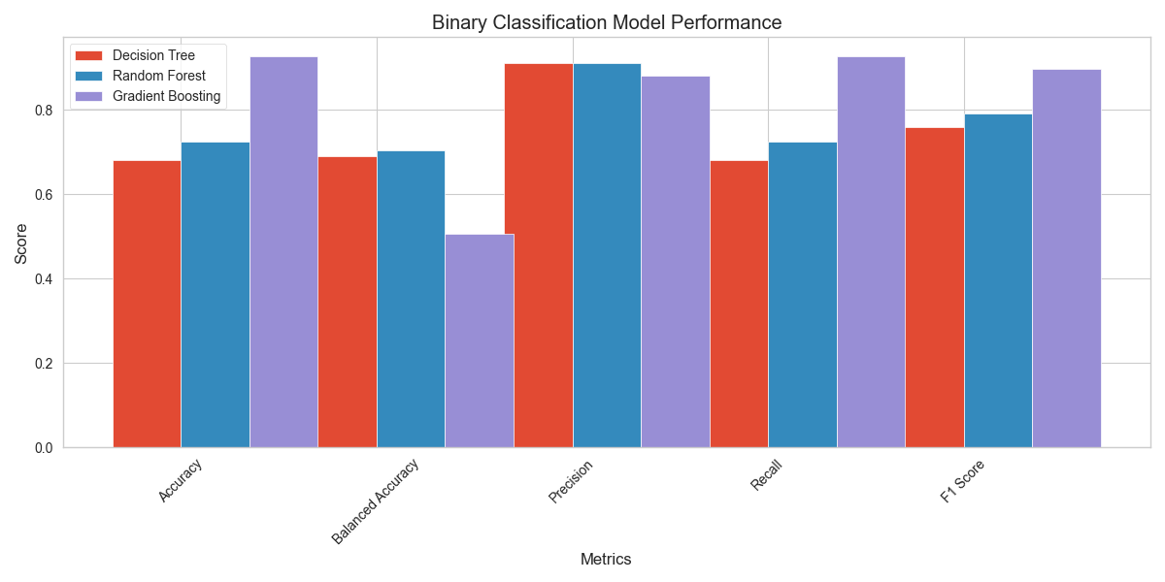
Results Binary Classification
Random Forest: 70.4% balanced accuracy, most reliable overall
Decision Tree: 69.0% balanced accuracy, consistent performance
Gradient Boosting: 50.7% balanced accuracy, misleading high accuracy (92.6%)
Model | Accuracy | Balanced Accuracy | Precision | Recall | F1 Score
Decision Tree | 0.681 | 0.69 | 0.911 | 0.681 | 0.759
Random Forest | 0.725 | 0.704 | 0.912 | 0.725 | 0.791
Gradient Boosting | 0.926 | 0.507 | 0.88 | 0.926 | 0.897

Slide 11
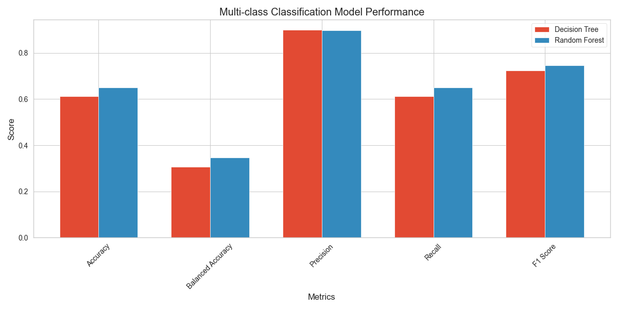
Results Multi Classification
Model | max_depth | n_estimators | min_samples_split | min_samples_leaf
Decision Tree | 3 | N/A | 2 | 1
Random Forest | 5 | 200 | 5 | 1
Random Forest: 34.6% balanced accuracy, struggles with minority classes
Decision Tree: 30.6% balanced accuracy, similar limitations
Both models show bias toward majority class (no use)

Slide 12
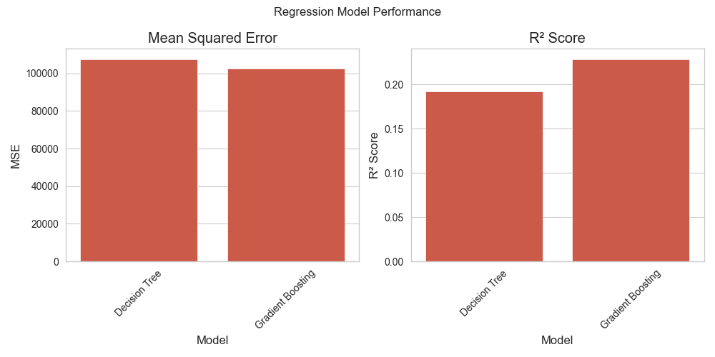
Results Regression
Gradient Boosting: R² = 0.229, marginally better
Decision Tree: R² = 0.192, similar performance
Neither model predicts usage levels well
Model | max_depth | n_estimators | min_samples_split | min_samples_leaf | learning_rate
Decision Tree | 5 | N/A | 5 | 2 | N/A
Gradient Boosting | 3 | 100 | 2 | 1 | 0.1

Slide 13
Discussion
Models show varying performance across different tasks, with binary classification performing best.
The high balanced accuracy of Random Forest (70.4%) in binary classification suggests it's the most reliable model for predicting alcohol use.
The poor performance in multi-class classification (34.6% balanced accuracy) shows difficulty in distinguishing between different levels.
Regression models show limited predictive power (R² < 0.23), suggesting that predicting exact usage frequency is challenging
Variable Types Impact
Binary: Best performance, loses detail
Ordinal: Struggles with uneven classes
Numerical: Most detailed but hardest to predict
Key Variables & Ethics
Family and peer factors most significant
School factors moderately important
Must avoid deterministic predictions
Focus on correlations, not causation

Slide 14
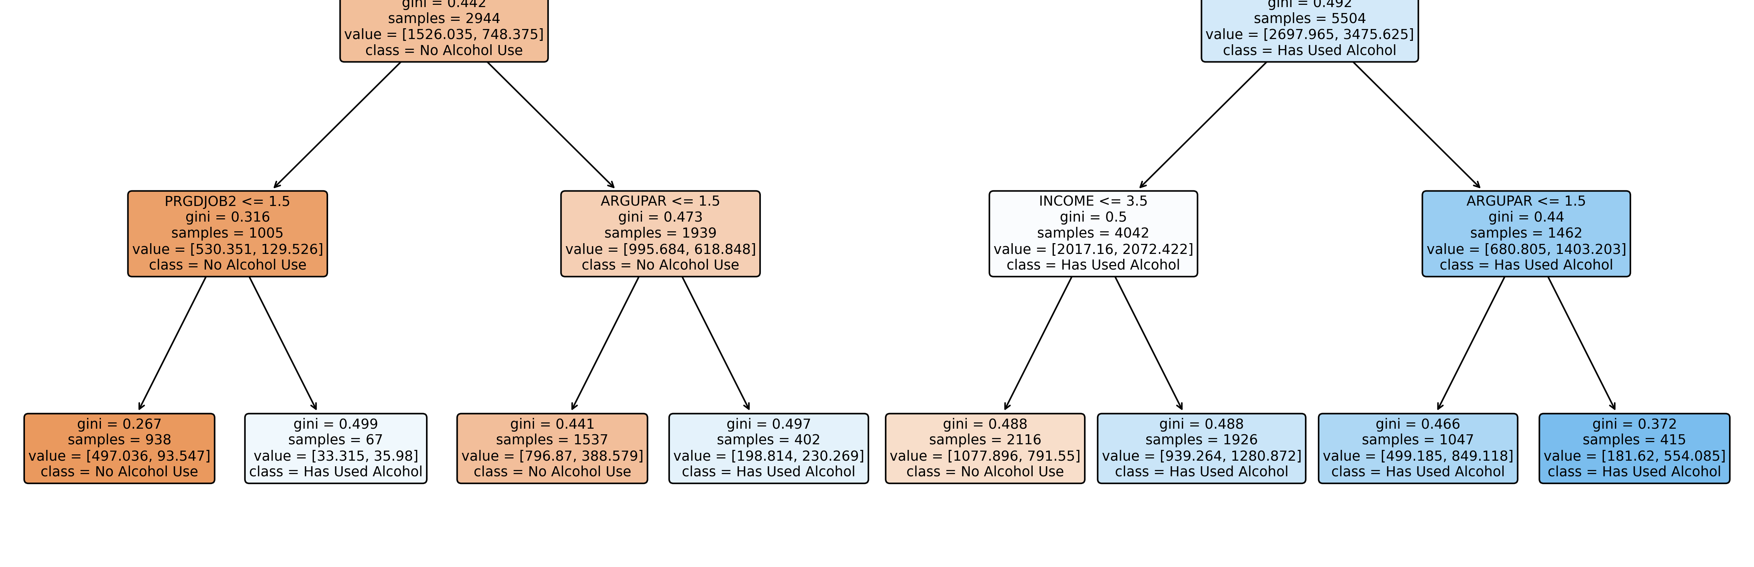
Tree Diagram
Path Analysis (Root to rightmost leaf):
Parental monitoring is primary predictor
Higher parent involvement doesn't guarantee prevention
Parent-child conflict increases risk despite supervision
Family dynamics are strongest
PRLMTTV2 > 1.5 (Higher TV monitoring)
PARHLPHW > 1.5 (More homework help)
ARGUPAR > 1.5 (More parent arguments)
Result: "Has Used Alcohol" (415 samples, gini = 0.372)
Key Variables & Ethics
Family and peer factors most significant
School factors moderately important
Must avoid deterministic predictions
Focus on correlations, not causation

Slide 15

Conclusion
Key Findings
Family dynamics strongest predictor of youth alcohol use
Simple binary prediction more reliable than detailed usage levels
Balanced accuracy reveals limitations in minority class prediction
Practical Applications
School counselors can identify risk factors
Prevention programs should focus on family communication
Resource allocation for targeted intervention programs
Limitations & Ethics
Models predict risk, not certainty
Should not be used for individual profiling
Cultural and socioeconomic factors need consideration
Privacy concerns in data collection and use

Slide 16

Conclusion
Future Directions
Include more diverse demographic data
Develop time-based prediction models
Focus on protective factors, not just risks
Incorporate qualitative family dynamics data
Recommendations
Strengthen family-based prevention programs
Enhance parent-child communication support
Create balanced intervention strategies
Regular model updates with new data

Slide 17
Biblliography
SAMHSA. (2020). National Survey on Drug Use and Health (NSDUH). Substance Abuse and Mental Health Services Administration. Retrieved from https://www.samhsa.gov/data/data-we-collect/nsduh-national-survey-drug-use-and-health/datafiles/2020

