Slide 1



AI's Growing Economic Footprint in Denver
Denver's AI Economy
Denver is positioned to become a major hub for AI innovation and economic growth. The projected increase in AI's contribution to the metro economy signifies a transformative period, attracting talent and investment.
Economic Contribution
Investment Growth
Tech Expansion
AI projected to contribute $15 billion to Denver's economy by 2030, up from $5 billion currently.
Increased investment in AI startups is a key driver of this economic expansion.
Existing tech companies are expanding their operations by integrating advanced AI technologies.
denverai.com
Notes:
This slide highlights the significant economic impact of Artificial Intelligence on Denver. By 2030, AI is expected to contribute $15 billion to the local economy, a threefold increase from its current $5 billion contribution. This substantial growth is attributed to burgeoning investment in AI startups and the strategic expansion of established tech firms leveraging AI capabilities. Denver is solidifying its position as a burgeoning center for AI innovation and development.

Slide 2



Denver's Evolving Job Market
AI's Economic Impact
Artificial Intelligence is reshaping Denver's employment landscape, driving demand for new specialized roles and requiring a significant portion of the current workforce to adapt their skills. This transformation presents both challenges and opportunities for career growth and economic development in the region.
New Job Creation
Upskilling Imperative
Emerging Skill Demands
Anticipate 20K new AI-centric roles by 2028, including AI researchers, data scientists, and AI ethics officers.
Approximately 40% of existing jobs will need to evolve to incorporate AI-driven workflows.
Demand is rising for specialized skills in machine learning, natural language processing, and AI ethics.
denverai-economy.com
Notes:
This slide highlights the significant impact of AI on Denver's job market. We are projecting the creation of 20,000 new AI-related positions by 2028, encompassing diverse roles from technical specialists like AI researchers and data scientists to crucial positions like AI ethics officers and prompt engineers. Furthermore, a substantial 40% of current jobs will require adaptation to integrate AI-driven processes. This underscores the critical need for upskilling and reskilling initiatives to prepare the workforce for these changes and ensure continued economic growth.

Slide 3


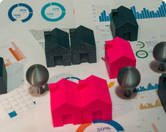
Sectoral Impact of AIAcross Denver Industries
Healthcare
Finance
Real Estate
AI enhances diagnostics and personalized medicine, expecting a 25% efficiency boost by 2027.
AI-powered fraud detection and algorithmic trading are standard, improving security and speed by an estimated 15%.
AI revolutionizes property management and market analysis for more accurate valuations and smoother transactions.
Artificial intelligence is reshaping various sectors in Denver, moving beyond just technology. Explore its influence on key local industries.
www.denveraiimpact.com
Notes:
This slide highlights the broad impact of AI across Denver's primary industries. We see significant advancements in healthcare, with AI expected to improve efficiency by 25% by 2027 through enhanced diagnostics and personalized medicine. In finance, AI is crucial for fraud detection and trading, offering an estimated 15% improvement in security and speed. The real estate sector is also benefiting, as AI transforms property management and market analysis, leading to more precise valuations and streamlined transactions. These examples demonstrate AI's integral role in Denver's economic diversification and future growth.

Slide 4
Denver: A Thriving AI Innovation Hub
3
Major Research
Institutions
Leading institutions driving AI advancements and research.
150+
AI Startups
AI Ecosystem Growth
A growing number of startups innovating in the AI space.
Denver is emerging as a key center for AI innovation. The city supports a dynamic environment with 3 major AI research institutions and over 150 AI startups. This growth is fueled by substantial investment, attracting venture capital to foster AI development and talent.
$500M
Venture Capital
Invested
Significant capital inflow supporting AI companies in the last year.
www.denverai.com
Notes:
Denver is rapidly becoming a significant hub for artificial intelligence innovation. The city benefits from the presence of three major AI research institutions and hosts over 150 AI startups. This vibrant ecosystem has attracted substantial venture capital, with $500 million invested in local AI companies over the past year. This investment underscores Denver's potential and commitment to fostering AI development and attracting top talent in the field.

Slide 5
AI Challenges & Ethics
Job Displacement
Automation driven by AI could affect approximately 10-15% of jobs, particularly those involving repetitive tasks, necessitating proactive workforce adaptation strategies.
While AI offers immense potential, its integration introduces significant challenges and ethical considerations that require careful navigation.
Data Privacy Concerns
The escalating use of AI intensifies concerns surrounding the security of sensitive data and the safeguarding of individuals' personal information.
Algorithmic Bias
Ensuring AI systems operate with fairness and equity is a complex, continuous challenge, demanding rigorous development and oversight.
ai-ethics-initiatives.org
Notes:
As we embrace AI, we must acknowledge the hurdles ahead. Automation poses a risk to 10-15% of jobs, especially those that are routine. Data privacy is paramount as AI systems handle vast amounts of personal information. Critically, we must address algorithmic bias to ensure AI promotes fairness and equity, not discrimination. These ethical considerations are vital for responsible AI deployment.

Slide 6
Infrastructure and Connectivity
Expanding Broadband Coverage
Denver aims for 95% broadband coverage by 2026, ensuring widespread access to the internet. This expansion is key to supporting the growing computational demands of AI technologies.
Robust digital infrastructure is crucial for AI advancement. Denver is investing in expanding its high-speed internet access to support AI.
Facilitating AI Adoption
Enhanced connectivity will enable broader adoption of AI across businesses and residences. It provides the necessary foundation for AI-powered services and innovations to flourish.
www.denverai.gov/infrastructure
Notes:
This slide highlights Denver's commitment to building the digital infrastructure necessary for the AI revolution. A key initiative is expanding high-speed internet access, with a target of 95% broadband coverage by 2026. This investment is vital for meeting the computational demands of AI and enabling its widespread adoption across various sectors in Denver.

Slide 7
Shaping Denver's AI Future
Local government initiatives are driving Denver's AI progress. Policies are being crafted to foster innovation and manage ethical considerations, focusing on AI ethics and workforce reskilling.
AI Ethics Guidelines
Workforce Reskilling Grants
Innovation Hubs
Developing comprehensive ethical frameworks to ensure responsible AI deployment and use within the city.
Supporting the creation of collaborative spaces for AI research, development, and business incubation.
Providing financial support and training programs to help residents adapt to AI-driven economic changes.
denver.gov/ai-initiatives
Notes:
This slide outlines Denver's proactive approach to AI. We are focusing on two critical areas: establishing robust AI ethics guidelines to ensure responsible innovation and implementing reskilling grants to support our workforce through this technological shift. Our goal is to foster an inclusive AI future for all Denver residents.

Slide 8
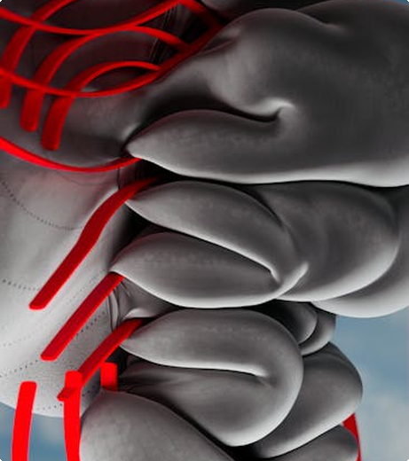
Denver's Future Outlook: A Leading AI City
Denver is strategically positioned to become a premier hub for AI adoption and innovation. Through sustained investment, forward-thinking policies, and a strong emphasis on talent development, the city's AI sector is projected to expand by an impressive 200% in the coming decade. This growth will significantly enhance economic prosperity and accelerate technological progress.
Denver AI Initiative
February 10, 2026
www.denverai.gov
Notes:
This slide outlines Denver's bright future in Artificial Intelligence. We are projecting a 200% growth in the AI sector over the next ten years. This expansion is fueled by strategic investments, supportive policies, and a dedicated focus on developing a skilled AI workforce. This initiative will not only drive technological advancement but also foster significant economic prosperity for the city.

