Slide 1
VerilogTetris
Dogan akad and philip tsang

Slide 2
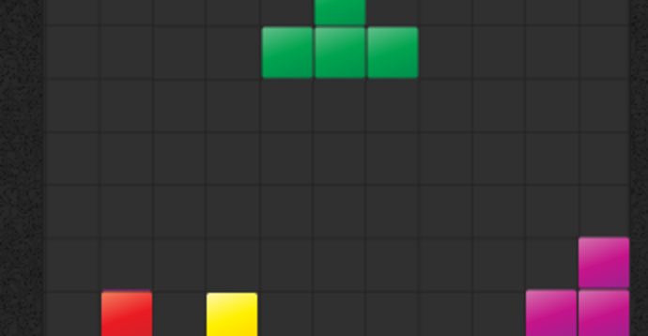
Tetrisian Logic Components
Super Rotation System
Gravitation
World Animations
Logic of Tetris rotation
Game flow logic to place blocks
Winning, row reductions, lost

Slide 3
Schematic
Control acts as user interface input
Datapath is signaled by states computed in Control
VGA receives appropriate signals and creates the game

Slide 4
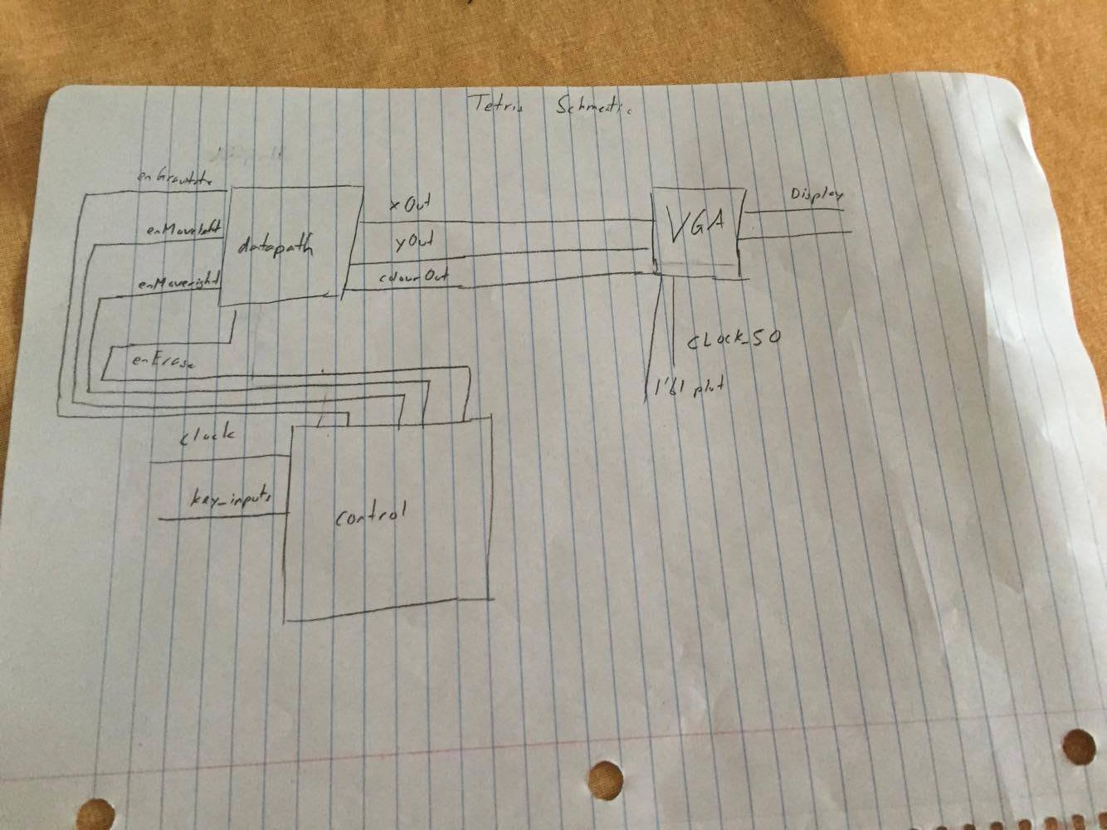
Schematic

Slide 5
VerilogTetris Challenges
Unexpected behavior in latches
Collisions of animations and different states of the game
Logic branches extremely deeply for many different states of the game

Slide 6
Lessons Learned
Need to plan time accordingly to a more difficult project.
Pay attention to the latches created.
Draw the schematic before you code.
Test more often.

