Slide 1
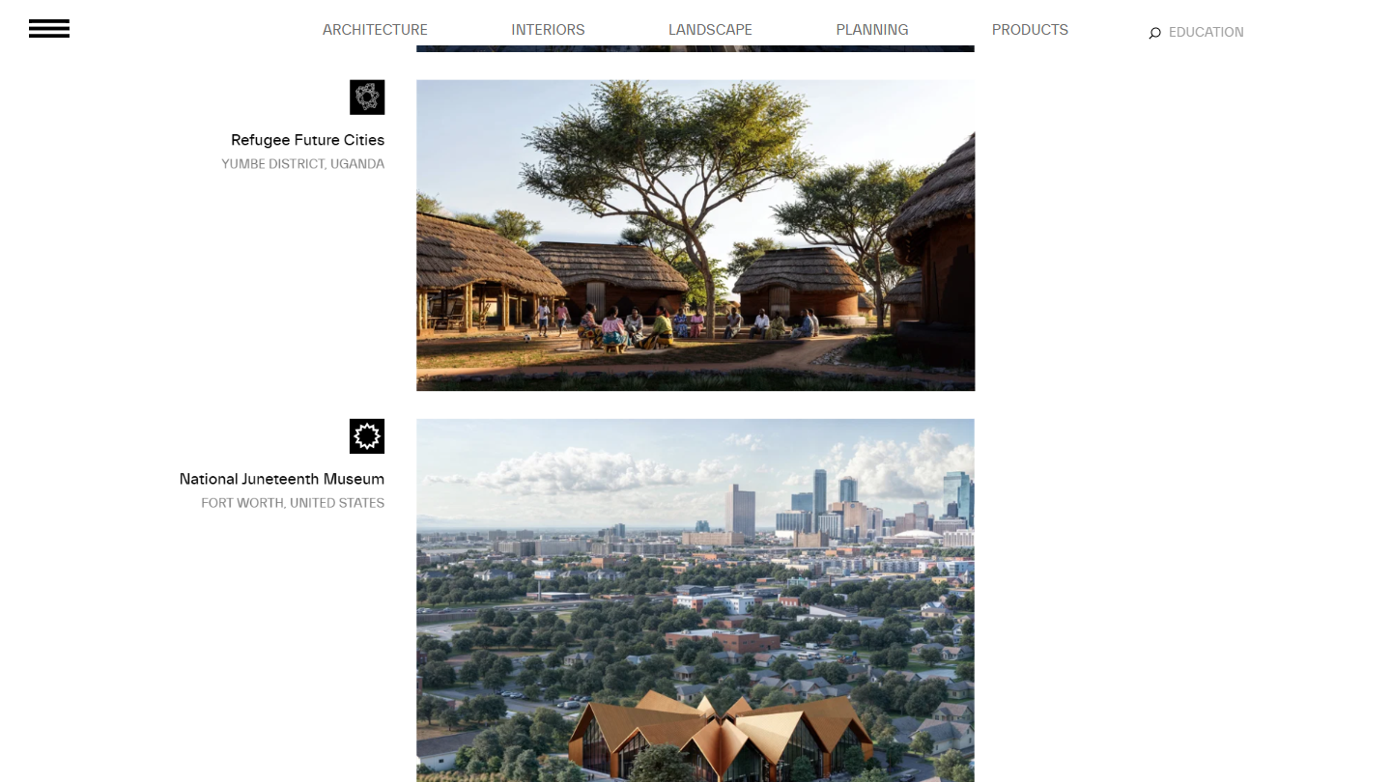
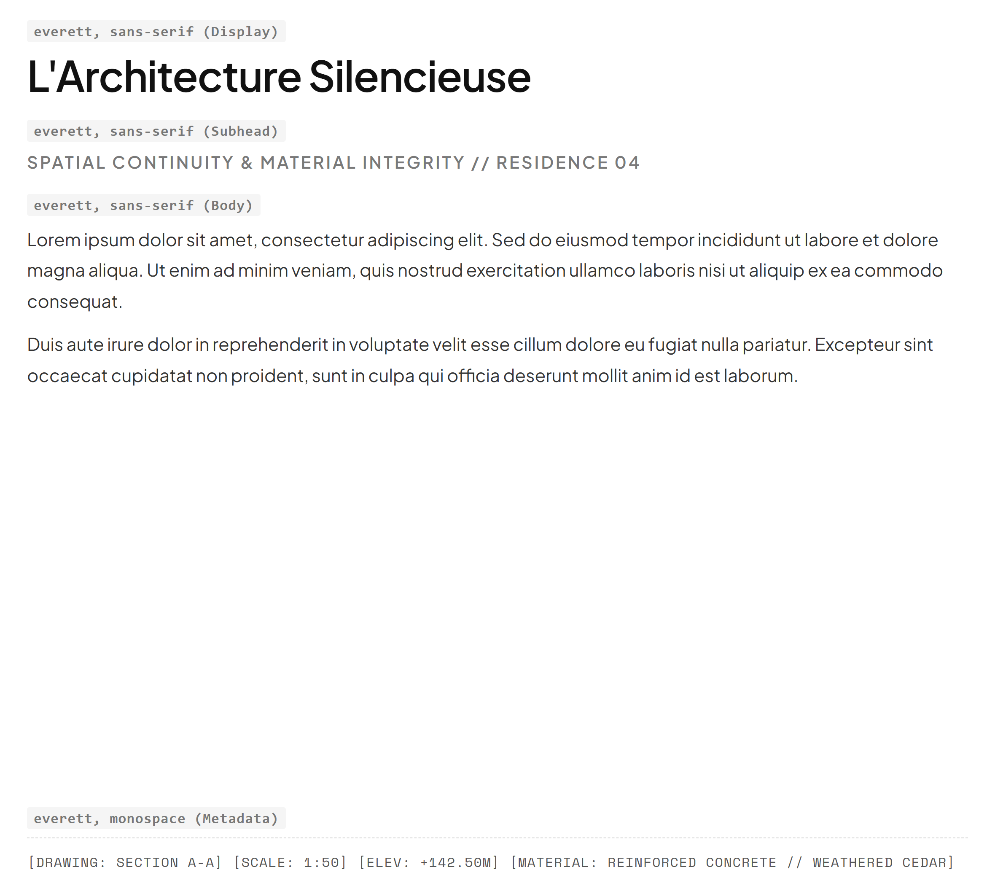
BIG | BJARKE INGELS GROUP
https://big.dk
01 / 10
#FFFFFF
#000000
#797979
#E5E5E5
Canvas / Background
Primary Text Ink
Secondary / Narrative
Border / Structure

Slide 2
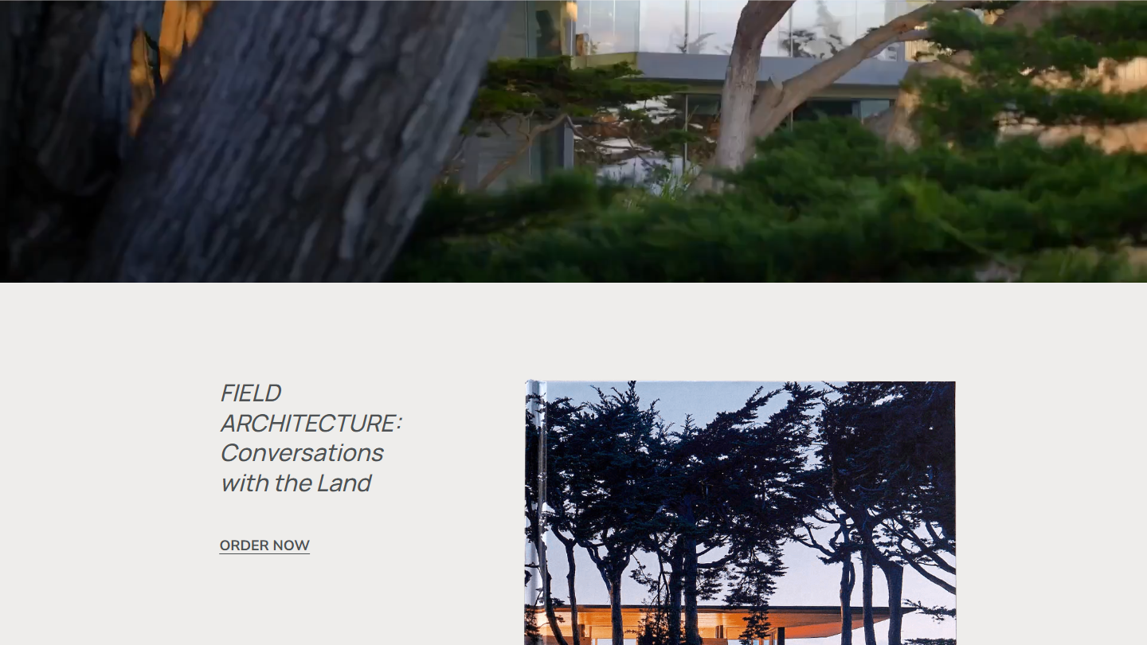
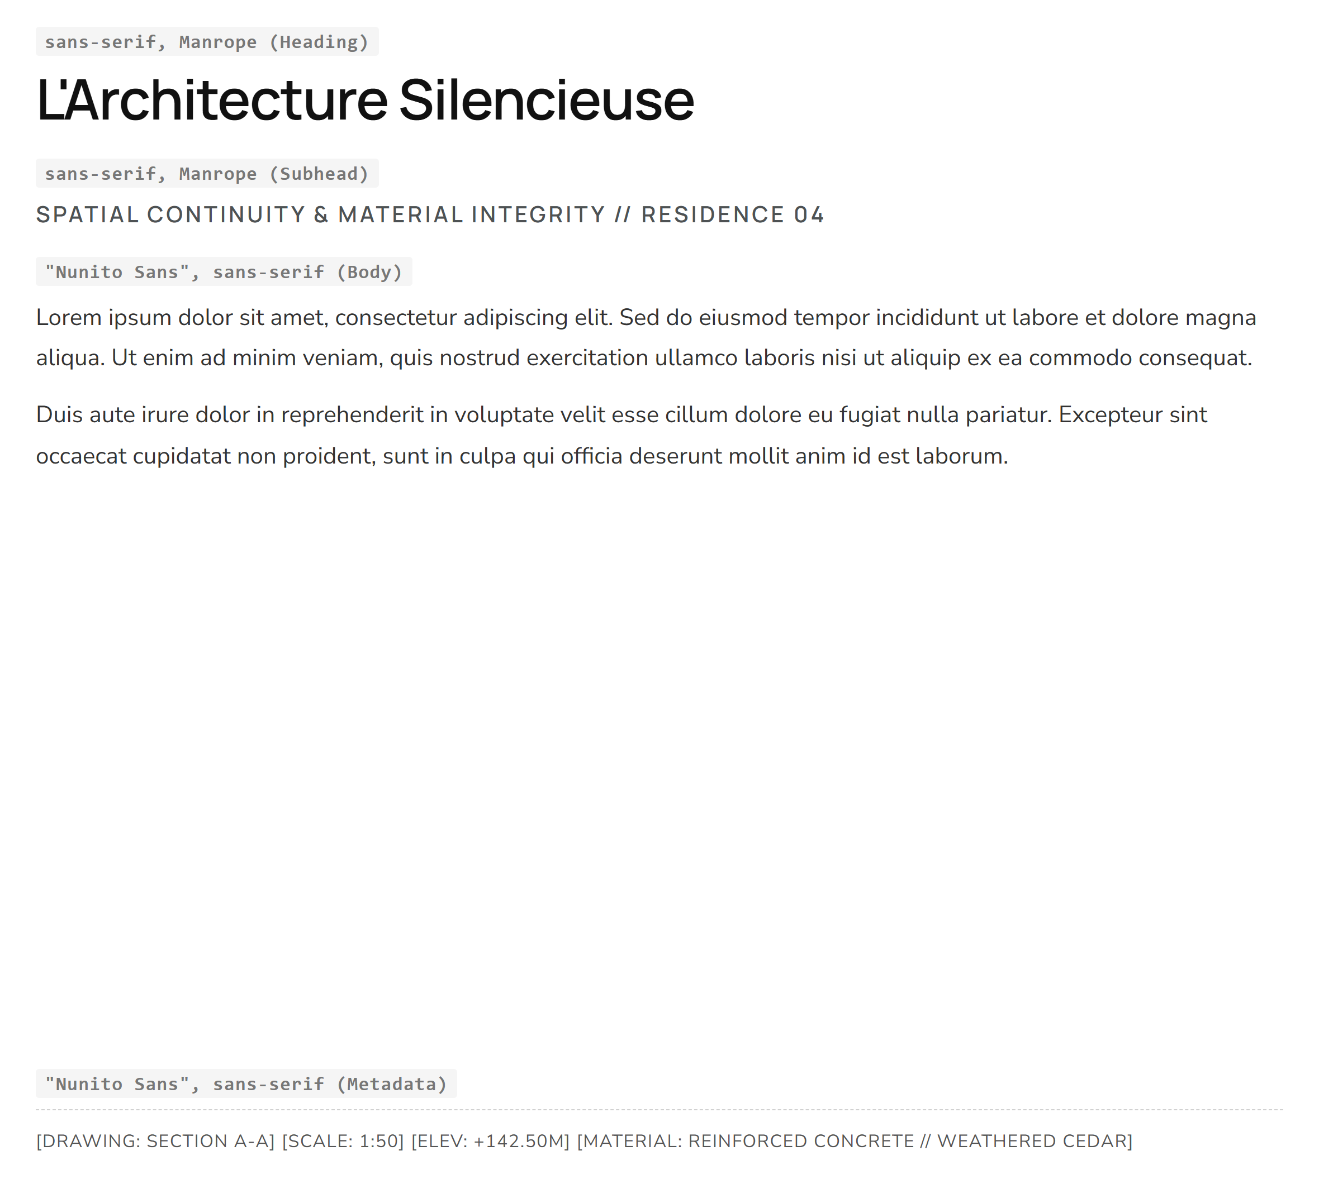
FIELD ARCHITECTURE
https://fieldarchitecture.com
02 / 10
#FFFFFF
#000000
#4E5254
#EEEDEB
Canvas / Background
Body Narrative Ink
Heading & Nav
Section Container

Slide 3
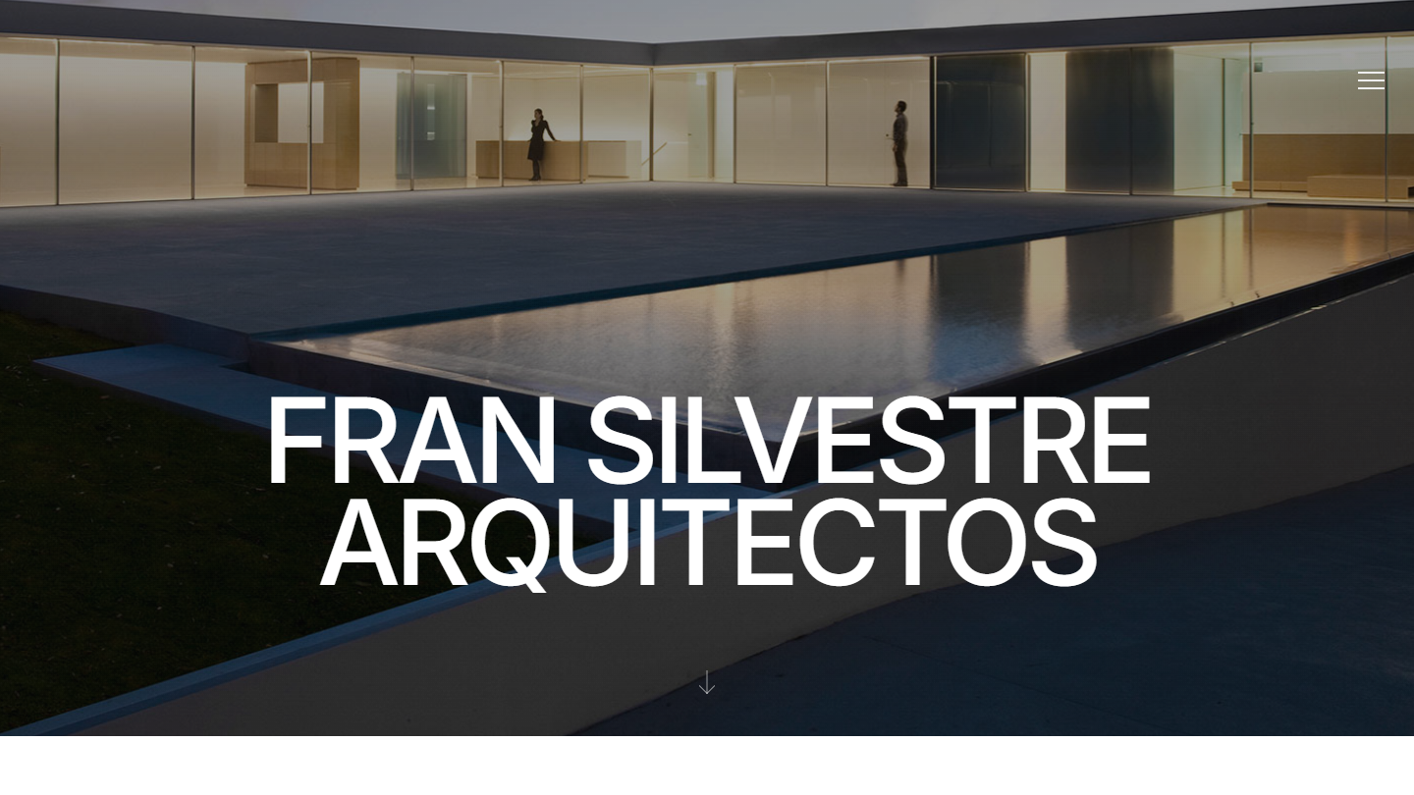
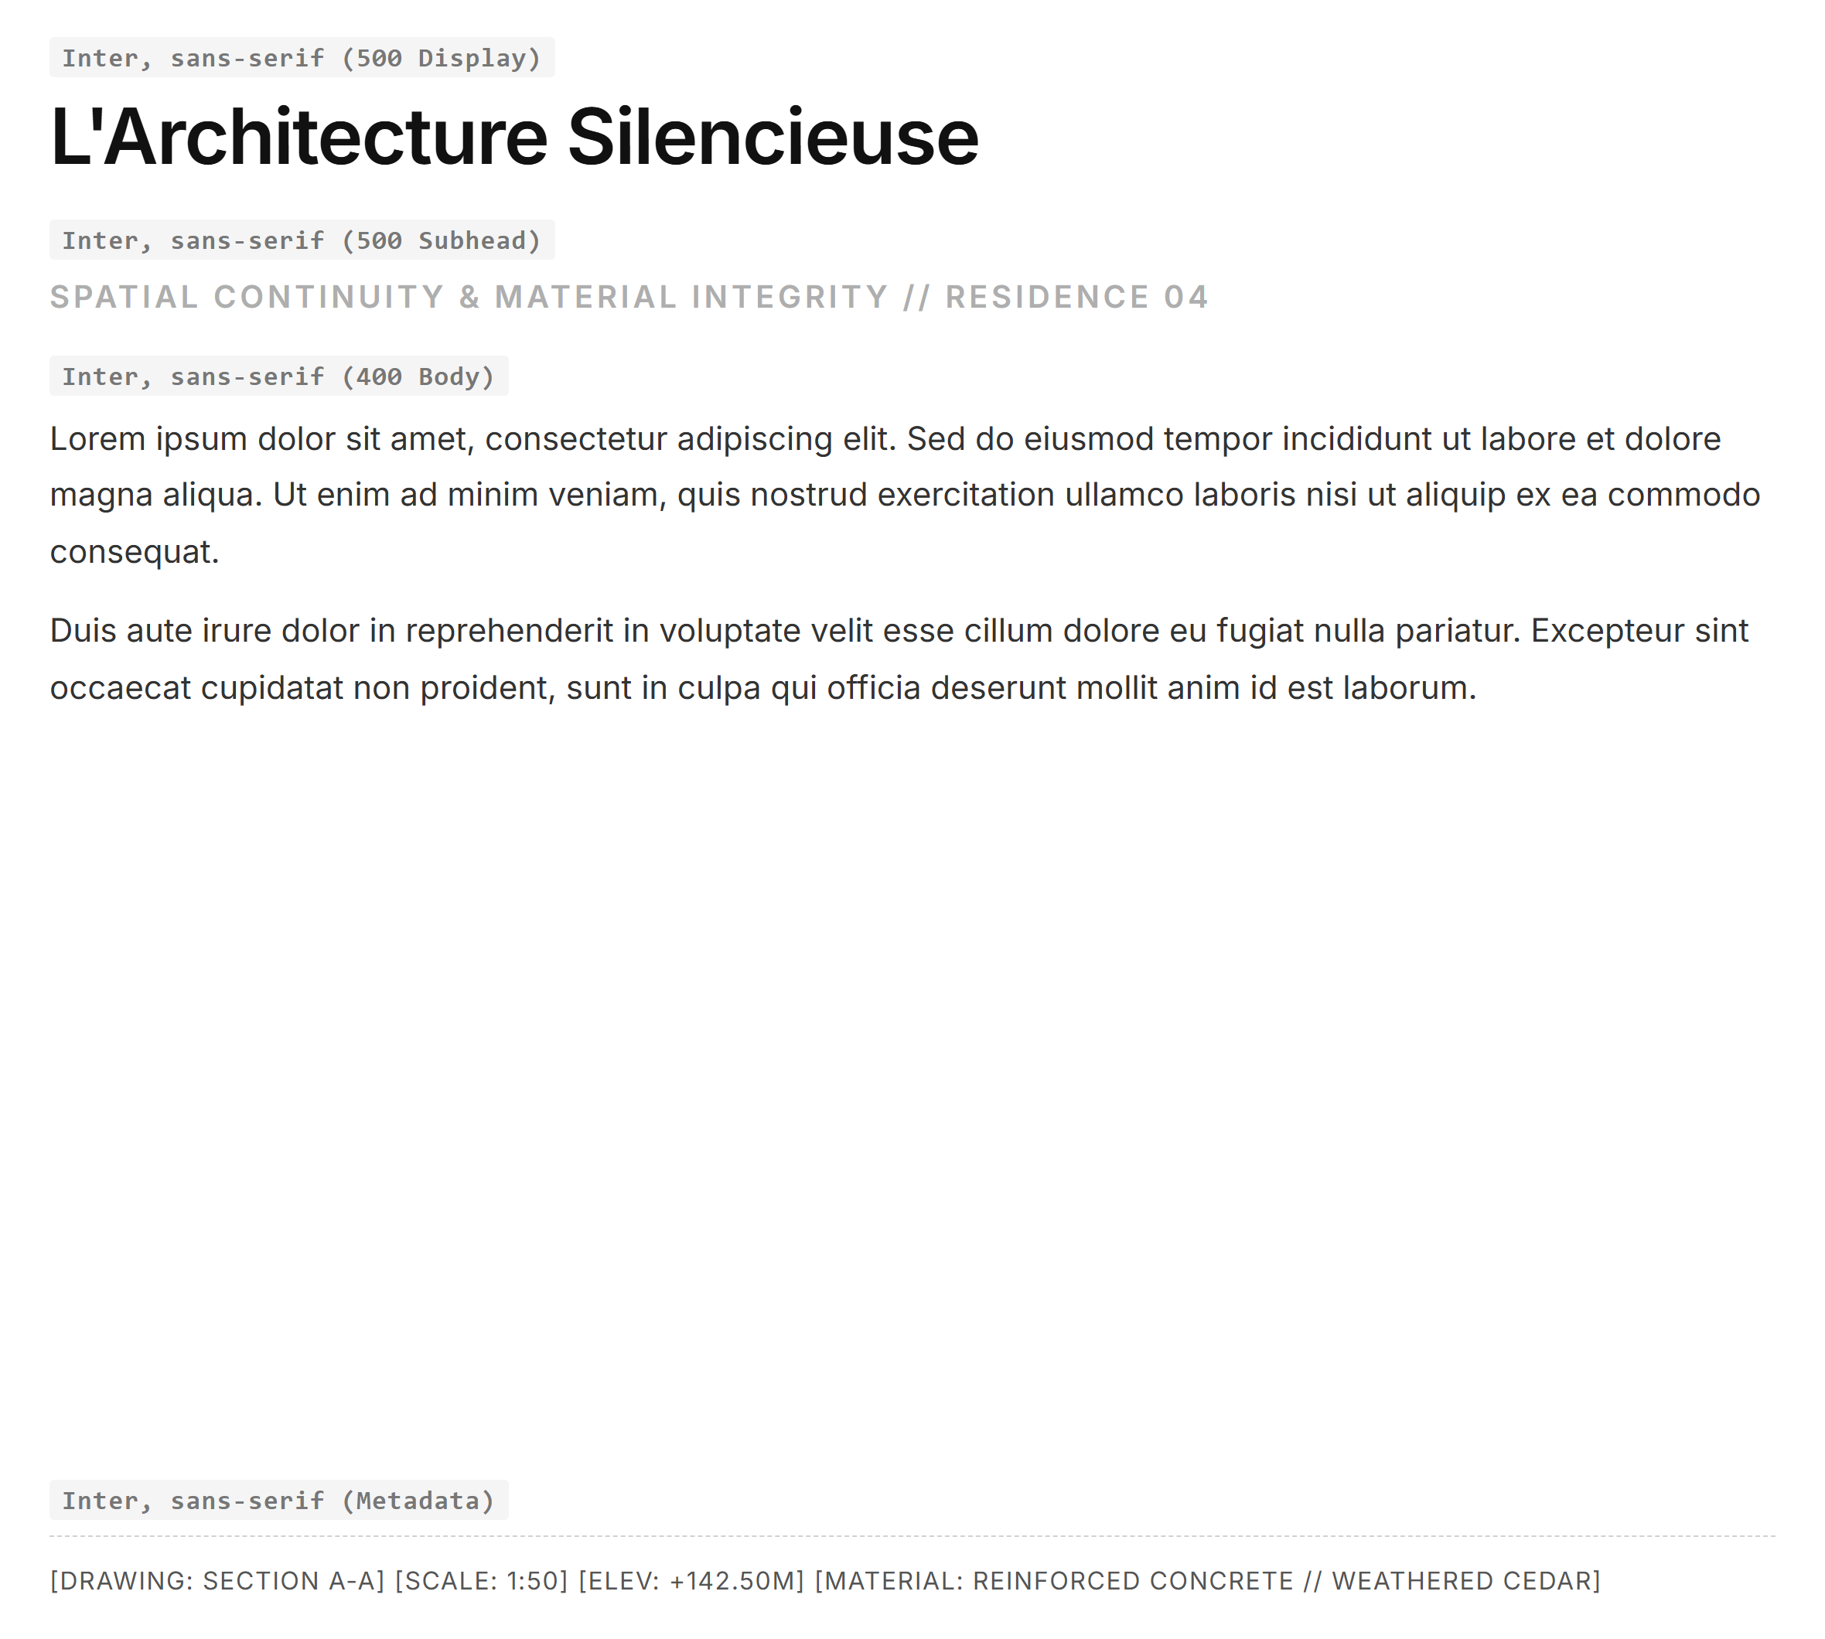
FRAN SILVESTRE ARQUITECTOS
https://fransilvestrearquitectos.com
03 / 10
#FFFFFF
#000000
#777777
#AEAEAE
Canvas / Background
Paragraph Ink
Subhead / Nav
Display Meta

Slide 4
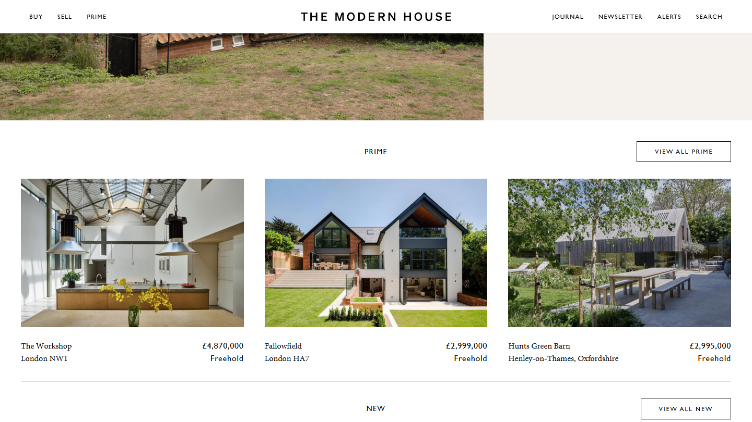
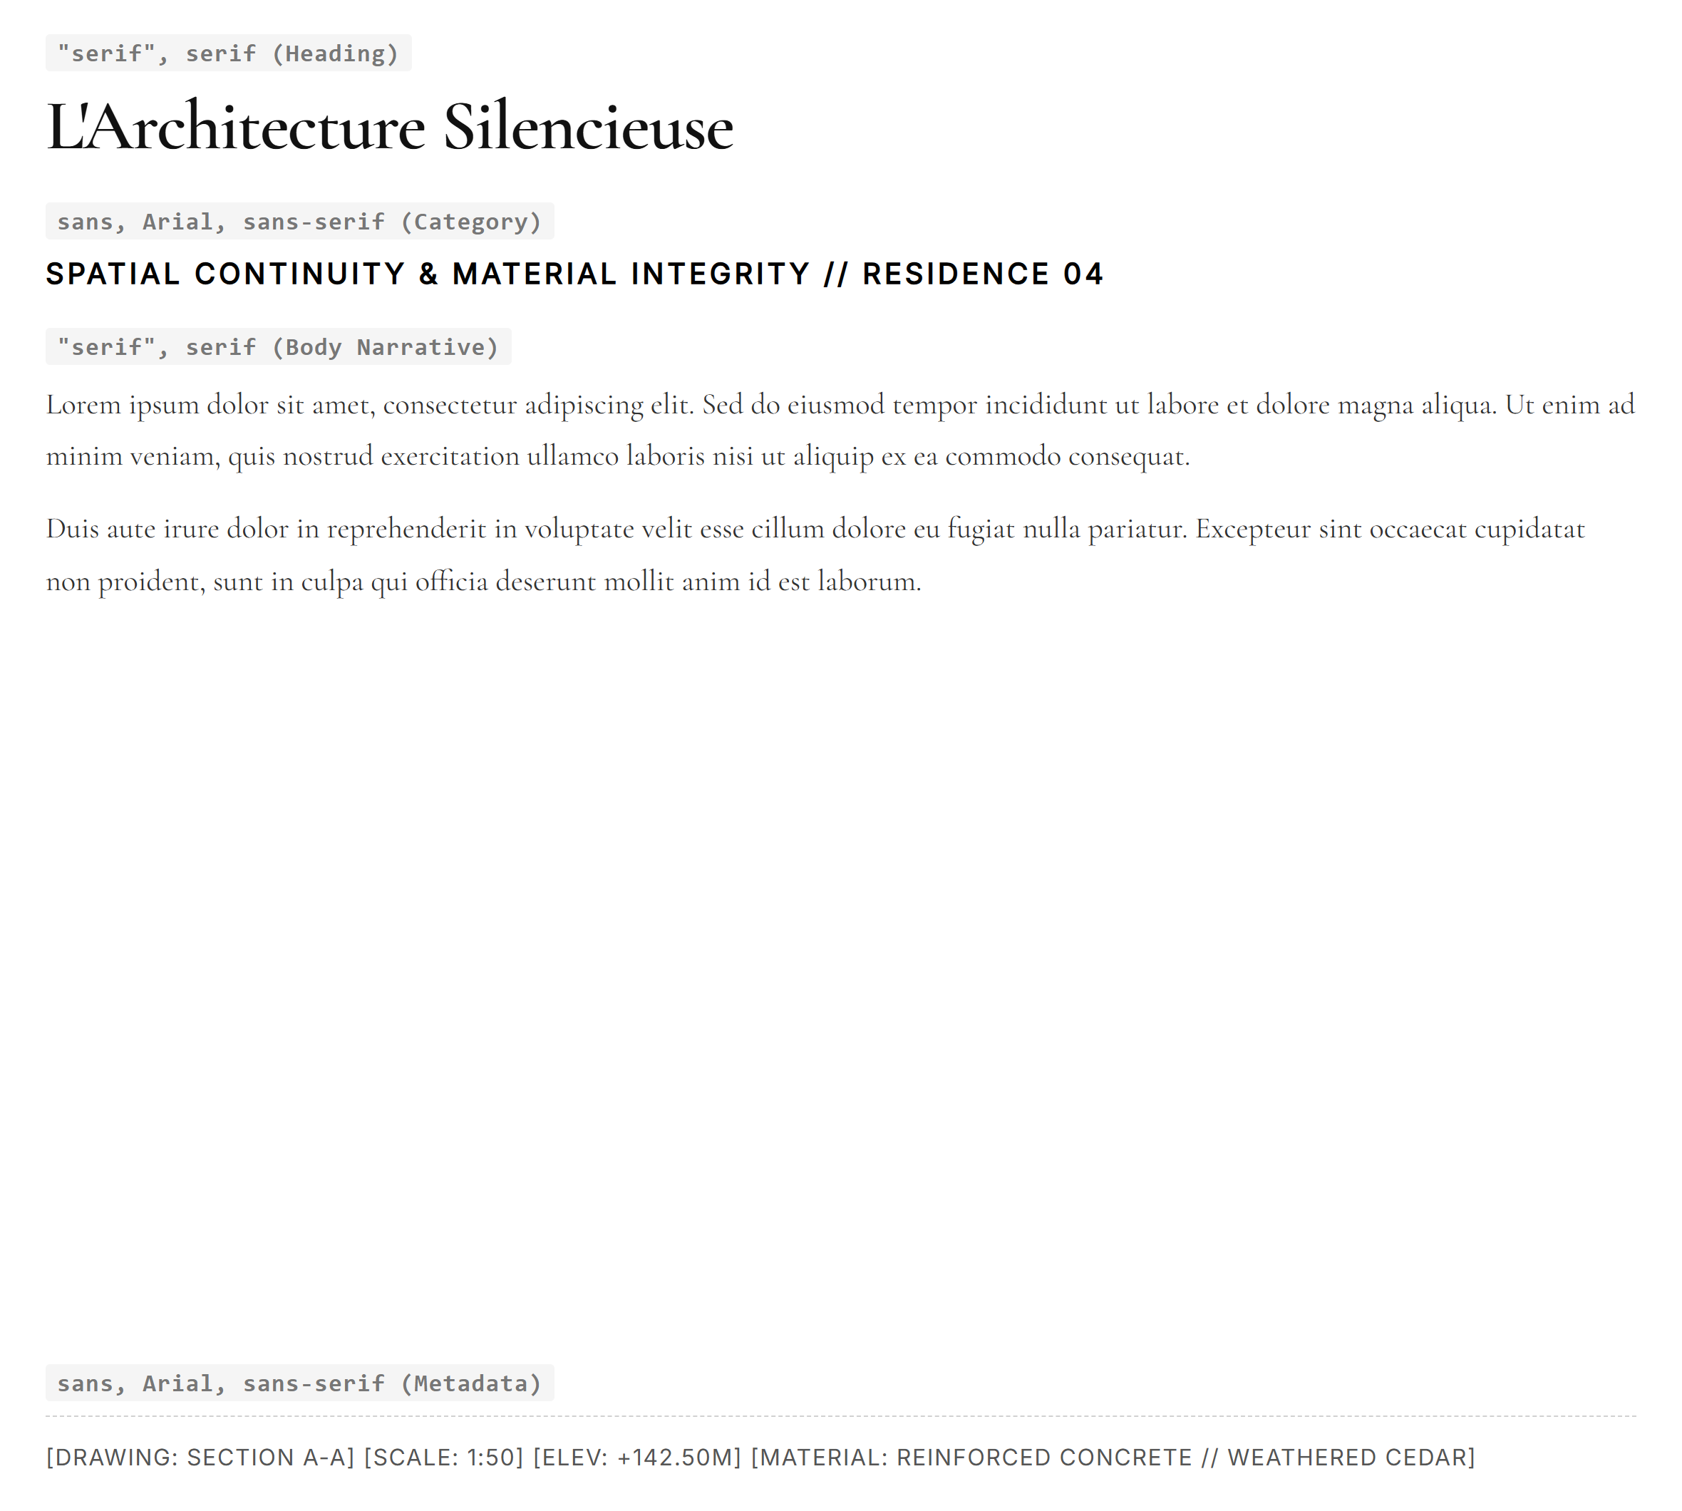
THE MODERN HOUSE
https://themodernhouse.com
04 / 10
#FFFFFF
#000000
#313131
#F5F3EF
Canvas / Background
Editorial Serif Ink
Secondary Text
Paper Tint Container

Slide 5
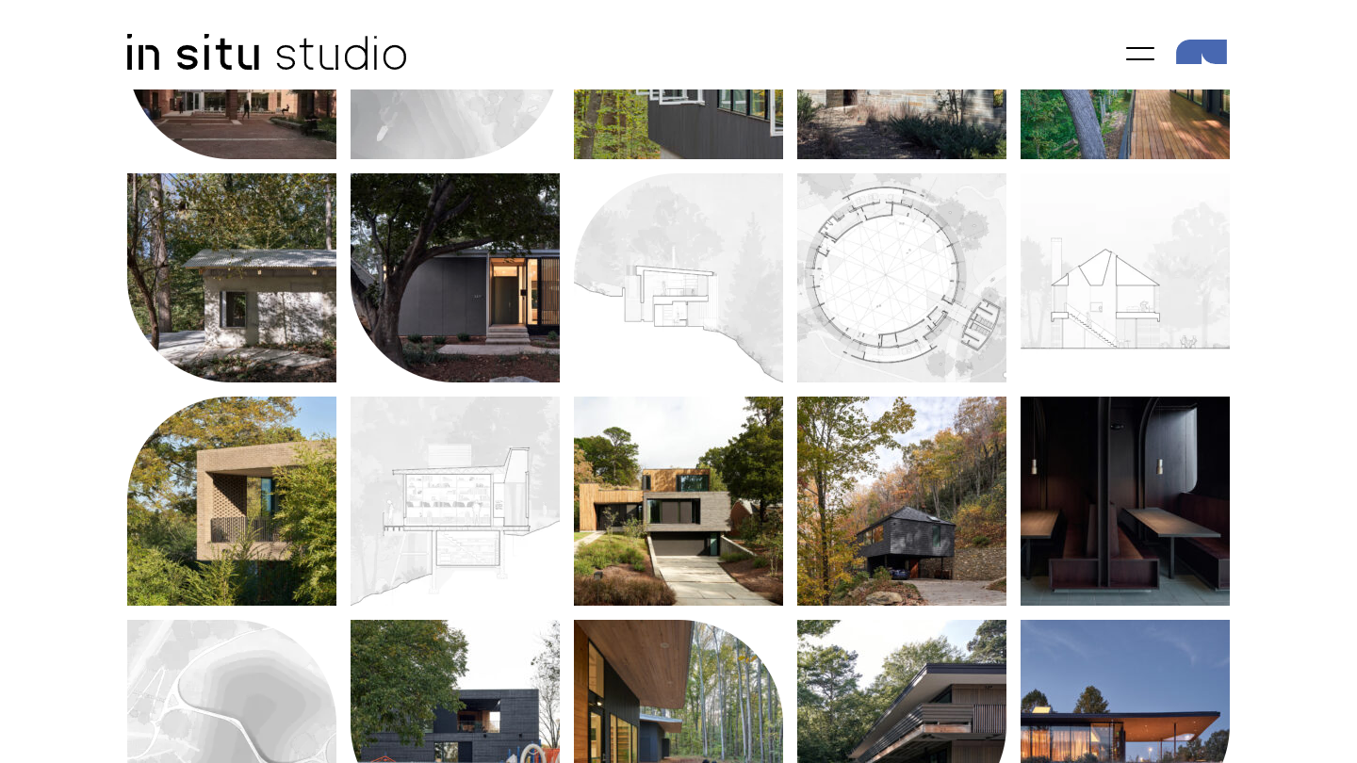
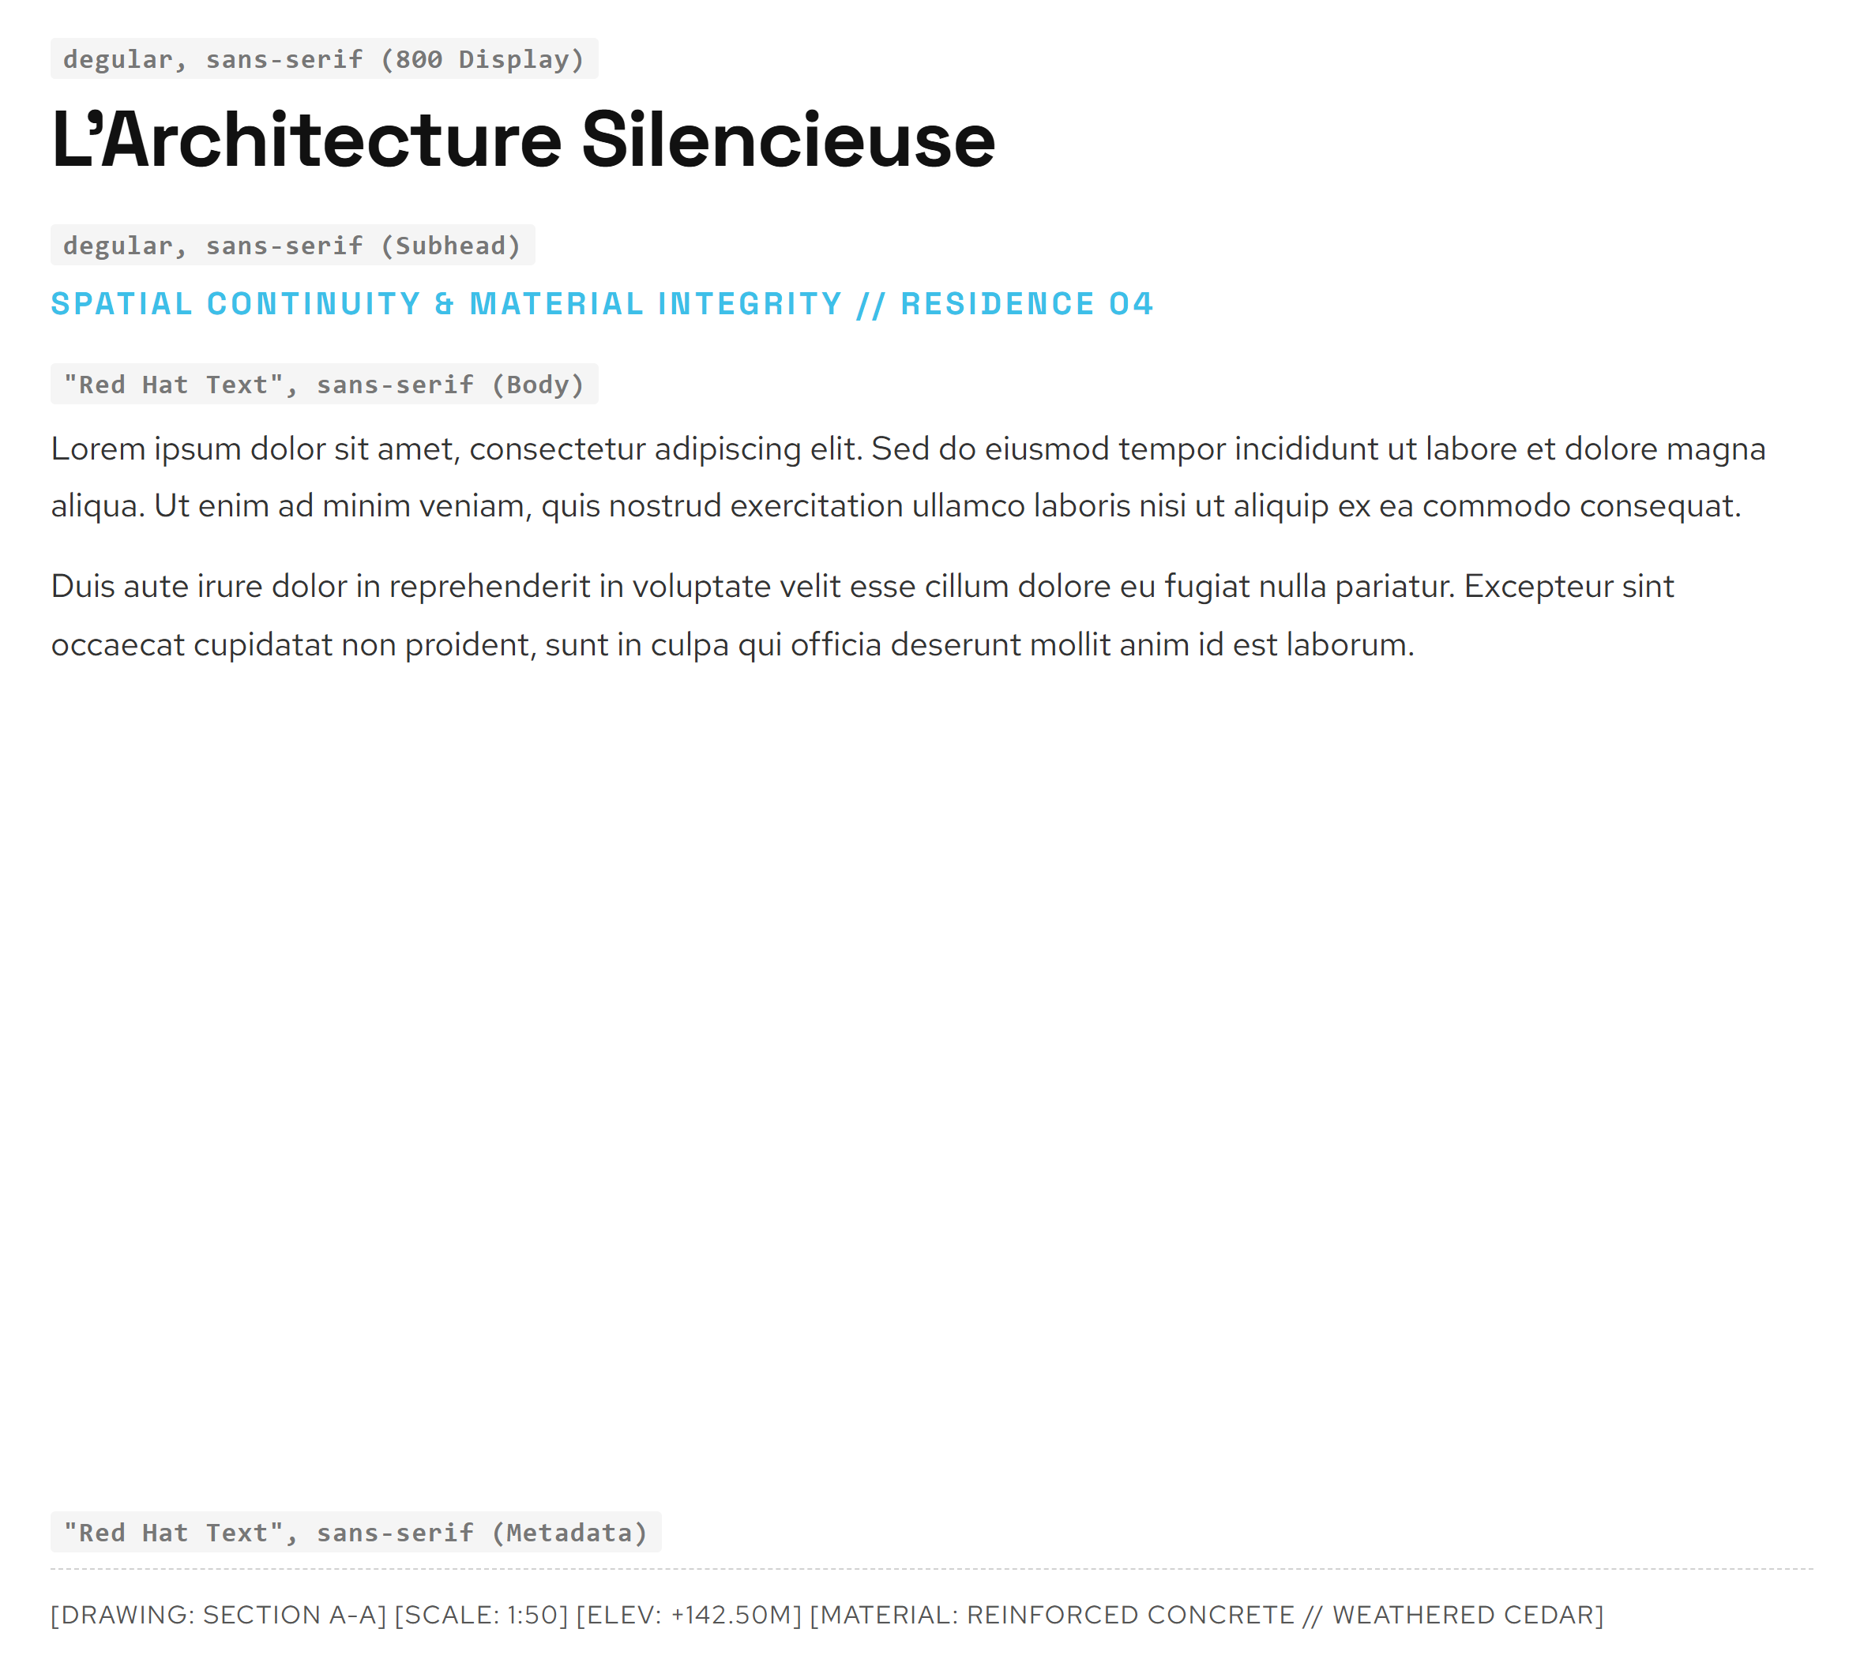
IN SITU STUDIO
https://insitustudio.us
05 / 10
#FFFFFF
#000000
#3DBFE8
#BDE1F4
Canvas / Background
Primary Text Ink
Link Accent Cyan
Light Tint Container

Slide 6
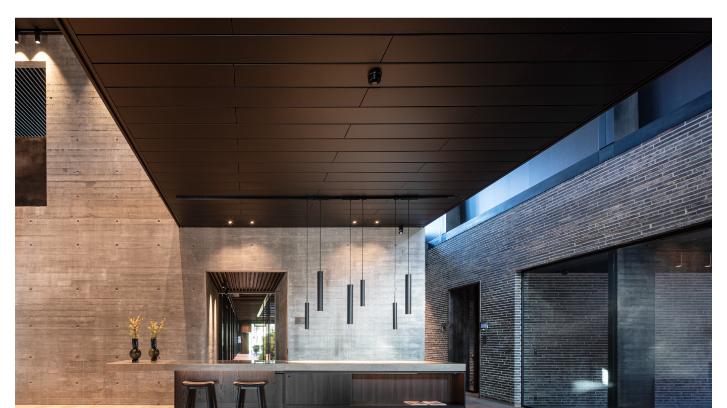
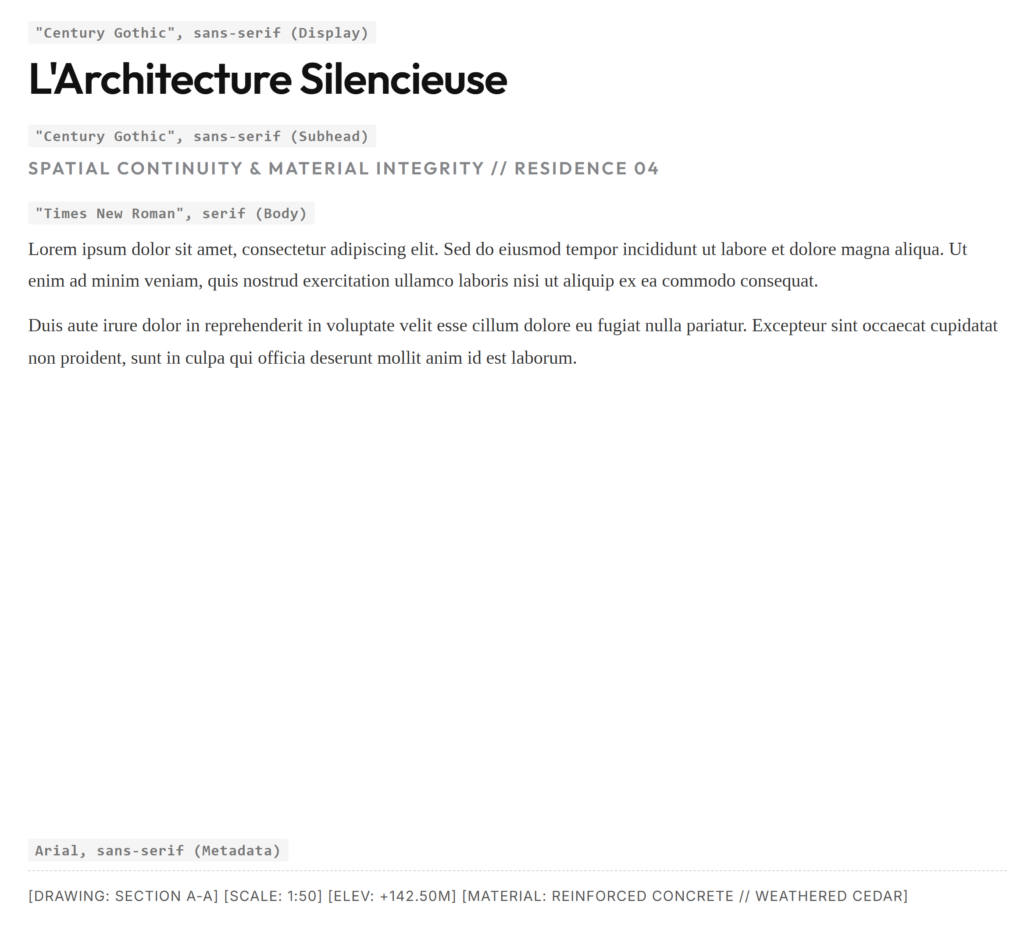
RAVN ARKITEKTUR
https://ravnarkitektur.dk
06 / 10
#FFFFFF
#000000
#85868A
#666666
Canvas / Background
Primary Text Ink
Metadata Grey
Panel Frame

Slide 7

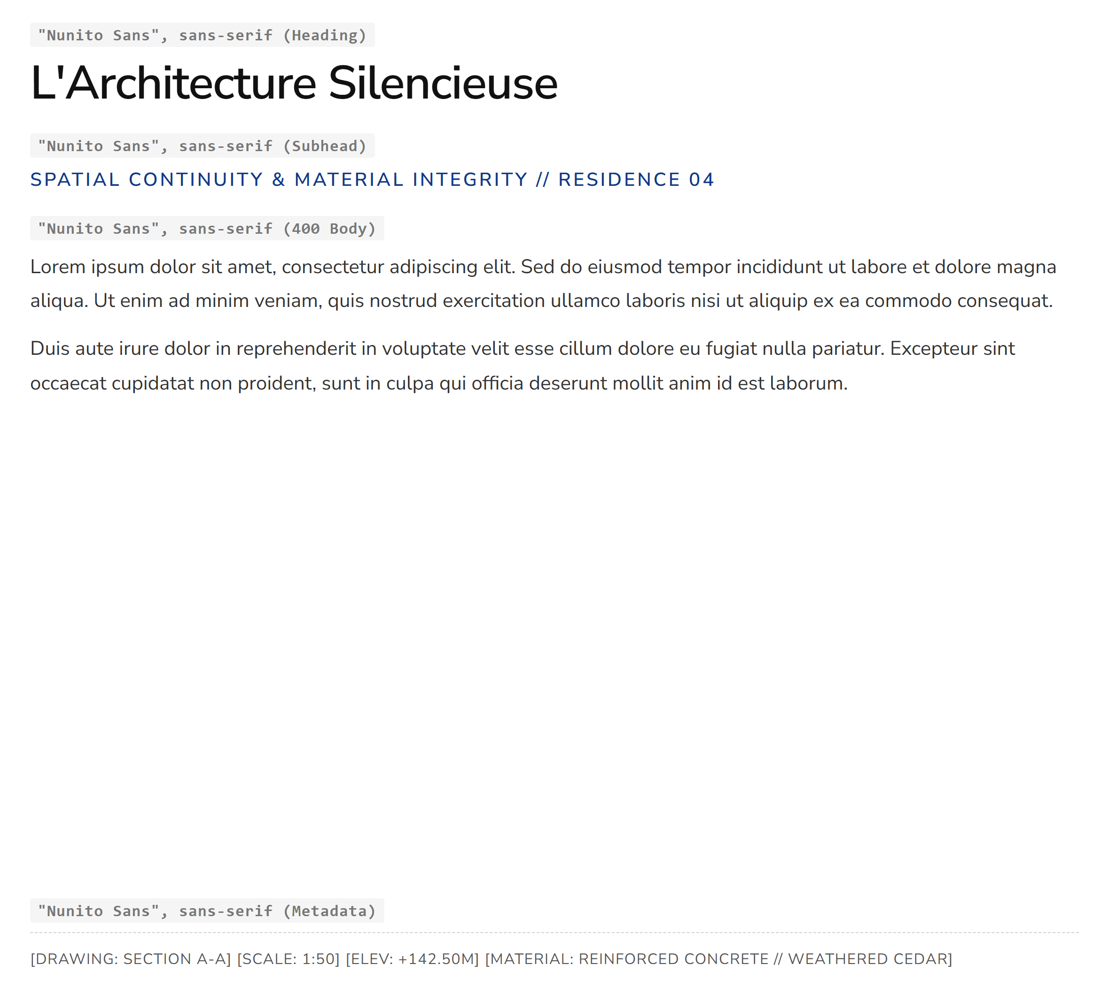
STUDIO MM ARCHITECT
https://maricamckeel.com
07 / 10
#FFFFFF
#000000
#666666
#123A8A
Canvas / Background
Primary Text Ink
Case Study Body
Link Accent Blue

Slide 8
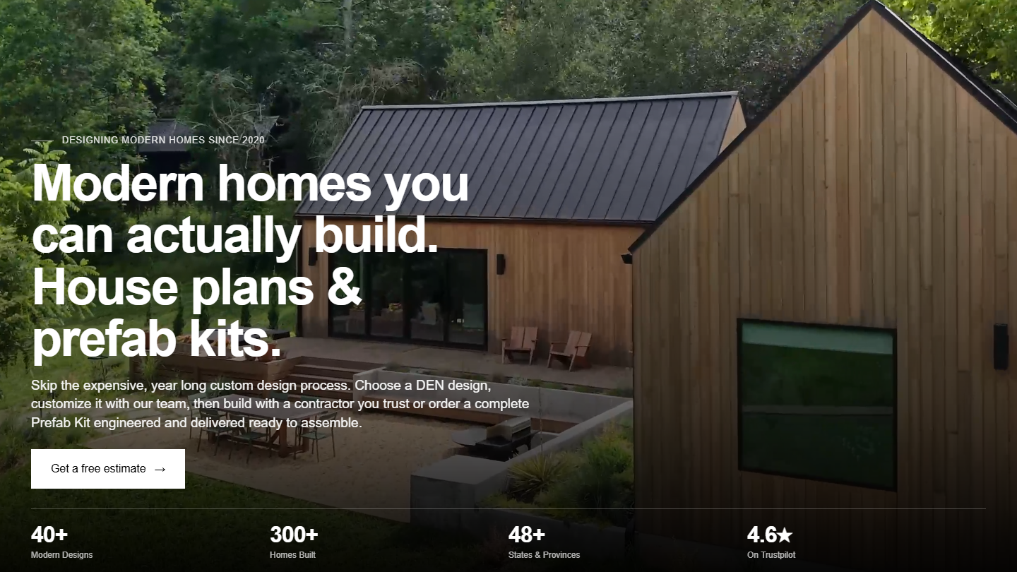
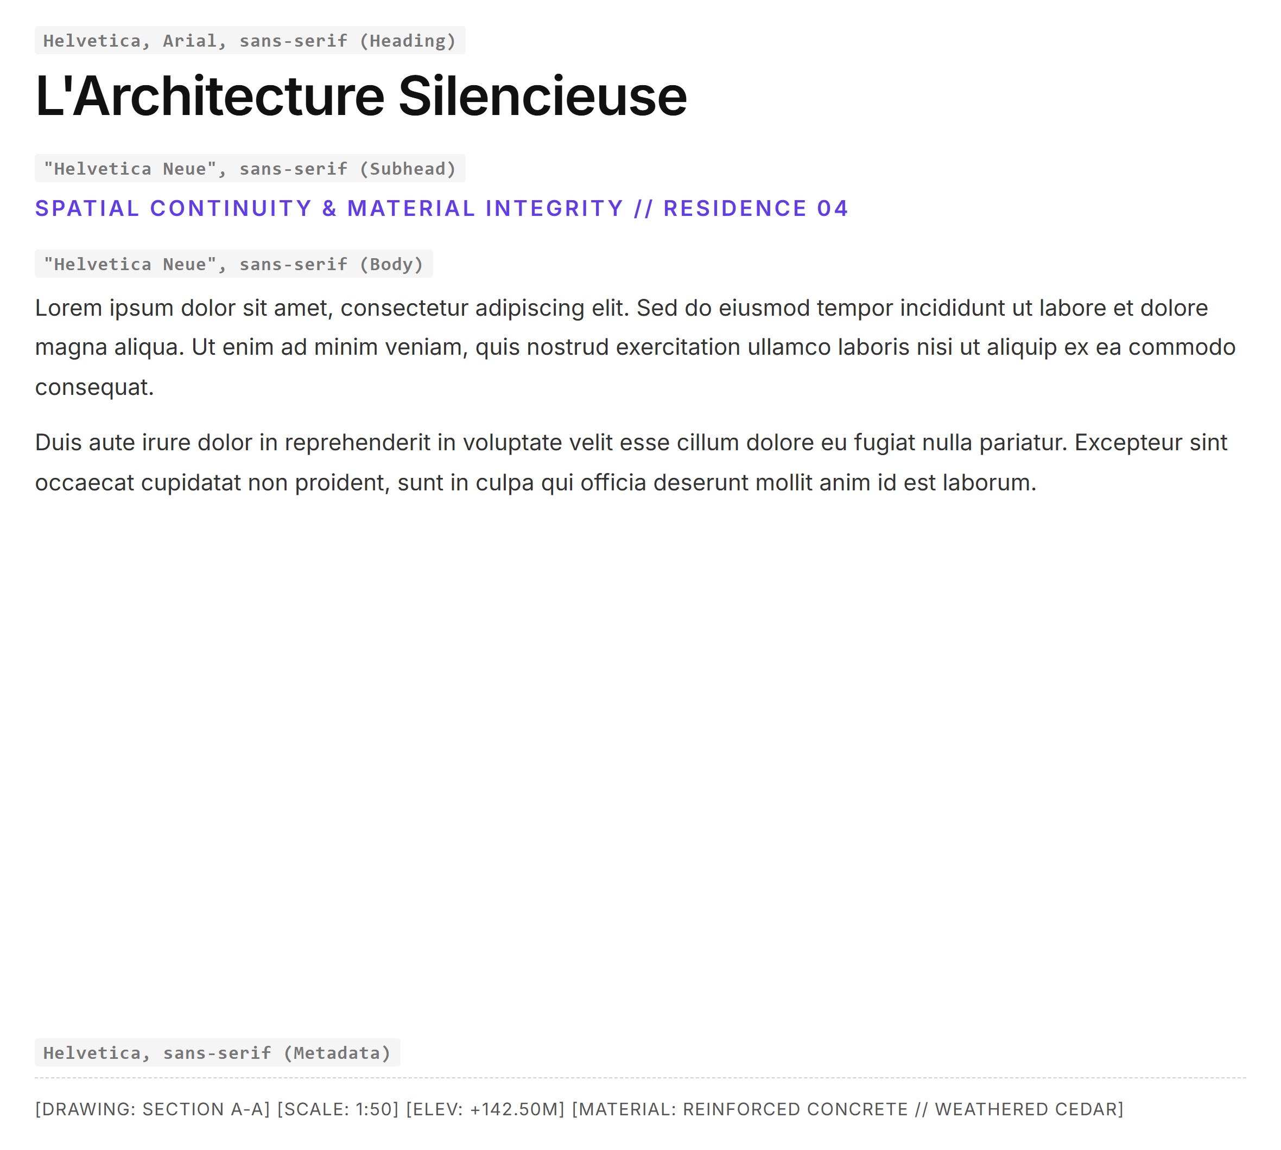
DEN OUTDOORS
https://denoutdoors.com
08 / 10
#FFFFFF
#000000
#F0EEE9
#623CEA
Primary Canvas
Text / Hero Dark
Warm Section BG
Interactive Purple

Slide 9
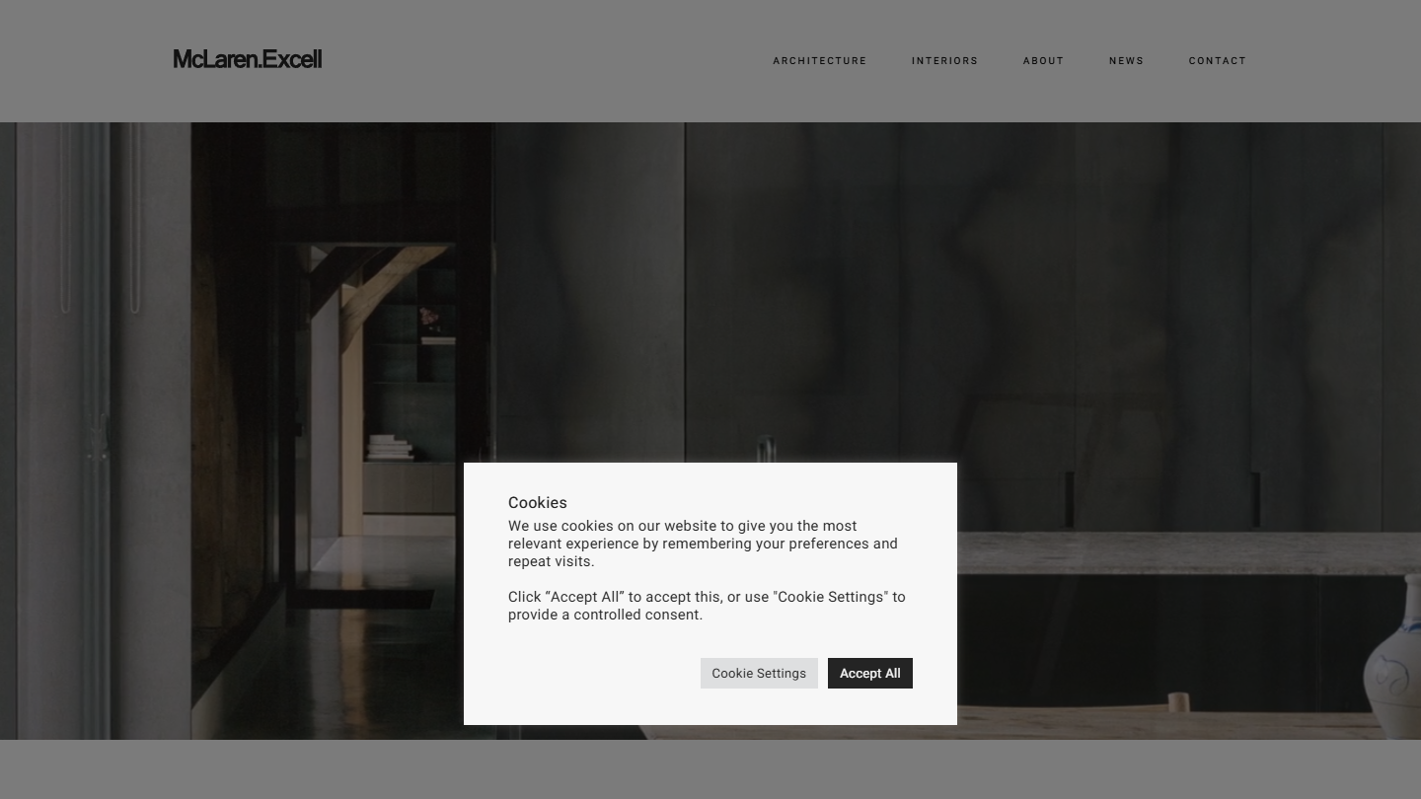
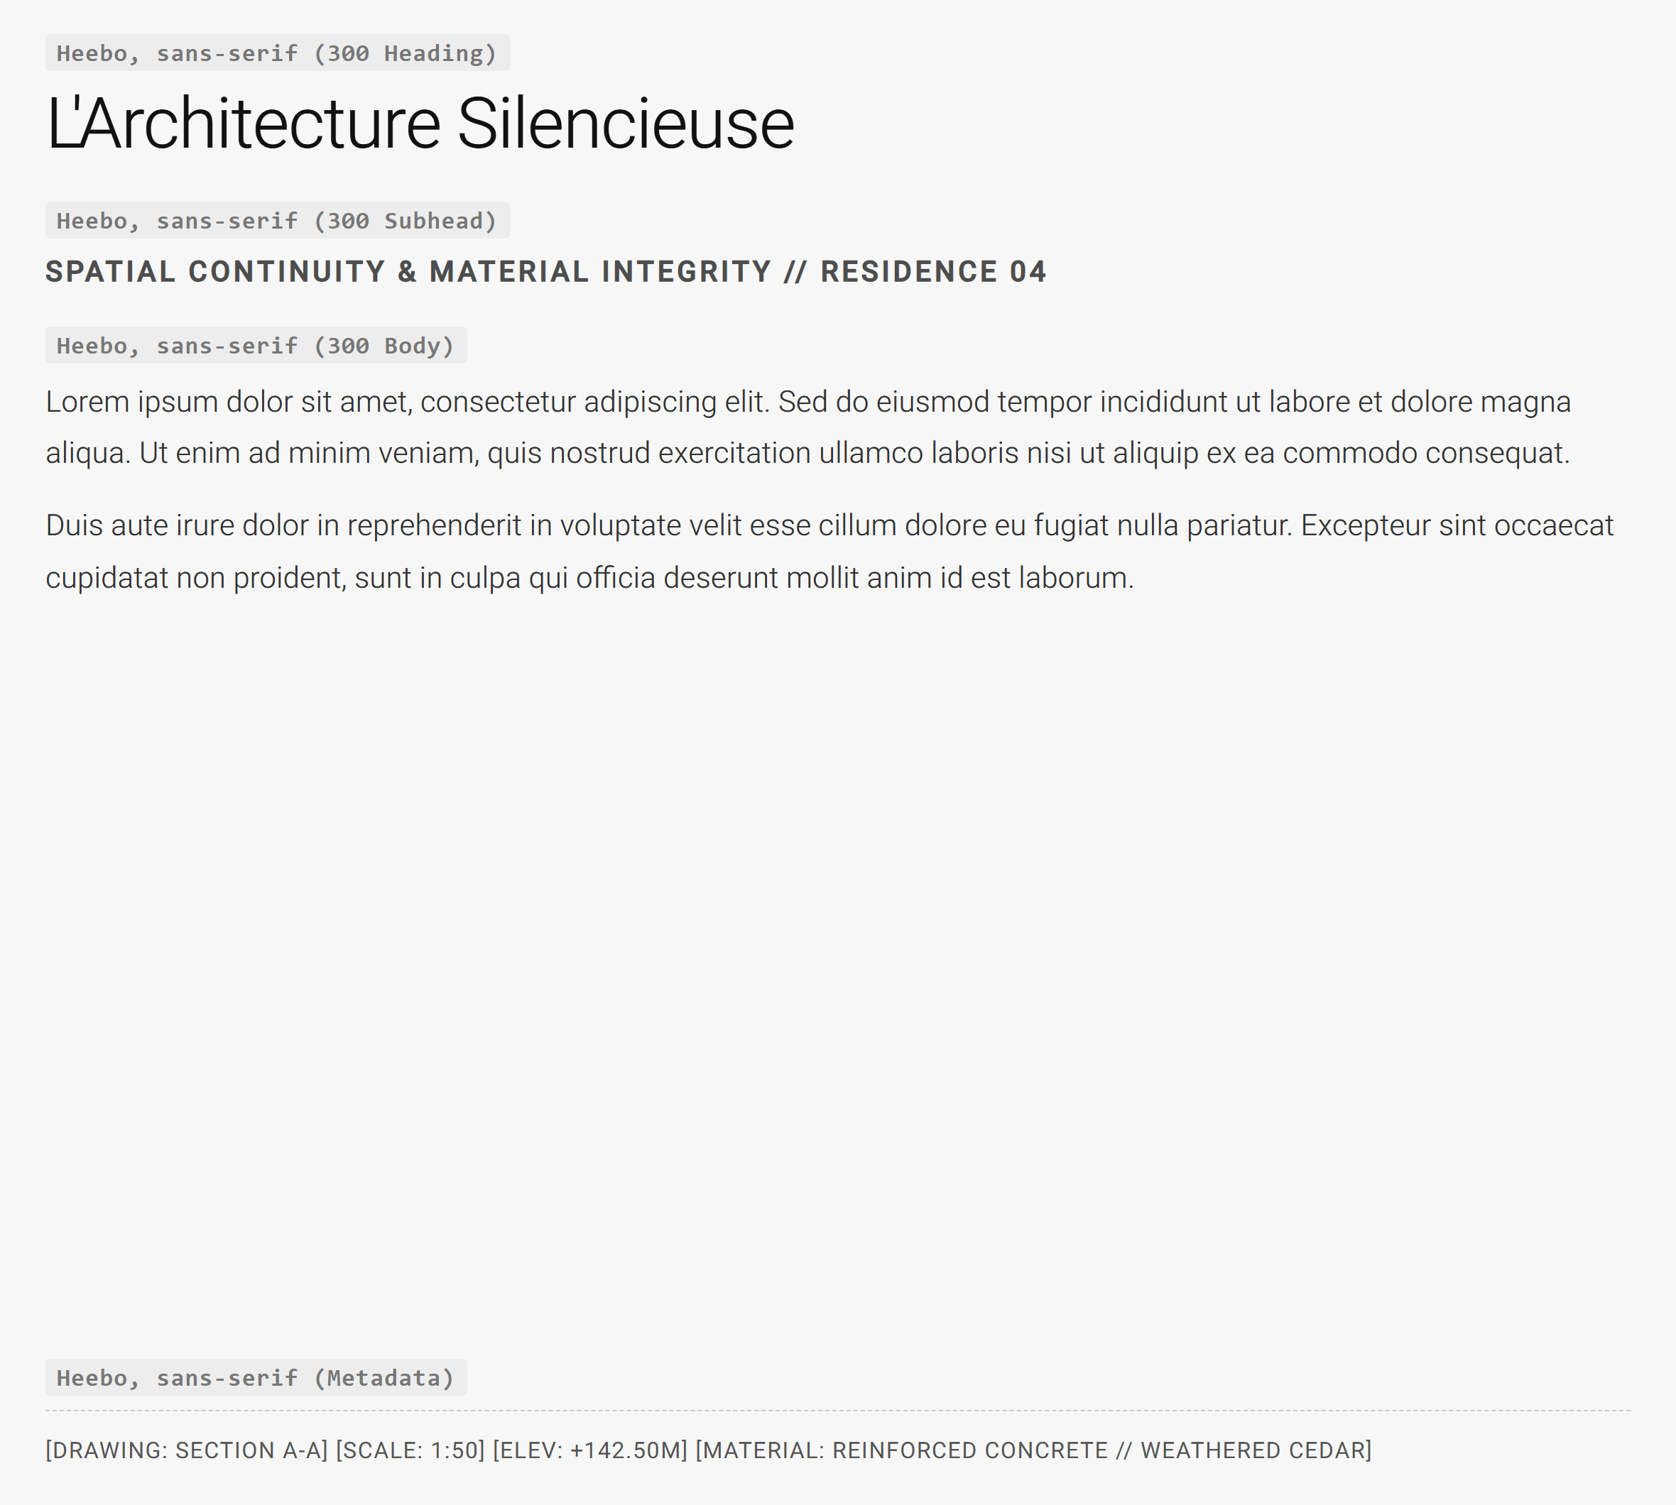
MCLAREN EXCELL
https://mclarenexcell.com
09 / 10
#F7F7F7
#242424
#4D4D4D
#DEDFE0
Canvas / Background
Primary Dark Ink
Secondary Slate
Structure Border

Slide 10
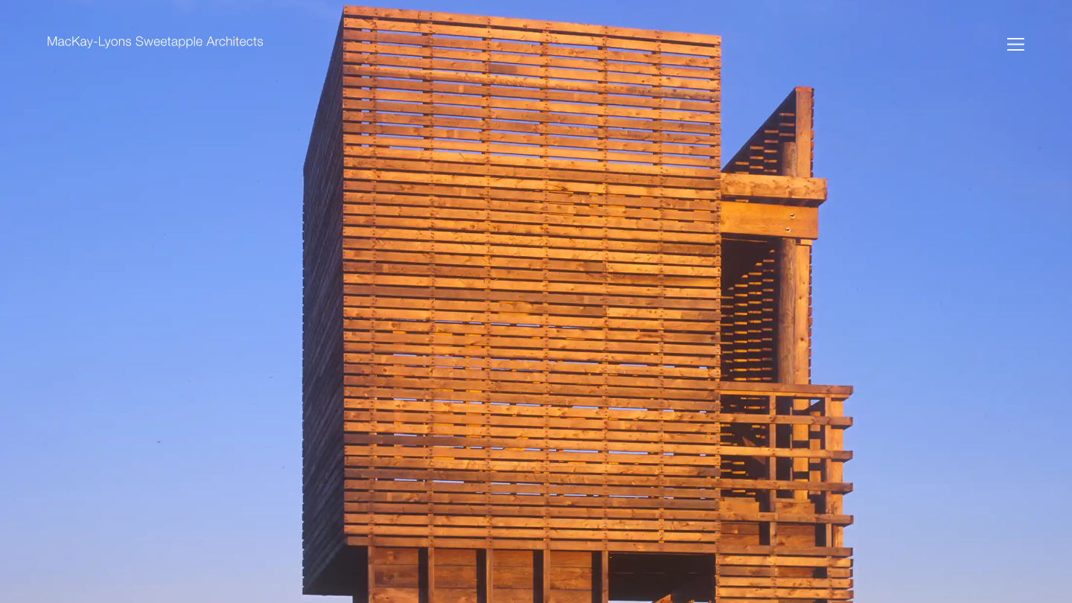
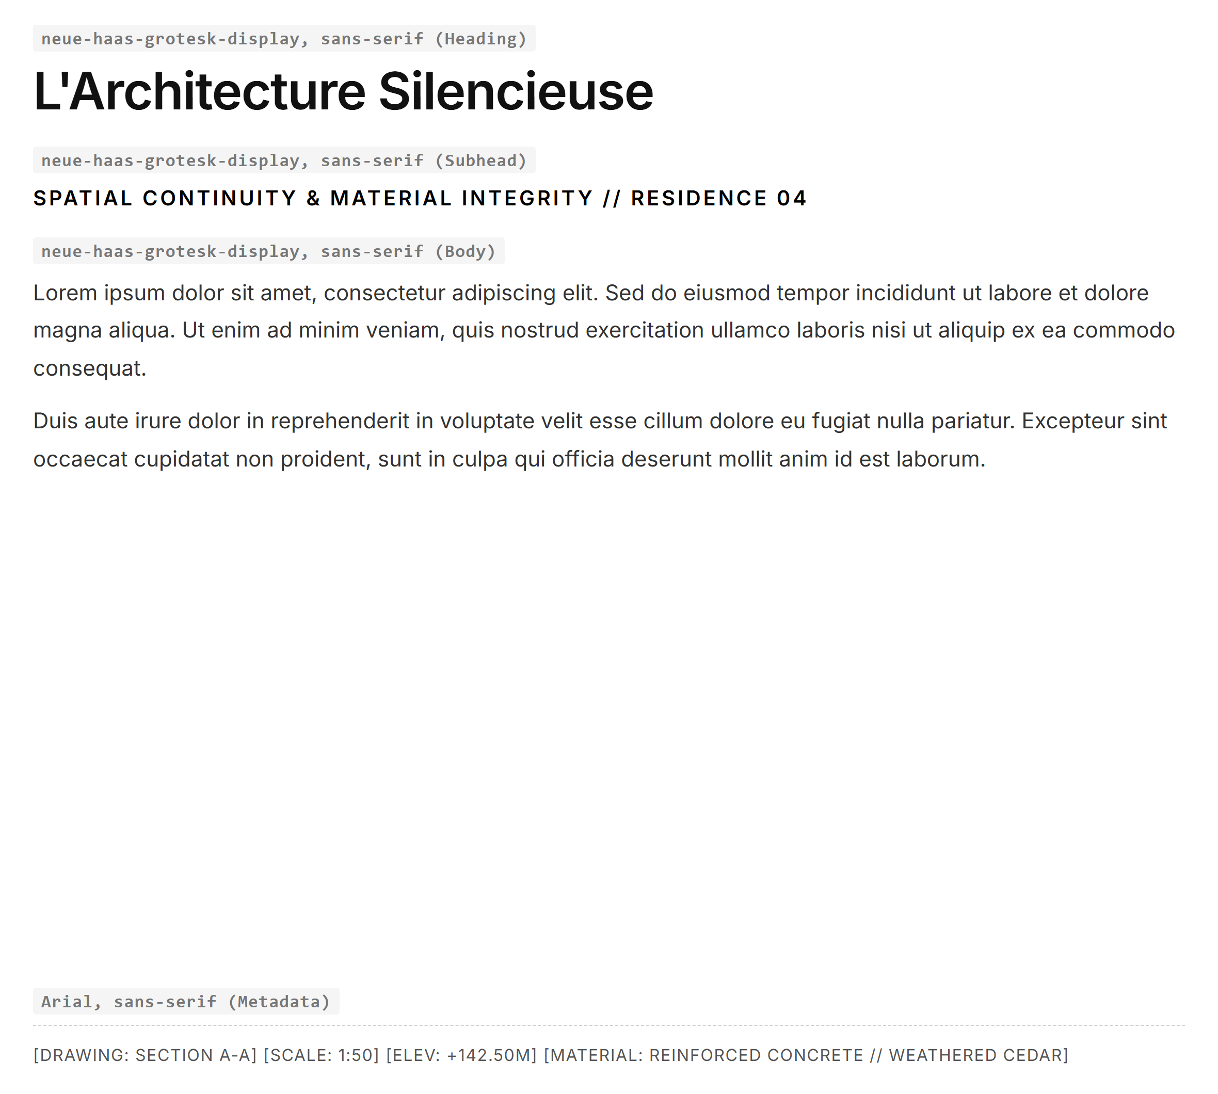
MACKAY-LYONS SWEETAPPLE
https://mlsarchitects.ca
10 / 10
#FFFFFF
#000000
#4F5861
#9BA5AE
Canvas / Background
Primary Text Ink
Atlantic Slate
Sea Mist Tint

