Slide 1

TankX HFT Quant - Case Study Real Time Arbitrage Monitoring
Dogan Parlak
Notes:
Hello and welcome to my case study presentation about real time arbitrage monitoring.

Slide 2
Content
Introduction to the assignment
Methodology used for the implementation
Results & Discussion
Conclusion
Notes:
Today, I will start with introducing the assignment.
Then I will briefly mention the methodology that I have used for the implementation.
Afterward, I will show some tables and plots to demonstrate the results and highlight the important outcomes.
Finally, I will mention the takeaways.

Slide 3
Introduction
Analyze and observe rapidly changing real-time financial data to determine whether there is an arbitrage opportunity in the provided market.
Retrieve book ticker data from Binance.
Notes:
The assignment asks for us to analyze and observe the real-time binance book ticker data to determine whether there is an arbitrage oppurtunity.

Slide 4

Methodology
A websocket stream to fetch book ticker data of Binance using appropriate on_open, on_message, on_error and on_close methods.
on_error and on_close methods to display the error and close messages.
on_open method to display the connection message and subscribe to the symbols with appropriate naming.
on_message method to store the received data's symbol, update ID, best ask and bid price, and calculate ask and bid arbitrage values. Then, check for triangular arbitrage.
Calculation of values to check for triangular arbitrage using the most recent observation of each symbol:
Notes:
In order to accomplish this, a websocket stream connection was established using the port 9443 of Binance Stream.
To be able to listen this stream, four methods which are on open, on message, on error and on close were implemented.
On error and on close methods were used to display the error and close messages.
On the other hand, on open method was used to display the connection message and subscribe to the symbols with appropriate naming.
Finally, an on message method was implemented to store the recieved data’s symbol, update ID, best ask and best bid price, and calculate ask and bid arbitrage values. Then, check for triangular arbitrage was completed considering the given inequalities.
If one of the two inequalities were satisfied, then it was marked as a triangular arbitrage.

Slide 5
Results & Discussion
Arbitrage Found | Symbol 1 | Symbol 2 | Symbol 3
Yes | BTCEUR | EURUSDT | BTCUSDT
Yes | ETHEUR | EURUSD | ETHUSDT
Yes | LTCBTC | BTCUSDT | LTCUSDT
No | XRPBTC | BTCUSDT | XRPUSDT
No | ADABTC | BTCUSDT | ADAUSDT
Yes | ETHBTC | BTCEUR | ETHEUR
No | EURUSDT | USDTGBP | EURGBP
Yes | BCHBTC | BTCUSDT | BCHUSDT
Yes | EOSBTC | BTCUSDT | EOSUSDT
No | LINKBTC | BTCUSDT | LINKUSDT
Several pairs of symbols were monitored for triangular arbitrage opportunity.
They were classified according to arbitrage presence.
Notes:
To initiate the results and discussion, the monitored symbols are introduced.
Several pairs of symbols were monitored for triangular arbitrage opportunity.
They were classified according to arbitrage presence within the monitored interval.
Factors such as liquidity may not offer enough volume for traders to execute triangular arbitrage strategies profitably.

Slide 6
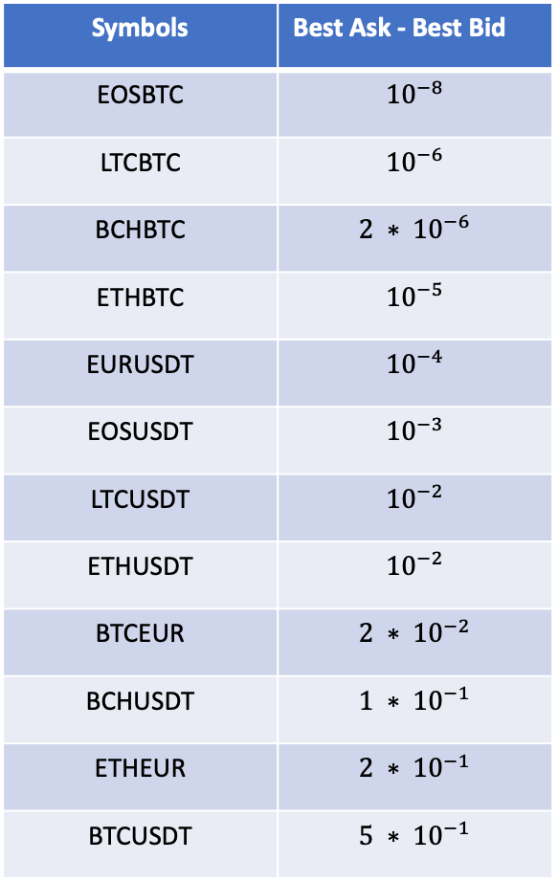
Results & Discussion
Symbols | Best Ask - Best Bid
EOSBTC | $${10}^{−8}$$
LTCBTC | $${10}^{−6}$$
BCHBTC | $${2 ∗ 10}^{−6}$$
ETHBTC | $${10}^{−5}$$
EURUSDT | $${10}^{−4}$$
EOSUSDT | $${10}^{−3}$$
LTCUSDT | $${10}^{−2}$$
ETHUSDT | $${10}^{−2}$$
BTCEUR | $${2 ∗ 10}^{−2}$$
BCHUSDT | $${1 ∗ 10}^{−1}$$
ETHEUR | $${2 ∗ 10}^{−1}$$
BTCUSDT | $${5 ∗ 10}^{−1}$$
The difference between the best ask and best bid prices served as an indicator of liquidity, hence indirectly pointing to a higher potential for arbitrage.
Best Ask Price = Lowest available sell price
Best Bid Price = Highest available buy price
Notes:
Among the pairs with arbitrage presence, the table displays the symbols ranked according to the difference between their average best ask and best bid price.
The difference between the best ask and best bid prices served as an indicator of liquidity, hence indirectly pointing to a higher potential for arbitrage.

Slide 7
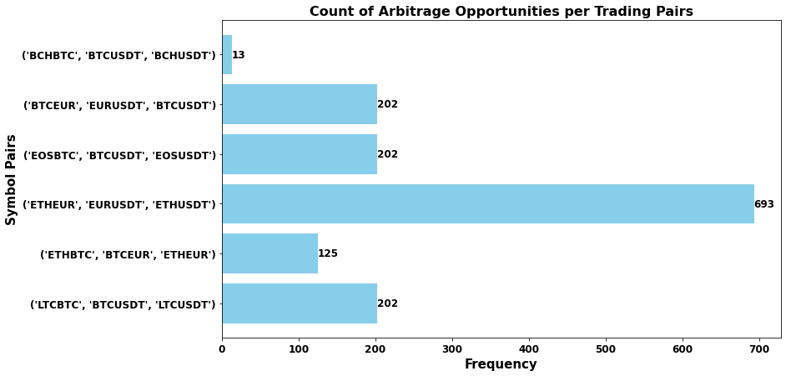
Results & Discussion
Distribution of arbitrage opportunities per trading pairs.
ETHEUR, EURUSDT, ETHUSDT was the most frequently observed triangular arbitrage pair.
Notes:
On the right you can observe the distribution of arbitrage opportunities per trading pairs.
ETHEUR, EURUSDT, ETHUSDT was the most frequently observed triangular arbitrage pair.

Slide 8
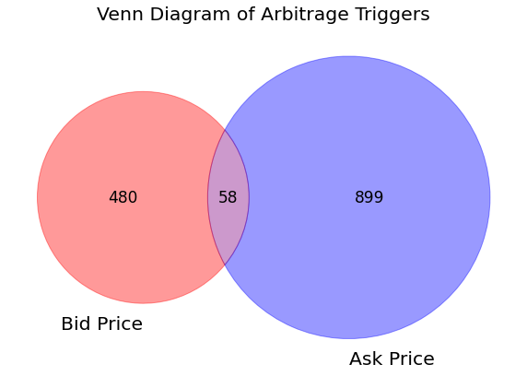
Results & Discussion
Diagram showing distribution of arbitrage triggers.
In most cases, ask prices triggered the arbitrage opportunity, followed by bid prices, and both together.
Notes:
Finally, the venn diagram on the right shows the distribution of arbitrage triggers according to the checked inequalities.
In most cases, ask prices triggered the arbitrage opportunity, followed by bid prices, and both together.

Slide 9
Conclusion
Arbitrage thrived in pairs such as ETHEUR, EURUSDT, and ETHUSDT, driven by their high liquidity, active trading, and price disparities across exchanges or trading pairs.
Traders capitalize on these variations by purchasing at lower prices and selling at higher ones simultaneously.
The ask price, indicative of sellers' willingness to sell, often initiated arbitrage opportunities more than the bid price, fostering natural price discrepancies that traders can exploit for profit.
Notes:
As a conclusion,
Arbitrage thrived in pairs such as ETHEUR, EURUSDT, and ETHUSDT, driven by their high liquidity, active trading, and price disparities across exchanges or trading pairs.
Traders capitalize on these variations by purchasing at lower prices and selling at higher ones simultaneously.
The ask price, indicative of sellers' willingness to sell, often initiated arbitrage opportunities more than the bid price, fostering natural price discrepancies that traders can exploit for profit.

Slide 10

Q&A
Thank you for listening!

