Slide 1
The 12th International Conference on Computer Technology Applications (ICCTA 2026)
June 17–19, 2026 · Vienna, Austria · FH JOANNEUM University of Applied Sciences
Mechanism of Action of Pharmacological Agents: A Deep Learning Prediction Model Using Smooth Muscle Contractility Signals
Fatma Tuana Doğu · Ramazan Özgür Doğan · Hülya Doğan · İlyas Ay · Zain Kalha · Yeşim Kaya Yaşar · Sena F. Sezen
Karadeniz Technical University
Trabzon University
Notes:
This work concerns the mechanism of action (MoA) of pharmacological agents — how a drug acts on its target. We frame MoA determination as a classification task on smooth-muscle contractility signals, introduce a new 578-signal dataset, and propose a hybrid CNN–Transformer that outperforms a wide range of baselines. Joint work of Karadeniz Technical University and Trabzon University.

Slide 2
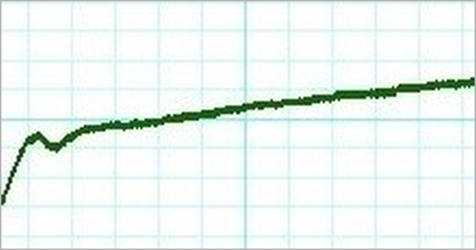
BACKGROUND
Why mechanism of action matters
1
The mechanism of action (MoA) describes how a drug acts on its biological target, and it underpins pharmacology and drug discovery.
2
In smooth-muscle studies, the mechanism is read from contractility signals, since agonists cause contraction and antagonists block it.
A smooth-muscle contractility trace (KCl)
3
These signals are hard to read: they are one-dimensional and irregular, varying in size, frequency, duration and relaxation.
Recorded in organ-bath / myograph experiments
Mechanism of Action of Pharmacological Agents: A Deep Learning Prediction Model Using Smooth Muscle Contractility Signals
2
Notes:
The mechanism of action describes how a drug acts on its biological target and underpins pharmacology and drug discovery. In smooth-muscle studies it is read from contractility signals, since agonists cause contraction and antagonists block it. These signals are one-dimensional and irregular, which makes them hard to interpret by eye.

Slide 3
THE PROBLEM
Three barriers to scalable MoA analysis
1
2
3
Manual interpretation
No standardised data
Little deep learning
Reading signals by eye is subjective, so results differ between observers and laboratories.
Most existing studies are manual and descriptive, and no shared benchmark dataset is available.
Deep learning works well on many biomedical signals, but has rarely been applied to contractility data.
Mechanism of Action of Pharmacological Agents: A Deep Learning Prediction Model Using Smooth Muscle Contractility Signals
3
Notes:
Three barriers limit current practice. Reading signals by eye is subjective, so results differ between observers and laboratories. There is no standardised benchmark dataset, as most studies are manual and descriptive. And deep learning, though strong on other biomedical signals, has rarely been applied to contractility. This work targets all three.

Slide 4
CONTRIBUTIONS
What this work delivers
01
02
A curated 1D dataset
A hybrid deep model
We curated 578 digitised contractility signals.
They span four agents and four mechanisms.
The dataset is standardised and publicly released.
A 1D CNN extracts local features and a Transformer adds global context.
The model is trained end-to-end on raw signals.
It requires no manual feature engineering.
Mechanism of Action of Pharmacological Agents: A Deep Learning Prediction Model Using Smooth Muscle Contractility Signals
4
Notes:
There are two contributions. First, a curated dataset of 578 contractility signals covering four agents and their four mechanisms, released publicly. Second, a hybrid model that combines a 1D CNN for local features with a Transformer for global context, trained end-to-end on raw signals with no manual feature engineering.

Slide 5
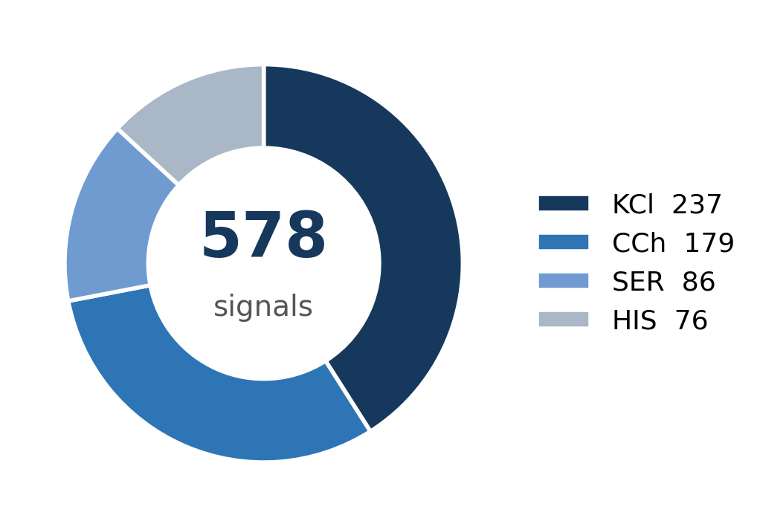
DATASET
A curated contractility signal dataset
How the dataset was built
Tracheal and bladder tissues were isolated from 50 Balb/c mice.
Contractile force was recorded in an organ bath or DMT myograph.
Tissues were stimulated with KCl, carbachol, serotonin and histamine.
Signals were exported from LabChart 8 and released on Hugging Face.
Mechanism of Action of Pharmacological Agents: A Deep Learning Prediction Model Using Smooth Muscle Contractility Signals
5
Notes:
The dataset was built from tracheal and bladder tissue of 50 mice, with contractile force recorded in an organ bath or myograph. Tissues were stimulated with four agents — KCl, carbachol, serotonin and histamine — giving 578 signals (237 / 179 / 86 / 76). Note the class imbalance, which matters for sensitivity later. The data is openly available.

Slide 6
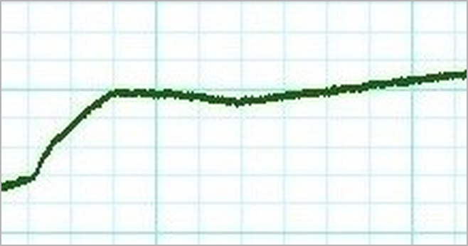
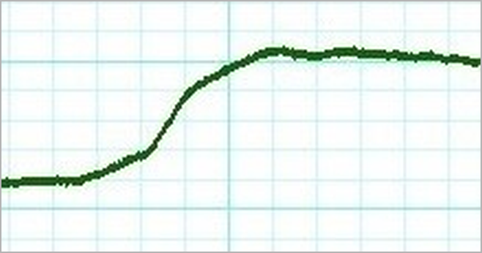
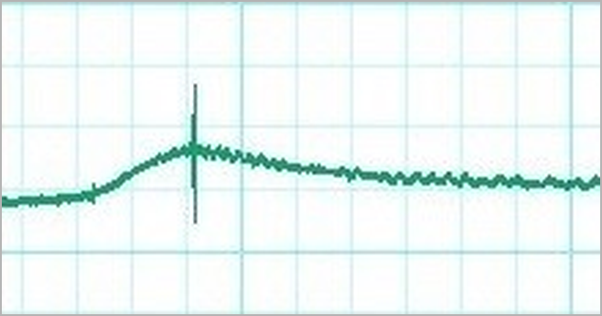
DATASET
Four agents, four signal signatures
KCl
Carbachol (CCh)
Calcium channel modulation
Muscarinic receptor activation
237 signals
179 signals
Serotonin (SER)
Histamine (HIS)
Serotonergic receptor pathway
Histaminergic receptor pathway
86 signals
76 signals
Mechanism of Action of Pharmacological Agents: A Deep Learning Prediction Model Using Smooth Muscle Contractility Signals
6
Notes:
Each agent produces a distinct signal: KCl gives a sustained contraction, carbachol a cumulative staircase, and serotonin and histamine their own rise-and-plateau shapes. These differences are real but subtle and noisy, so fixed rules struggle and a learned model is well suited.

Slide 7
PROPOSED METHOD
A hybrid CNN–Transformer pipeline
Input signal
→
1D Conv
encoder
→
Embedding &
Tokenization
→
Transformer
× 5
→
Classifier
Each raw trace is normalised and resampled to a fixed length of 10,000 samples. This keeps every input the same size and preserves its temporal structure.
Three Conv1D layers with batch-norm and GELU extract local waveform features. The channels grow from 1 to 768 as the signal is progressively downsampled.
The feature map is reshaped into a sequence of tokens. A learnable class token and positional embeddings are added to preserve temporal order.
Five pre-norm self-attention blocks (8 heads, d=768) capture long-range dependencies. A 768→3072→768 feed-forward network follows each attention layer.
Only the class token is carried forward for prediction. A layer-norm and linear layer then map it to one of the four mechanism classes.
Output classes: Calcium channel modulation · Muscarinic · Serotonergic · Histaminergic receptor pathway
Mechanism of Action of Pharmacological Agents: A Deep Learning Prediction Model Using Smooth Muscle Contractility Signals
7
Notes:
The model has four stages. The raw signal is normalised and resampled to 10,000 samples. A 1D convolutional encoder (three layers, channels 1→768) extracts local features. These become tokens with a class token and positional embeddings, processed by five Transformer blocks (8 heads, d=768) for global context. The class token is then classified into one of four mechanisms. In short: convolution for local detail, attention for global context.

Slide 8
EXPERIMENTS
Training & evaluation protocol
5-fold
Adam
4 metrics
RTX 3060
Stratified cross-validation
80 / 20 split · seed 42
lr 1e-5 · batch 16
50 epochs
Accuracy · Precision
Sensitivity · F1
PyTorch
Ubuntu 22.04
Benchmarked against 4 classical ML and 6 deep models (ResNet, Inception, EfficientNet, MobileNet, ConvNeXt, Swin)
Mechanism of Action of Pharmacological Agents: A Deep Learning Prediction Model Using Smooth Muscle Contractility Signals
8
Notes:
Evaluation used 5-fold stratified cross-validation (80/20 split, seed 42). Deep models were trained with Adam (lr 1e-5, batch 16, 50 epochs, cross-entropy). We report accuracy, precision, sensitivity and F1, since accuracy alone is misleading under class imbalance. The model is compared against four classical and six deep baselines.

Slide 9
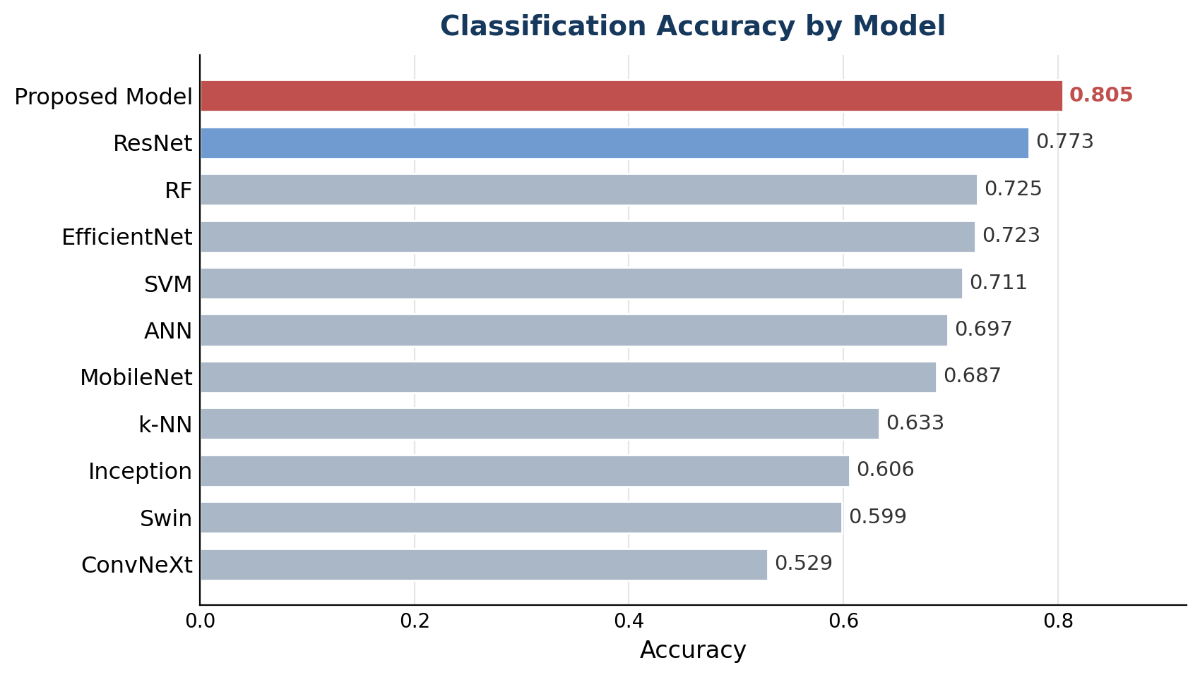
RESULTS
Best-in-class across every metric
0.8046
0.8097
Accuracy
Precision
0.7651
0.7763
Sensitivity
F1-score
Our model beats the strongest baseline (ResNet) by about 3% in accuracy and precision.
Mechanism of Action of Pharmacological Agents: A Deep Learning Prediction Model Using Smooth Muscle Contractility Signals
9
Notes:
The proposed model reaches 80.5% accuracy, 81.0% precision, 76.5% sensitivity and 0.776 F1, leading on every metric. It improves on the strongest baseline, ResNet, by about 3% in accuracy and precision. Notably, the image-transformer models (ConvNeXt, Swin) perform worst — explained on the next slide.

Slide 10
RESULTS
Full benchmark
Model | Accuracy | Precision | Sensitivity | F1-score
k-NN | 0.6333 | 0.6082 | 0.5631 | 0.5615
SVM | 0.7111 | 0.7220 | 0.6513 | 0.6720
RF | 0.7249 | 0.7108 | 0.6775 | 0.6830
ANN | 0.6972 | 0.6783 | 0.6287 | 0.6359
ResNet | 0.7734 | 0.7775 | 0.7483 | 0.7580
Inception | 0.6056 | 0.6568 | 0.5452 | 0.5628
EfficientNet | 0.7233 | 0.7248 | 0.6748 | 0.6896
MobileNet | 0.6869 | 0.7004 | 0.6582 | 0.6711
ConvNeXt | 0.5294 | 0.5792 | 0.4594 | 0.4604
Swin | 0.5987 | 0.6450 | 0.5895 | 0.6008
Proposed Model | 0.8046 | 0.8097 | 0.7651 | 0.7763
Mechanism of Action of Pharmacological Agents: A Deep Learning Prediction Model Using Smooth Muscle Contractility Signals
10
Notes:
The full table compares all eleven models on the four metrics. Classical methods sit in the 0.63–0.72 range, and ResNet is the strongest baseline at 0.773. The proposed model (bottom row) is best in every column. This slide is kept for detailed questions.

Slide 11
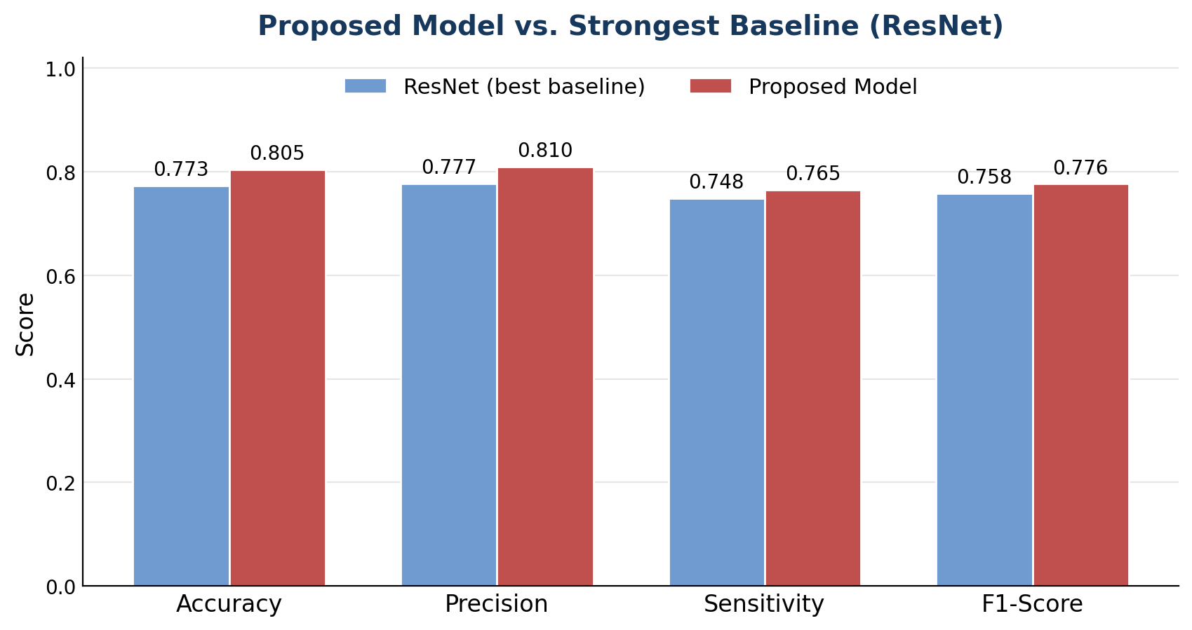
DISCUSSION
Why the hybrid design wins
Local and global, together
The convolutional encoder captures local waveform features.
The Transformer captures long-range temporal context.
Image models such as ConvNeXt and Swin do not transfer to 1D signals.
Higher precision than sensitivity makes the model conservative.
Mechanism of Action of Pharmacological Agents: A Deep Learning Prediction Model Using Smooth Muscle Contractility Signals
11
Notes:
The hybrid wins by combining two scales: the CNN captures local waveform shape, while the Transformer captures long-range structure. Image-transformer models (ConvNeXt, Swin) underperform because a 2D bias does not transfer to 1D signals. Precision exceeds sensitivity, so the model is conservative — accurate when positive, but missing some minority-class cases.

Slide 12
OUTLOOK
Limitations & next steps
Limitations
Future work
The dataset is still limited in size.
Only four mechanism classes are covered.
Class imbalance reduces sensitivity on smaller classes.
We will enlarge the dataset and add more mechanism classes.
We will address class imbalance with data augmentation.
We will add interpretable attention and real-time scoring.
Mechanism of Action of Pharmacological Agents: A Deep Learning Prediction Model Using Smooth Muscle Contractility Signals
12
Notes:
Limitations: the dataset is modest in size, covers only four mechanisms, and the class imbalance lowers sensitivity on smaller classes. Future work will enlarge the dataset, address imbalance with augmentation, add interpretable attention, and move toward real-time scoring during experiments.

Slide 13
CONCLUSION
Takeaways
Inferring the mechanism of action from contractility signals can be framed as a data-driven classification problem.
1
Our hybrid CNN–Transformer outperforms classical machine learning and modern deep models, reaching 80.5% accuracy and 0.776 F1.
2
The approach reduces manual work and improves reproducibility, and it can help accelerate preclinical drug discovery.
3
Dataset: huggingface.co/datasets/pharmaiktu/contractility-signals
Notes:
Three takeaways: MoA inference from contractility signals can be framed as classification; the hybrid CNN–Transformer beats classical and deep baselines (80.5% accuracy, 0.776 F1); and the approach reduces manual work and improves reproducibility, supporting preclinical drug discovery. The dataset is openly available.

Slide 14


Thank you
Questions & discussion welcome
WITH THANKS TO OUR INSTITUTIONS AND FUNDERS
Karadeniz Technical University
Trabzon University
Trabzon, Türkiye
Trabzon, Türkiye
Project 125E093
Project 35726
Funding: TÜSEB (Project 35726) · TÜBİTAK (Project 125E093)
Dataset: huggingface.co/datasets/pharmaiktu/contractility-signals
PharmAI · Karadeniz Technical University & Trabzon University
Notes:
Acknowledge funding from TUSEB (project 35726) and TUBITAK (project 125E093), and the two universities. Likely questions: the sensitivity/imbalance gap, the choice of five Transformer blocks and eight heads, the 10,000-sample input length, and generalisation to other tissues or agents.

