Slide 1
The 12th International Conference on Computer Technology Applications (ICCTA 2026)
June 17–19, 2026 · Vienna, Austria · FH JOANNEUM University of Applied Sciences
A Novel Neuro-Focus Fusion Framework for Fully Focused Microscopic Imaging
Beyza Aktürk · Ramazan Özgür Doğan · Ümit Uzun · Sena F. Sezen · Hülya Doğan
Karadeniz Technical University
Trabzon University
Notes:
Good morning / afternoon, everyone, and thank you for being here. I'm presenting our work on Neuro-Focus Fusion — a new way to turn a stack of microscope photos taken at different focus depths into one photo where everything is sharp. This is joint work between Karadeniz Technical University and Trabzon University. The problem is simple to state: at high zoom, a microscope can only keep a thin slice of the sample in focus at once. Our method learns the fully sharp image with a small neural network, and it beats the existing methods on every quality score we measured.

Slide 2
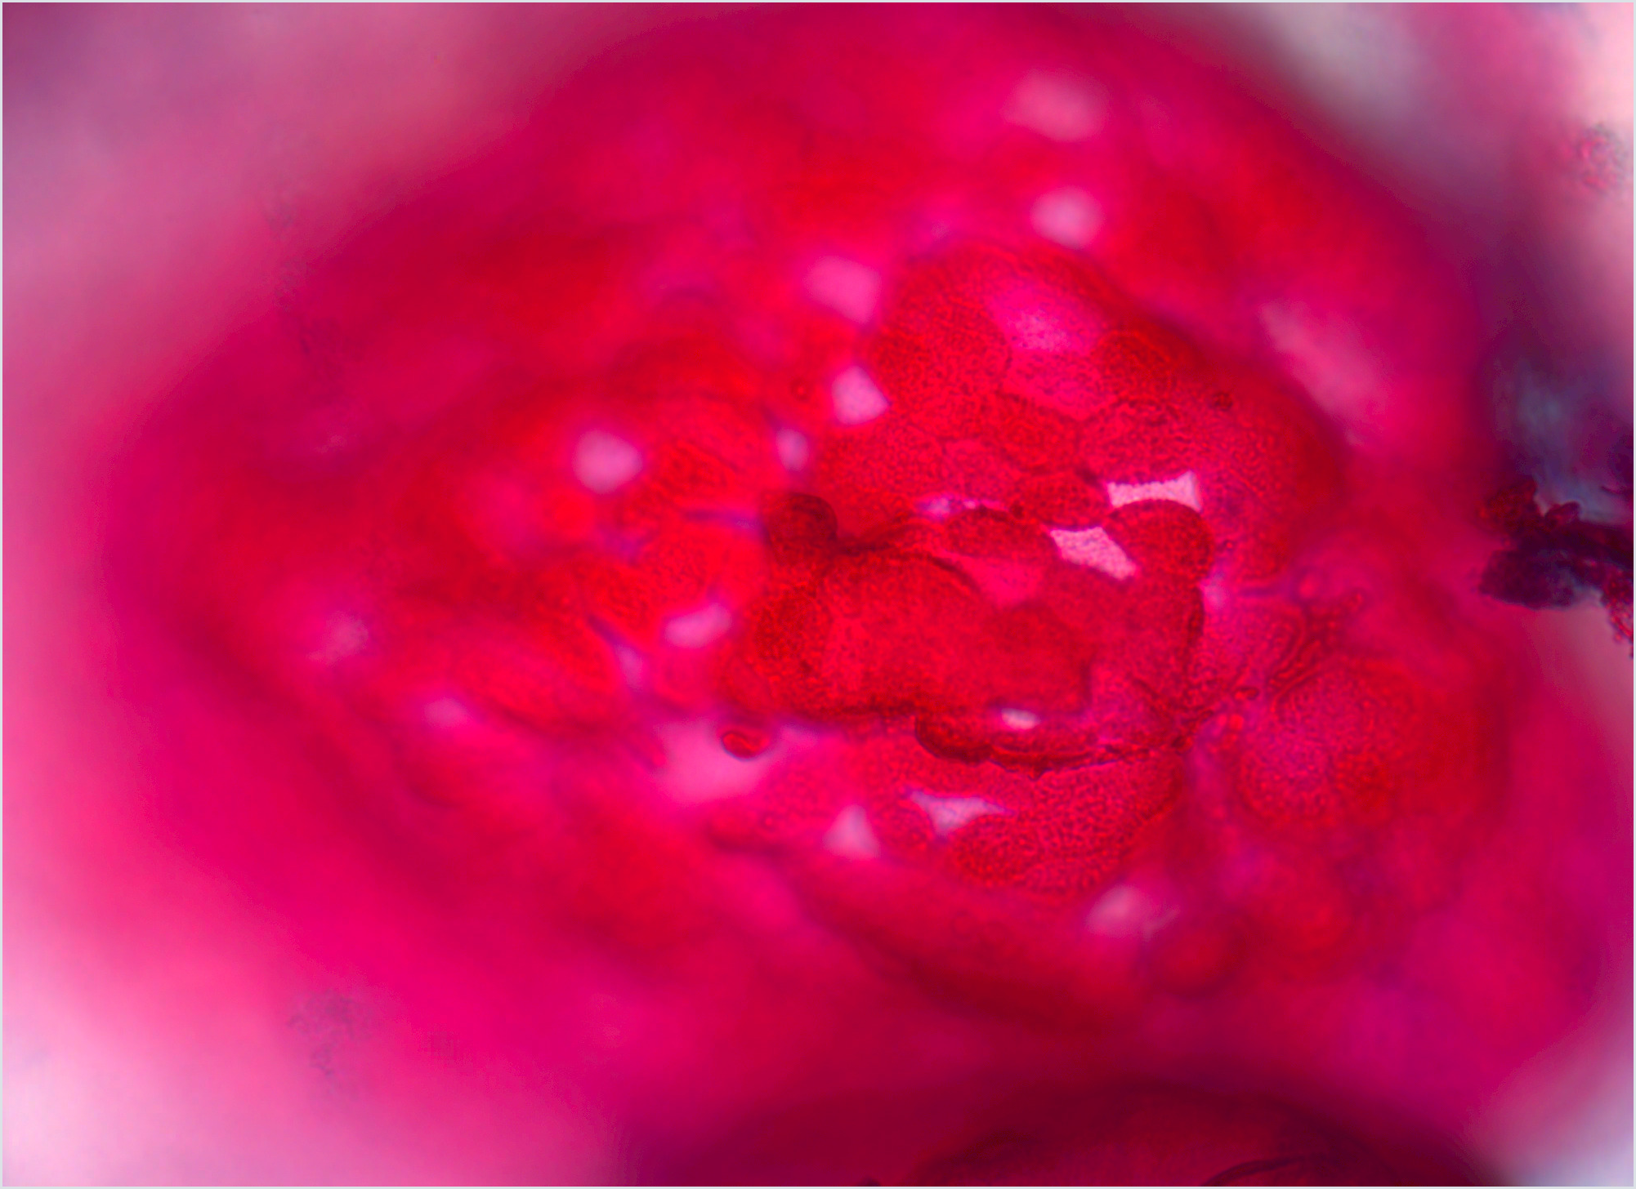
BACKGROUND
The focus problem in microscopy
1
At high magnification, only a thin slice of the sample is in focus, so structures at other depths look blurry.
2
This missing detail makes microscope images hard to read and hard to measure accurately.
3
Our goal is to build a single, fully sharp image from a stack of photos taken at different focus depths.
In this microscope photo, only part of the image is in focus.
A Novel Neuro-Focus Fusion Framework for Fully Focused Microscopic Imaging
2
Notes:
Let me set the scene. Every microscope has a limited focus range, and at high zoom that range is very small — only a thin slice of the sample is sharp at any one time. Everything above or below that slice is blurry. So important structures that sit at different depths can't all be sharp in a single photo, and that missing detail makes the images hard to read and hard to measure. The common fix is to take a stack of photos, each focused at a different depth, and the question we answer is how to combine that stack into one photo where everything is in focus.

Slide 3
THE PROBLEM
Why current methods fall short
Special optics
Pixel rules
Transform methods
Deep learning
Extra lenses and masks work, but they are expensive and hard to reuse on other microscopes.
Simple sharpness rules are easily fooled by noise and leave errors at edges.
Wavelet and DCT methods need hand-tuning and can blur the image or add ripples.
Current networks struggle to keep both the big picture and the fine focus, and don't transfer well.
A Novel Neuro-Focus Fusion Framework for Fully Focused Microscopic Imaging
3
Notes:
Why do we need something new? There are four common ways to solve this, and each has a real drawback. The first is special optics — extra lenses or masks on the microscope. They work, but they are costly and don't carry over to other microscopes. The second is simple pixel rules that pick the sharpest pixel using basic math; these are easily fooled by noise and leave errors at edges. The third is transform methods like wavelets or the DCT; they handle structure better but need hand-tuning and can blur the image or add ripples. And the fourth is modern deep learning, which is powerful but struggles to keep both the overall structure and the fine focus, and often doesn't work well on new kinds of samples. Our method is built to avoid all four of these problems.

Slide 4
CONTRIBUTION
Neuro-Focus Fusion (NFF)
01
02
A smooth, learned image
Sharp by design
The network learns the sharp image as one smooth function.
A small network replaces picking pixels one by one.
This avoids the seams and breaks of stacking methods.
Turning each position into 42 numbers helps capture fine detail.
It learns on its own — no hand-tuning needed.
It is small and works on many kinds of samples.
A Novel Neuro-Focus Fusion Framework for Fully Focused Microscopic Imaging
4
Notes:
Our contribution is Neuro-Focus Fusion, or NFF, and it has two ideas. The first is a change in how we represent the image. Instead of picking sharp pixels out of the stack, we let a small network learn the sharp image as one smooth function of position. Because the image is now smooth rather than stitched together from pixels, we naturally avoid the seams and breaks that stacking methods create. The second idea is what makes it sharp. A plain network that maps a position straight to a colour tends to give a blurry result, so we first turn each position into 42 numbers, which lets the network show fine, sharp detail. The whole thing learns on its own with no hand-tuning, it is small, and it works on very different kinds of samples.

Slide 5
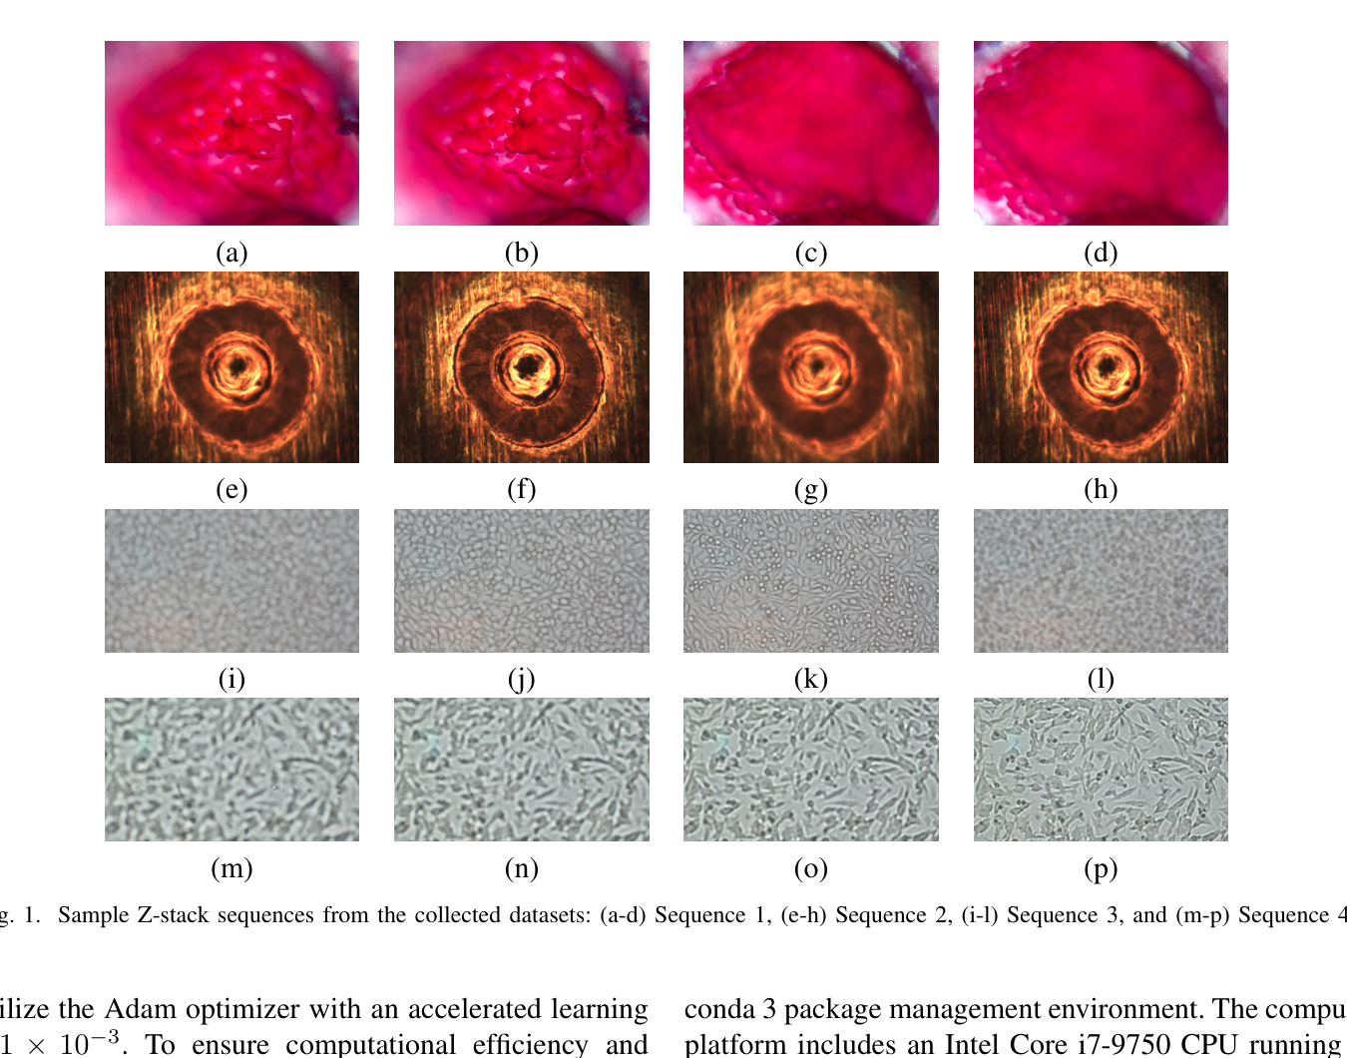
DATASETS
Four very different photo stacks
Stack 1 is biological tissue, captured on a Zeiss microscope at 1996×1450 pixels with 20 photos.
Stack 2 is an industrial laser-welding surface, captured at 1024×768 pixels with 13 photos.
Stack 3 is neuroblastoma cells, imaged with a 20× microscope at 3840×2160 pixels with 53 photos.
Stack 4 is fibroblast cells, imaged with a 20× microscope at 3840×2160 pixels with 37 photos.
These are example photos from each stack.
A Novel Neuro-Focus Fusion Framework for Fully Focused Microscopic Imaging
5
Notes:
To test how well the method holds up, we chose four very different photo stacks — you can see examples on the right. Stack 1 is biological tissue, about 2000 by 1450 pixels with 20 photos. Stack 2 jumps to an industrial sample — laser-welding surfaces — to check the method on material rather than cells. Stacks 3 and 4 are high-resolution cell images, neuroblastoma and fibroblast cells, at roughly 4K resolution with 53 and 37 photos each, giving deep focus coverage. By mixing biological and industrial samples, low and high photo counts, and very different textures, this is a tough test of how general the method is.

Slide 6
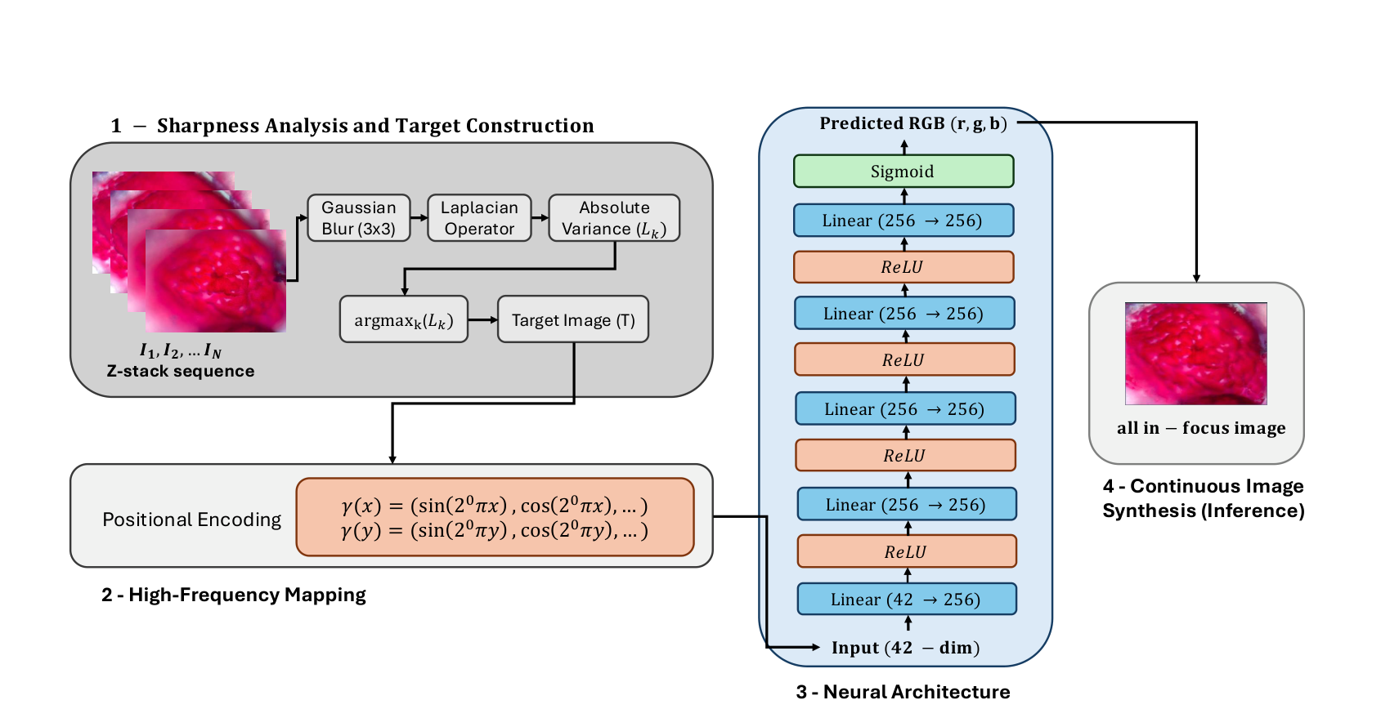
PROPOSED METHOD
How NFF works — four steps
1
First, we measure how sharp each pixel is across the stack and keep the sharpest one everywhere, which builds a single sharp target image to learn from.
2
Next, each pixel position is turned into 42 numbers using sine waves, so the network can show fine, sharp detail instead of a blur.
3
Then, a small network with four layers of 256 units predicts the colour at each pixel, and it is trained to match the sharp target image.
4
Finally, the whole in-focus image is created in a single pass, giving a smooth result with no seams.
Fig. 2 · How the four steps fit together
A Novel Neuro-Focus Fusion Framework for Fully Focused Microscopic Imaging
6
Notes:
Here is the whole method in four steps, shown in the diagram on the right. Step one: we find the sharp parts. We lightly smooth each photo to reduce noise, measure how sharp each pixel is, and keep the sharpest one everywhere. That gives us a single sharp target image that tells the network where the in-focus detail should be. Step two: we turn each pixel position into 42 numbers using sine waves. This sounds technical, but the idea is simple — feeding raw positions to the network gives a blurry result, and these extra numbers let it show fine, sharp detail. Step three: a small network — four layers of 256 units — takes those numbers and predicts the colour at each pixel, and we train it to match the sharp target. Step four: once it is trained, the whole in-focus image is created in a single pass, and because it is one smooth function, the result has no seams and handles small shifts between photos well.

Slide 7
EXPERIMENTS
Setup & how we measured quality
PyTorch
Adam
RTX 3060
No perfect
image
Python 3.12
Ubuntu 22.04
learning rate 1e-3
small batches
Intel i7-9750
16 GB RAM
so we use
no-reference scores
Because there is no perfect reference image, we use four no-reference scores: NIQE and BRISQUE should be low (how natural and how distorted), while PSI and Entropy should be high (how sharp and how detailed).
A Novel Neuro-Focus Fusion Framework for Fully Focused Microscopic Imaging
7
Notes:
A quick word on how we tested it. Everything was built in PyTorch and trained with the Adam optimiser at a learning rate of 1e-3, processing the image in small batches so it fits on a single, ordinary RTX 3060 graphics card. The tricky part is measuring quality: our microscope stacks have no perfect, fully-sharp reference image to compare against, so we can't use the usual error measures. Instead we use four well-known scores that judge an image on its own. NIQE rates how natural the image looks and BRISQUE rates how distorted it is — for both, lower is better. PSI rates how sharp it is and Entropy rates how much detail it holds — for both, higher is better. Together they give a fair, all-round picture of quality.

Slide 8
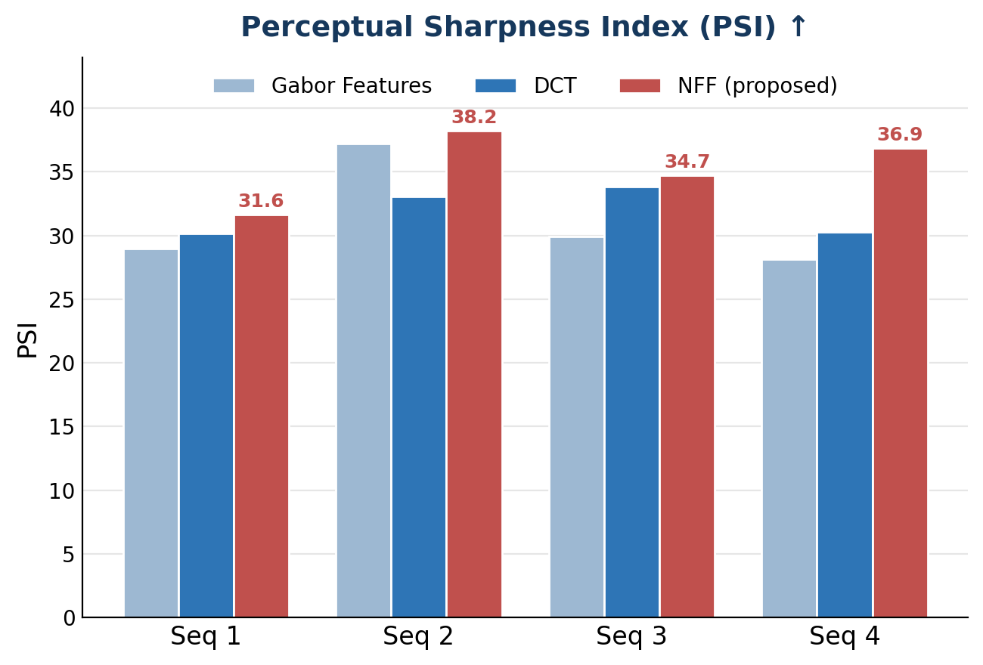
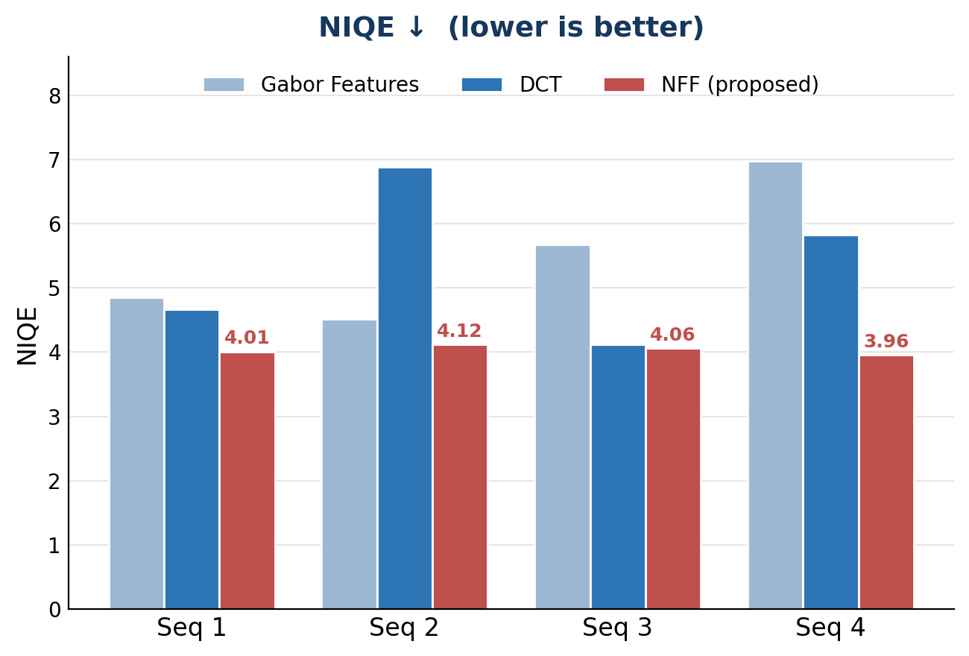
RESULTS
Best score on every quality measure
A Novel Neuro-Focus Fusion Framework for Fully Focused Microscopic Imaging
8
Notes:
Now the results. These two charts compare NFF, in red, against the two strongest older methods — DCT and Gabor features — on all four stacks. On the left is the sharpness score, PSI, where higher is better: NFF has the tallest bar in every single stack, so the extra detail step really does make the result sharper. On the right is NIQE, how natural the image looks, where lower is better: again NFF is the lowest everywhere, and notice how steady it stays — around 4 on every stack — while the older methods jump around. The takeaway is simple: across four very different samples, NFF gives both the sharpest and the most natural result, with no special tuning per sample.

Slide 9
RESULTS
Full results — Stacks 1 & 2
Photo Stack 1
Photo Stack 2
Method | NIQE↓ | BRISQUE↓ | PSI↑ | EN↑ | NIQE↓ | BRISQUE↓ | PSI↑ | EN↑
Laplacian Pyramid | 8.68 | 52.60 | 18.35 | 4.41 | 5.14 | 43.53 | 33.48 | 7.27
Gradient | 6.31 | 47.48 | 26.25 | 6.09 | 12.68 | 53.46 | 31.23 | 6.88
DCT | 4.66 | 43.69 | 30.16 | 6.77 | 6.88 | 48.32 | 33.09 | 7.17
Wavelet Transform | 6.80 | 48.46 | 23.34 | 6.57 | 9.69 | 51.30 | 32.58 | 7.13
Cross Bilateral Filter | 8.43 | 55.34 | 20.15 | 5.97 | 5.57 | 46.89 | 32.44 | 7.24
FMMEF | 8.15 | 52.16 | 23.36 | 6.17 | 6.00 | 46.08 | 33.42 | 7.18
Guided Filtering | 6.53 | 47.46 | 26.46 | 6.33 | 4.51 | 36.73 | 34.53 | 7.49
Gabor Features | 4.85 | 45.11 | 28.99 | 6.88 | 4.51 | 35.97 | 37.25 | 7.48
NFF (ours) | 4.01 | 43.16 | 31.63 | 7.01 | 4.12 | 33.19 | 38.23 | 7.52
Lower is better for NIQE and BRISQUE; higher is better for PSI and Entropy. Stacks 3 & 4 show the same result — NFF best on all scores.
A Novel Neuro-Focus Fusion Framework for Fully Focused Microscopic Imaging
9
Notes:
For the full picture, here are all the numbers for the first two stacks, against eight older fusion methods. The four columns on the left are Stack 1, the four on the right are Stack 2. Remember: the down-arrow scores, NIQE and BRISQUE, want low values, and the up-arrow scores, PSI and Entropy, want high values. Our NFF row, highlighted at the bottom, wins every single column — the lowest NIQE and BRISQUE and the highest PSI and Entropy, on both stacks. I'll keep this up for questions, but the short version is that NFF isn't just slightly ahead; it is the best on all four scores, and Stacks 3 and 4, which I left out for space, show exactly the same result.

Slide 10
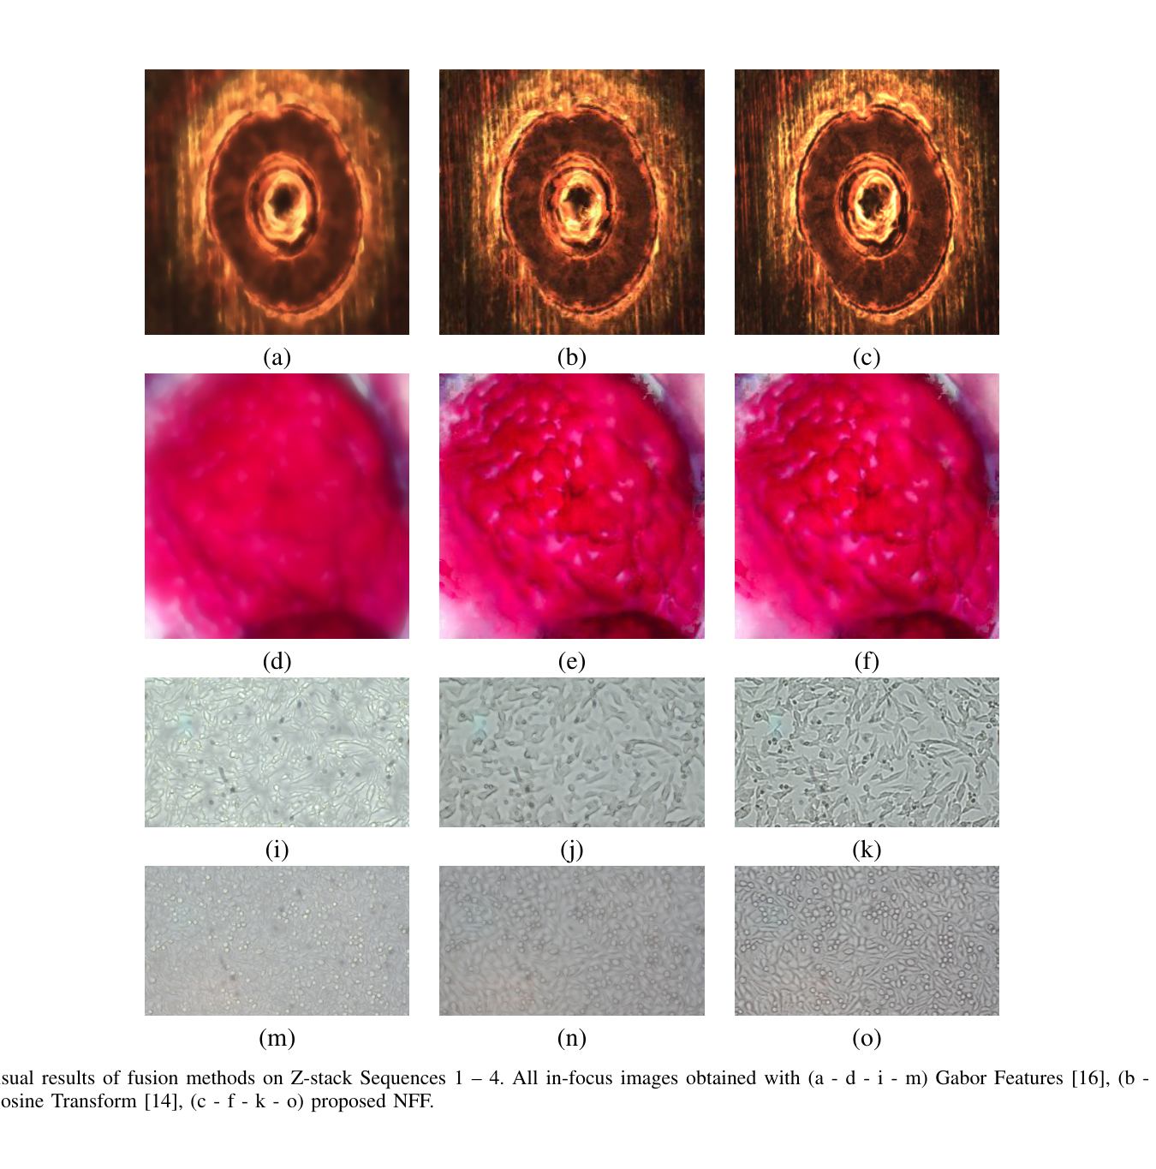
RESULTS
Sharper, cleaner results
In each row, the columns are Gabor, DCT, and our NFF, from left to right.
NFF removes the leftover blur and edge errors of older methods.
Edges and small details look clearly sharper.
The result is smooth and natural, with no seams.
A Novel Neuro-Focus Fusion Framework for Fully Focused Microscopic Imaging
10
Notes:
Numbers are convincing, but for a paper about image quality, seeing it matters most. In this figure each row is one sample, and the three columns are Gabor features on the left, the DCT in the middle, and our NFF on the right. Look along any row: the two older methods leave some blur and visible errors, especially at edges, while the NFF column on the right is clearly sharper and cleaner. Small details and edges that are smeared in the other columns come back crisply with NFF, and because the image is built as one smooth result rather than stitched from pixels, there are no blocky seams. This is the visual version of the higher sharpness scores we just saw.

Slide 11
DISCUSSION
Why this approach wins
A smooth model avoids the seams of pixel-picking methods.
Turning positions into numbers brings back the fine detail a network would lose.
Because it learns a smooth result, it handles small shifts in the stack well.
It learns on its own and fits each sample without any hand-tuning.
Best in class
NFF scores best on all four measures — NIQE, BRISQUE, PSI and Entropy — across every photo stack.
The method stays robust, lightweight and flexible.
A Novel Neuro-Focus Fusion Framework for Fully Focused Microscopic Imaging
11
Notes:
So why does this approach win? Four reasons. First, by learning one smooth image instead of choosing among pixels, we avoid the seams that pixel-picking methods leave at edges. Second, turning positions into numbers brings back the fine detail a plain network would smooth away — that's what drives the higher sharpness scores. Third, because it fits one smooth result over the whole image, it is forgiving of small shifts between the photos in the stack. And fourth, the whole thing learns on its own, so unlike the transform methods it needs no hand-tuning and adapts itself to each sample. The result, on the right, is the best score on all four measures across all four stacks, from a method that stays robust, small and flexible.

Slide 12
CONCLUSION
Takeaways
NFF learns the fully sharp image as one smooth function, instead of picking pixels.
1
It gets the best scores on all four quality measures across very different samples.
2
It is robust, lightweight and flexible — useful for digital pathology and material science.
3
Next, we plan to build real-time tools and automatic cell analysis for digital pathology.
Notes:
To wrap up, three takeaways. First, the core idea: NFF learns the fully sharp image as one smooth function, instead of picking or blending pixels. Second, the payoff: it gets the best score on all four quality measures — NIQE, BRISQUE, PSI and Entropy — across both biological and industrial samples. Third, the practical value: it is robust, small and flexible, which makes it a good fit for high-resolution microscopy in digital pathology and material science. Looking ahead, we want to build this into real-time tools to support automatic cell analysis. Thank you.

Slide 13

Thank you
Questions & discussion welcome
WITH THANKS TO OUR INSTITUTIONS AND FUNDER
Karadeniz Technical University
Trabzon University
Drug & Pharm. Tech. Center
Trabzon, Türkiye
TÜBİTAK · Project 125E093
Supported by TÜBİTAK Research Project 125E093.
PharmAI · Karadeniz Technical University & Trabzon University
Notes:
Thank you very much for your attention — I'd be glad to take your questions. I want to thank the Karadeniz Technical University Drug and Pharmaceutical Technology Center for their support, and our funder TÜBİTAK, under project 125E093. Some questions I'm ready for: how we choose how many numbers to use for each position; how training time grows with image size and the number of photos; how well it copes with noisy stacks; and how it could be made to run in real time. Thank you.

