Slide 1
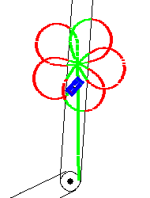
P545 Term Project
Doga Tuncay
Kurt Weisman
Hasan Kurban

Slide 2
Ideas
Speed Control
Path Planning
Tactical Maneuvers
Obstacle Avoidance

Slide 3
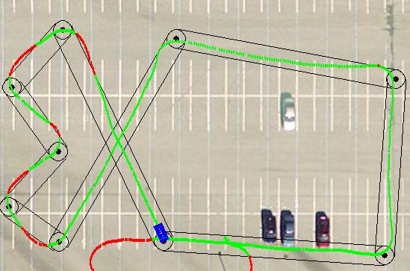
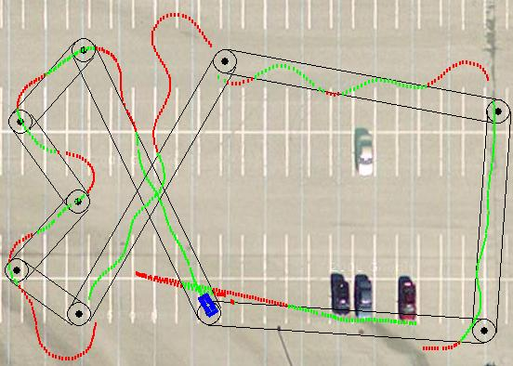
Observations of Speed Control
Throttle : %70
Throttle : %50

Slide 4
“Speed Control”
Change the breaking and throttle percentages between %45 - %80 to get the best result when the Cart comes to turning points and between the waypoints
Slowing down and speeding up by checking distances (For ex. Distance to turn > 7 meters speed up , distance to turn < 3 meters slow down)
Way points passing speed – Finding the optimum speed of passing the way points

Slide 5
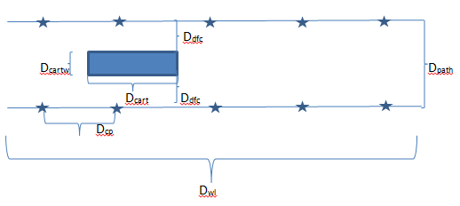
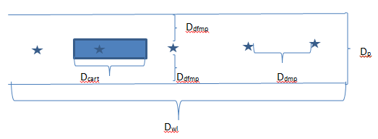
Observations of Path Planning
Horizontal Control
Vertical Control

Slide 6
Horizontal Control Parameters
D_{cart} : Length of the cart
D_{cp} : Length of check points
D_{wl} : Length of the road between two waypoints
D_{cartw} is the width of the cart
D_{dfc} is the perpendicular difference from cart to the borders of the path
D_{path} is the width of the path
We try to check the distance from the cart to the borders of the way in every 3 meters (The length of the cart) by using GPS system. We will keep the same distance from the left and right side of the cart by using check points and the calculation of distances.

Slide 7
Path Planning
Vertical Control is easier and logical
Managed by creating synthetic points between two waypoints.
Targeted the synthetic points
Done by dividing path by 2, 4 , 8 , 16 ..
There is no need to use synthetic points for the distances between two waypoints < certain distance

Slide 8
Parameters of Vertical Control
D_{cart} : Length of the cart
D_{mp} : Length of middle points
D_{wl} : Length of the road between two waypoints
D_{dfmp} is the perpendicular distance from middle points to the borders
D_{path} is the width of the path
D_{dmp :} distance between two middle points
We try to set some aritmatical middle points and set them as our aim.

Slide 9
Parameters of Vertical Control
D_{cart} : Length of the cart
D_{mp} : Length of middle points
D_{wl} : Length of the road between two waypoints
D_{dfmp} is the perpendicular distance from middle points to the borders
D_{path} is the width of the path
D_{dmp :} distance between two middle points
We try to set some aritmatical middle points and set them as our aim.

Slide 10
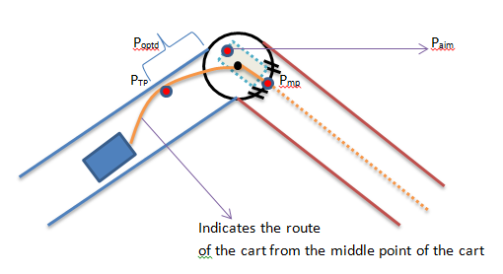
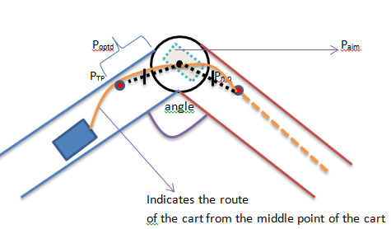
Observations of Tactical Maneuvers

Slide 11
Parameters of Tactical Maneuvers
We have a way point circle with the radius of 3 meters and we have a middle point of P which splits the arc of the waypoint into two equal parts. We will try to get to the P_{mp} point by calculating the optimum P_{optd} which is the optimum distance from the waypoint and P_{TP} where is the point the cart will start getting close to the border. After we get closer to the P_{Tp} we will aim the P_{aim} where is the optimal turning point to be able to aim the cart’s from as perpendicular as possible to the P_{mp} point.
We have three calculations here : P_{TP} , P_{aim} , P_{mp}
This figure will be the same but to the different directions when heading to different directions, East or West.

Slide 12
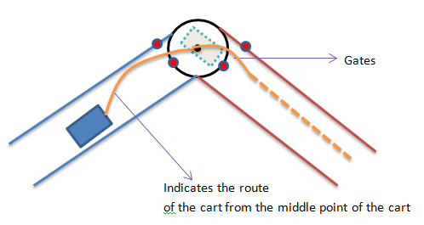
Path Planning
Better strategy
Easier
Not too many geometrical calculations

Slide 13
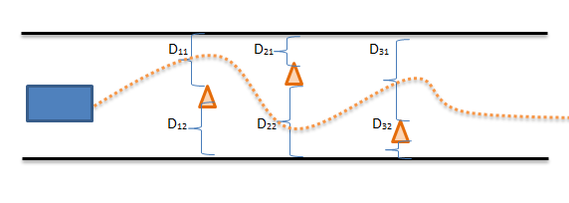
Observations of Obstacle Avoidence
Finding the distances from left and right of the obstacles and decide whether you go left or right by comparing the distances

Slide 14
Logic Of the Obstacle Avoidance
If obstacle_lat >= wp_lat:
    If obstacle_lon <= wp_lon:
        new_sytnp = [obstacle_lat + c, obstacle_lon +c]
    else:
        new_sytnp = [obstacle_lat + c, obstacle_lon - c]
else:
  If obstacle_lon <= wp_lon:
        new_sytnp = [obstacle_lat - c, obstacle_lon + c]

Slide 15
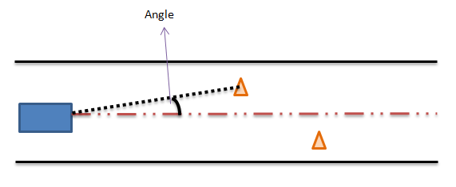
Obstacle Avoidance
The angle between from cart to obstacle and from the cart to the next waypoint, is checked with using forward_azimuth function. If the angle is smaller or equal to some angle degrees
Easier
Ease of calculations

Slide 16
Thank You !

