Slide 1
Study Of unindexed web :Presenters: Arvind Dwarakanath Chi-yang Tsao Doga Tuncay

Slide 2
Brief Recap!!
UnWeb or unindexed web are those web-pages that are not indexed by a search engine.
The project determines how a user navigates to and from unindexed web-pages.

Slide 3
Basic Tools
URL Crawler tool – utilizes a tool that scans all the reachable URLs given a root node upto a predetermined level.
Human driven Events analysis – using this tool in combination with an http analyzer returns the URLs that were traversed by a user in a session.
Scraper – uses Bing to check whether the current URL is indexed or not.

Slide 4
Storage Design of Crawler Data
The storage of Crawler Data takes place in two phases.
The URL details show the details of the URL accessed.
The storage of the link details how URL <http:/x> is a parent of <http:/y> and the access code.

Slide 5
Schema for URL details
CREATE TABLE url_crawler ( id unsigned INT NOT NULL AUTO-INCREMENT PRIMARY KEY, URL VARCHAR(700), Secured VARCHAR(10), tld VARCHAR(4), index INT(1) );
Note: The URL data type is to be unique so that we don’t store the same URL’s details multiple times.

Slide 6
Schema for Link Changes
CREATE TABLE Link ( id_1 INT, id_2 INT, http_access INT, PRIMARY KEY (id_1, id_2), FOREIGN KEY id_1 REFERENCES url_crawler(id), FOREIGN KEY id_2 REFERENCES url_crawler(id), PRIMARY KEY(id_1, id_2) );
Note: The Link value (child, parent) will be unique.

Slide 7
Storage Design of Human-Driven Events
Event_Id | Sequence_Id | Session_Id | url_name | Indexed | process | Host | IP_address
INT | INT | INT | VAR | VAR | VAR | VAR | VAR

Slide 8
Crawler Queries
Connectivity – Are 2 URLs connected?
Nearest Neighbor – Till first level
Redirect Back – How many go back to the root?
Count Broken Links/Redirects
All the queries utilize Breadth First Search Traversal to access
the next level nodes.

Slide 9
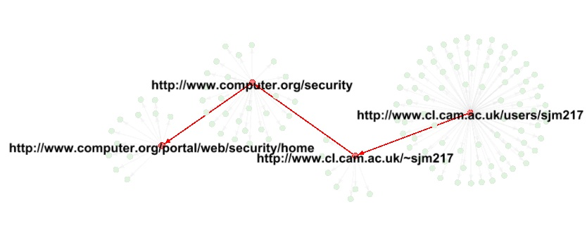
Connectivity Visualization

Slide 10
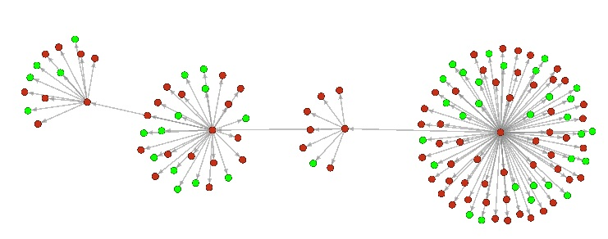
Connectivity Visualization for Indexed/Unindexed

Slide 11
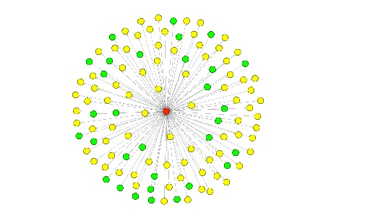
Nearest-Neighbor Visualization

Slide 12
Details for Human-Driven Events
Data Migration Code – 4 steps
Create Table
Xls to csv
Csv to Mysql
Update Session Id’s
Scraper and Index Update – 3 Steps
Mysql to Notepad (Scraper Input)
Scraper dumps to Indexed info to CSV
Csv to Mysql

Slide 13
HDE Queries
Find the consecutive URLs’ first level of URLs and common links
Finds how a user can access unindexed webpages from indexed webpages
Find out the number of indexed and unindexed webpages for a specified session
Finds the number of indexed and unindexed URLs of all sessions, output the root information and show that root URL whether a search engine or not
See the manual and screenshots hyperlink for more information http://www.dtuncay.com/documents/USER%20MANUAL%20HDE%20v2.pdf

Slide 14
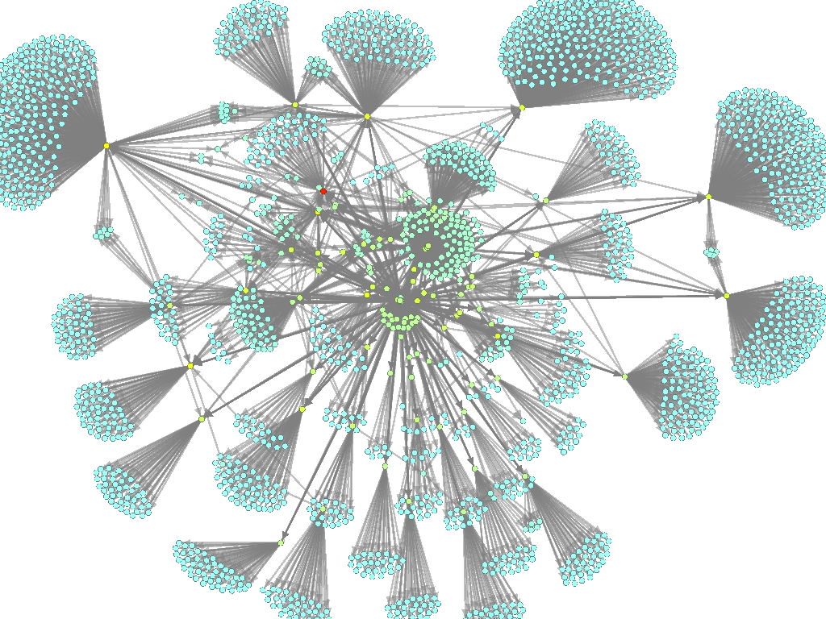
That’s all, Folks !!

