Slide 1
Ministry/ Organization name: Ministry of Health&Family Welfare
Problem Statement Number/ID: SS42
Domain Bucket: Android app development
Team Name : Ctrl Alt Defeat
Team Leader Name : Aditya Goyal
INTERNAL HACKATHON @ IET DAVV INDORE
PS and Team Details

Slide 2
Problem Statement Description
Emergencies and disasters impact population's health. Public health plays a critical role in working with health and non-health sectors responsible for preparing for and responding to emergencies. In emergencies, large numbers of people may require medical attention. Health care systems may be over-stretched, and public order may be threatened. Hence, we want software solution such that social media can be used in public health emergency response. Such tool/page/plugin should have the below capabilities.
(1) Alarm message during emergencies
(2) Providing precautinary steps to be taken during emergency/disasters
(3) Help in finding nearby available healthcare systems
(4) Providing First aid/primary steps to be taken/provided to patients, in case of emergencies/disasters.
Organization

Slide 3
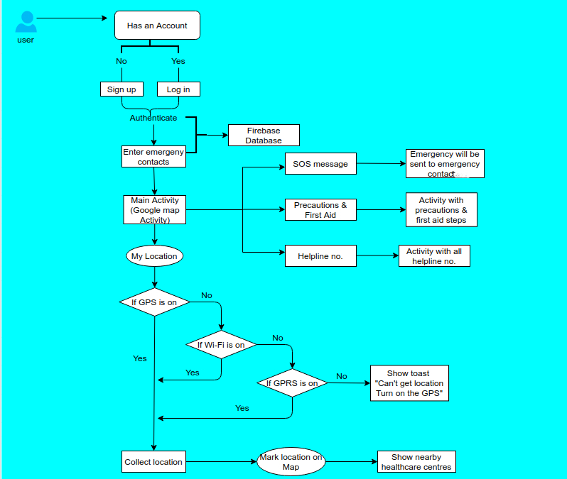
Idea / Approach details

Slide 4
Technology Selection
Android
Firebase Storage & Authentication
Google map API
JAVA

Slide 5
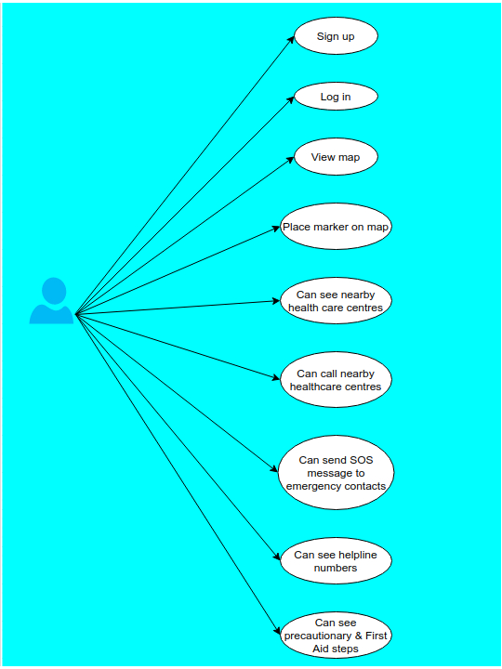
Preliminary Analysis and Design

Slide 6
Preliminary Analysis and Design
Dependencies
Show Stopper
Dependencies
1.IT technician is require for handling application
2.Web server require for accessing firebase storage
3.Web server require for accessing firebase authentication
1.Firebase authentication
2.Firebase Storage
3.Google map API

