Slide 1
Mídias
Executando sons

Slide 2
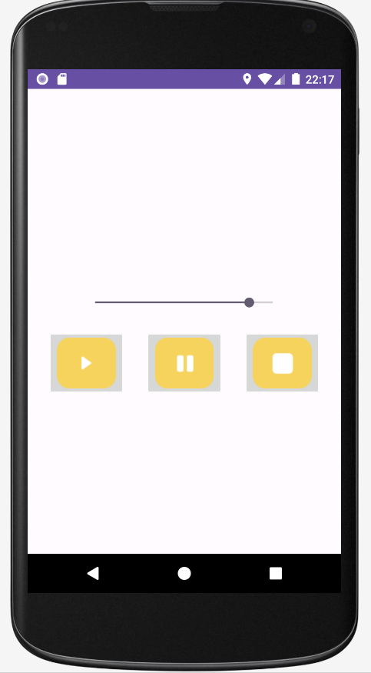

Slide 3
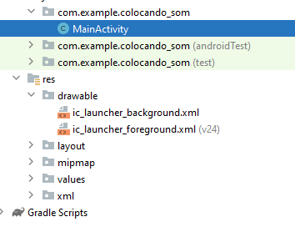
Vamos colar as imagens que estão no bit.ly

Slide 4
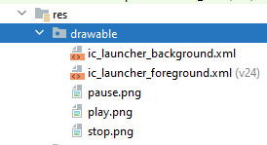

Slide 5
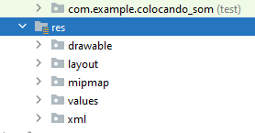
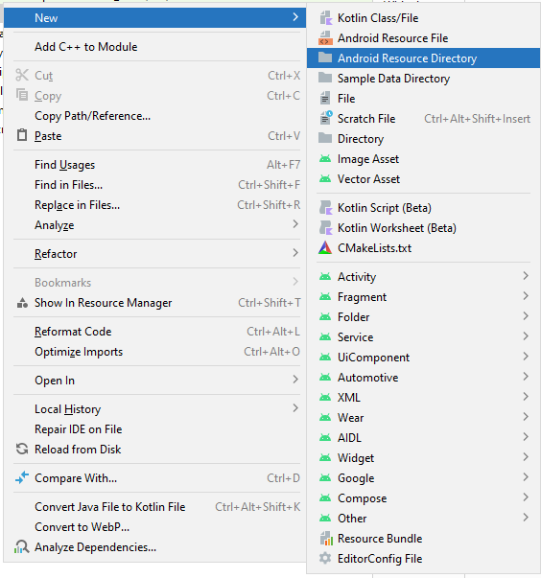

Slide 6
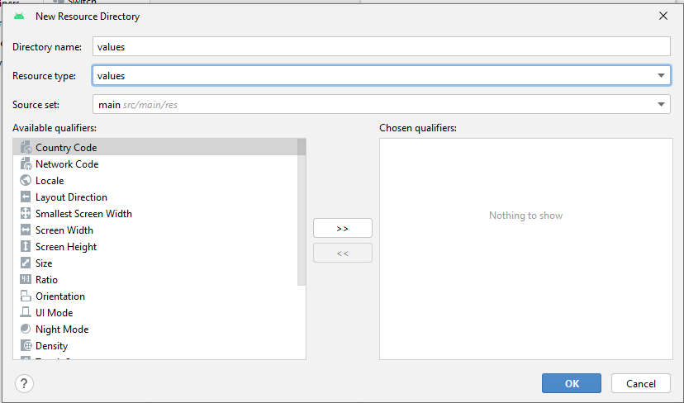

Slide 7
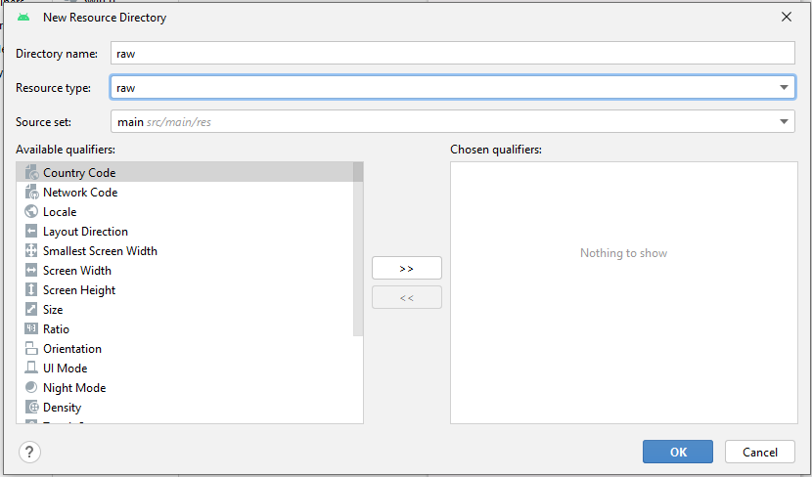
Vamos trocar para raw é utilizado para guardar arquivos de mídia

Slide 8
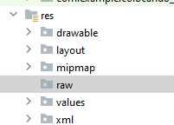

Slide 9
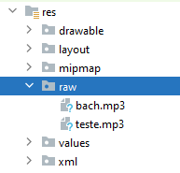
Vamos colar os arquivos de mp3

Slide 10
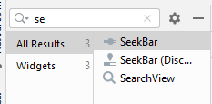

Slide 11


Slide 12
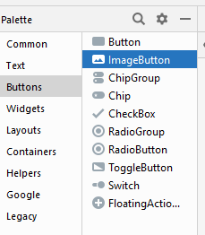

Slide 13
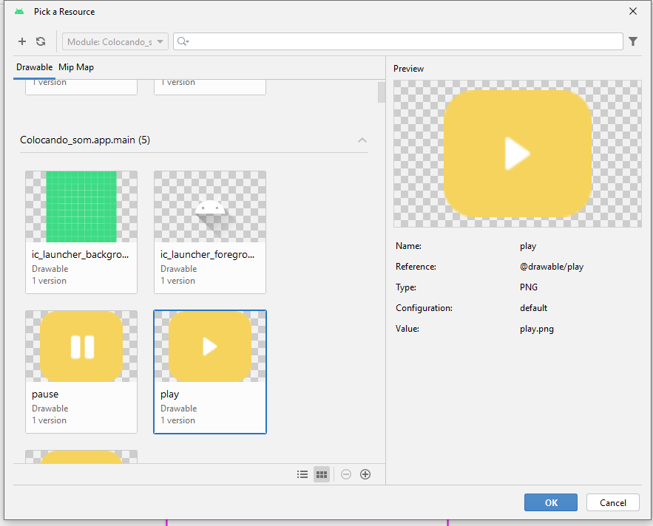

Slide 14
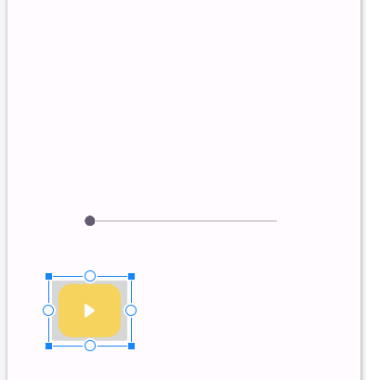

Slide 15
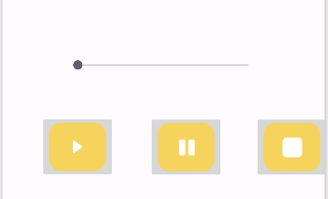

Slide 16
Selecione todos os botões

Slide 17
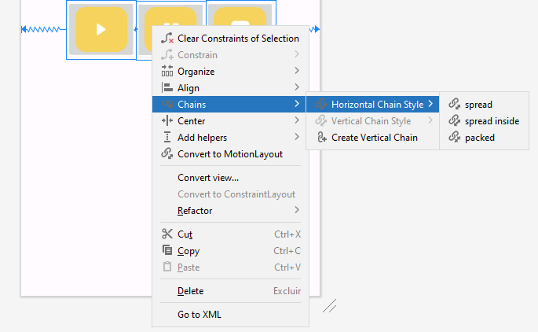

Slide 18
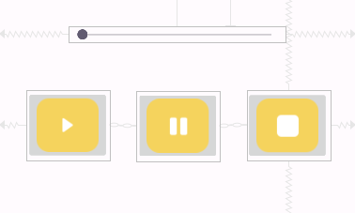

Slide 19


Slide 20
public class MainActivity extends AppCompatActivity { private MediaPlayer mediaPlayer; @Override protected void onCreate(Bundle savedInstanceState) { super.onCreate(savedInstanceState); setContentView(R.layout.activity_main); mediaPlayer = MediaPlayer.create(getApplicationContext(),R.raw.teste);

Slide 21
//criação de método public void executarSom (View view){ if (mediaPlayer != null){ mediaPlayer.start(); }

Slide 22
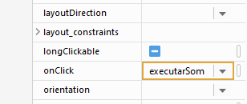

Slide 23
//pause public void pausarMusica(View view){ if(mediaPlayer.isPlaying() ){ mediaPlayer.pause(); } }

Slide 24


Slide 25
//stop public void pararMusica (View view){ if (mediaPlayer.isPlaying()){ mediaPlayer.stop(); mediaPlayer = MediaPlayer.create(getApplicationContext(),R.raw.teste); }

Slide 26


Slide 27
public class MainActivity extends AppCompatActivity { private MediaPlayer mediaPlayer; private SeekBar seekVolume;

Slide 28
protected void onCreate(Bundle savedInstanceState) { super.onCreate(savedInstanceState); setContentView(R.layout.activity_main); mediaPlayer = MediaPlayer.create(getApplicationContext(),R.raw.teste); incializarSeekBar();

Slide 29
private void incializarSeekBar(){ seekVolume = findViewById(R.id.seekVolume); //configurar o audio manager audioManager = (AudioManager) getSystemService(Context.AUDIO_SERVICE); //recupera os valores de volume máximo e o volume atual int volumeMaximo = audioManager.getStreamMaxVolume(AudioManager.STREAM_MUSIC); int volumeAtual = audioManager.getStreamVolume(AudioManager.STREAM_MUSIC); //configurar os valores máximos para o SeekBar seekVolume.setMax(volumeMaximo); //configurar o progresso atual do seekBar seekVolume.setProgress(volumeAtual);

Slide 30
//permitir arrastar seekVolume.setOnSeekBarChangeListener(new SeekBar.OnSeekBarChangeListener() { @Override public void onProgressChanged(SeekBar seekBar, int i, boolean b) { audioManager.setStreamVolume(AudioManager.STREAM_MUSIC,i,0); } @Override public void onStartTrackingTouch(SeekBar seekBar) { } @Override public void onStopTrackingTouch(SeekBar seekBar) { } });

Slide 31
// método pausar a musica quando sair do app @Override protected void onStop() { super.onStop(); if(mediaPlayer.isPlaying() ){ mediaPlayer.pause(); }

Slide 32
//detruir uma activity @Override protected void onDestroy() { super.onDestroy(); if (mediaPlayer != null && mediaPlayer.isPlaying()){ mediaPlayer.stop(); mediaPlayer.release(); mediaPlayer = null; } }

Slide 33
@Override public void onProgressChanged(SeekBar seekBar, int i, boolean b) { //alteração da flag audioManager.setStreamVolume(AudioManager.STREAM_MUSIC,i,
AudioManager.FLAG_SHOW_UI); }

Slide 35
App utilizando vídeos

Slide 36

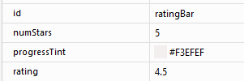
RatingBar

Slide 37
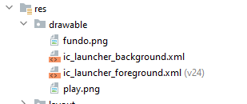

Slide 38


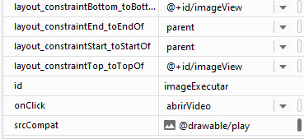
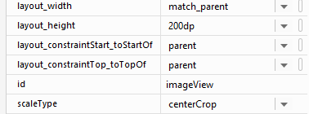

Slide 39


Slide 42
Vamos trocar para raw é utilizado para guardar arquivos de mídia

Slide 44
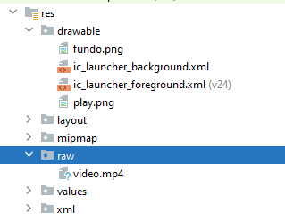

Slide 45
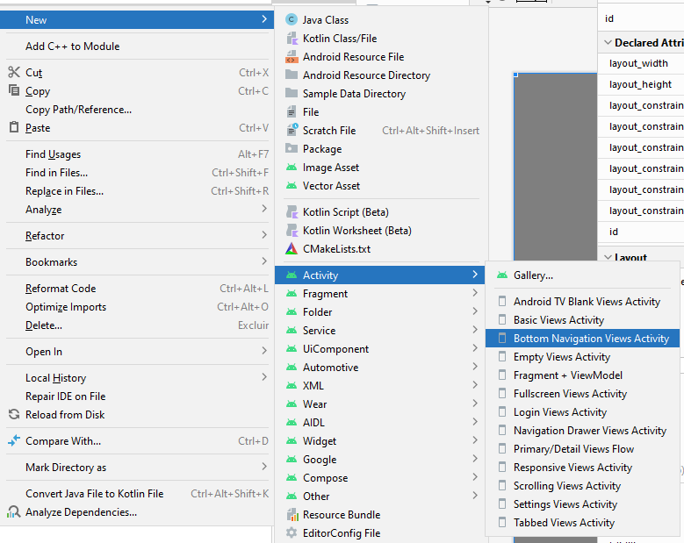
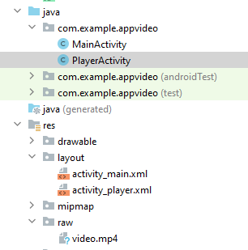

Slide 46
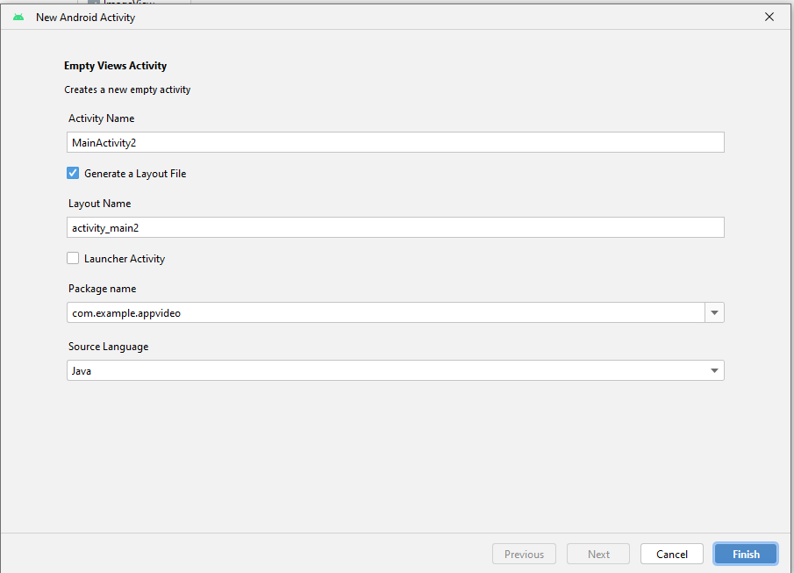
activity_player

Slide 47



Slide 49
public class MainActivity extends AppCompatActivity { @Override protected void onCreate(Bundle savedInstanceState) { super.onCreate(savedInstanceState); setContentView(R.layout.activity_main); } public void abrirVideo(View view){ startActivity( new Intent(this, PlayerActivity.class)); } }

Slide 51
public class PlayerActivity extends AppCompatActivity { private VideoView videoView; @Override protected void onCreate(Bundle savedInstanceState) { super.onCreate(savedInstanceState); setContentView(R.layout.activity_player);

Slide 52
videoView = findViewById(R.id.videoView); //modo fullscreem View decorView = getWindow().getDecorView(); int uiOpcoes = View.SYSTEM_UI_FLAG_FULLSCREEN; decorView.setSystemUiVisibility(uiOpcoes);

Slide 53
//executaro o video videoView.setMediaController(new MediaController(this));
//executa os controles padrão videoView.setVideoPath("android.resource://" +
getPackageName() + "/"+ R.raw.video);// define o caminho do video videoView.start();//executa o video } }

