Slide 1


Magpie.
Collect curiosities. Talk them through.
A personal wiki for the things you find shiny, with a conversation partner who remembers. Built for the Krava × Linq Hackathon.
MAGPIE.WIKI · FRONTIER TOWER SF · MAY 30, 2026

Slide 2






Three dimensions. Five modes. One conversation.
Every thought finds its place in a wiki that grows with you. Subject. Topic. Facet. Add bullets when something hits, then explore from any angle.
Maggie
Brief
Challenge
Questions
Convo
Voice-first capture. Tap the mic, talk, bullets appear.
A smart primer on any topic before a dinner party.
A steelman or paradox that sharpens your thinking.
Open questions that make people feel interesting.
Talk it through with Maggie. She remembers everything.
"What you collect comes out in conversation."
Text Maggie from iMessage. She captures and connects. Your wiki grows organically. Private by default.

Slide 3

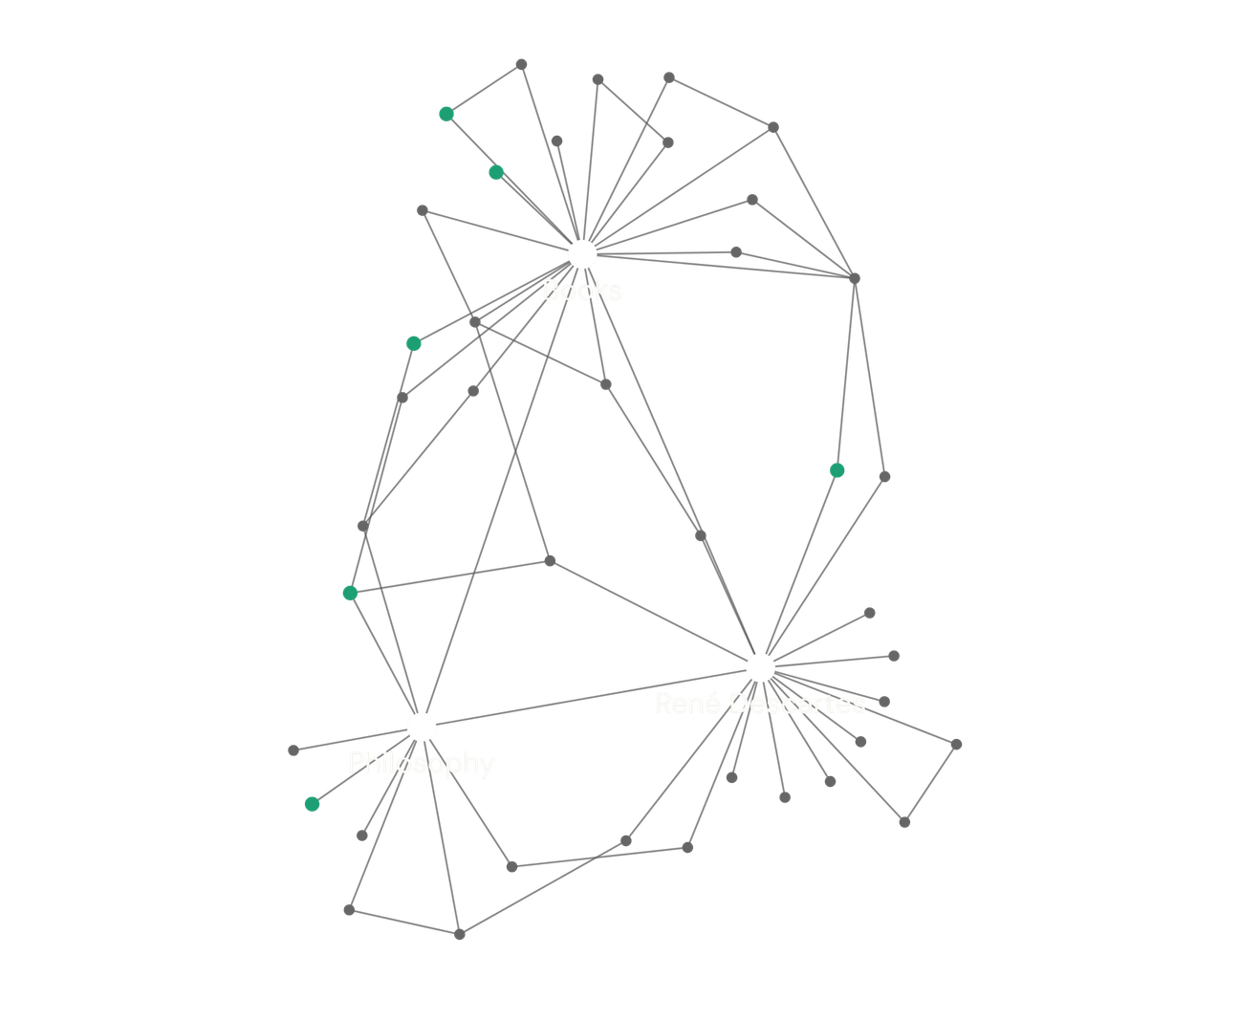
GRAPH VIEW
The connections you didn't notice.
Visualize the relationships between your notes. Find hidden patterns in your thinking through a visually engaging and interactive graph.
As your wiki grows, Maggie surfaces things you've already written about that connect to whatever you're working on now.

Slide 4


Built with serious infrastructure.
Privacy and messaging, handled by the best.
Privacy Infrastructure for AI
iMessage & SMS for AI Agents
"Privacy as infrastructure. Not a pinky promise."
"The same infrastructure that powers Poke."
PasskeyID authentication via Face ID / Touch ID
•
Native iMessage, RCS, and SMS delivery
•
AES-256-GCM encrypted memory for all wiki data
•
Trusted by 50,000+ teams on Linq Blue
•
PrivateLLM inference inside H100 Trusted Execution Environments
•
Read receipts, voice notes, and tapbacks supported natively
•
Also powered by Anthropic (Claude Sonnet 4.5 + Haiku 4.5) · Routed through Krava's TEE inference router with zero retention.
SOC 2 Type II certified architecture
•
Seamless fallback when iMessage is unavailable
•

