Slide 1

COMP90024 Cluster and Cloud Computing Assignment 2 Team18
Jiazhen Hu 971800
Yuxuan Chen 1035457
Yizhou Wang 669016
Zhiyuan Shen 1033415
Tonghao Wang 1039694
Notes:
Hello everyone, I am Haotian. today, I'm going to present the value generated in my work place.

Slide 2





Roles
Yizhou Wang
Yuxuan Chen
Jiazhen Hu
Zhiyuan Shen
Tonghao Wang
Jobs
Tweet harvesting
&
Text analysis
Tweet harvesting
&
Scenario design
System architecture
&
CouchDB
Web design
&
Review
Auto deployment
With
Ansible
COMP90024 TEAM18
Notes:
My presentation has four parts.

Slide 3

Scenarios
Scenario
The tweet content cover the information regarding to the crime.
The tweet content cover the information regarding to the wrath.
The tweet content cover the information regarding to the lust.
The tweet content cover the information regarding to the dirty words.
Overall sentimental score related to the whole tweet sentence.
COMP90024 TEAM18

Slide 4
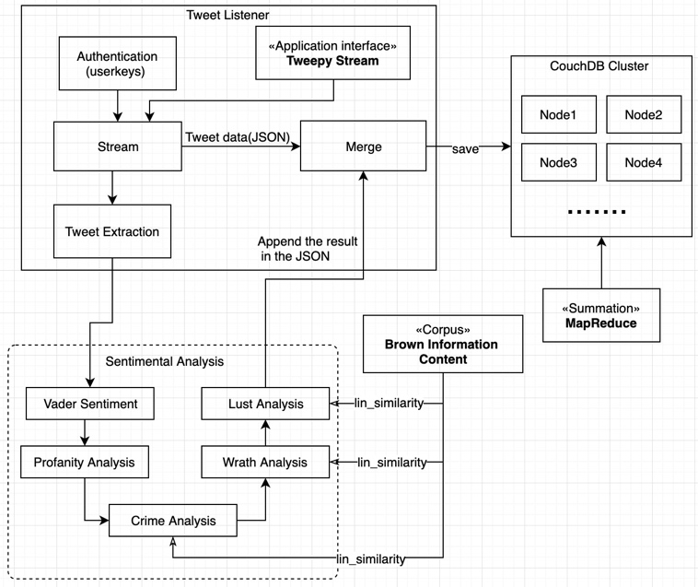
Text Analysis Procedure
COMP90024 TEAM18
Notes:
My presentation has four parts.

Slide 5
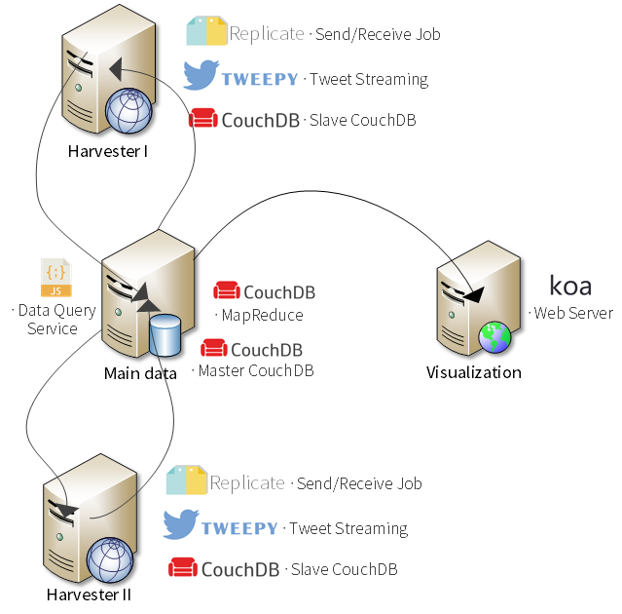
Architecture of system
COMP90024 TEAM18
Notes:
My presentation has four parts.

Slide 6
Ansible Procedure
COMP90024 TEAM18
Notes:
My presentation has four parts.

Slide 7


Links
Video
Website
COMP90024 TEAM18
Notes:
My presentation has four parts.

