Slide 1
CMPE316 Game Project presentatıon
Ali Doğukan Dulupçu
Ömer Faruk Kavlak
Şevket Kaan Aslan

Slide 2
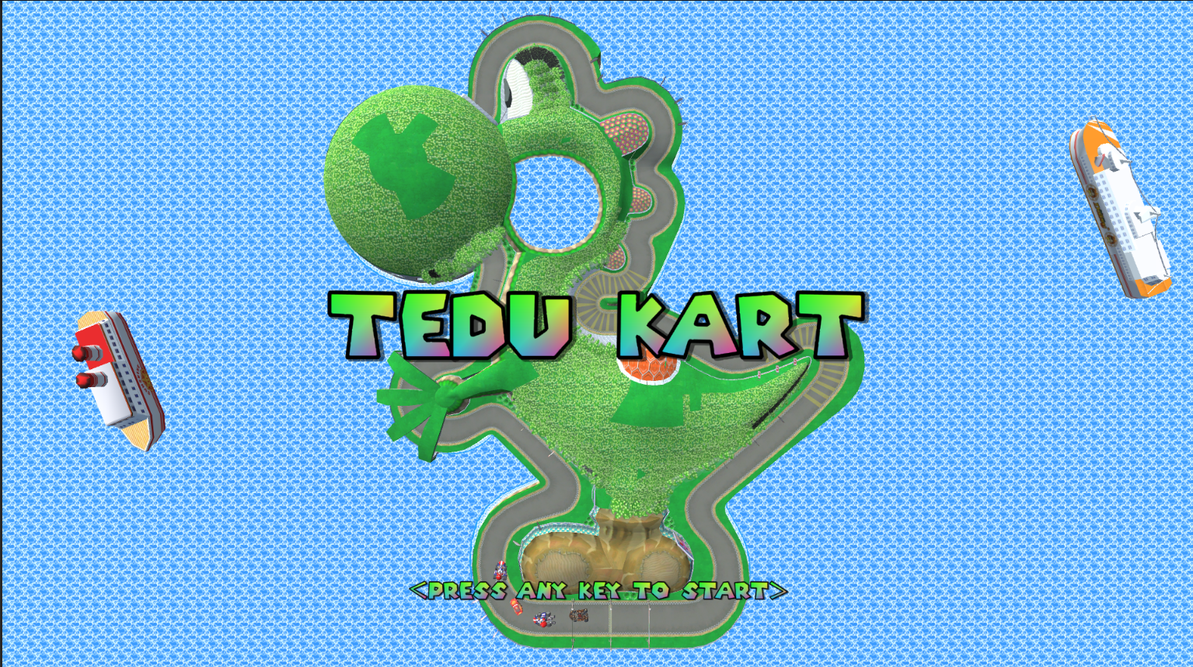
TEDU KART – Arcade Kart Race

Slide 3
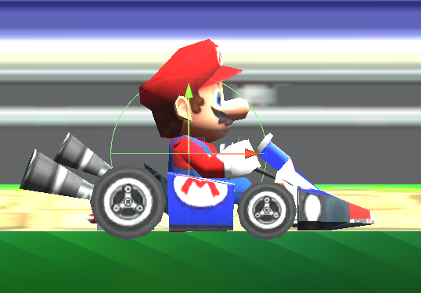
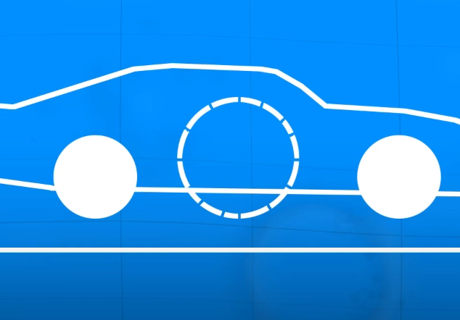
PHYSICS
To achieve more arcadelike driving physics, we used a moving sphere. Car model is attached to said sphere with a fixed joint.

Slide 4
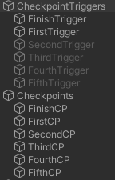
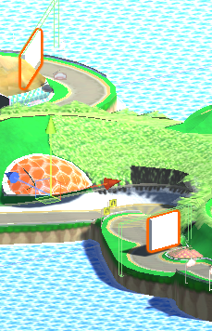
CHECKPOINTS

Slide 5


BUFFS/POWER UP

Slide 6
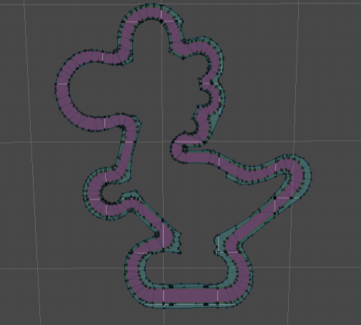
AI
Opponent AI is implemented using Unity Navmesh.
To introduce randomness, AI destination is set to a child of a checkpoint randomly.

