Slide 1
MovieRec
Doğuhan Yeke 1942507
Utku Çağlayan 1942572

Slide 2
Motivation
Experimented with two approaches mainly Collaborative filtering and Content based filtering
Unsatisfied with the result of movie recommendation system assignment
We wanted to do something better, more usable

Slide 3
Problem
Creating a recommendation system which will leverage
our taste of movies
similar users behaviour pattern
good movies liked by many

Slide 4
Dataset
MovieLens Dataset(20m) [1]
IMDb Dataset [2] for extra features:
directors (array of nconsts) - director(s) of the given title
writers (array of nconsts) - writer(s) of the given title
27278 movies in MovieLens
Features found for 27236 movies

Slide 5
All Features, So Far
userId
movieId
rating
tag
genres
tagId,relevance
directors
writers

Slide 6
Our Work
Collaborative filtering:
User Behaviour
Good at finding trends
Content based filtering:
Focus on User’s taste
Good at recommending similar items
Not being satisfied with each approach separately, wanted to combine both

Slide 7
Our Work
Collaborative Filtering
Hybrid recommendations
Content-based Filtering

Slide 8
Our Work
Collaborative Part:
Used a method of the Matrix Factorization family called ALS
Trained with best parameters of assignment
Finds good rated movies but content is ignored

Slide 9
Our Work
Content-based Part:
Running KNN to find similar users and recommending the movies they liked did not resonate with us.
We wanted try a new approach.

Slide 10
Our Work
Finding similar user is not appropriate
Instead, find a similar movie!
Finding similar movie is more relevant than finding similar user
So, need to find a similar movie
How do we find a similar movie?

Slide 11
Help of Movie Features
Writer and Director(to get nearly same tactics of director and taste of creator)
Stanley Kubrick and Nuri Bilge Ceylan
Genres(general theme for movie)
Drama & Action
Comedy & Animation
Tags (from each user, special characteristics for movie)
1980s, dragon, mars etc.

Slide 12
One Problem:
How do we calculate similarity score at all?

Slide 13

ALL MOVIES
weight
movie1
rank
movie2
movie3
movie4

Slide 14




Slide 15
Similarity Measurement
Jaccard Distance
For categorical data:
Director and Writer List
Genres List
Cosine Similarity
For continuous data:
Tags and relevance

Slide 16
Experiments
Tried with an included user from dataset
Observed its relevance with suggested movies
Results are promising
All given is related to user’s content(drama) and good rated movies
Tried ourselves
Good!

Slide 17
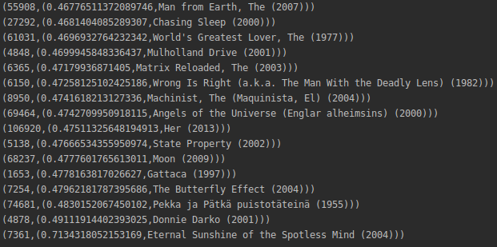
Notes:
Other than 3-4 miss hits, almost all of the movies are ranked above 7.3 on Imdb. Even better, list includes few movies that I would rate a solid 5. One of the movies is in my top 5.

Slide 18
Future Work
Tag relevance score not used at all
Collaborative filtering needs more work to give good results
Numerical experiment methodology needed
User interface

Slide 19
References
1.http://files.grouplens.org/datasets/movielens/ml-20m-README.html
2.https://www.imdb.com/interfaces/
3.https://en.wikipedia.org/wiki/Similarity_measure

