Slide 1
When and why does ApET work?
CSE590 · MIDTERM PROGRESS
Understanding reconstruction-based visual token compression in LLaVA-1.5-7B
APET IN ONE LINE
SIMPLE, AND STRONG
OUR QUESTION
No attention scores for selection: keep hard-to-reconstruct features; merge discarded states into similar retained states.
At an average budget of 64 visual tokens, the paper reports 95.2% relative performance and 1.46× total inference speedup.
How can a linear, geometric criterion work inside a nonlinear VLM, and when does it fail?
Peng Chen · SBU ID 117702477 · October 2026
Published results: Ma et al., CVPR 2026, Tables 1 and 7. Speed measured on POPE / single A100; not our Kaggle timing.
Notes:
Hello, I’m Peng Chen. My project asks when and why ApET preserves a vision-language model’s answers.
Visual tokens make inference expensive. ApET keeps features that are difficult to reconstruct from a small basis, and combines discarded features with similar retained ones.
The paper reports about ninety-five percent of its average benchmark performance at a much smaller token budget. The speedup shown here also comes from the paper, not my Kaggle measurements.
My goal is to understand how this geometric criterion relates to preserving information needed for actual answers.

Slide 2

Method and three research questions
Image
CLIP encoder
ApET stage 1
LLM
ApET stage 2
LLM
336×336
576 tokens
keep K₁
blocks 1–16
keep K₂
blocks 17–32
Setup: LLaVA-1.5-7B · native ApET code · Kaggle 2×T4, locked environment · GQA 800, MMStar 1,500, TextVQA 100 · avg. 64 or 192 tokens
RQ1 · Does E track answer sensitivity?
RQ2 · Selection and merging
RQ3 · An evidence-led improvement?
Component pilots and broad native-versus-random comparisons are complete. Attribution remains open.
30 selected questions. Compare E ranking with an IH-inspired retain-one response: first reference-token probability relative to all visual states removed.
Conditional on the analysis. No validated improvement or adaptive policy yet.
Next: controlled component tests on outcome-unselected cohorts.
E: reconstruction error from 10 FPS basis features. Two stages: 96→32 (avg. 64) or 288→96 (avg. 192). · 2 / 5
Notes:
I use LLaVA one point five, with seven billion parameters, and the native ApET implementation.
The model starts with five hundred and seventy-six visual tokens. ApET compresses before the language model and again after block sixteen. Our two schedules average sixty-four or one hundred and ninety-two tokens across the decoder layers. Reconstruction scores selection; compression itself retains and merges features.
Experiments run on two Kaggle T4 GPUs with a locked environment. The larger comparisons cover GQA, MMStar and TextVQA.
RQ1 compares reconstruction-error rankings with measured answer sensitivity. RQ2 asks how selection and merging contribute to preservation. RQ3 considers a lightweight improvement only if the evidence supports it.
The small RQ1 study is largely complete. Component attribution remains the main open question.

Slide 3
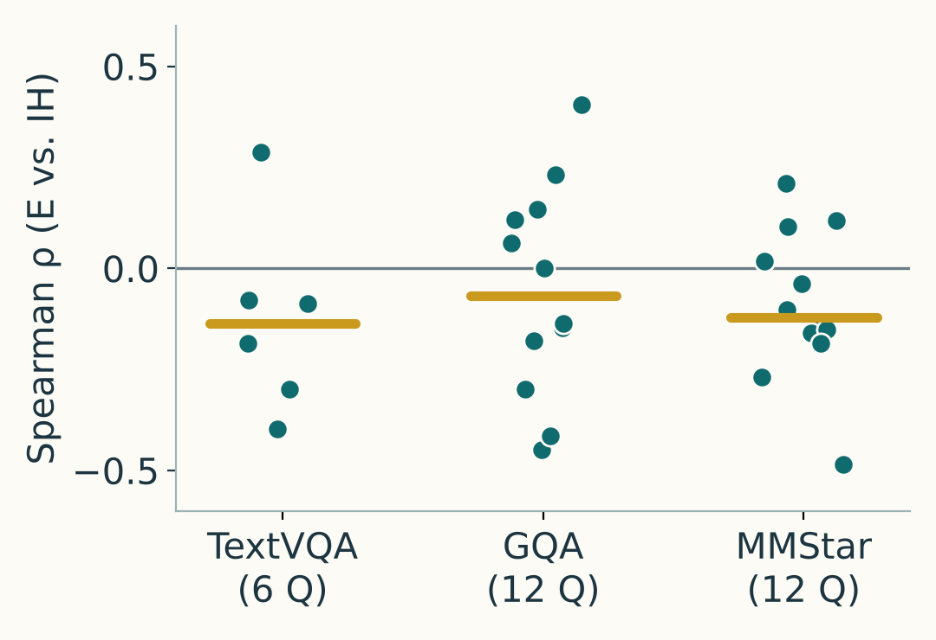
From reconstruction error to answer preservation
① E and answer sensitivity differ
② Merging has uneven roles
③ Performance depends on task
IH-inspired retain-one test: first reference-token probability relative to removing all visual states. 30 selected questions.
Earlier input-only288 panel: 24 images. Basis slots excluded from merge targets.
Native − random at the same budget:
96→32 (average 64 tokens).
Share of incoming merges
TextVQA100 (consensus)
Lowest-E retained quarter
+20.9 score points
66.1%
GQA +2.5 · MMStar −0.1 (accuracy)
4,569 of 6,912 dropped sources
④ Accuracy hides answer turnover
Highest-E retained quarter
34 lost · 26 gained
1.8%
GQA800: 69.0% → 68.0%
Median correlations: −0.14 to −0.07.
Interpretation depends on the intervention.
Protecting the top 28 rerouted
only 21 / 6,912 sources.
36 lost · 40 gained
MMStar1500: 34.7% → 35.0%
① Selected30. ② Input288 / 24 images. ③ Avg64; native − random (3-seed mean).
TextVQA: consensus; others: accuracy. ④ Avg192 vs. full576. Sources: saved RQ1/RQ2 records. · 3 / 5
Notes:
There are four findings.
First, reconstruction error does not consistently agree with measured answer sensitivity. On thirty selected questions, we compared E rankings with an IH-inspired retain-one ranking. Median correlations were slightly negative, although individual questions differed. This scores the first reference-answer token, not true token importance.
Second, retained tokens receive very different amounts of merging. In the earlier input-only panel, the lowest-E quarter of ordinary retained targets received about sixty-six percent of incoming merges. The highest-E quarter received about two percent.
This may be expected: discarded low-error features may resemble these targets. It also explains why protecting the highest-E targets barely changed the computation. Some retained states may preserve distinctive features, while others collect discarded information. Whether this division helps answers still needs investigation.
Third, ApET’s advantage over random selection depends on the task. At the same average budget of sixty-four tokens, the gap is about twenty-one score points on TextVQA, two and a half on GQA, and unclear on MMStar. TextVQA uses a consensus score; the other two use accuracy.
Fourth, similar overall accuracy can hide different answers. At an average budget of one hundred and ninety-two, GQA loses thirty-four previously correct answers and gains twenty-six. On MMStar, it loses thirty-six and gains forty, while accuracy changes very little.
So overall performance and answer preservation are separate outcomes. Both matter when we explain why compression works.

Slide 4
Roadblocks and fixes
A stable pipeline; remaining scientific limits are explicit
Roadblock | Problem | Action | Status
Integration | Kaggle package drift | Locked native environment | Resolved
Run-to-run variation | Fresh encodes vary; saved-feature replays agree. | Differences appear after merging; cause unconfirmed. Keep first captures; repeat critical cases. | Managed; cause open
Selection bias | Diagnostic cases include known native failures. | Use for case analysis; compare methods on outcome-unselected cohorts. | Limited scope
Planning risk | Component attribution remains open. | One controlled comparison; negative results also count. | Open
FP16 accumulation is a candidate explanation, not a confirmed root cause. Fixed-feature replay and fresh-run repeatability are different checks. · 4 / 5
Notes:
There were three main roadblocks.
First, Kaggle package updates caused compatibility problems. The locked environment now makes the setup reproducible.
Second, some fresh compressed runs changed answers, while replaying saved features gave identical outputs. One diagnostic found differences after merging. Floating-point accumulation is a possible cause, but the exact cause is unconfirmed. I keep first captures and repeat critical cases.
Third, the diagnostic panel includes known ApET failures. It supports case analysis, while broader outcome-unselected cohorts are needed for method comparisons.

Slide 5
Next steps: explain first, then explore
01 · Separate the components
02 · Roles of retained tokens
03 · RQ3 exploration
Which operation helps?
Who collects information?
A small improvement?
E vs. random: basis + merge rule fixed.
Merge vs. drop: selection fixed.
Use an outcome-unselected cohort.
Study merge loads and feature changes alongside answer turnover. Compare retained-token roles across stages and tasks.
No fixed direction yet. Use RQ1/RQ2 evidence to choose and evaluate one modest change, if justified.
SUCCESS CRITERION · RQ3 REMAINS CONDITIONAL
One controlled comparison on ≥100 outcome-unselected questions: matched budgets, 3 random seeds and paired intervals. Negative results count; a small improvement is optional.
Protocol Nov 6 · pilot Nov 13 · main run Nov 20 · RQ3 go/no-go Nov 24 · final Dec 15 · 5 / 5
Notes:
The next steps are to explain these observations before choosing an improvement.
First, separate selection from merging on a cohort not selected from ApET’s wins or losses. Compare E-based and random selection with basis handling and the merge rule fixed. Compare merging with dropping under the same selection.
Second, investigate the different roles of retained tokens. Study merge loads and feature changes alongside answer turnover, across stages and tasks. This can test whether collecting discarded information helps some answers while disturbing others.
Third, RQ3 remains exploratory. We have not chosen a fixed improvement direction. If the analysis identifies a consistent problem, we can evaluate one modest change.
The main deliverable is one controlled comparison on at least one hundred outcome-unselected questions, with matched budgets, random seeds where relevant, and paired uncertainty estimates. A clear negative result also counts. Thank you.

