Slide 1
When and why does ApET work?
CSE590 · MIDTERM PROGRESS
Understanding reconstruction-based visual token compression in LLaVA-1.5-7B
APET IN ONE LINE
SIMPLE, AND STRONG
OUR QUESTION
No attention scores for selection: keep hard-to-reconstruct features; merge discarded states into similar retained states.
At an average budget of 64 visual tokens, the paper reports 95.2% relative performance and 1.46× total inference speedup.
How can a linear, geometric criterion work inside a nonlinear VLM, and when does it fail?
Peng Chen · SBU ID 117702477 · October 2026
Published results: Ma et al., CVPR 2026, Tables 1 and 7. Speed measured on POPE / single A100; not our Kaggle timing.
Notes:
Hello, I’m Peng Chen. My project asks when and why ApET preserves a vision-language model’s answers.
Visual tokens make inference expensive. ApET keeps features that are difficult to reconstruct from a small basis, and combines discarded features with similar retained ones.
The paper reports about ninety-five percent of its average benchmark performance at a much smaller token budget. The speedup shown here also comes from the paper, not my Kaggle measurements.
My goal is to understand how this geometric criterion relates to preserving information needed for actual answers.

Slide 2

Method and three research questions
Image
CLIP encoder
ApET stage 1
LLM
ApET stage 2
LLM
336×336
576 tokens
keep K₁
blocks 1–16
keep K₂
blocks 17–32
Setup: LLaVA-1.5-7B · native ApET code · Kaggle 2×T4, locked environment · GQA 800, MMStar 1,500, TextVQA 100 · avg. 64 or 192 tokens
RQ1 · Does E track answer sensitivity?
RQ2 · Selection and merging
RQ3 · An evidence-led improvement?
Component pilots and broad native-versus-random comparisons are complete. Attribution remains open.
30 selected questions. Compare E ranking with an IH-inspired retain-one response: first reference-token probability relative to all visual states removed.
Conditional on the analysis. No validated improvement or adaptive policy yet.
Next: controlled component tests on outcome-unselected cohorts.
E: reconstruction error from 10 FPS basis features. Two stages: 96→32 (avg. 64) or 288→96 (avg. 192). · 2 / 5
Notes:
I use LLaVA one point five, with seven billion parameters, and the native ApET implementation.
The model starts with five hundred and seventy-six visual tokens. ApET compresses before the language model and again after block sixteen. Our two schedules average sixty-four or one hundred and ninety-two tokens across the decoder layers.
Experiments run on two Kaggle T4 GPUs with a locked environment. The larger comparisons cover GQA, MMStar and TextVQA.
RQ1 compares reconstruction-error rankings with measured answer sensitivity. RQ2 asks how selection and merging contribute to preservation. RQ3 considers a lightweight improvement only if the evidence supports it.
The small RQ1 study is largely complete. Component attribution remains the main open question.

Slide 3
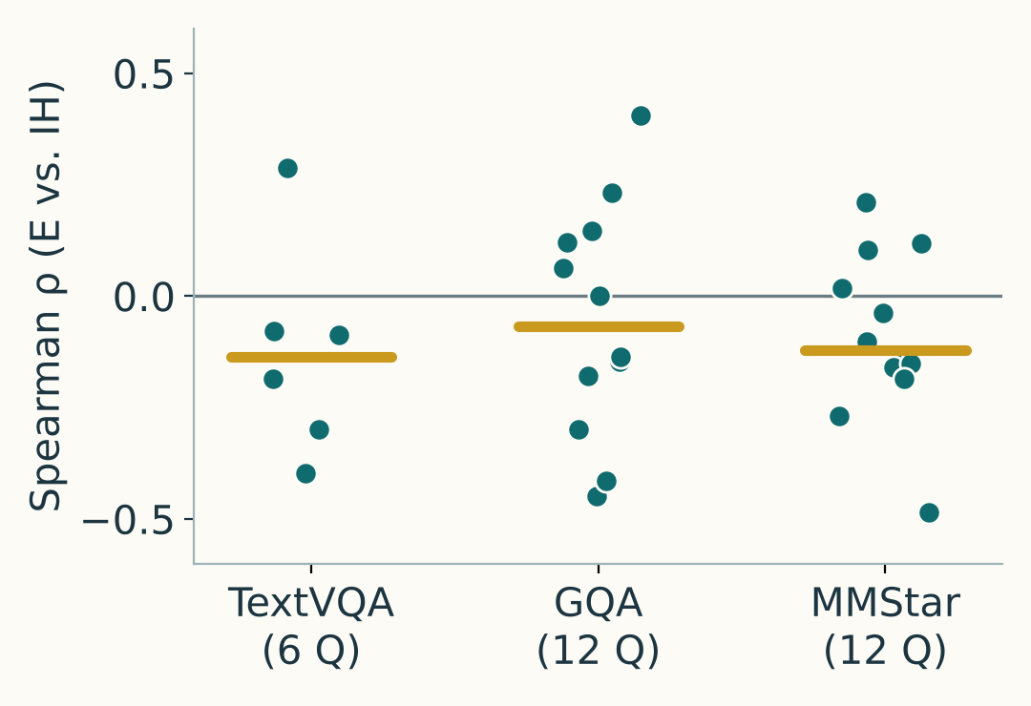
From reconstruction error to answer preservation
① E and answer sensitivity differ
② Merging has uneven roles
③ Performance hides details
IH-inspired retain-one test: first reference-token probability relative to removing all visual states. 30 selected questions.
Earlier input-only288 panel: 24 images. Basis slots excluded from merge targets.
Native advantage varies by task and budget; similar scores hide answer turnover.
Share of incoming merges
TextVQA100 · native − random
Lowest-E retained quarter
64 avg: +20.9 pts
66.1%
192 avg: +9.4 pts
4,569 of 6,912 dropped sources
GQA800 · average budget 192
Highest-E retained quarter
34 lost · 26 gained
1.8%
Accuracy 69.0% → 68.0%
Median correlations: −0.14 to −0.07.
Interpretation depends on the intervention.
Protecting the top 28 rerouted
Smaller gap on GQA;
no clear gap on MMStar.
only 21 / 6,912 sources.
① Selected30; IH-inspired. ② Input288 / 24 images. ③ Staged cohorts; random = 3-seed mean. Sources: saved RQ1/RQ2 records. · 3 / 5
Notes:
There are three findings.
First, reconstruction error does not consistently agree with measured answer sensitivity. On thirty selected questions, we compared E rankings with an IH-inspired retain-one ranking. Median correlations were slightly negative, although individual questions differed. This scores the first reference-answer token, not true token importance.
Second, retained tokens receive very different amounts of merging. In the earlier input-only panel, the lowest-E quarter of ordinary retained targets received about sixty-six percent of incoming merges. The highest-E quarter received about two percent.
This may be expected: discarded low-error features may resemble these targets. It also explains why protecting the highest-E targets barely changed the computation: few sources were merging into them. Some retained states may preserve distinctive features, while others collect discarded information. Whether this division helps answers still needs investigation.
Third, complete ApET performs better than random in some settings, but the advantage depends on task and budget. On TextVQA, the gap is about twenty-one points at the smaller budget and nine at the larger budget. It is smaller on GQA and unclear on MMStar.
Average scores also hide answer turnover. At the larger budget, GQA loses thirty-four previously correct answers and gains twenty-six. Accuracy drops by only one point.
These findings connect reconstruction, aggregation, and answer preservation. They also suggest specific next experiments.

Slide 4
Roadblocks and fixes
A stable pipeline; remaining scientific limits are explicit
Roadblock | Problem | Action | Status
Integration | Kaggle package drift | Locked native environment | Resolved
Run-to-run variation | Fresh encodes vary; saved-feature replays agree. | Differences appear after merging; cause unconfirmed. Keep first captures; repeat critical cases. | Managed; cause open
Selection bias | Diagnostic cases include known native failures. | Use for case analysis; compare methods on outcome-unselected cohorts. | Limited scope
Planning risk | Component attribution remains open. | One controlled comparison; negative results also count. | Open
FP16 accumulation is a candidate explanation, not a confirmed root cause. Fixed-feature replay and fresh-run repeatability are different checks. · 4 / 5
Notes:
There were three main roadblocks.
First, Kaggle package updates caused compatibility problems. The locked environment now makes the setup reproducible.
Second, some fresh compressed runs changed answers, while replaying saved features gave identical outputs. One diagnostic found differences after merging. Floating-point accumulation is a possible cause, but the exact cause is unconfirmed. I keep first captures and repeat critical cases.
Third, the diagnostic panel includes known ApET failures. It supports case analysis, while broader outcome-unselected cohorts are needed for method comparisons.

Slide 5
Next steps follow the three findings
01 · Separate the components
02 · Roles of retained tokens
03 · Test reconstruction
Which operation helps?
Who collects information?
Is reconstruction safe?
E vs. random: basis + merge rule fixed.
Merge vs. drop: selection fixed.
Use an outcome-unselected cohort.
Check loads and feature changes across stages and budgets. Compare no, half-strength and native merging.
Replace a few features with linear reconstructions. Keep sequence length; control the change size.
SUCCESS CRITERION · RQ3 REMAINS CONDITIONAL
One controlled comparison on ≥100 outcome-unselected questions: matched budgets, 3 random seeds and paired intervals. Negative results count; a small improvement is optional.
Protocol Nov 6 · pilot Nov 13 · main run Nov 20 · RQ3 go/no-go Nov 24 · final Dec 15 · 5 / 5
Notes:
The next steps follow directly from the findings.
First, separate selection from merging on a cohort not selected from ApET’s wins or losses. Compare E-based and random selection with basis handling and the merge rule fixed. Compare merging with dropping under the same selection.
Second, investigate the different roles of retained tokens. Check merge loads across stages and budgets, measure actual feature changes, and test whether changing the strength of merging affects answers.
Third, test reconstruction more directly. Replace a few features with their linear approximations while keeping sequence length unchanged. Control the size of the feature change, so a smaller perturbation is not mistaken for a special reconstruction effect.
RQ3 stays conditional. If these tests identify a consistent problem, we can evaluate one small modification.
The main deliverable is one controlled comparison on at least one hundred outcome-unselected questions, with matched budgets, random seeds where relevant, and paired uncertainty estimates. A clear negative result also counts. Thank you.

