Slide 1
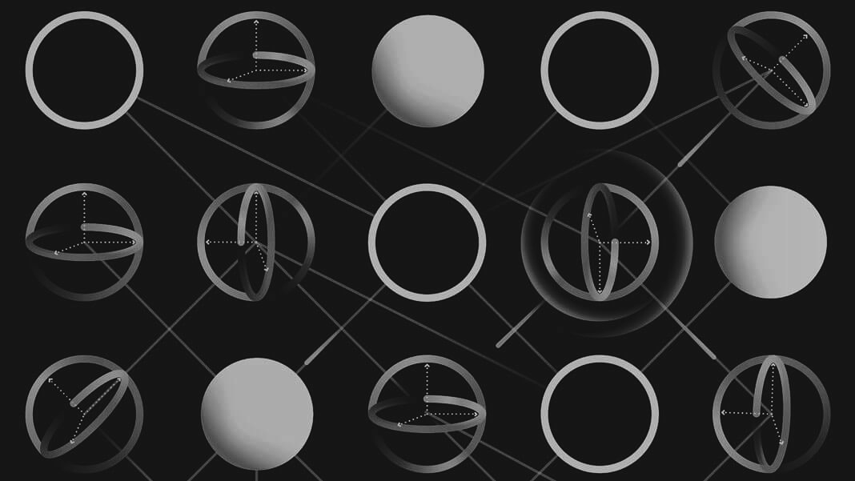
QUANTUM MACHINE
LEARNING
Notes:
sfzgxdhxjyjdtyjdryj

Slide 2





İlknur Tepe
@ilknurtepe
@ScienceLoverIT
Notes:
Kuantum Makine Öğrenmesi
Kuantum Makine Öğrenimi
Kuantum Öğrenmesi
Kuantum Yapay Öğrenme

Slide 3
Quantum Machine Learning
Gartner Hype Cycle
Classic Data vs Quantum Data
Classical Machine Learning vs Quantum Machine Learning
Quantum Annealing
Pennylane
QML Working Group
Notes:
tfhyjxryjdt

Slide 4
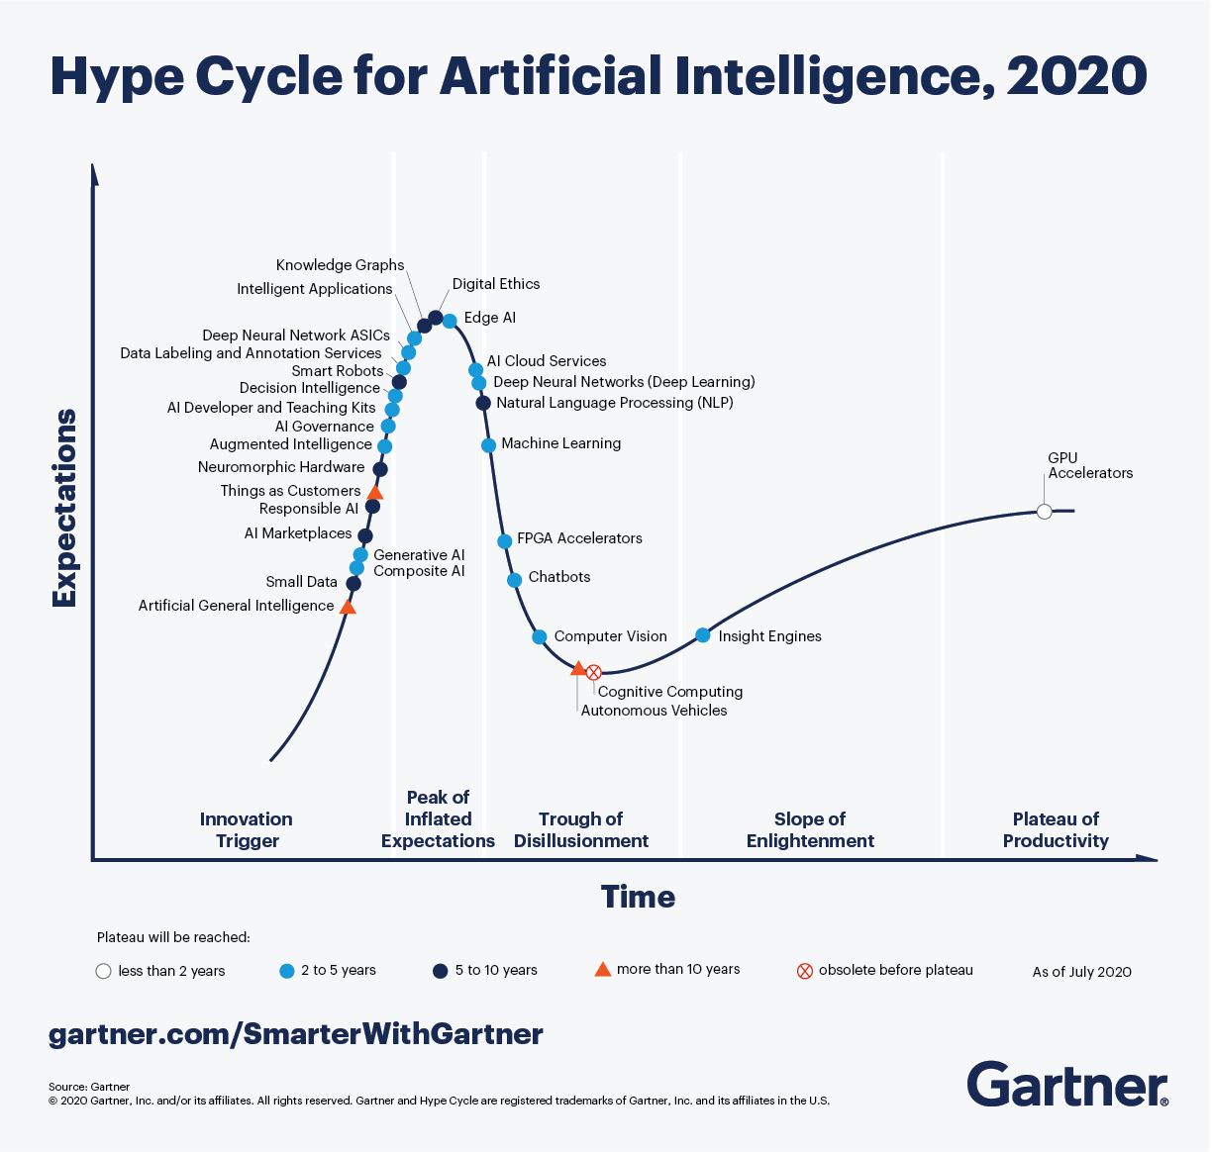
Gartner Hype Cycle for Artificial Intelligence 2020
Despite the global impact of COVID-19, 47% of artificial intelligence (AI) investments were unchanged since the start of the pandemic and 30% of organizations actually planned to increase such investments, according to a Gartner poll. Only 16% had temporarily suspended AI investments, and just 7% had decreased them.
AI is starting to deliver on its potential and its benefits for businesses are becoming a reality.
Notes:
rfyhjdtjdtj

Slide 5
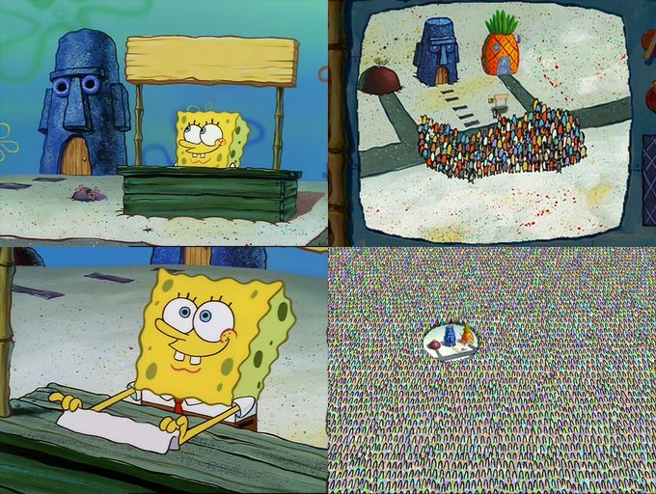
Quantum
Machine
Learning
Quantum Computing
Quantum Machine
Learning

Slide 6

Quantum Machine
Learning
Quantum machine learning is a research area that explores the interplay of ideas from quantum computing and machine learning.
Notes:
Kuantum makine öğrenimi, kuantum hesaplama ve makine öğreniminden gelen fikirlerin karşılıklı etkileşimini araştıran bir araştırma alanıdır.

Slide 7
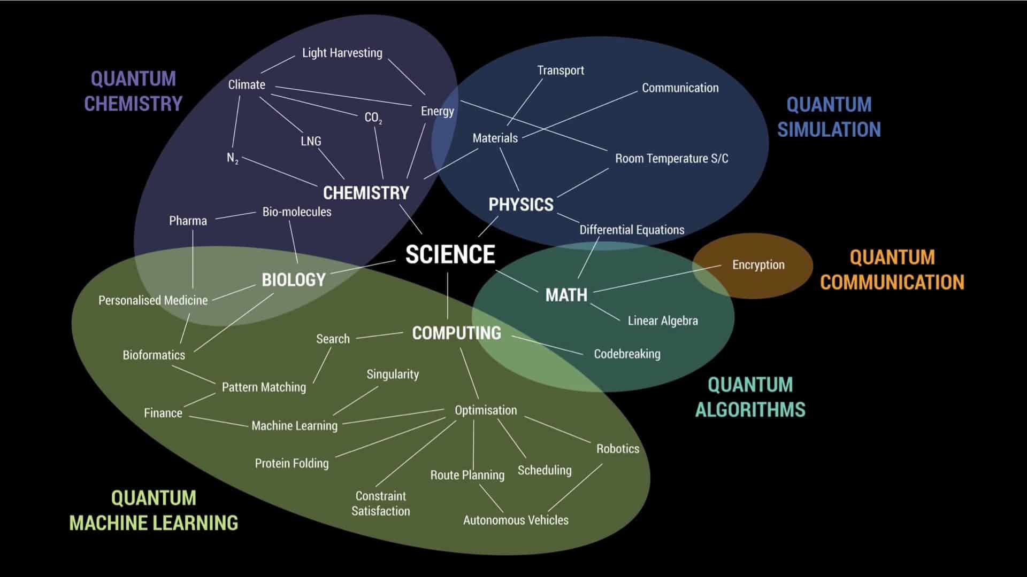
Notes:
Bu alanlarda araştırmalar yapılıyor. Genel olarak teorik çalışmalar yapılıyor.

Slide 8
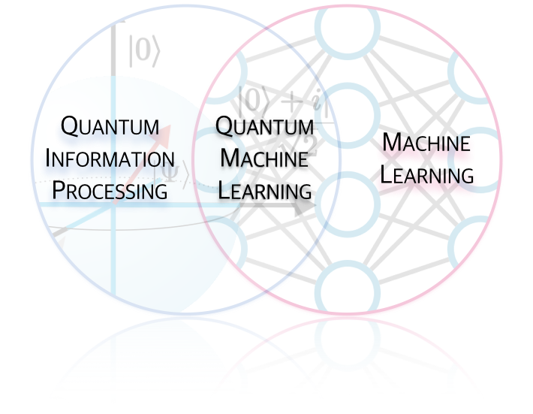

Slide 9
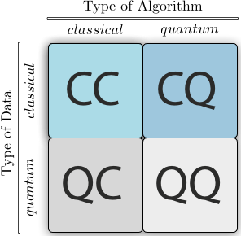
Machine
Learning
Quantum
Computing
Notes:
yjdtjdtj

Slide 10
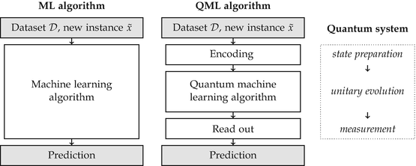
ML vs QML
Notes:
dtyjdtyjdtjdtuj

Slide 11
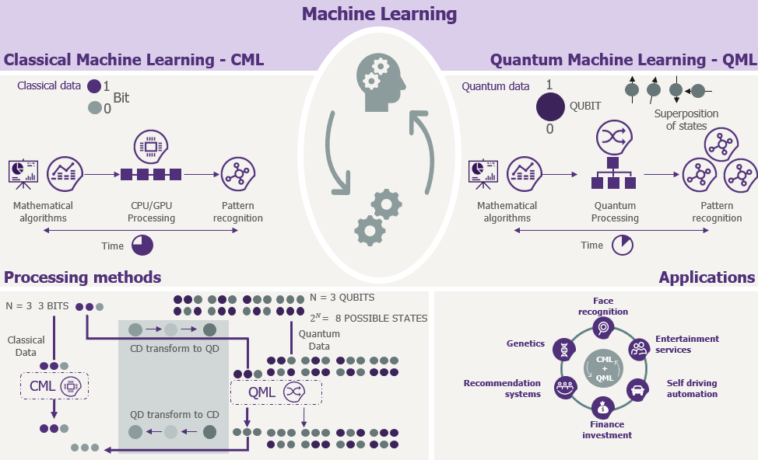
Notes:
dtyjdtjdtyj

Slide 12
Quantum Annealing
Simulated Annealing (Thermal Jump)
Cost
Local
Minimum
Global
Minimum
Quantum Annealing
(Quantum Tunneling)
Configuration
Notes:
dtyjdtjdty

Slide 13
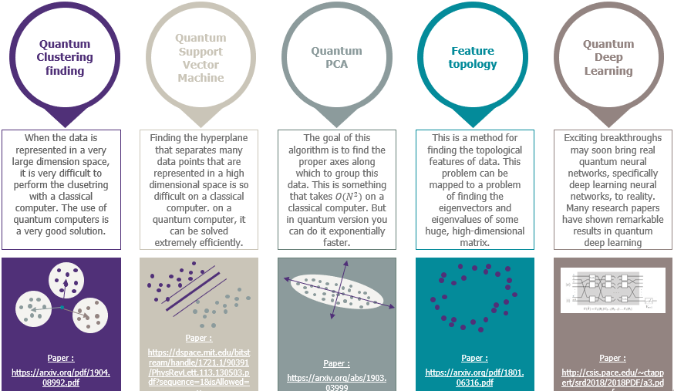
Notes:
dtjdtjdtyj

Slide 14
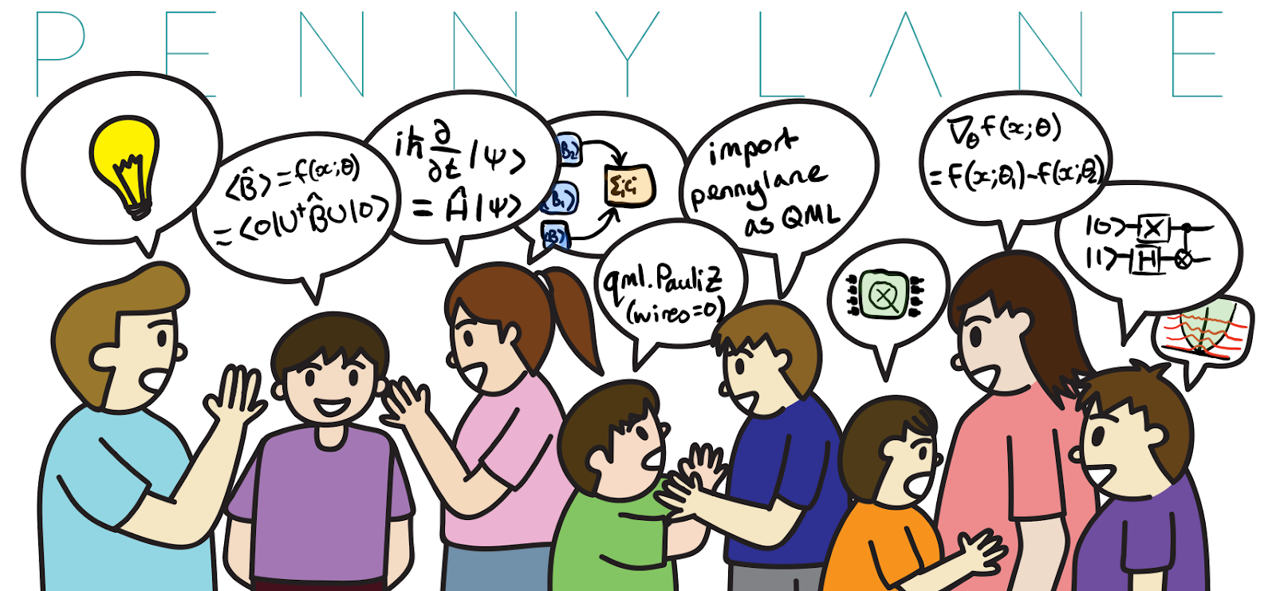
Notes:
dtyjdtyjdtyj

Slide 15
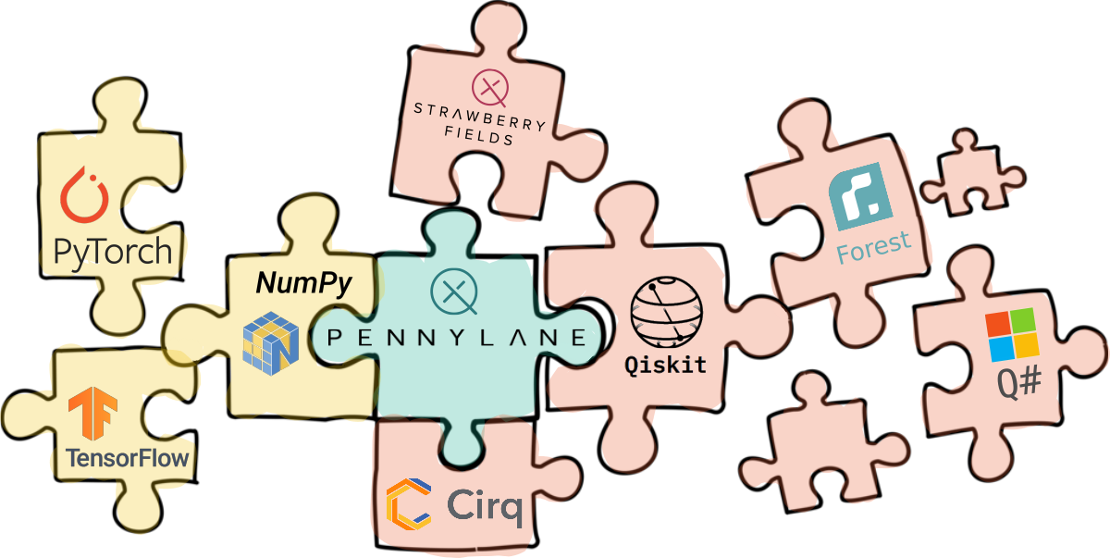
Notes:
djdyjdtyj

Slide 16
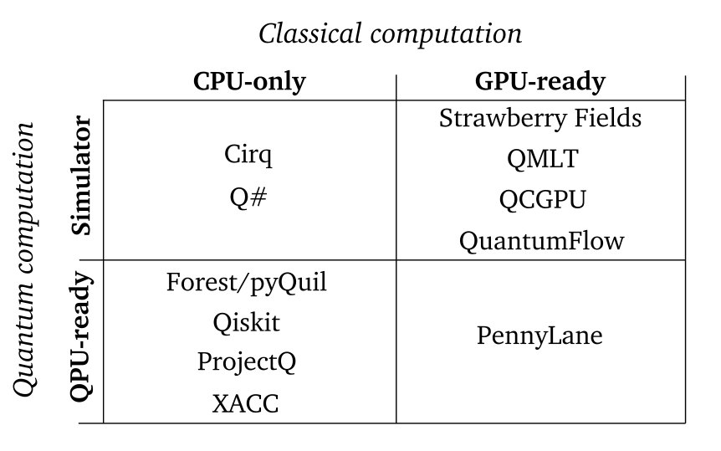
Notes:
dtyjftj

Slide 17
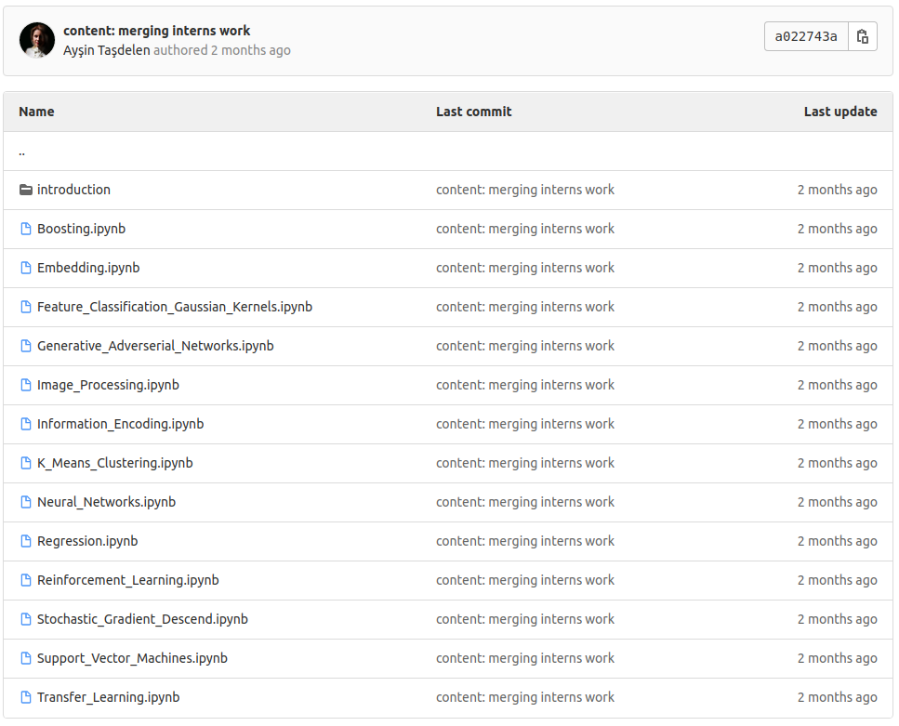


QML Working Group
https://qturkey.slack.com/
gitlab.com/qkitchen/qml-educational-materials/
Notes:
dyjdtjdy

Slide 18




https://medium.com/qturkey/
Kuantum Türkiye
Web Sites
kuantumturkiye.org
http://qturkey.org
@KuantumTurkiye
https://qturkey.slack.com/
https://www.linkedin.com/company/qturkey
Notes:
dtyjdtjdt

Slide 19
İlknur Tepe
@ilknurtepe
@ScienceLoverIT
Notes:
djdjydt

