Slide 1

Project No: BİL-03
14. Proje Fair and Competition(2021)
Engineering Faculty
REGIONAL EARTHQUAKE FORECASTING FOR TÜRKIYE USING THE PAST EARTHQUAKE DATA AND DIFFERENT FORECASTING MODELS
Doğuş KAR and Muhammed Ömer KESKİN
Department: Computer Engineering
Mentor: Prof. Dr. Serkan GÜNAL

Slide 2


Project no: BİL-03
Abstract
Computer Engineering
This Project is supported by TÜBİTAK 2209-A Research Project Support Programme
The aim of this project is to forecast earthquakes in Türkiye using various forecasting models based on deep learning.
Specifically, long short-term memory (LSTM) networks are used for the forecasting task.

Slide 3
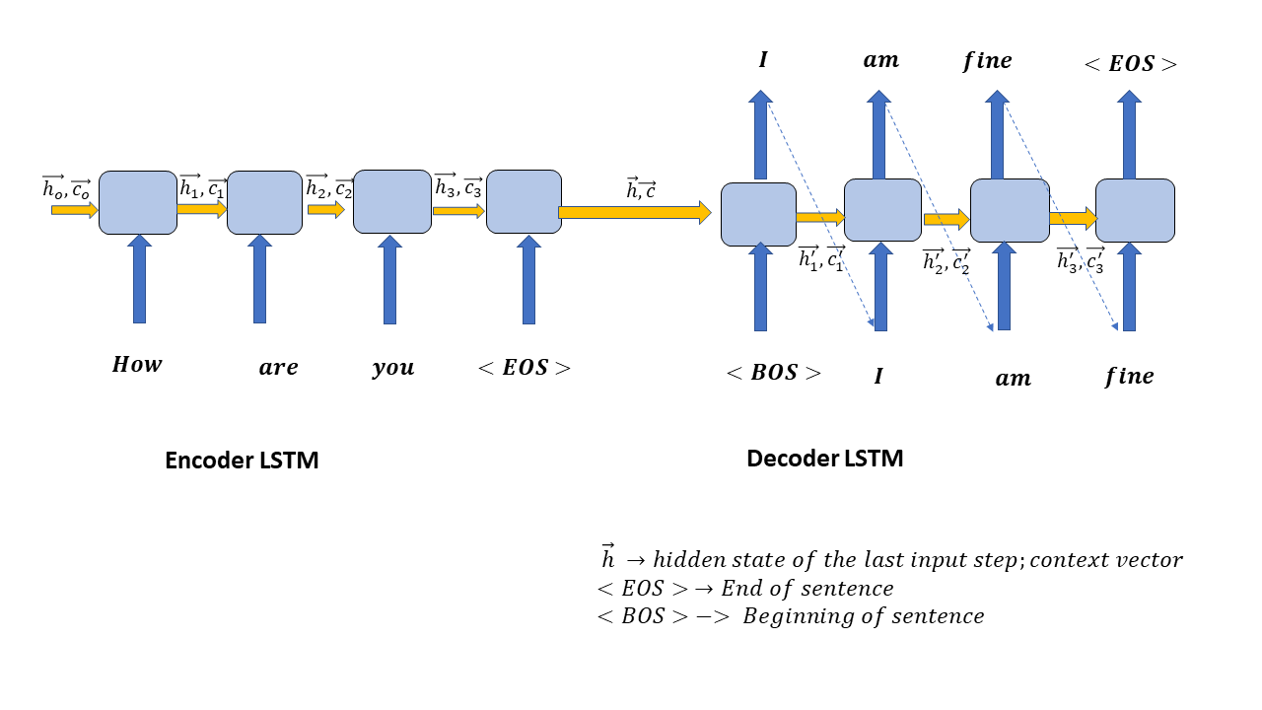
Project no: BİL-03
Sequence-to-Sequence LSTM
Computer Engineering
Sequence-to-Sequence (Seq2Seq) is a type of Encoder-Decoder model using RNN.
Seq2Seq modelling is about training the models that can convert sequences from one domain to sequences of another domain
It can be used as a model for machine interaction and machine translation.

Slide 4
Project no: BİL-03
Data Set
Computer Engineering
The dataset covers earthquakes between the year 1900 and 2021 30 March.
53.554 earthquake data with a magnitude greater than 3.
The data set includes date, earthquake magnitude, latitude, longitude and depth information.
datetime | lat | lon | depth | magnitude
1905-04-30 16:13:00 | 39.8 | 30.5 | 22 | 5.5
1905-05-01 19:00:01 | 39.9 | 31.1 | 5 | 4.9
1905-10-22 03:42:00 | 41 | 31 | 27 | 5.4
1905-12-04 07:04:00 | 39 | 39 | 30 | 6.5
1905-12-04 09:40:00 | 39 | 39 | 30 | 5.8

Slide 5
Project no: BİL-03
Features
Computer Engineering
The selected model utilizes statistical features extracted from various parameters of previous earthquakes.
Previous 30 earthquake data were used to extract for an earthquake.
Feature No | Feature Description
1 – 7 | [Min, Max, Mean, Median, Variance, Skewness, Kurtosis] of MAGNITUDE
8 – 14 | [Min, Max, Mean, Median, Variance, Skewness, Kurtosis] of LATITUDE
15 – 21 | [Min, Max, Mean, Median, Variance, Skewness, Kurtosis] of LONGITUDE
22 – 28 | [Min, Max, Mean, Median, Variance, Skewness, Kurtosis] of DEPTH
29 – 35 | [Min, Max, Mean, Median, Variance, Skewness, Kurtosis] of DATETIME

Slide 6
Project no: BİL-03
Training
Computer Engineering
Features and varaibles
Statistical features | Magnitude features Magnitude and depth features Magnatude, depth, timstamp features …
Backward size | 20, 30, 50, 100
Magnitude | Grather than 3, 4, 4.4, 5, 5.3
Batch size | 10, 20, 50, 100 and size of data
Epochs number | 200, 500, 1000
Initial learn rate | 0.1, 0.01, 0.05, 0.001

Slide 7
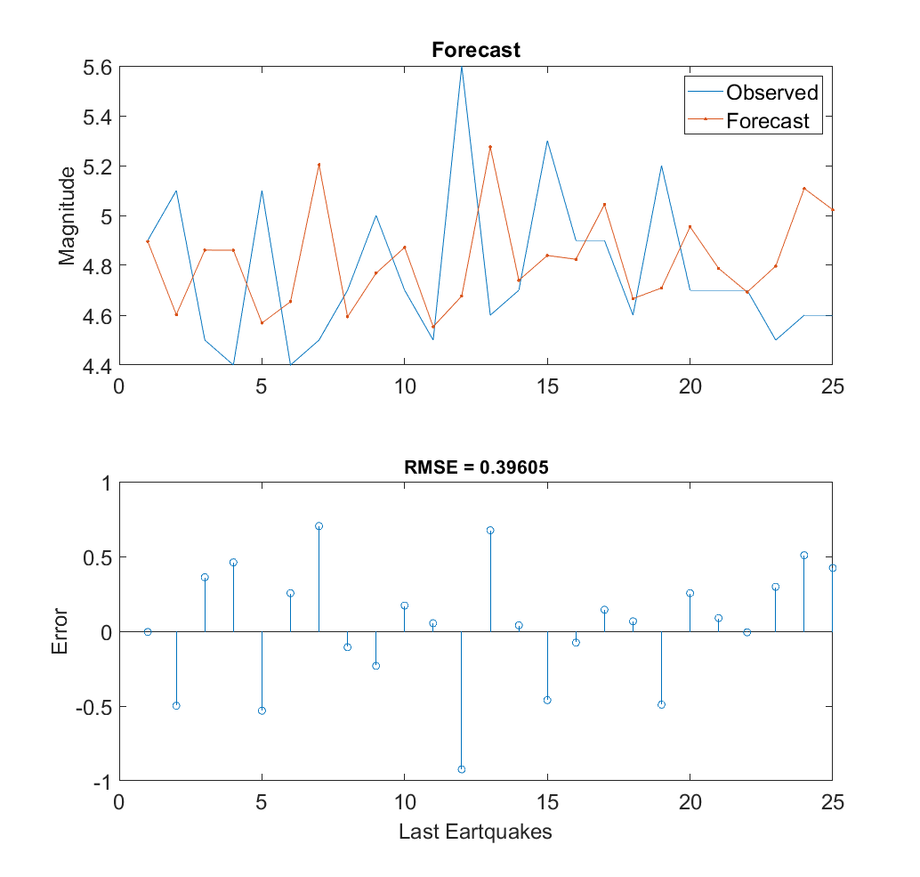
Project no: BİL-03
Results for Türkiye
Computer Engineering
Magnitudes are grather than 4.4
3.113 traing data
25 test data
Feature backward size is 30
1000 Epoch
100 Batch size

Slide 8
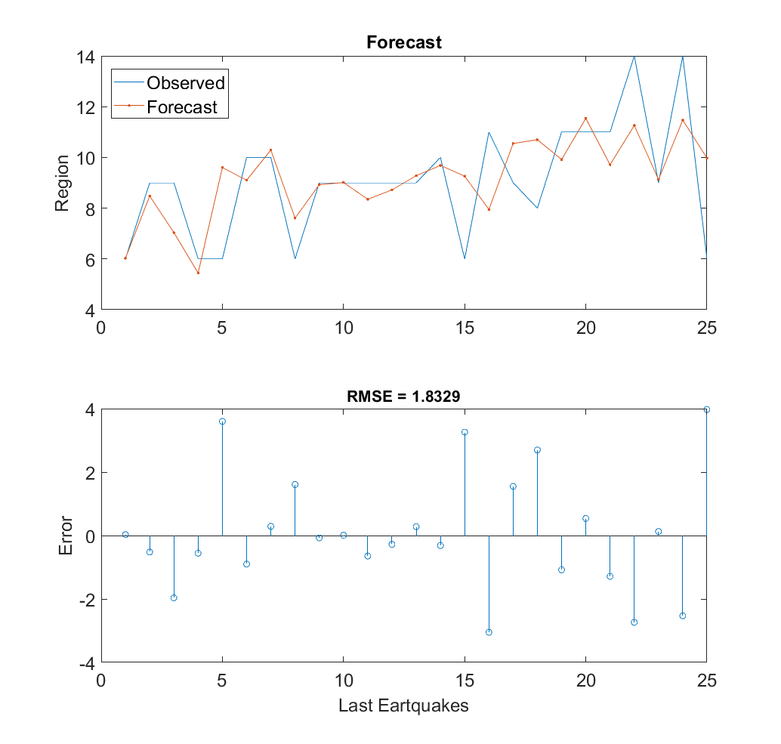
Project no: BİL-03
Results for Türkiye
Computer Engineering
Magnitudes are grather than 5
945 traing data
25 test data
Feature backward size is 30
500 Epoch
100 Batch size

Slide 9
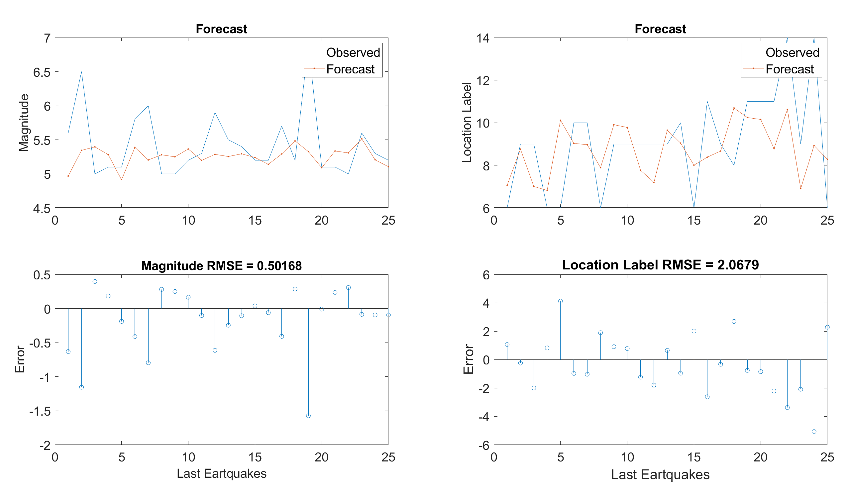
Project no: BİL-03
Results for Türkiye
Computer Engineering
Magnitudes are grather than 5, Feature backward size is 30, 500 Epoch

Slide 10
Project no: BİL-03
Dividing The Data Set
Computer Engineering

Slide 11
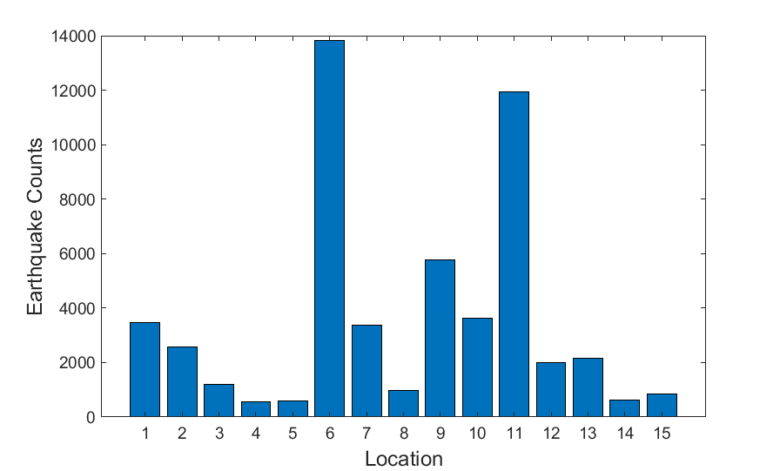
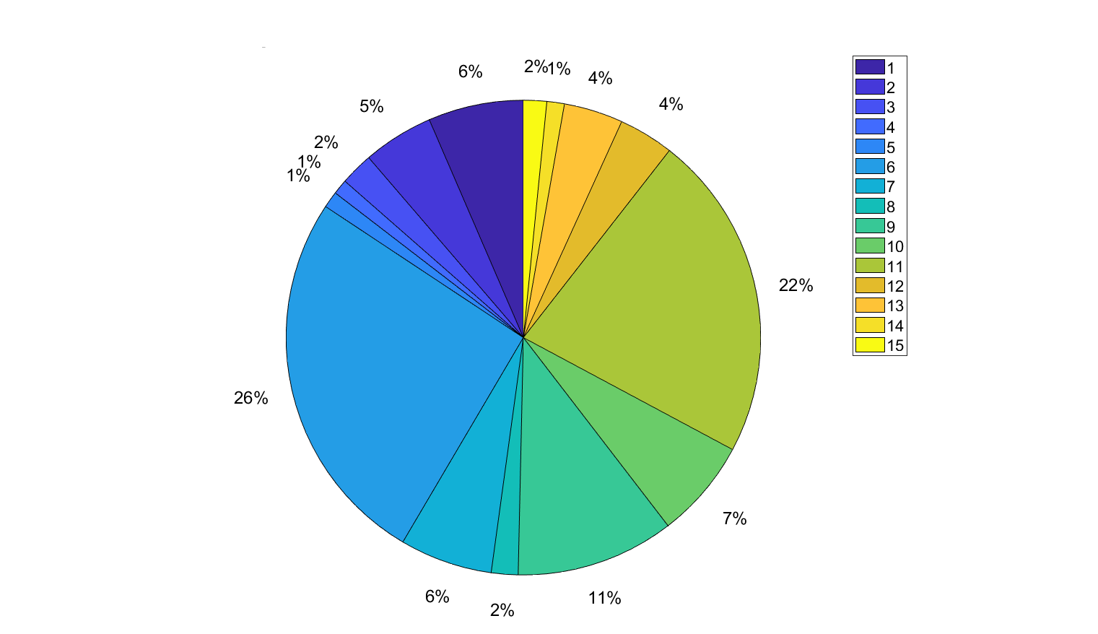
Project no: BİL-03
Magnitudes is greater than 3
Computer Engineering

Slide 12
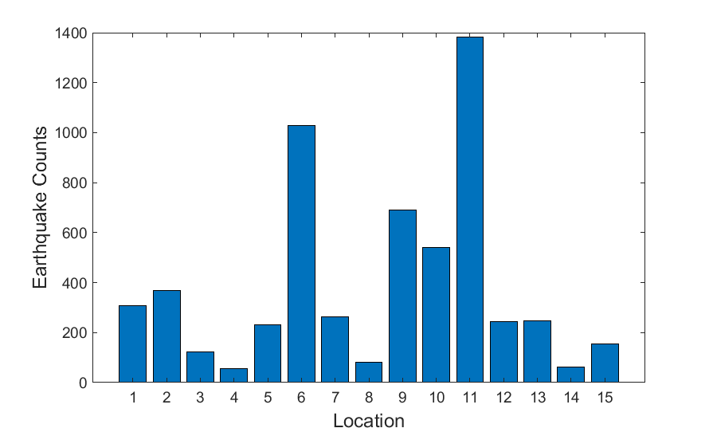
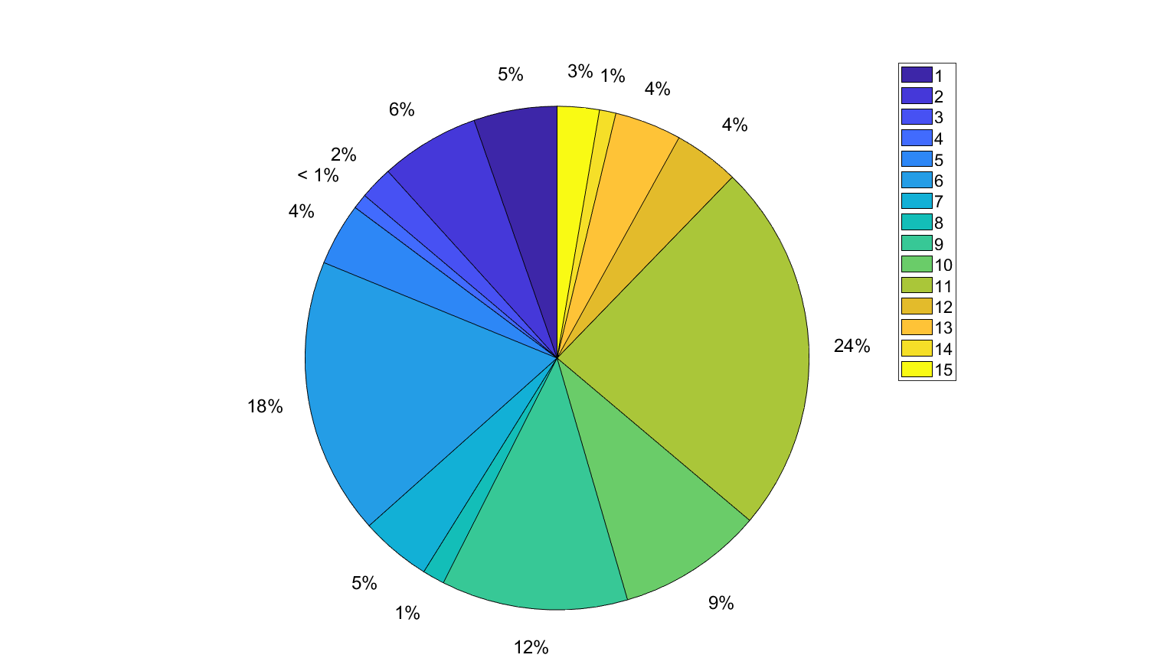
Project no: BİL-03
Magnitudes is greater than 4
Computer Engineering
5.784 data

Slide 13
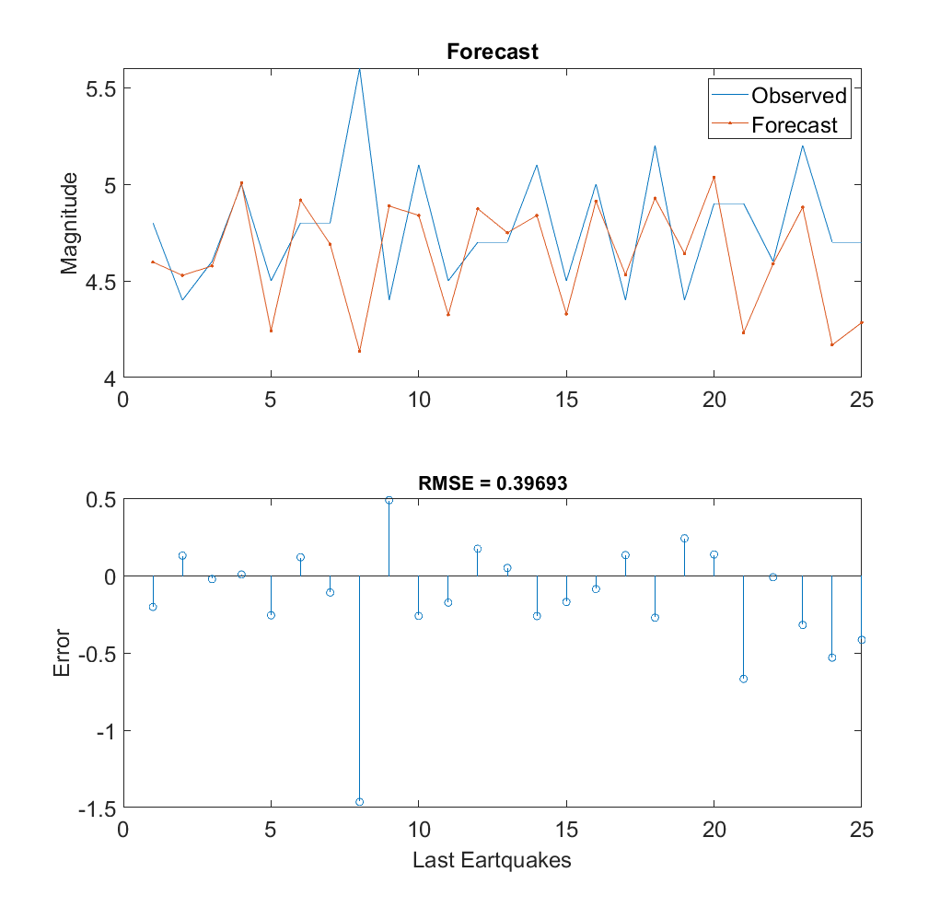
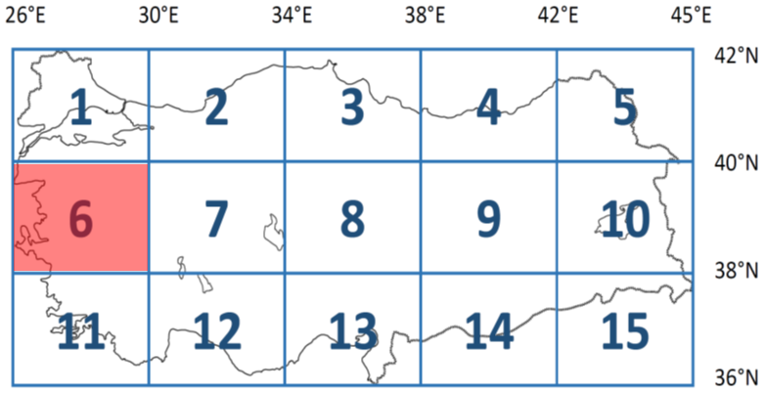
Project no: BİL-03
Results for Selected Region
Computer Engineering
6. Region
Magnitudes are grather than 4.4
504 traing data
25 test data
Feature backward size is 30
1000 Epoch
100 Batch size

Slide 14
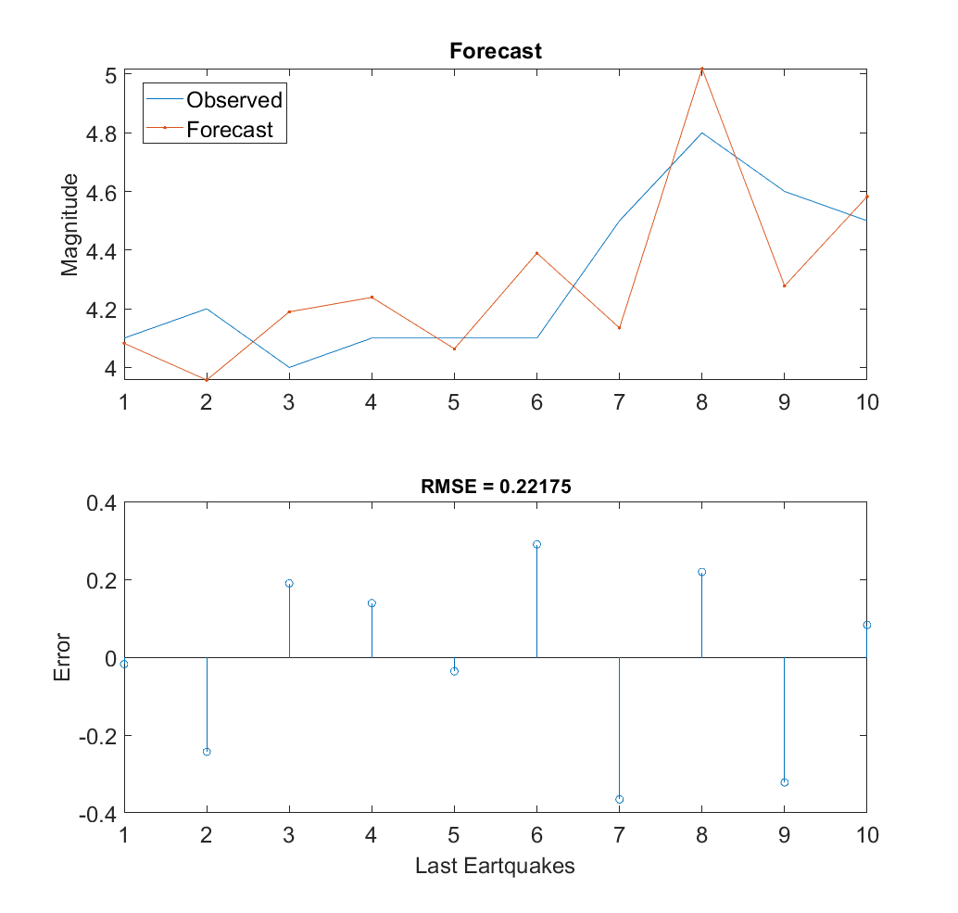
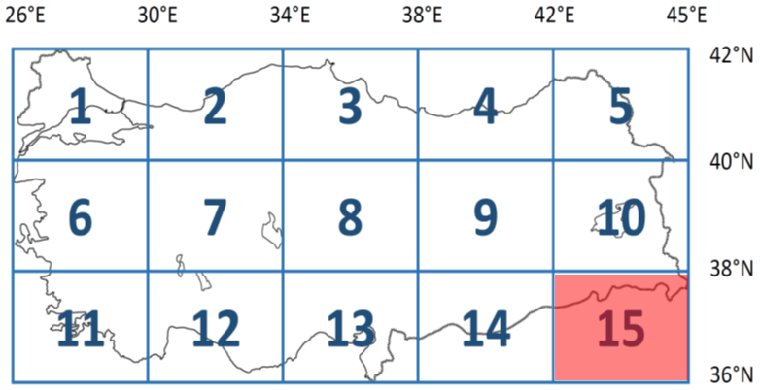
Project no: BİL-03
Results for Selected Region
Computer Engineering
15. Region
Magnitudes are grather than 4
146 traing data
10 test data
Feature backward size is 30
1000 Epoch
100 Batch size

Slide 15
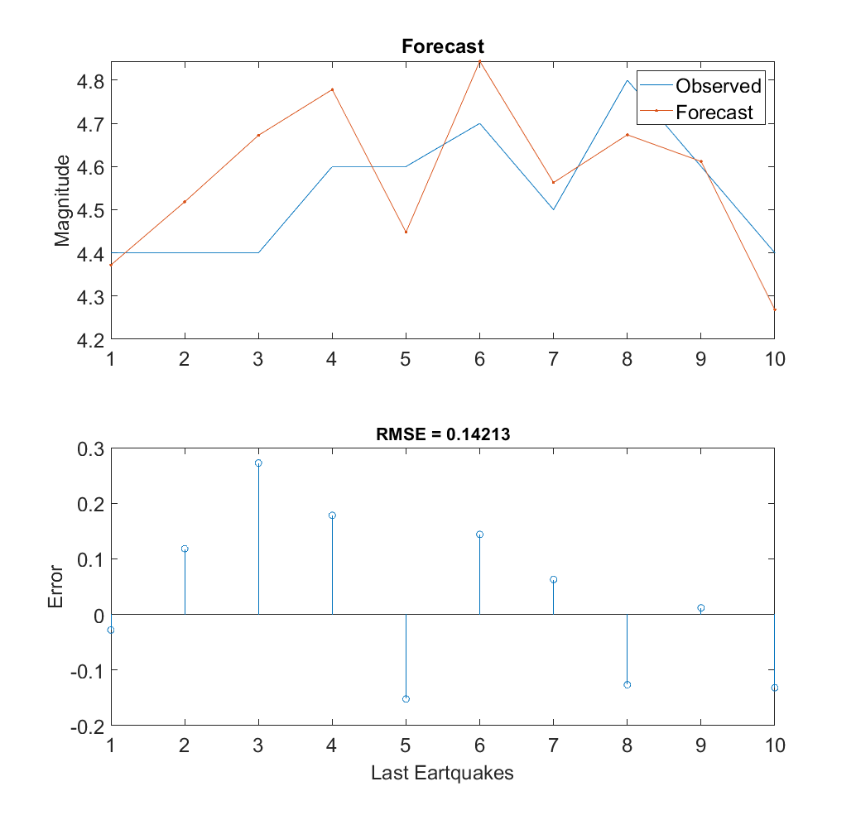
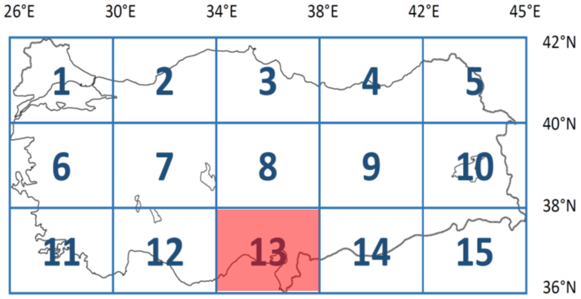
Project no: BİL-03
Results for Selected Region
Computer Engineering
13. Region
Magnitudes are grather than 4.4
116 traing data
10 test data
Feature backward size is 30
1000 Epoch
100 Batch size

Slide 16
Project no: BİL-03
Conclusion
Computer Engineering
Based on the results we have obtained, we have demonstrated that the more limited area is studied to make earthquake forecasts, the better results can be achieved.
Better results can be obtained by choosing different models according to the activity of the fault lines in the region.

Slide 17
Project no: BİL-03
Conclusion
Computer Engineering
In these studies, we forecasts of the magnitude and location of the earthquake.
We tried to make time predictions but we haven't gotten good results yet.
We want to achieve good results by making predictions about time in the upcoming period.

Slide 18
Project No: BİL-03
14. Proje Fair and Competition(2021)
Engineering Faculty
Thanks for your attention
Doğuş KAR and Muhammed Ömer KESKİN
Department: Computer Engineering
Prof. Dr. Serkan GÜNAL

