Slide 1
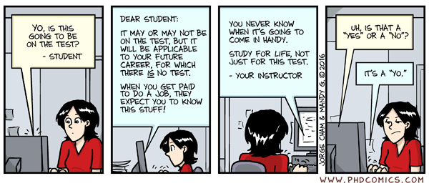
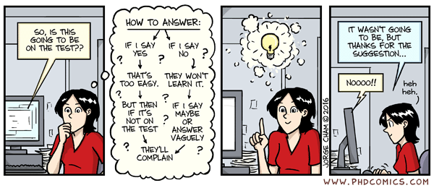
Comic of the day

Slide 2

CSE 341 – System Administration Final Information
Joseph LEDET
Department of Computer Engineering
Akdeniz University
josephledet@akdeniz.edu.tr

Slide 3
DATE/TIME/LOCATION
Date
Monday 2-January-2023
Time
10:30 - 12:10
Location
Amfi 4

Slide 4
GRADING INFORMATION
100 points
Represents 40% of Final grade

Slide 5
Topics Covered
All topics discussed this semester
Command Line
Managing Files
Creating, Viewing, and Editing Text Files
Managing Users and Groups
Controlling Access
Monitoring and Managing Processes, Services and Daemons
SSH
Logs
Networking
Archiving and Copying Between Systems
File Systems
Not covered in lecture but included as additional material
Installing and Updating Software Packages

Slide 6
Format
Short answer questions
Define important terms
Give Examples
Know specific commands
Problems
How to perform tasks using commands
Long answer questions
Explain important concepts

Slide 7
FINAL NOTE
Open
Book/Notes (Anything paper)
Eyes
Mind
Closed
Phone
Computer
Electrical Devices
Mouth

