Slide 1

WOW - such WordArt
#couldbewebdeveloper
#winnerwinner
#thatclipartskill
DOGZ DIRECTION
WEBSITE CONTENT

Slide 2
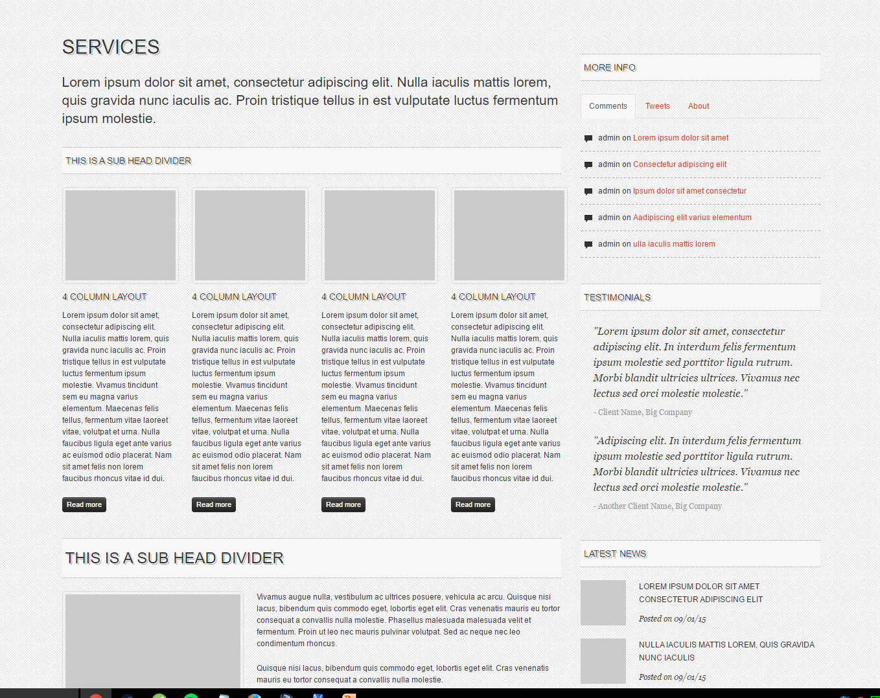
Services
- Dog Training Services –
Using the renowned "Canine Leadership System"- a system which equips YOU to teach your dog manners, loose lead walking and effective dog handling techniques. Consultations at both your home and in the community empower you to take control of your dog!
The Canine Leadership System can also help with problem behaviors such as barking, jumping on furniture, pulling on lead and difficulties socializing with others.
Packages –
Initial meeting and introduction - FREE! This system is about empowering you with the skills to teach your dog. Before commiting to a training package we have to work out whether the Alpha Training Method will be right for you and your dog. This obligation free introduction is a short meeting in which we will discuss your dog, any problem behaviours, and if you decide that the Alpha Training method is right for you create a training package that will suit your needs.
Please call for an obligation free visit to discuss the right package for you and your dog.

Slide 3
Services
- Dog Walking –
Regular walking is important for your dog's health and can help to burn excess energy resulting in a healthier happier dog (and owner!).
Price schedule Walking Plan Casual Walks 1 – 4 walks per week (up to 2 dogs) 15mins $10.00 Per Walk 30mins $20.00 Per Walk Regular Walks 5 – 7 walks per week (up to two dogs) 15mins $10.00 Per Walk 30mins $18.00 Per Walk

Slide 4
Services
- Pet Sitting (Dogs & Cats)- One visit per day(up to two pets) 1 – 4 Days $24.00 Per Visit 5 – 9 Days $22.00 Per Visit 10+ Days $20.00 Per Visit Extra Visit On Same Day $18.00 Extra Pet $5.00 Plus 15mins Playtime $8.00 Plus 30mins Dog Walk $15.00 Please phone or email regarding prices for other animals.

Slide 5

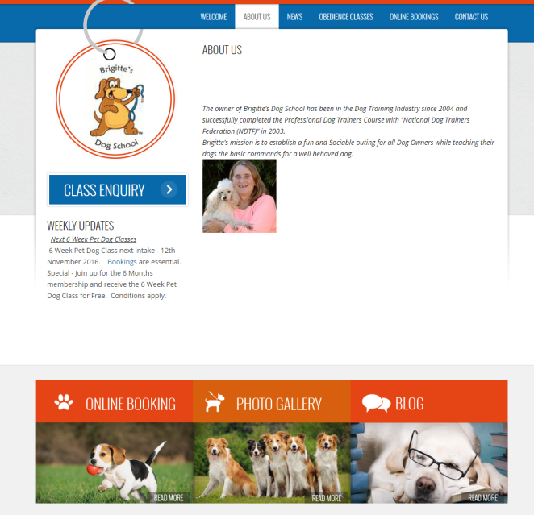
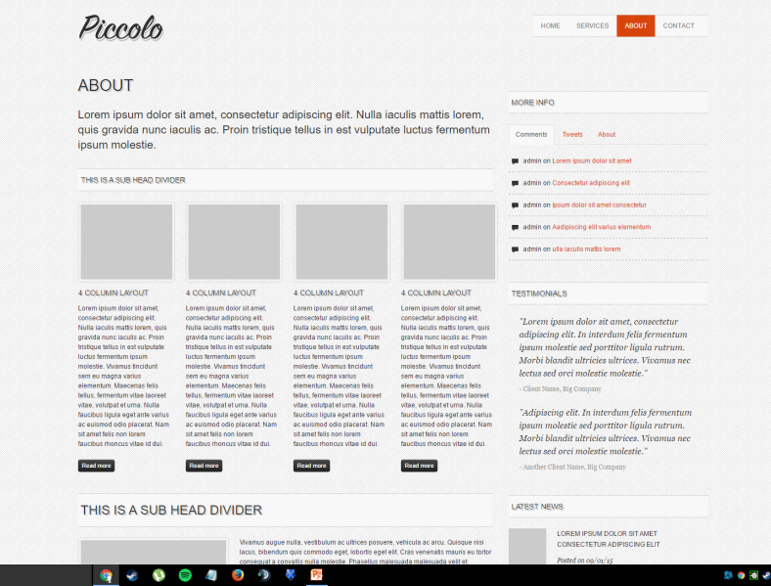
About
This page is complicated- can we just make it like a paragraph, testamonials and photo of Benny? Kind of like example to right-→
Text
Ben’s love for animals began when he was a child with his first dog, a Golden Retriever named Euriah. Twenty years later Ben’s passion for dogs was reignited when he and his wife Emma adopted Rosie.
Ben began to research different methods of training and attended puppy school with Rosie. Rosie was clever and could do all commands in class, but became food motivated and left her manners at the door when she got home! On walks she was so excited and pulled on her lead, as she got bigger walking her became a chore.
It was then that Ben turned to an Alpha Dog Trained Professional to help Rosie.
After a few weeks friends and family began to comment on how well behaved Rosie was, walks became enjoyable and food rewards were soon phased out- this Alpha Training really worked…
After seeing these results for himself Ben decided to study to become a Dog Trainer and completed the Alpha Dog Professional Trainer Course himself in 2016.
Ben’s passion now is to empower other owners to teach their dogs so that they both can experience the joys of life with their dog.
Testamonials- how can we get these?

Slide 6
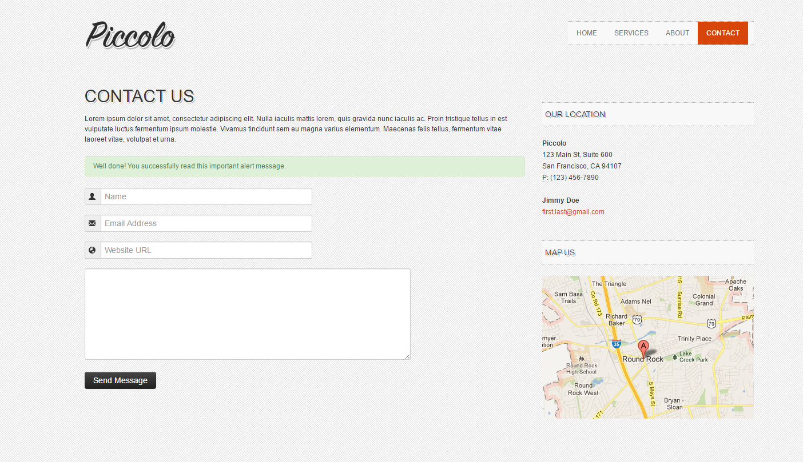

Contact
CONTACT US
Phone Ben is always happy to answer your questions, call him on 0434 897 097.
Hours We are open seven days a week. Please call or send an enquiry and we will get back to you as soon as possible.
Our Location
Dogz Direction currently services the Outer North Western Suburbs including Diggers Rest, Melton, Sunbury and surrounds. Others areas are available by request for Dog Training.
Ben Burke
Phone: 04034 897 097
Email : dogzdirection@outlook.com
MAP – maybe just Diggers Rest or service area of outer melbourne?

