Slide 1
Longest Common Subsequence

Slide 2
Common subsequence
A subsequence of a string is the string with zero or more chars left out
A common subsequence of two strings:
A subsequence of both strings
Ex: x = {A B C B D A B }, y = {B D C A B A}
{B C} and {A A} are both common subsequences of x and y

Slide 3
Longest Common Subsequence
Given two sequences x[1 . . m] and y[1 . . n], find a longest subsequence common to them both.
“a” not “the”
x:
A
B
C
B
D
A
B
BCBA = LCS(x, y)
y:
B
D
C
A
B
A
functional notation, but not a function

Slide 4
Motivation for LCS
Text editors.
Misspelt Words Matching
Bioinformatics: LCS is used in Molecular Biology for DNA sequences
Unix File Comparison.

Slide 5
Brute-force LCS algorithm
Check every subsequence of x[1 . . m] to see if it is also a subsequence of y[1 . . n].
Analysis
2^{m} subsequences of x (each bit-vector of length m determines a distinct subsequence of x).
Hence, the runtime would be exponential !
Towards a better algorithm: a DP strategy
Key: optimal substructure and overlapping sub-problems
First we’ll find the length of LCS. Later we’ll modify the algorithm to find LCS itself.

Slide 6
DP Algorithm
Key: find out the correct order to solve the sub-problems
Total number of sub-problems: m * n
c[i–1, j–1] + 1 if x[i] = y[j],
max{c[i–1, j], c[i, j–1]} otherwise.
c[i, j] =
0
j
n
0
 |  | C(i, j)
i
m

Slide 7
DP Algorithm
LCS-Length(X, Y)
1. m = length(X) // get the # of symbols in X
2. n = length(Y) // get the # of symbols in Y
3. for i = 1 to m c[i,0] = 0 // special case: Y[0]
4. for j = 1 to n c[0,j] = 0 // special case: X[0]
5. for i = 1 to m // for all X[i]
6. for j = 1 to n // for all Y[j]
7. if ( X[i] == Y[j])
8. c[i,j] = c[i-1,j-1] + 1
9. else c[i,j] = max( c[i-1,j], c[i,j-1] )
10. return c

Slide 8
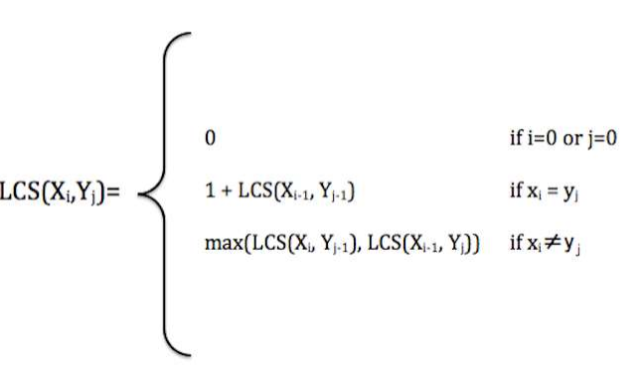
Recursive Relation

Slide 9
LCS Example
We’ll see how LCS algorithm works on the following example:
X = ABCB
Y = BDCAB
What is the LCS of X and Y?
LCS(X, Y) = BCB
X = A B C B
Y = B D C A B

Slide 10
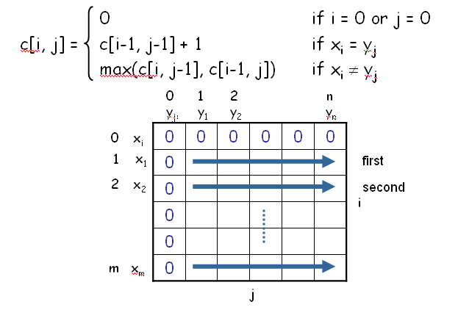
Computing the Length of the LCS

Slide 11
LCS Example (0)
ABCB
BDCAB
j 0 1 2 3 4 5
i
Y[j]
B
D
C
A
B
0
X[i]
A
1
2
B
3
C
4
B
X = ABCB; m = |X| = 4
Y = BDCAB; n = |Y| = 5
Allocate array c[5,6]

Slide 12
LCS Example (1)
ABCB
BDCAB
j 0 1 2 3 4 5
i
Y[j]
B
D
C
A
B
0
X[i]
0
0
0
0
0
0
A
1
0
2
B
0
3
C
0
4
B
0
for i = 1 to m c[i,0] = 0
for j = 1 to n c[0,j] = 0

Slide 13
LCS Example (2)
ABCB
BDCAB
j 0 1 2 3 4 5
i
Y[j]
B
D
C
A
B
0
X[i]
0
0
0
0
0
0
A
1
0
0
2
B
0
3
C
0
4
B
0
if ( X_{i} == Y_{j} )
c[i,j] = c[i-1,j-1] + 1
else c[i,j] = max( c[i-1,j], c[i,j-1] )

Slide 14
LCS Example (3)
ABCB
BDCAB
j 0 1 2 3 4 5
i
Y[j]
B
D
C
A
B
0
X[i]
0
0
0
0
0
0
A
1
0
0
0
0
2
B
0
3
C
0
4
B
0
if ( X_{i} == Y_{j} )
c[i,j] = c[i-1,j-1] + 1
else c[i,j] = max( c[i-1,j], c[i,j-1] )

Slide 15
LCS Example (4)
ABCB
BDCAB
j 0 1 2 3 4 5
i
Y[j]
B
D
C
A
B
0
X[i]
0
0
0
0
0
0
A
1
0
0
0
0
1
2
B
0
3
C
0
4
B
0
if ( X_{i} == Y_{j} )
c[i,j] = c[i-1,j-1] + 1
else c[i,j] = max( c[i-1,j], c[i,j-1] )

Slide 16
LCS Example (5)
ABCB
BDCAB
j 0 1 2 3 4 5
i
Y[j]
B
D
C
A
B
0
X[i]
0
0
0
0
0
0
A
1
0
0
0
0
1
1
2
B
0
3
C
0
4
B
0
if ( X_{i} == Y_{j} )
c[i,j] = c[i-1,j-1] + 1
else c[i,j] = max( c[i-1,j], c[i,j-1] )

Slide 17
LCS Example (6)
ABCB
BDCAB
j 0 1 2 3 4 5
i
Y[j]
B
D
C
A
B
0
X[i]
0
0
0
0
0
0
A
1
0
0
0
0
1
1
2
B
0
1
3
C
0
4
B
0
if ( X_{i} == Y_{j} )
c[i,j] = c[i-1,j-1] + 1
else c[i,j] = max( c[i-1,j], c[i,j-1] )

Slide 18
LCS Example (7)
ABCB
BDCAB
j 0 1 2 3 4 5
i
Y[j]
B
D
C
A
B
0
X[i]
0
0
0
0
0
0
A
1
0
0
0
0
1
1
2
B
0
1
1
1
1
3
C
0
4
B
0
if ( X_{i} == Y_{j} )
c[i,j] = c[i-1,j-1] + 1
else c[i,j] = max( c[i-1,j], c[i,j-1] )

Slide 19
LCS Example (8)
ABCB
BDCAB
j 0 1 2 3 4 5
i
Y[j]
B
D
C
A
B
0
X[i]
0
0
0
0
0
0
A
1
0
0
0
0
1
1
2
B
0
1
1
1
1
2
3
C
0
4
B
0
if ( X_{i} == Y_{j} )
c[i,j] = c[i-1,j-1] + 1
else c[i,j] = max( c[i-1,j], c[i,j-1] )

Slide 20
LCS Example (9)
ABCB
BDCAB
j 0 1 2 3 4 5
i
Y[j]
B
D
C
A
B
0
X[i]
0
0
0
0
0
0
A
1
0
0
0
0
1
1
2
B
0
1
1
1
1
2
3
C
0
1
1
4
B
0
if ( X_{i} == Y_{j} )
c[i,j] = c[i-1,j-1] + 1
else c[i,j] = max( c[i-1,j], c[i,j-1] )

Slide 21
LCS Example (10)
ABCB
BDCAB
j 0 1 2 3 4 5
i
Y[j]
B
D
C
A
B
0
X[i]
0
0
0
0
0
0
A
1
0
0
0
0
1
1
2
B
0
1
1
1
1
2
3
C
0
1
1
2
4
B
0
if ( X_{i} == Y_{j} )
c[i,j] = c[i-1,j-1] + 1
else c[i,j] = max( c[i-1,j], c[i,j-1] )

Slide 22
LCS Example (11)
ABCB
BDCAB
j 0 1 2 3 4 5
i
Y[j]
B
D
C
A
B
0
X[i]
0
0
0
0
0
0
A
1
0
0
0
0
1
1
2
B
0
1
1
1
1
2
3
C
0
1
1
2
2
2
4
B
0
if ( X_{i} == Y_{j} )
c[i,j] = c[i-1,j-1] + 1
else c[i,j] = max( c[i-1,j], c[i,j-1] )

Slide 23
LCS Example (12)
ABCB
BDCAB
j 0 1 2 3 4 5
i
Y[j]
B
D
C
A
B
0
X[i]
0
0
0
0
0
0
A
1
0
0
0
0
1
1
2
B
0
1
1
1
1
2
3
C
0
1
1
2
2
2
4
B
0
1
if ( X_{i} == Y_{j} )
c[i,j] = c[i-1,j-1] + 1
else c[i,j] = max( c[i-1,j], c[i,j-1] )

Slide 24
LCS Example (13)
ABCB
BDCAB
j 0 1 2 3 4 5
i
Y[j]
B
D
C
A
B
0
X[i]
0
0
0
0
0
0
A
1
0
0
0
0
1
1
2
B
0
1
1
1
1
2
3
C
0
1
1
2
2
2
4
B
0
1
1
2
2
if ( X_{i} == Y_{j} )
c[i,j] = c[i-1,j-1] + 1
else c[i,j] = max( c[i-1,j], c[i,j-1] )

Slide 25
LCS Example (14)
ABCB
BDCAB
j 0 1 2 3 4 5
i
Y[j]
B
D
C
A
B
0
X[i]
0
0
0
0
0
0
A
1
0
0
0
0
1
1
2
B
0
1
1
1
1
2
3
C
0
1
1
2
2
2
4
B
3
0
1
1
2
2
if ( X_{i} == Y_{j} )
c[i,j] = c[i-1,j-1] + 1
else c[i,j] = max( c[i-1,j], c[i,j-1] )

Slide 26
LCS Algorithm Running Time
LCS algorithm calculates the values of each entry of the array c[m,n]
So what is the running time?
O(m*n)
since each c[i,j] is calculated in constant time, and there are m*n elements in the array

Slide 27
How to find actual LCS
The algorithm just found the length of LCS, but not LCS itself.
How to find the actual LCS?
For each c[i,j] we know how it was acquired:
A match happens only when the first equation is taken
So we can start from c[m,n] and go backwards, remember x[i] whenever c[i,j] = c[i-1, j-1]+1.
2
2
For example, here
c[i,j] = c[i-1,j-1] +1 = 2+1=3
2
3

Slide 28
Finding LCS
j 0 1 2 3 4 5
i
Y[j]
B
D
C
A
B
0
X[i]
0
0
0
0
0
0
A
1
0
0
0
0
1
1
2
B
0
1
1
1
1
2
3
C
0
1
1
2
2
2
4
B
3
0
1
1
2
2
Time for trace back: O(m+n).

Slide 29
Finding LCS (2)
j 0 1 2 3 4 5
i
Y[j]
B
D
C
A
B
0
X[i]
0
0
0
0
0
0
A
1
0
0
0
0
1
1
2
B
0
1
1
1
1
2
3
C
0
1
1
2
2
2
4
B
3
0
1
1
2
2
LCS (reversed order):
B
C
B
B C B
(this string turned out to be a palindrome)
LCS (straight order):

