Slide 1
Garov egasini tanlang
Garov egasini tanlang
Garov egasini tanlang
Garov egasini tanlang
Garov egasini tanlang
Garov egasini tanlang
Garov egasini tanlang
O’zi
O’zi
Boshqa shaxs
Avtomobil
Avtomobil
Ko’chmas mulk
Tilla buyum
Sugurta

Slide 2
Garov egasini tanlang
Garov egasini tanlang
Garov egasini tanlang
Garov egasini tanlang
Garov egasini tanlang
Garov egasini tanlang
Garov egasini tanlang
O’zi
O’zi
Boshqa shaxs
Ishonchnoma
Quyidagi fieldlar buladi:
FISH
FISH initsiali
Notarius FISH
Notarius manzili
Reestr raqami
Reestr sanasi
Avtomobil
Ko’chmas mulk
Tilla buyum
Sugurta

Slide 3
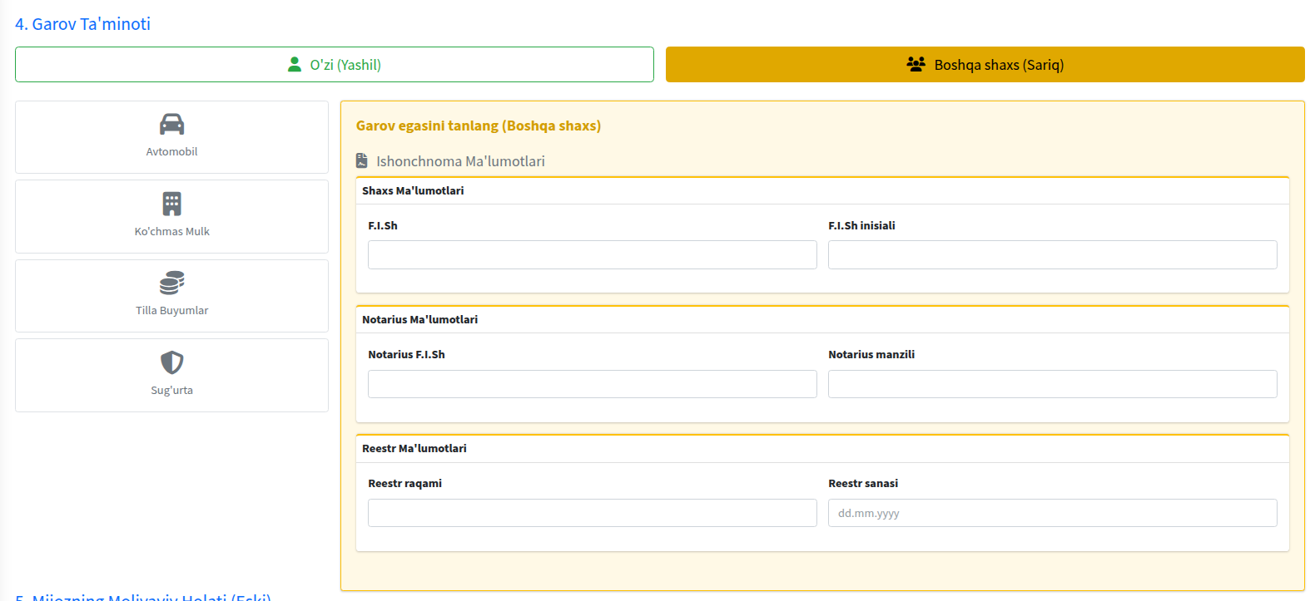
Ishonchnoma

