Slide 1
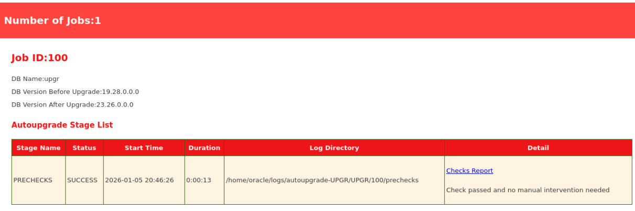

Slide 2
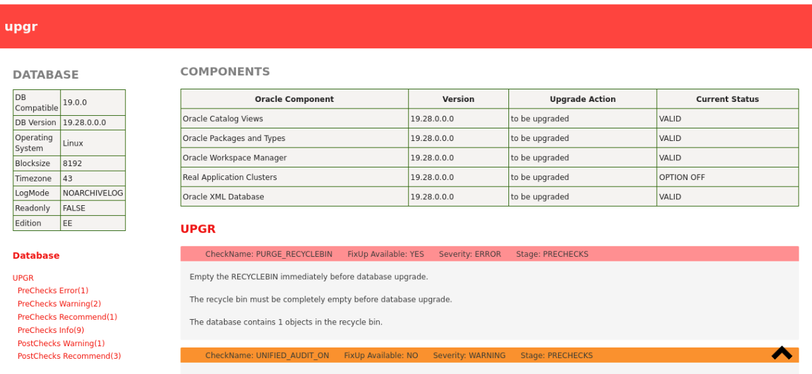

Slide 3
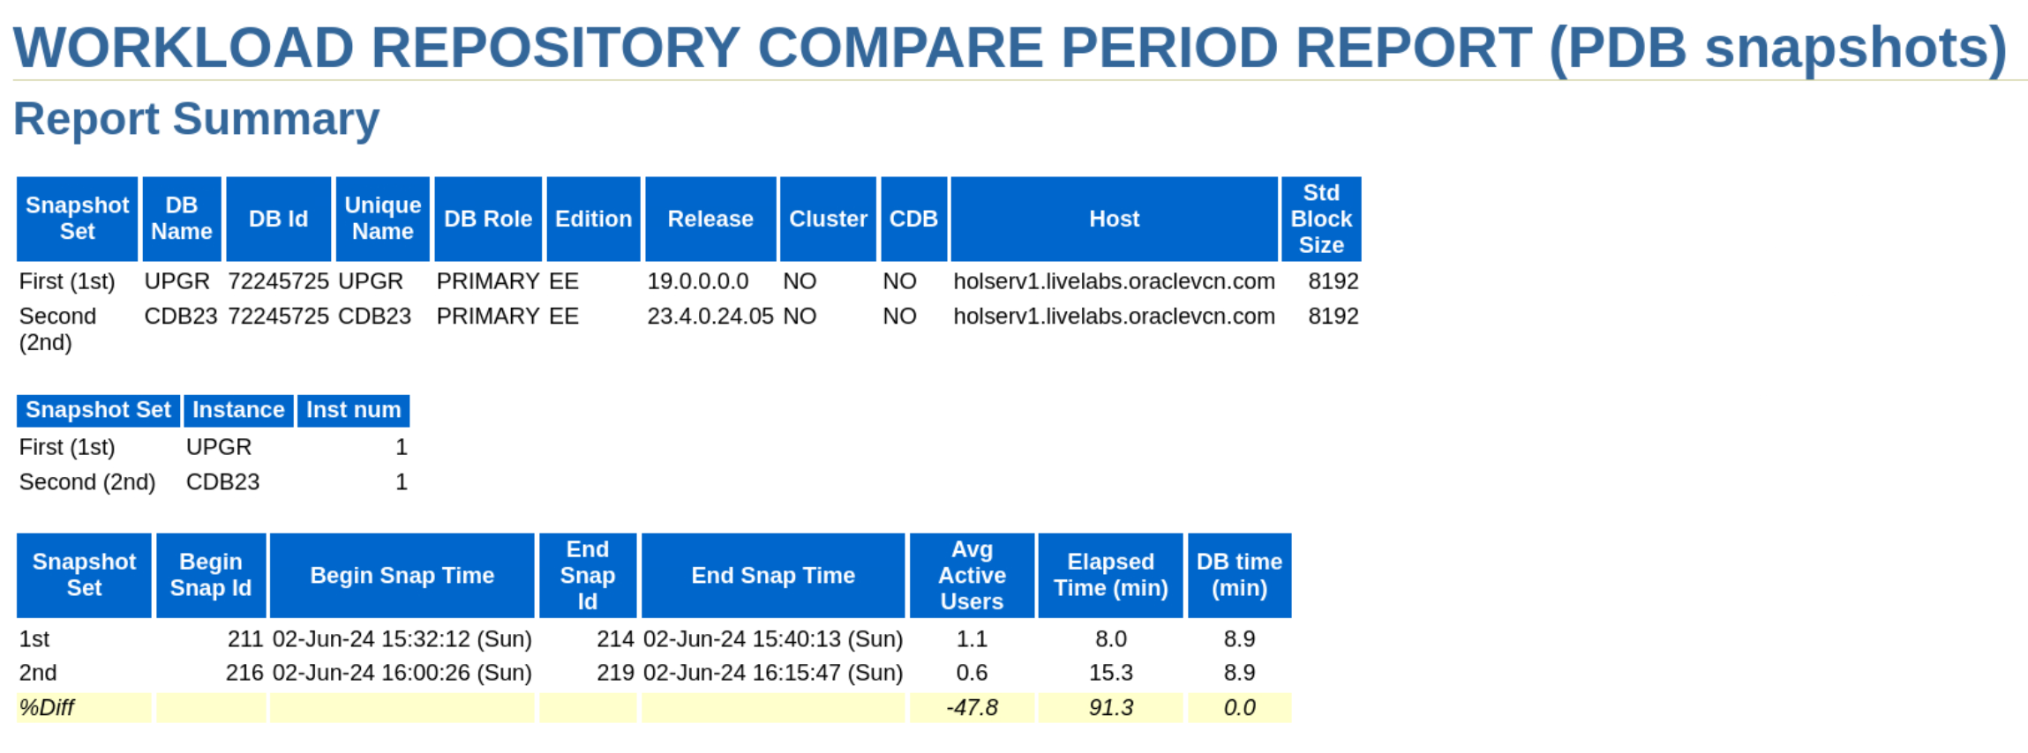
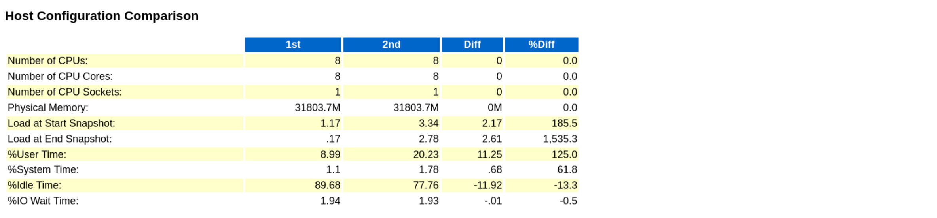

Slide 4
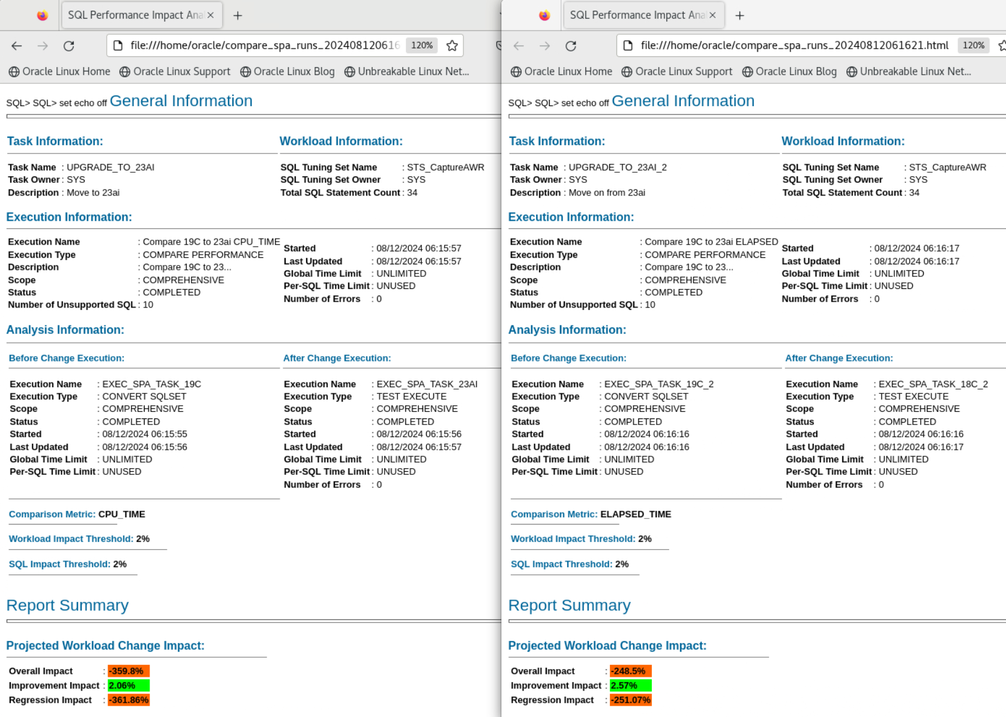

Slide 5
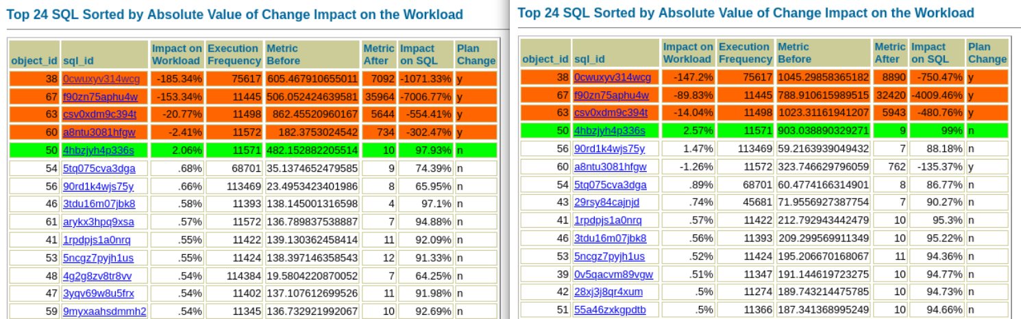

Slide 6
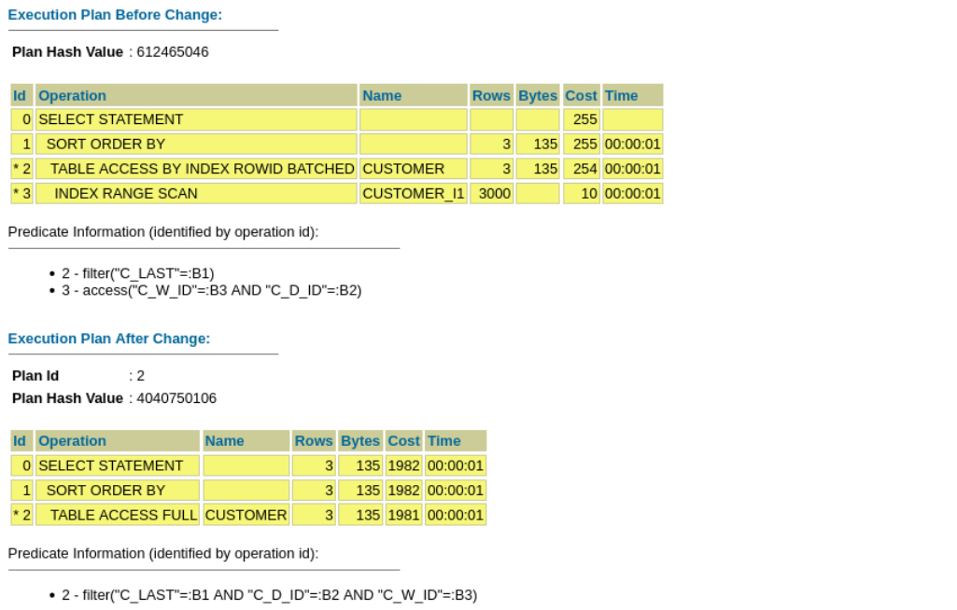

Slide 7
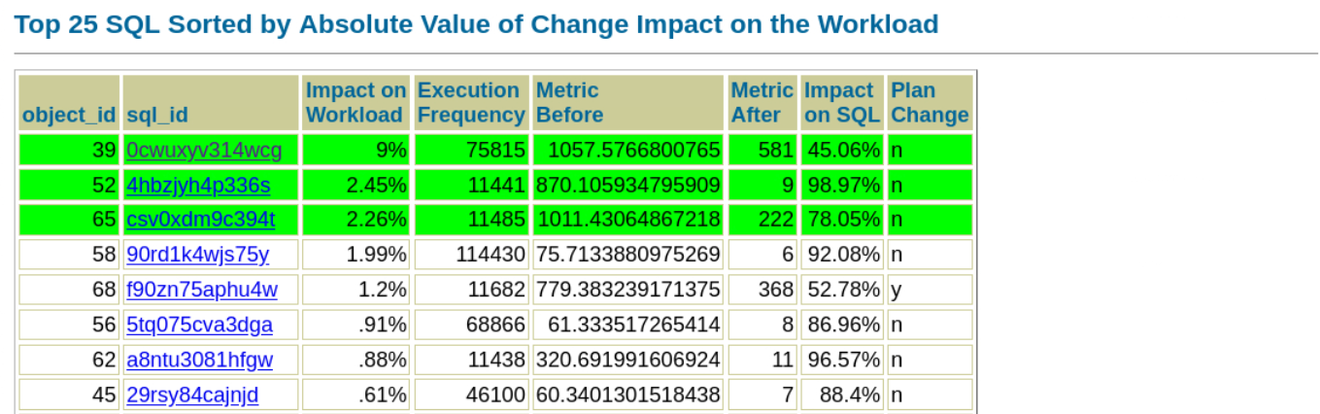

Slide 8
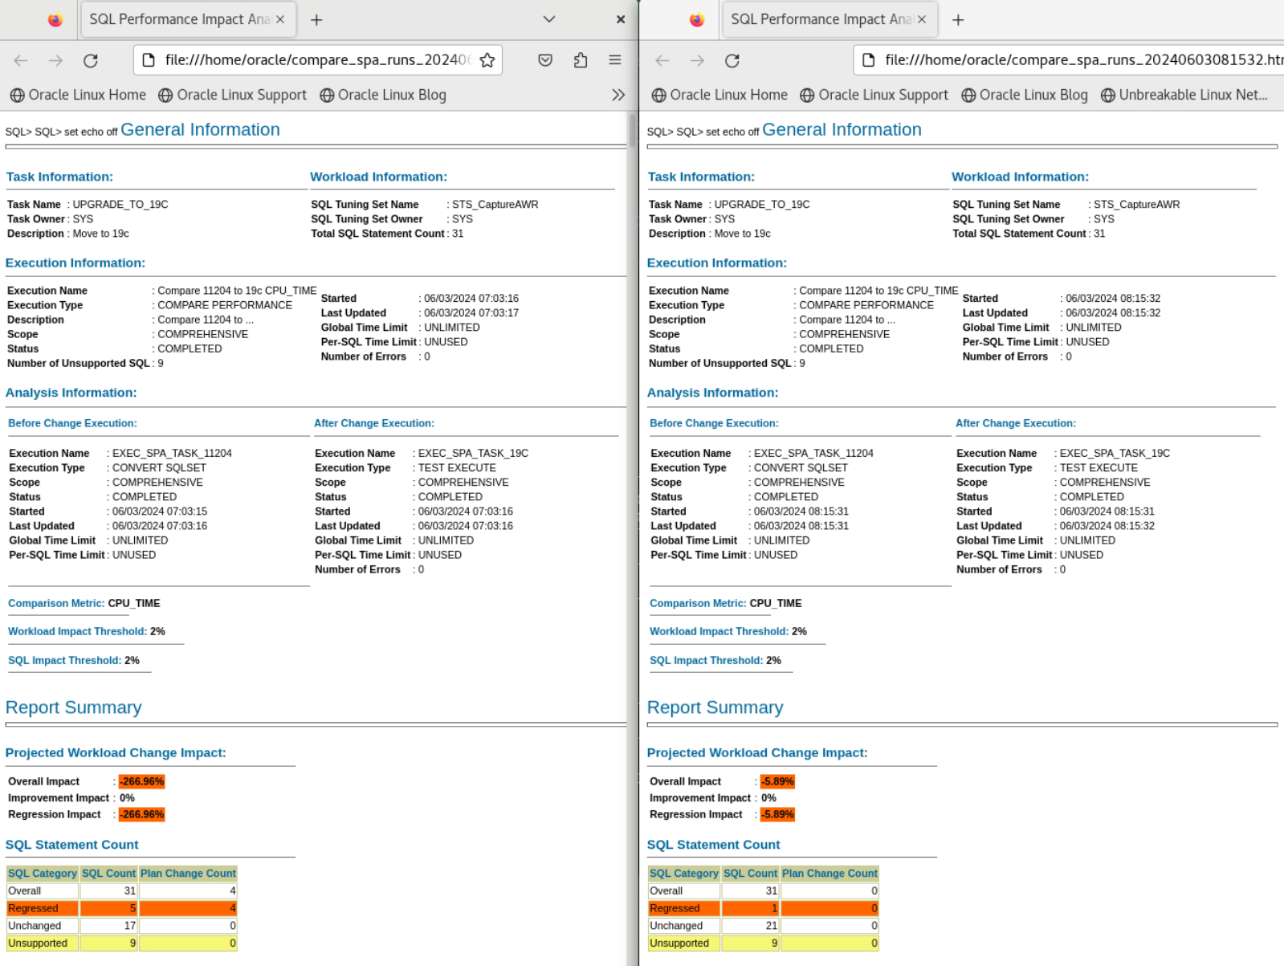

Slide 9
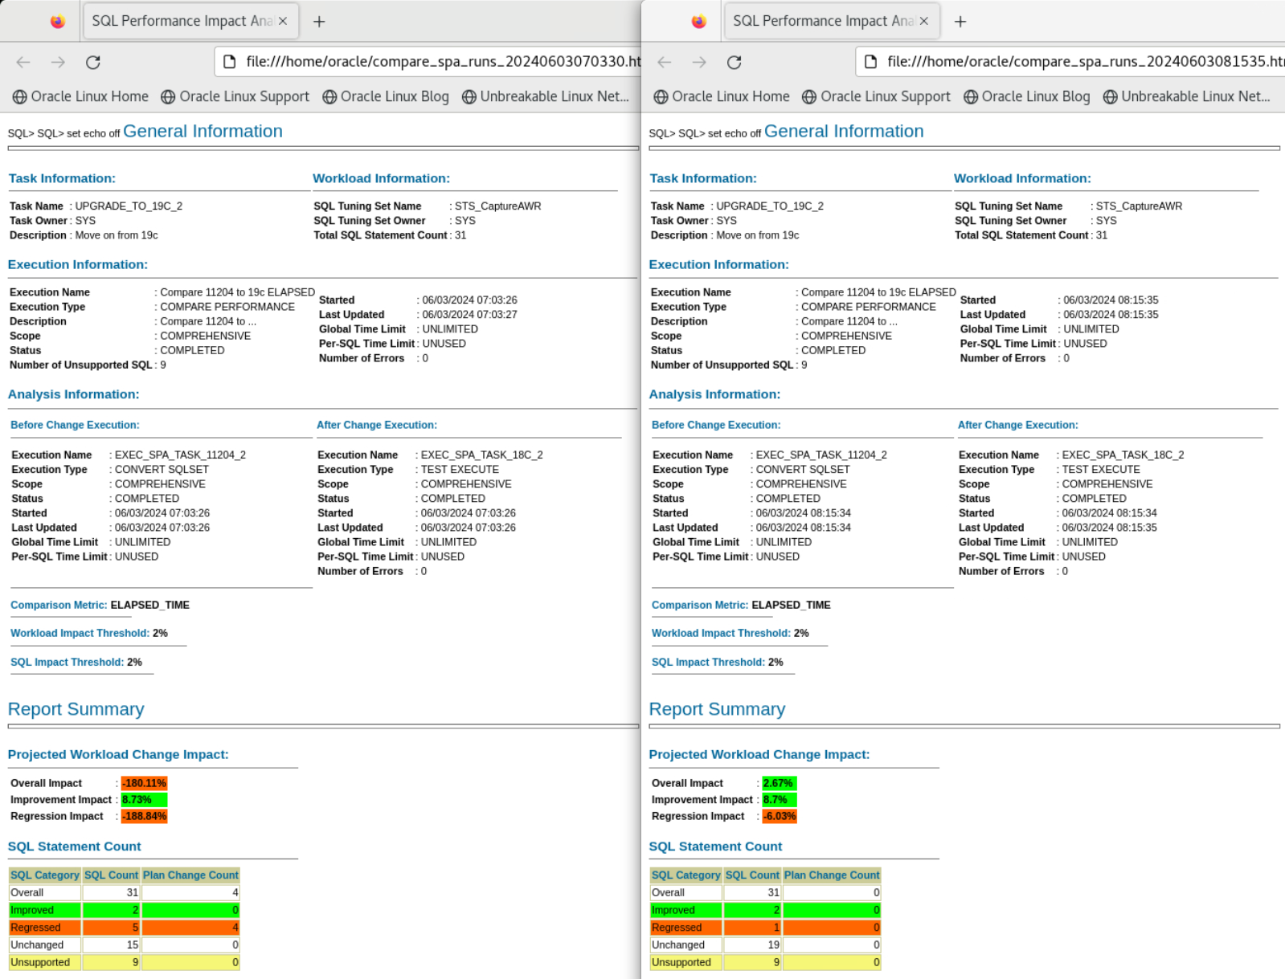

Slide 10
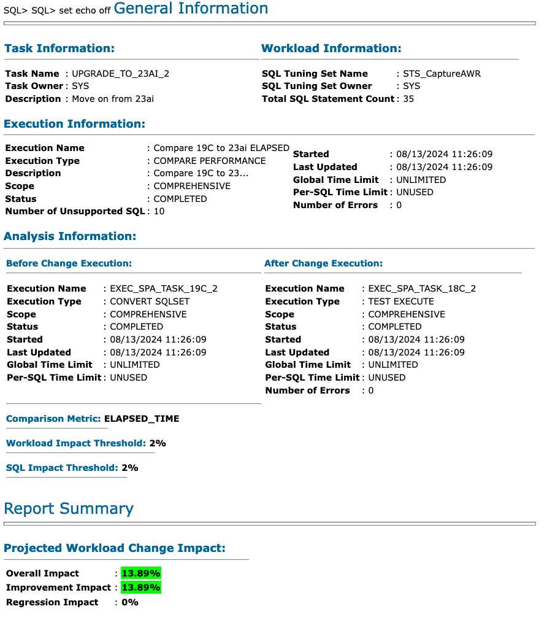

Slide 11
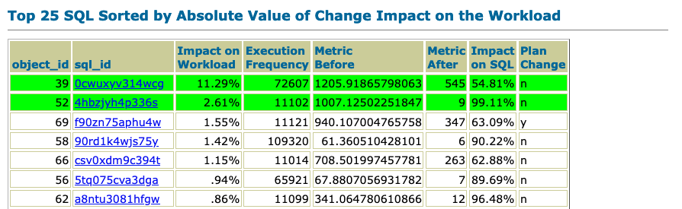

Slide 12
 | Database | PDBs | Set environment
Oracle Database 19c /u01/app/oracle/product/19
Oracle Database 21c /u01/app/oracle/product/21
Oracle AI Database 26ai /u01/app/oracle/product/26
UPGR
. upgr
BEIGE
. beige
CDB19
ORANGE, TERRACOTTA
. cdb19
CDB19ENC
CORAL, PLUM
. cdb19enc
COBALT
MOCHA
. cobalt
CDB26
RED, BLUE, GREEN
. cdb26
CDB26COM
YELLOW
. cdb26com
CDB26ENC
. cdb26enc

Slide 13
Labs
1 | 2 | Track 1 | 3 | 4 | 5 | 6 | 7 | 8 | 9 | 14
 |  | Track 2 | 10 | 15
 |  | Track 3 | 11 | 12 | 13

