Slide 1

#KidzHackPhilly
Lesson 5: drawing with coordinates

Slide 2
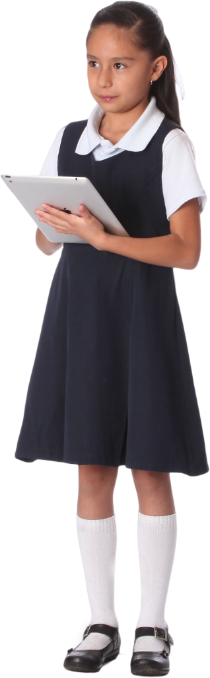
Today’s lesson
Review (5 min)
Software lesson (10 min)
Challenges (15 min)
Hands on (15 min)

Slide 3
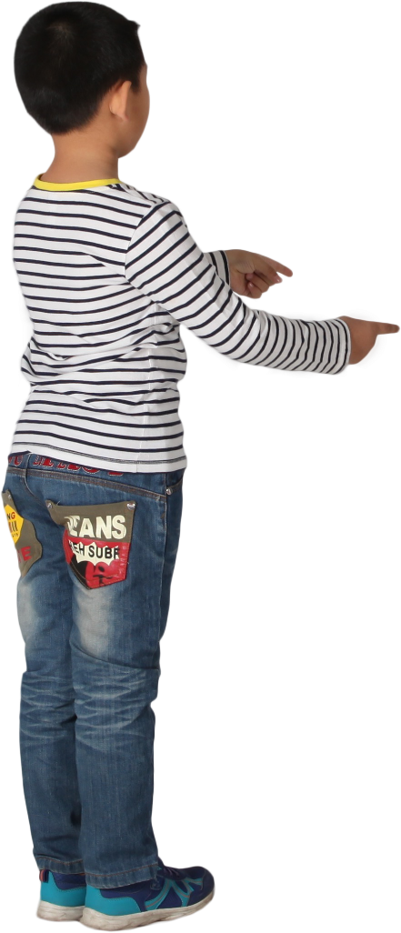
Review
Hardware lesson: Disk storage
Software lesson: Variables
Hands on
Use a variable to set the rotation speed for three different stickers.
Quiz results

Slide 4

Software lesson
Programming
Events
Graphics

Slide 5
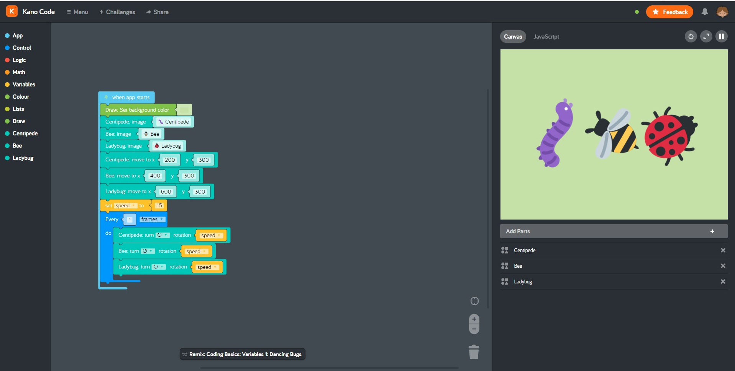
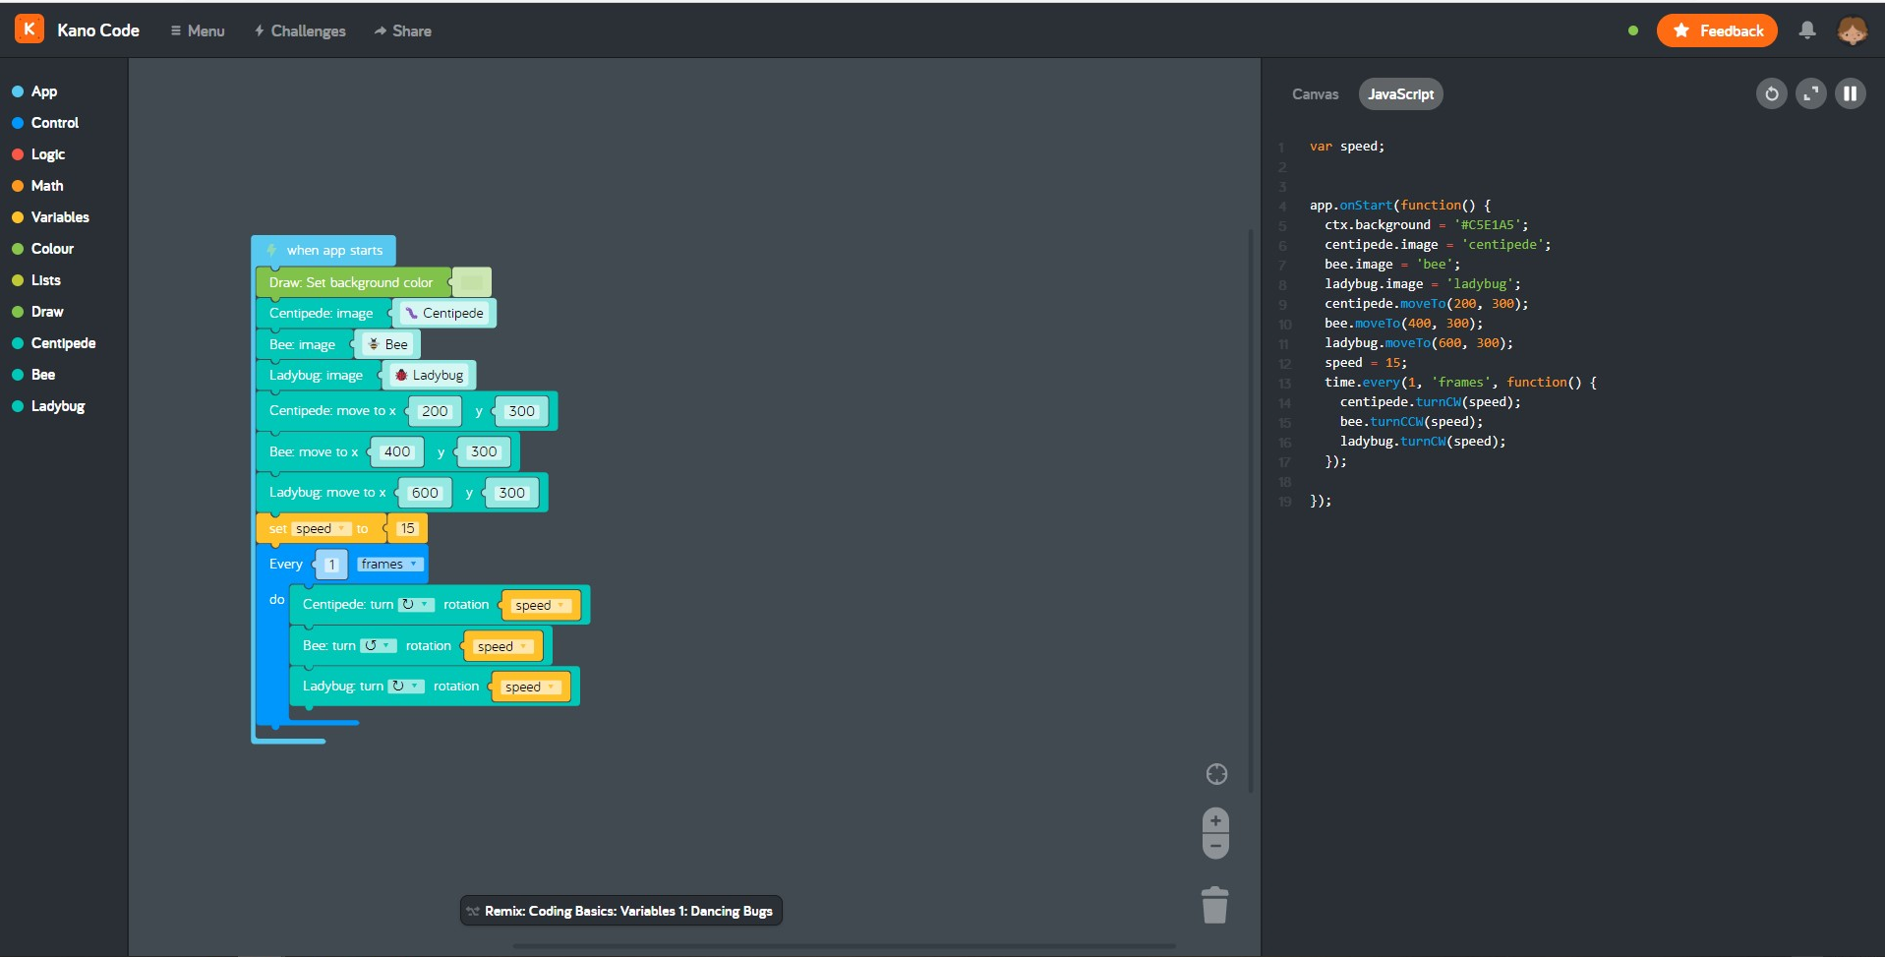
Programming with the Kano Code app
Kano Code is an app for writing and running programs using blocks
The blocks create JavaScript code which you can see
Share your programs as creations
Other Kano Club users can like or comment on your creations
Remix creations from other Kano Club users
Demo!
Notes:
Notes to coach on demo:
Start by showing how to create a program from from scratch
Switch between canvas and JavaScripts tabs
Show the restart, expand canvas and pause buttons
Show how to explore and remix creations form other members

Slide 6


Events
Events are used to change the flow of a program when something happens
When an app starts
When the mouse button is clicked
Event code blocks in Kano Code have a lightning bolt
The lightning bolt lights up when the event fires

Slide 7
Graphics
X axis
Programs that create images are called “Graphics” programs
Simple graphics programs are known as “two dimensional”
Two dimensional graphics have width and height but not depth
Images are drawn on a grid using dots known as “pixels”
The location of a pixel is known as a “coordinate” which has two parts:
Width, known as the “x” coordinate
Height, known as the “y” coordinate
Y axis
x=1 y=1 | x=2 y=1 | x=3 y=1 | x=4 y=1 | x=5 y=1
x=1 y=2 | x=2 y=2 | x=3 y=2 | x=4 y=2 | x=5 y=2
x=1 y=3 | x=2 y=3 | x=3 y=3 | x=4 y=3 | x=5 y=3
x=1 y=4 | x=2 y=4 | x=3 y=4 | x=4 y=4 | x=5 y=4
x=1 y=5 | x=2 y=5 | x=3 y=5 | x=4 y=5 | x=5 y=5
x=1 y=6 | x=2 y=6 | x=3 y=6 | x=4 y=6 | x=5 y=6
x=1 y=7 | x=2 y=7 | x=3 y=7 | x=4 y=7 | x=5 y=7
x=1 y=8 | x=2 y=8 | x=3 y=8 | x=4 y=8 | x=5 y=8
x=1 y=9 | x=2 y=9 | x=3 y=9 | x=4 y=9 | x=5 y=9
Notes:
Coach notes:
Ask the kids if they know any games that use a grid. Examples are bingo and battleship.

Slide 8


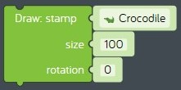
Drawing shapes
Shapes are drawn using lots of pixels
Drawing a shape one pixel at a time can be annoying
Kano Code makes it easy to draw shapes
Just move to the x,y coordinate where you want to draw the shape
Chose a pre-built shapes you can draw with a single code block
Ellipse (a stretched circle)
Stamp (a pre-drawn picture)

Slide 9

Hands on
Write a graphics program that draws a picture of a grassy field on a sunny day
Share your creation
See README.md for step-by-step instructions

