Slide 1

#KidzHackPhilly
Lesson 1: PCs and OSs

Slide 2

Today’s lesson
Hardware lesson (15 min)
Software lesson (15 min)
Hands on (90 min)

Slide 3
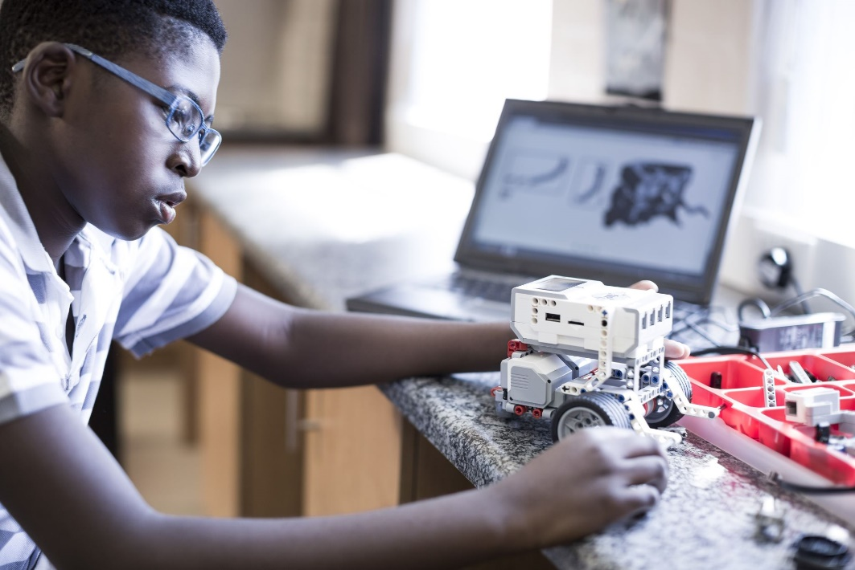
Hardware lesson
PC

Slide 4
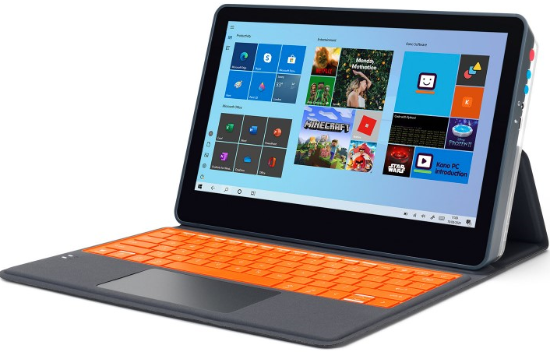
PC
PC stands for “Personal computer” and is a type of computing device
Other computing devices include mobile devices like smartphones
PCs are assembled from many different components:
CPUs, RAM, disks, displays and more
There are different types of PCs
Servers and desktops are stationary and must be connected to AC power.
Laptops and tablets are mobile and can run from battery power.
PC power states
Starting a PC is also known as “booting”.
Restarting a PC is also known as “rebooting”.
Turning off a PC is also known as “shutting down”.
Pausing a PC is also known as “sleeping”.
The Kano PC is a tablet
Includes a touchscreen display and detachable keyboard
Let’s watch a video! https://youtu.be/7xncj-Evf5k
Kano PC

Slide 5

Software lesson
OSes
SaaS subscriptions
Apps

Slide 6
OSes, SaaS subscriptions and Apps
OSes
SaaS subscriptions and apps
OS stands for “operating system”
System software that manages hardware, apps and common services
There are two major PC OSes
Microsoft Windows
Linux (including macOS)
The OS starts when you boot the PC
You use it to launch other apps and manage files
SaaS stands for “software as a service”
Subscription fee-based delivery of software services over the internet
Sometimes includes a trial period
Kano Club is an example
App stands for “application software”
Two types: web browser based or “rich client”
Apps access services by signing in
Kano Code is an example

Slide 7

Hands on
Assemble a PC from components.
Boot the PC and configure the OS.
Launch the Kano Code app
Activate your Kano Club subscription.
See README.md for step-by-step instructions.

