Slide 1
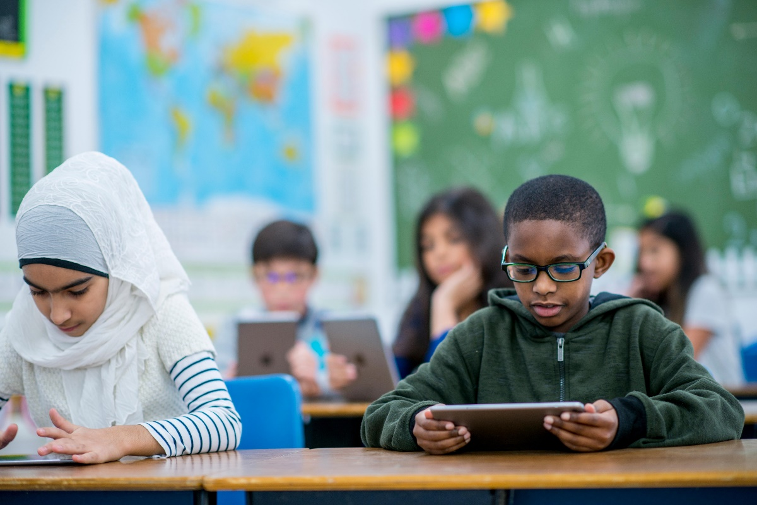
#KidzHackPhilly
Lesson 4: Storage and variables

Slide 2
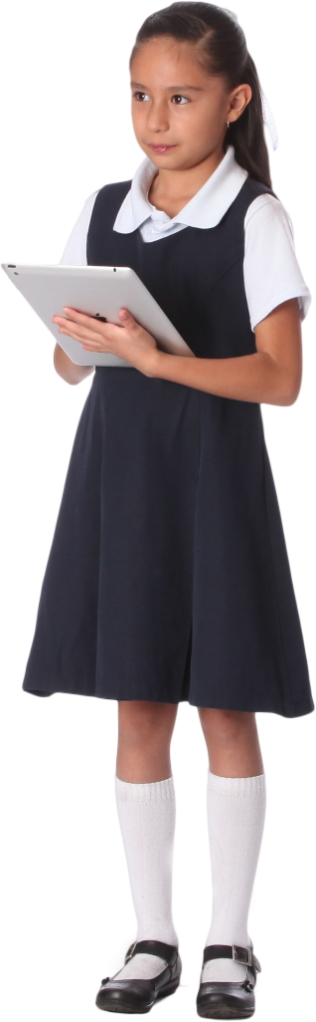
Today’s lesson
Review (10 min)
Hardware lesson (20 min)
Software lesson (20 min)
Challenge (10 min)

Slide 3
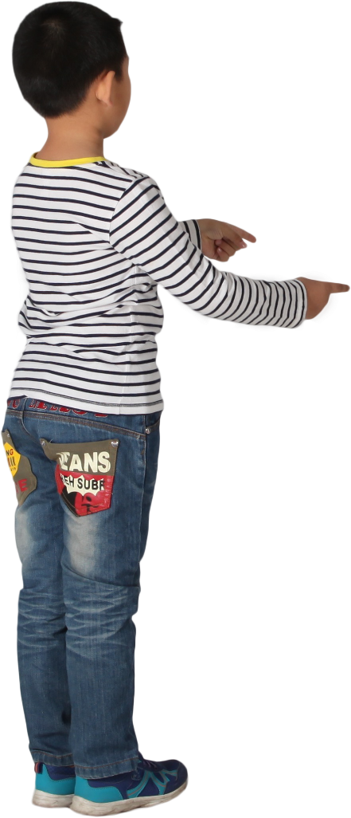
Review
Hardware lesson: RAM
Software lesson: Loops
Hands on
Complete a challenge that draws holes in a block of swiss cheese using a loop.
Make changes to the challenge.

Slide 4
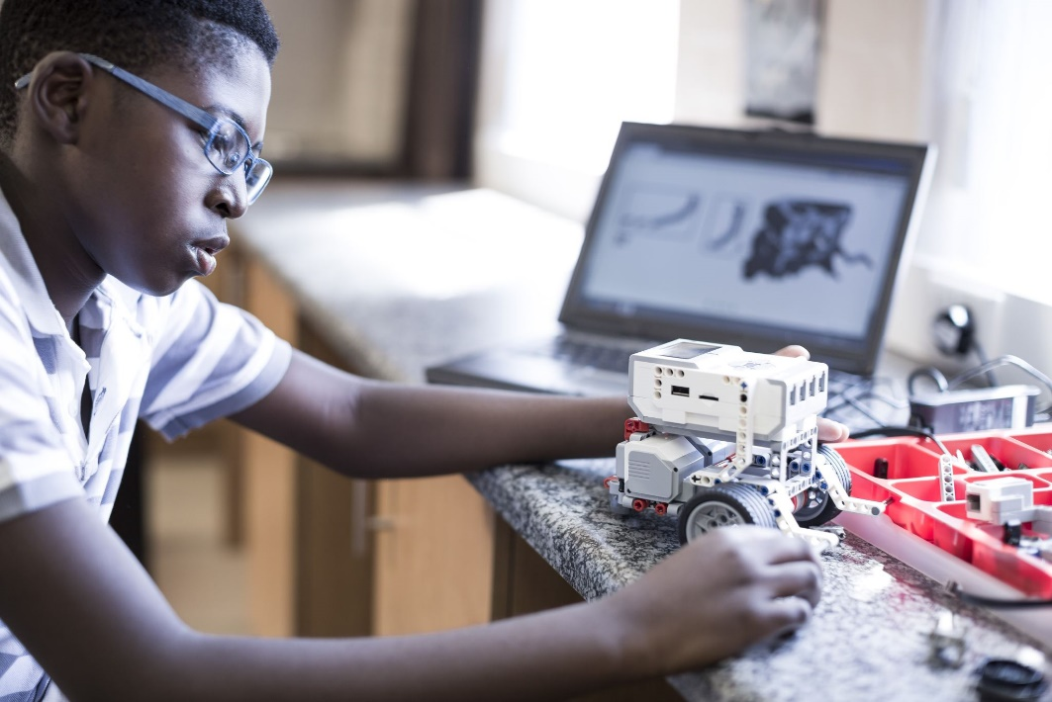
Hardware lesson
Disk storage

Slide 5
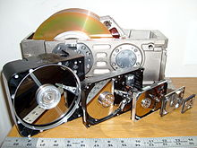
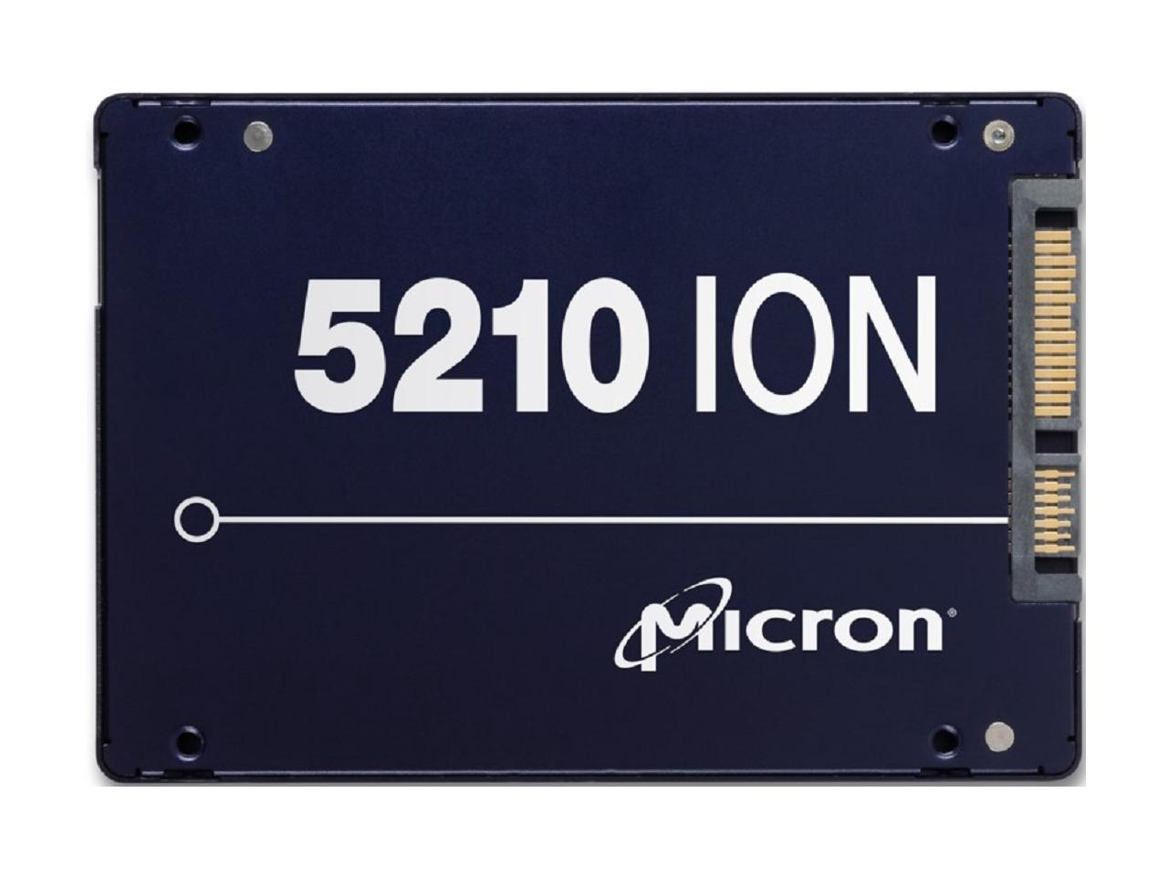
Disk storage
Disk storage is how computers save data. There are two main types:
HDD: Hard disk drives are older, slower and store data on spinning magnetic platters
SSD: Solid state drives are newer, faster and store data on chips
Disk storage is used to save data that won’t fit in RAM
Stores data even when the computer is off
Slower than RAM
Micron is one of the largest manufacturers of SSD storage
Let’s watch a video!
https://youtu.be/EZJzLQJMdXs
SSD Drives can store huge amounts of data
A Kano PC has a 64 gigabyte SSD
1 gigabyte is how many bytes?
1 byte is a group of how many bits?
A bit can be one of two numbers, what are they?
HDD
SSD

Slide 6

Software lesson
Variables

Slide 7
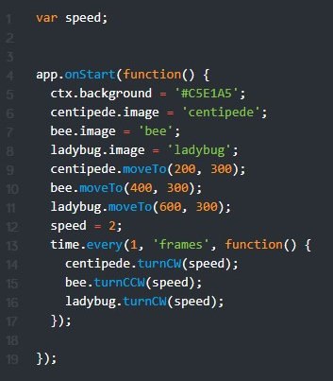

Variables
A variable is a coding technique for storing data in RAM so it can be used over and over again
There are many different types of variables
Numbers
Text, known as “strings”
Dates
And many more!
This program uses a variable named “speed” that makes 3 bugs spin at the same rate
Line 1: Variable declaration statement
Line 12: Variable assignment statement
Lines 14-16: Variable referenced in a loop

Slide 8
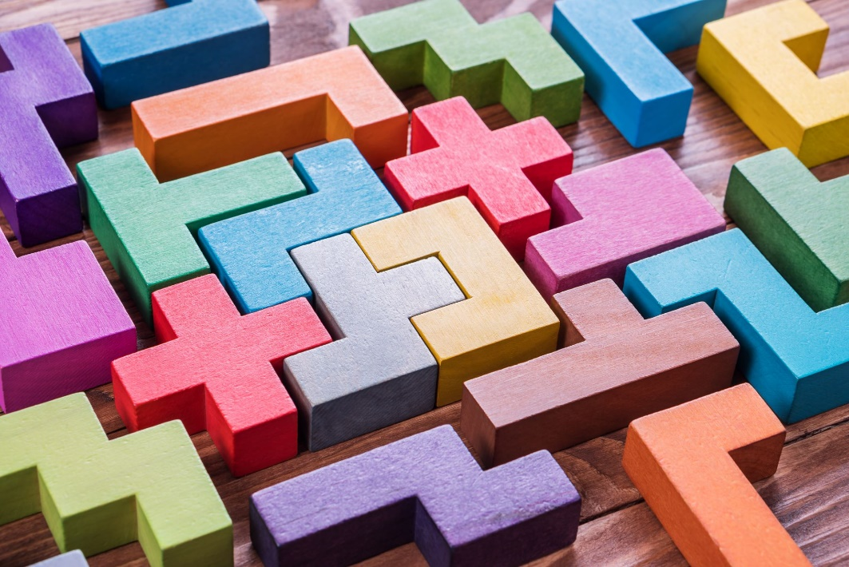
Hands on
Complete a challenge that uses a variable to rotate three bugs at the same rate in a loop.
Make changes to the challenge.
See README.md for step-by-step instructions.

Slide 9

Quiz 1: lessons 1-4
Your coach will send you a link to the quiz. Good luck!
Notes:
Link to quiz template: https://forms.office.com/Pages/ShareFormPage.aspx?id=DQSIkWdsW0yxEjajBLZtrQAAAAAAAAAAAANAAa2D2gZUNTI5T1FZMDhJU0xSR0hDU1ROOFo4OFdGRy4u&sharetoken=oVj0l9EzXHzxeeHd02fc

