Slide 1

#KidzHackPhilly
Lesson 4: Storage and variables

Slide 2

Today’s lesson
Review (10 min)
Hardware lesson (20 min)
Software lesson (20 min)
Challenge (10 min)

Slide 3
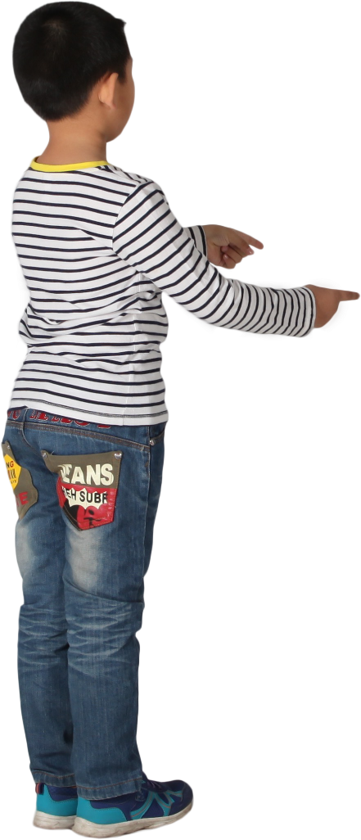
Review
Hardware lesson: CPU
Software lesson: Programs
Hands on
Complete a challenge that draws a monkey on a blue canvas.

Slide 4
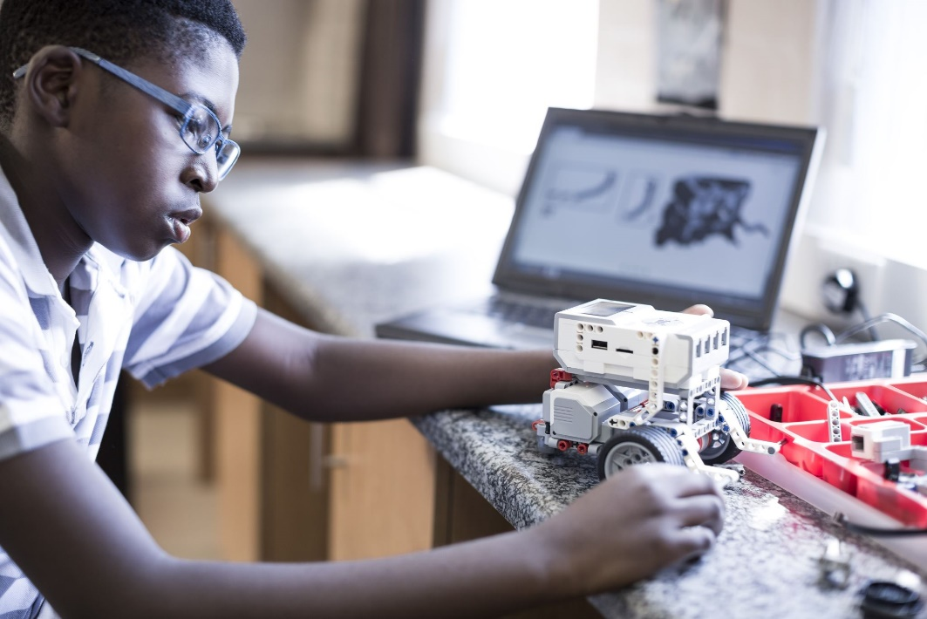
Hardware lesson
RAM

Slide 5
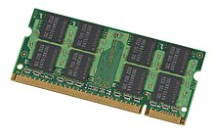
RAM
RAM stands for “Random Access Memory”
RAM is a type of computer memory
Stores working data while the computer power is on
Numbers
Text (also known as “strings”)
Data structures like lists
Supports very fast reads and writes
Kingston is one of the largest manufacturers of RAM chips
Let’s watch a video!
https://youtu.be/4mkbKsesqZo
Modern RAM used in computers and phones is known as Dynamic RAM or D-RAM
A Kano PC has 4 gigabytes of D-RAM
1 gigabyte is one billion bytes (1,000,000,000)
1 byte is 8 bits
A bit can be either be 0 or 1
D-RAM

Slide 6

Software lesson
Loops

Slide 7
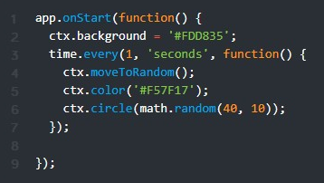

Loops
A loop is coding technique that repeats code over and over again
There are many different types of loops
Count control: runs a certain number of times
Condition control: runs if a condition is met
Infinite loops: Run forever!
Here’s a program that uses a loop that draws holes in swiss cheese
The loop starts on line 3, ends on line 7 and runs every 1 second forever.
The statements executed inside the loop are on lines 4, 5 & 6
4: moves to a random position
5: sets the color to orange
6: draws a circle with a random radius between 10 and 40 pixels

Slide 8

Hands on
Complete a challenge that draws random sized holes on a block of swiss cheease.
Make changes to the challenge.
See README.MD for step-by-step instructions.

