Slide 1
Predicting MSYE
Multisite Yield Efficiency at Chip Testing

Slide 2
MSYE – The challenge

Slide 3
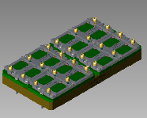
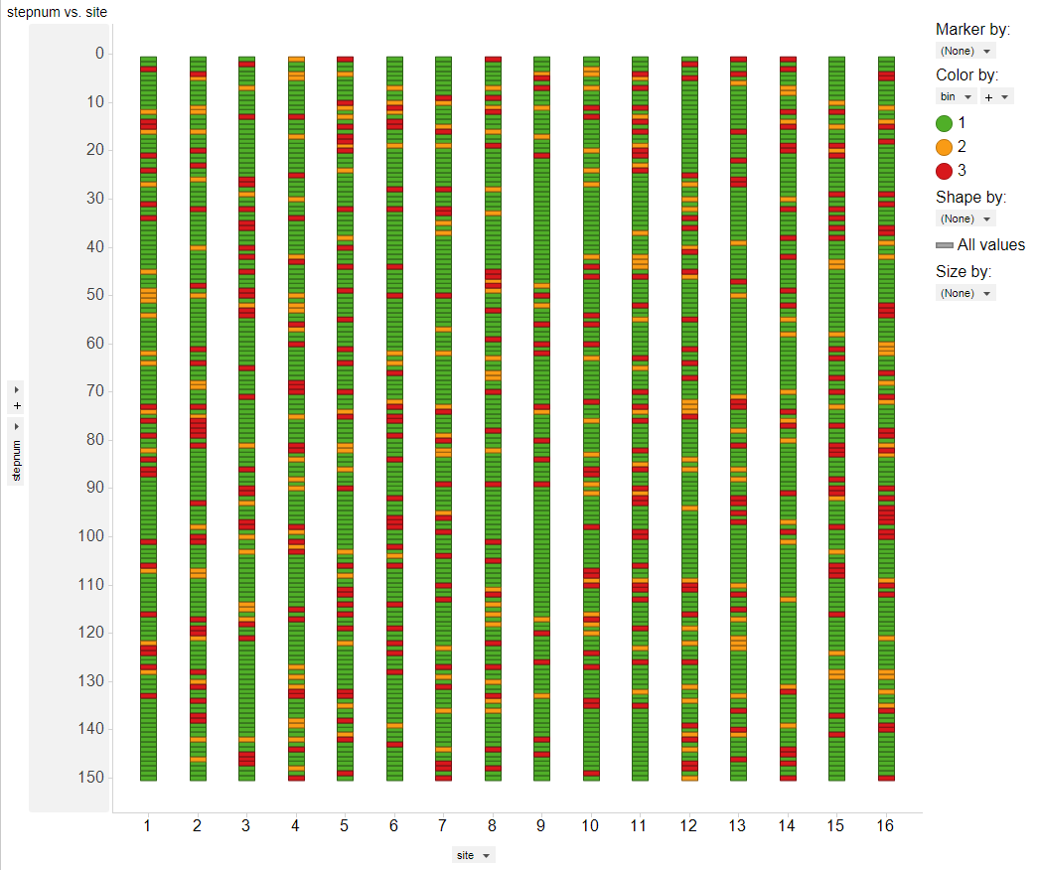
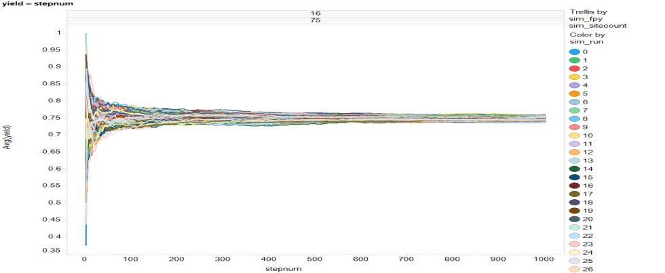
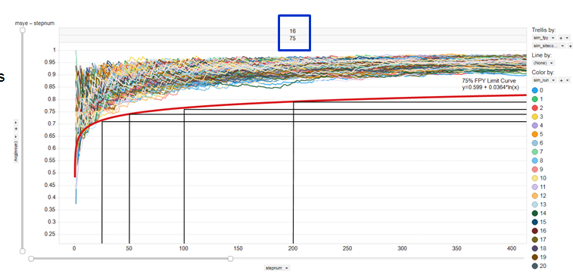
Semiconductor Final Test
Because
Test Lot material is from the same manufacturing lot
Test H/W is duplicate in each site
Performance should be the same in all test sites (Yield, Parametrics, etc)
Typical 16-site tester board with sockets
Simulation lot run
16 sites
75% yield
150 touchdowns (150*16 = 2400 units)
Simulated Yield at each TD out to 1000TD
Simulated MSYE at each TD out to 1000TD
MSYE = Total Lot Yield / Yield of Highest Yielding Site. Can be measured at any TD on cumulative results.

Slide 4
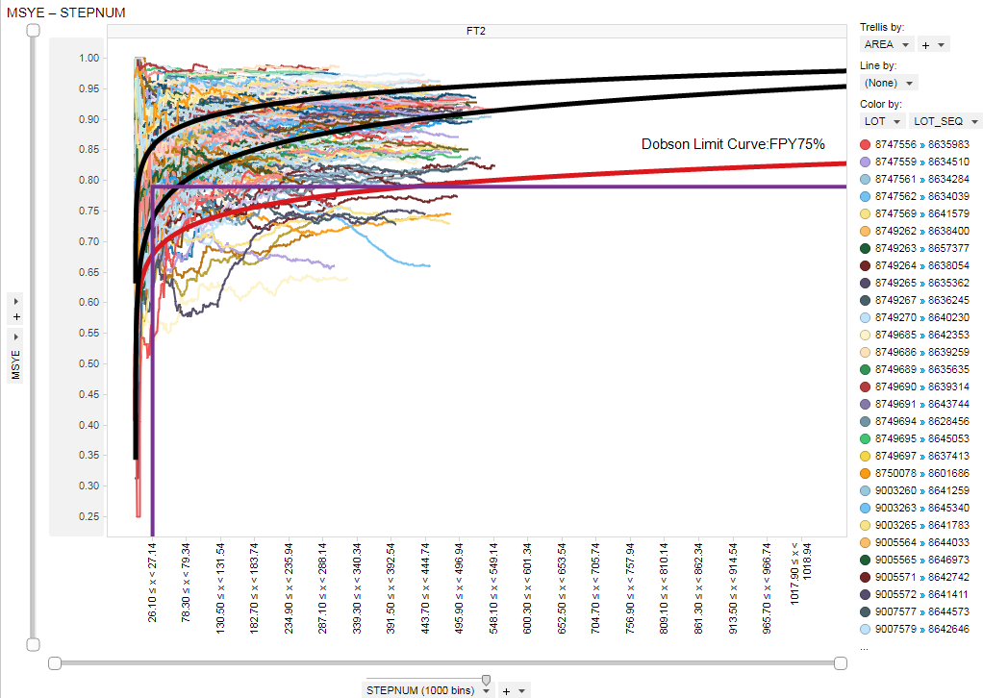
MSYE Example Product
Simulation envelope
Detection limit
Actual 1Q19 graph of MSYE for one product
Detection limit calculated based on simulation results
Limit = 0.6 + 0.4 * ln(x)
Objective is to prevent excursions below the detection limit by predicting when a setup is drifting into that region

Slide 5
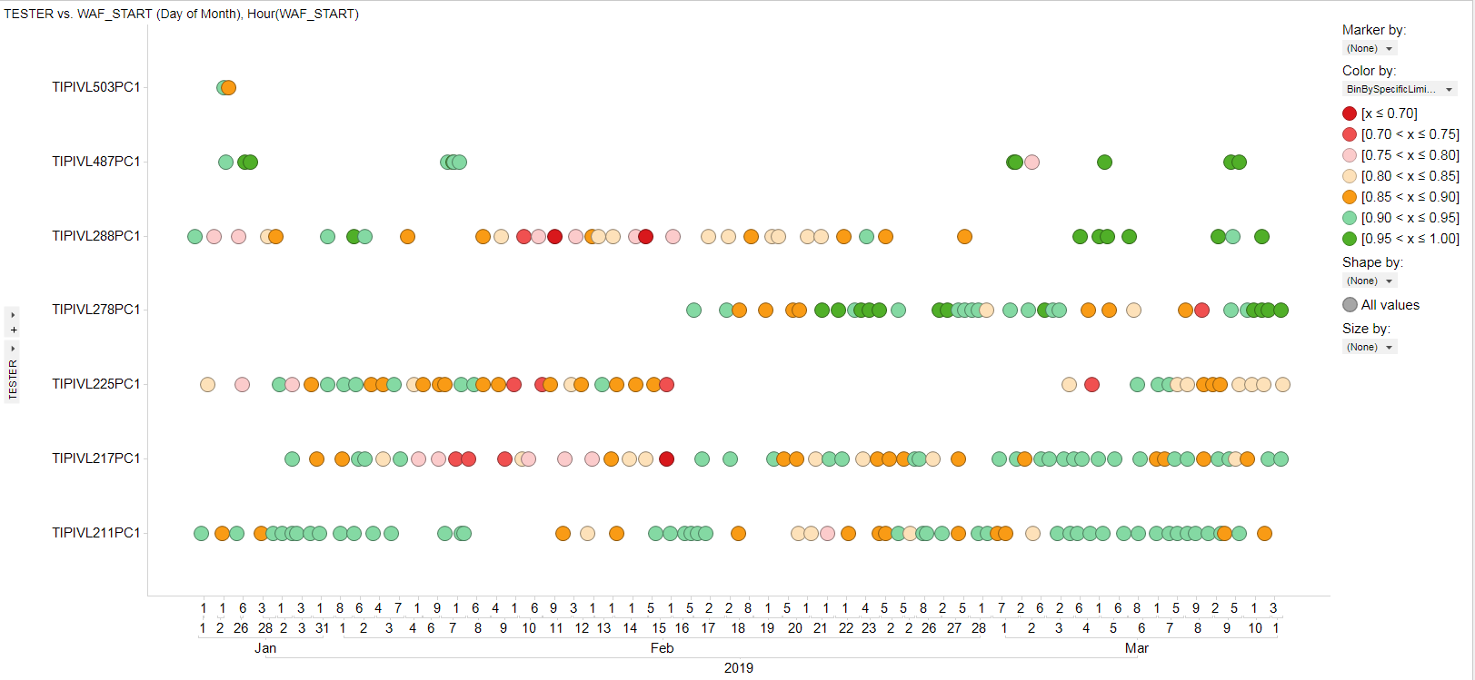
Predicting MSYE
Marginal - Undetected
Degrade to fail
We are using variation in MSYE to detect equipment failures
Sometimes, there appears to be degrading performance, followed by fail
In these cases, product and productivity are both lost until fail is detected and corrective action taken
Sometimes, fails seem to come out of nowhere
In both cases, there can be long periods of undetected “marginal” performance
Machine Learning Questions:
Can we learn to predict the failures?
Can we figure out which (of the many) variables are strongest impact to failures?

Slide 6
Selecting a model

Slide 7
The Basics
I want to predict MSYE
This is a value – not categorization
Need to use some type of Regression model
Here is the data
That is a lot of input variables - and that is not even all of them
Needs to be a Multple Regression of some type
Note that some of them are Time – this matters later
Great – Which MR model?
Much reading on the merits – Did not help me decide
Finally, decided to just experiment with a bunch of models
I would surely learn something
Setup Success DB

Slide 8
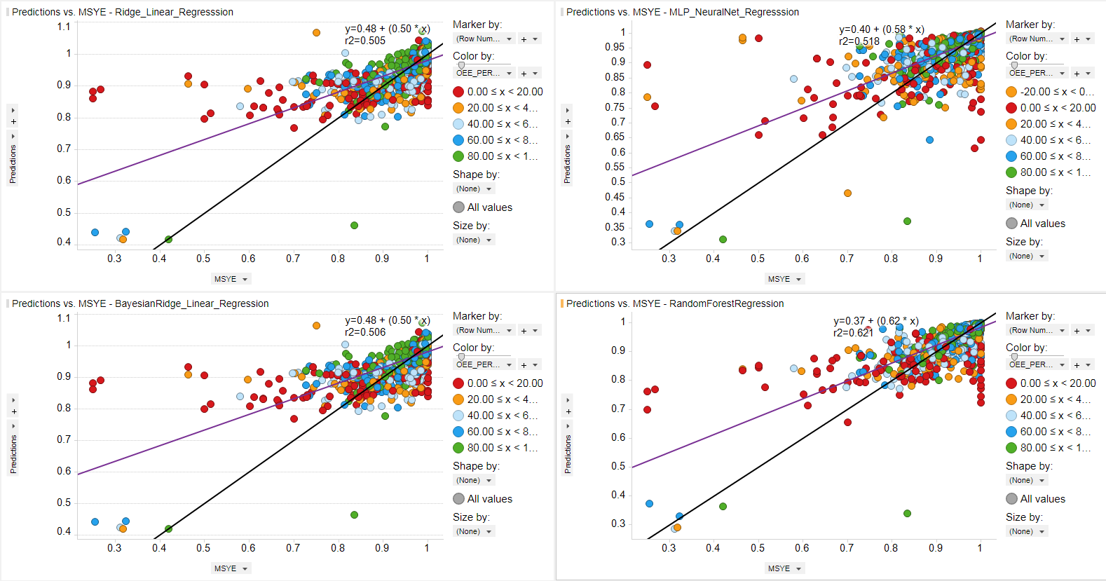
Model Selection
Played with 10 or so
From Class
LinearRegression
R² < 0.4
Keras Neural Net Regressor
Plain did not work, accuracy > 1%
Read some more sklearn documentation
RidgeLinear
BayesianRidgeLinear
MLP_NeuralNet Regressor
RandomForest Regressor
RandomForest has best R² at 0.62
But what are all those bad calls with actual of 1, but prediction as low as <0.7?
How do I choose?????

Slide 9
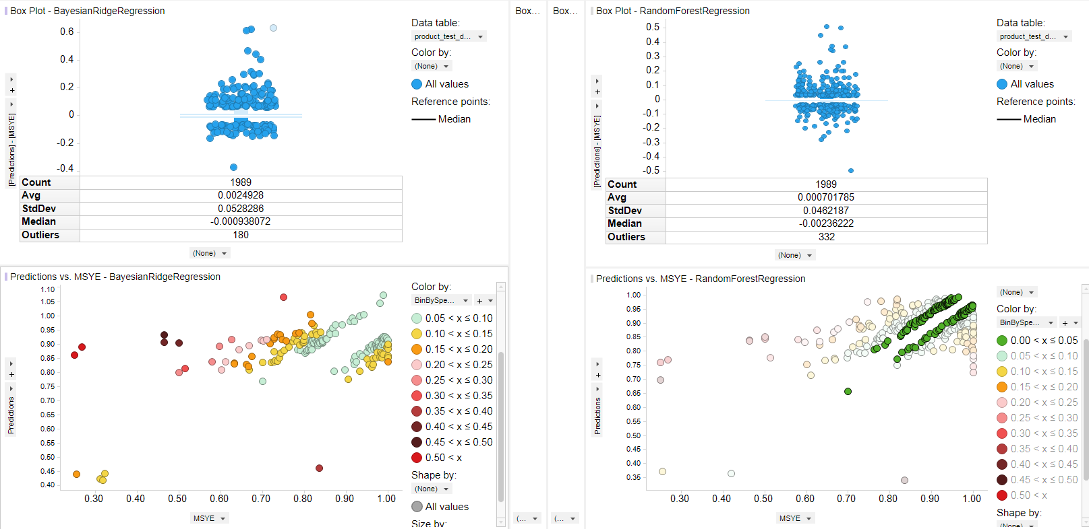
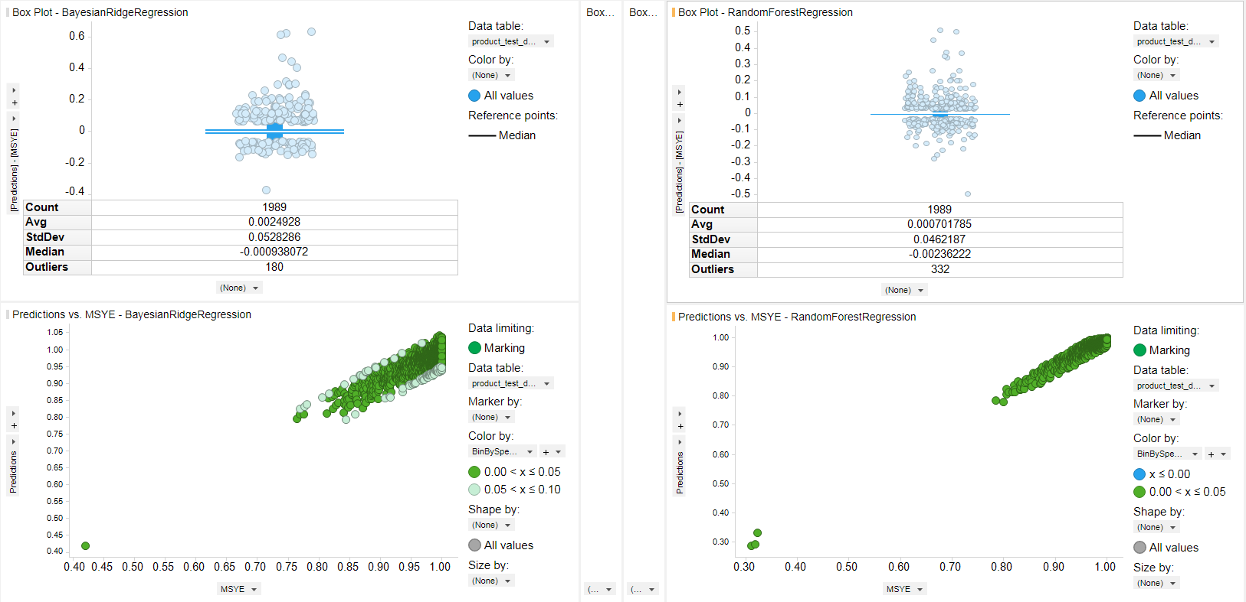
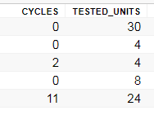
Final Selection
Standard Deviation of RF is better
BR outliers are spread more widely than RF
BR inliers are very tight
It’s a puzzle
Random Forest looks so good, but has a few really bad predictions
Small lots!
Remove
Update the dataset
RandomForest wins!!!!
Final Y_test R² = 69%
Outliers
Inliers

Slide 10
Predicting the future

Slide 11
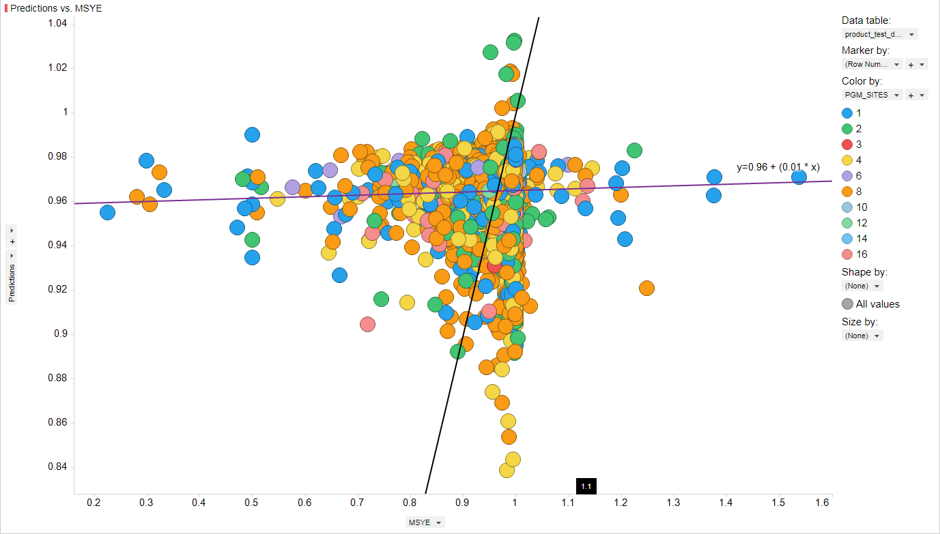

Do Not Lose the Objective - Prediction
Back to the Books
Need to predict what is going to happen – and be mostly right
Read, Read, Read – I can’t make sense of this stuff!!
Finally, just took some sample code (stock market predicting) and started adapting it step by step into my code
OK, the trick is to shift the Y (output) training data
ML then see the future outputs as the result of present inputs
Voila! The future is predicted
Unfortunately
R² Score: -0.03734763664152818

Slide 12
Think About Prediction Again
My teaching example
Stock market
One stock (GOOG)
My data
An entire month of data from a factory
Many products, many testers
Not in sequence
Oops – Shifting out of sequence data is just dumb!
Gotta do this again – with appropriately sequential data

Slide 13
Identifying impactful variables

Slide 14
Impactful Variables
Need to start with Principal Component Analysis
Did one round with Chris’s help
Results did not seem to make sense
Could not quickly translate back to features to try to understand
Random Forest Regression
Result provided is feature_importance
Not sure I understand what this is
Certainly not the same as LinearRegression coefficients
Great! More studying. Read, Read, Read
Basically never got a good start on evaluting variable impact

Slide 15
Current status

Slide 16
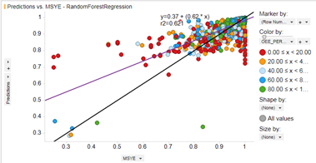
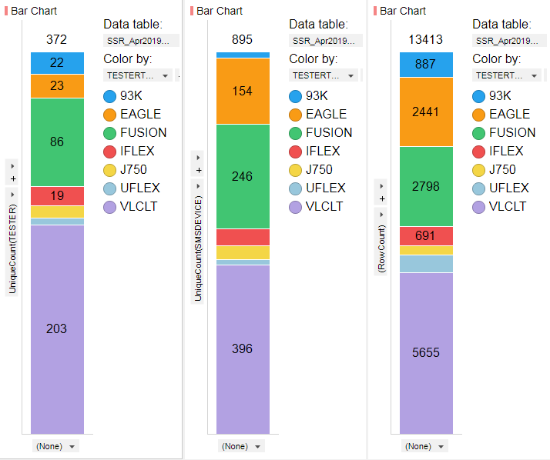
Current Status
Started with two questions
Can we learn to predict the failures?
Can we figure out which (of the many) variables are strongest impact to failures?
Predicting failures
Proved out a ML model with R² @ 0.69
Model was against 1 month, 1 factory data
372 Test Cells, 895 Products, 13,413 Lots
Considering all the variables – pretty good
Additional work required for time predictions
The Y-shift must be rotated by Test Cell and probably by Product or Product Family
But I am optimistic
Identifying impactful variables
Did not really get started

Slide 17
What is Next
Figure out how to be time predictive
Analyze Feature Importance
Once all this is working with Random Forest Regression, go back and try some other models again
Try on data from other factories
Then there is an entire journey of convincing people this is useful, figuring out how to deploy and use to improve cost and productivity

